Slide 1
Geostatistics and Programming Practices
March, 2019

Slide 2
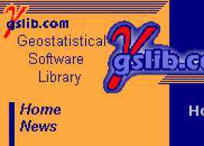
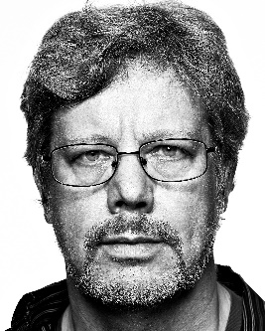

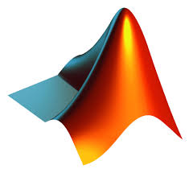

Common Programming Options
Fortran: derived from Formula Translation
Scientific and numeric computations
Very straightforward and stable
Capable of implementing obj-oriented programming
Python: High level, dynamically typed, interpreted language
Open source, lots of packages, easy to prototype
Capable of implementing object oriented practices
MATLAB: multi-paradigm numerical language
Tool boxes and engineering tools
Bash (Bourne-again shell): Unix shell and command language
Simple and often sufficient
Focus on programming practices and design principles
Become programing language agnostic
Use what is the best option for your application
Notes:
Originally developed by IBM^{[3]} in the 1950s for scientific and engineering applications, FORTRAN came to dominate this area of programming early on and has been in continuous use for over half a century in computationally intensive areas such as numerical weather prediction, finite element analysis, computational fluid dynamics, computational physics, crystallography and computational chemistry. It is a popular language for high-performance computing^{[4]} and is used for programs that benchmark and rank the world's fastest supercomputers.
Created by Guido van Rossum and first released in 1991, Python has a design philosophy that emphasizes code readability, notably using significant whitespace. It provides constructs that enable clear programming on both small and large scales

Slide 3
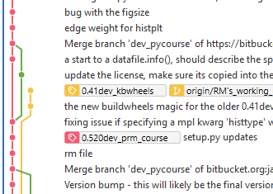



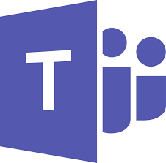
Version/Source Control
A critical component of software developments
Keep track of changes in a code repository
Enable team members working on the same and different problems/enhancements (Branching, merging, forking,…)
Improving code review process
Transparency in the development life cycle
Git is the most common version control systems
Others to mention:
Apache subversion, GNU Bazar, Microsoft Team Foundation Server(TFS)

Slide 4
Fortran Solution
Add all your Fortran project to one single solution
Enables you to build and maintain all project
Define build dependencies for each project
Use a version control system
I use Git under Microsoft teams (benefit from team management)
Visual studio can be used as a source control
Use branches to differentiate between different life cycle phase
Dev: Development
Master/Trunk: Most stable that can be released to production environment
Feature branches: Exploring ideas that take time to develop and needs to be isolated (essential for collaboration)
Share your code:
Best way of getting your code repository better

Slide 5
Object Oriented Central Principles
Encapsulation: Control how and object and its components can be accessed using access modifiers.
Abstraction: Hide all but relevant data about an object. Use abstraction to simplify the interaction of high level modules/objects with low level ones.
Inheritance: Using class hierarchy to make the code more readable, avoid repetition and improve maintainability. Using base class and subclasses that inherit from one/multiple base classes
Polymorphism: Same name different implementations. Overriding inherited methods and defining different implementations of an interface are good examples of polymorphism
Notes:
Encapsulation: using private and public access modifier and define accessor and mutators to control how and object can be queried/modified by other objects/applications

Slide 6
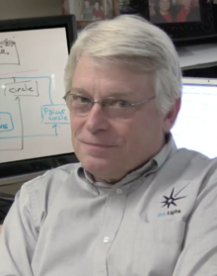
SOLID Design Principles
One of the most popular design principles for OO programming
S: Single responsibility principle
Easier to understand and maintain
O: Open/Closed principle
The software entity is open to extension but closed to modification
Using interfaces that are closed to modifications but new implementations can be added
L: Liskov Substitution Principle (Barbara Liskov)
Objects of a super class shall be replaceable by objects of its subclass without braking the application
I: Interface Segregation Principle
“Clients should not be forced to depend upon interfaces that they do not use”
D: Dependency Inversion Principle
High-level modules should not depend on low-level modules. Both should depend on abstractions. Abstraction defines how each high level module/object interact with the low level ones
Robert C. Martin
Notes:
S: A class/object should have one and only one responsibility. This makes it easier to maintain that class and your software/application in general. The requirements of a project or application will change over time, more responsibility for a class/object, makes it more likely to be changed and modified. Also, it will be very difficult to make responsibilities independent if they are implemented by the same class/object. Note that each change can have side effects and by limiting each class to a single responsibility, you can control the potential side effects. Ask yourself what is the responsibility of that class/module? If there is an and in your answer, most likely you are breaking the first principle
O: Robert C. Martin considers this the most important principle. It tells you to write your code so that you will be able to add new functionality without changing the existing code. The tight coupling of sub classes to their parent classes can make it difficult to follow this principle as you add more sub classes to extend the functionality. The idea of loose coupling through using interfaces has been introduced to address this issue. It uses interfaces instead of superclasses to allow different implementations which you can easily substitute without changing the code that uses them. The interfaces are closed for modifications, and you can provide new implementations to extend the functionality of your software.
The main benefit of this approach is that an interface introduces an additional level of abstraction which enables loose coupling. The implementations of an interface are independent of each other and don’t need to share any code. If you consider it beneficial that two implementations of an interface share some code, you can either use inheritance or composition.
L: Introduced by Barbara Liskov: The principle defines that objects of a superclass shall be replaceable with objects of its subclasses without breaking the application. That requires the objects of your subclasses to behave in the same way as the objects of your superclass. You can achieve that by following a few rules, which are pretty similar to the design by contract concept defined by Bertrand Meyer.
An overridden method of a subclass needs to accept the same input parameter values as the method of the superclass. That means you can implement less restrictive validation rules, but you are not allowed to enforce stricter ones in your subclass. Otherwise, any code that calls this method on an object of the superclass might cause an exception, if it gets called with an object of the subclass.
Similar rules apply to the return value of the method. The return value of a method of the subclass needs to comply with the same rules as the return value of the method of the superclass. You can only decide to apply even stricter rules by returning a specific subclass of the defined return value, or by returning a subset of the valid return values of the superclass. You can use a series of unit tests to check liskov substitution principle
I: Clients should not be forced to depend upon interfaces that they do not use. Sounds obvious, doesn’t it? But, it’s pretty easy to violate this interface, especially if your software evolves and you have to add more and more features. None of us willingly ignores common design principles to write bad software. But it happens quite often that an application gets used for multiple years and that its users regularly request new features.
From a business point of view, this is a great situation. But from a technical point of view, the implementation of each change bears a risk. It’s tempting to add a new method to an existing interface even though it implements a different responsibility and would be better separated in a new interface. That’s often the beginning of interface pollution, which sooner or later leads to bloated interfaces that contain methods implementing several responsibilities.

Slide 7
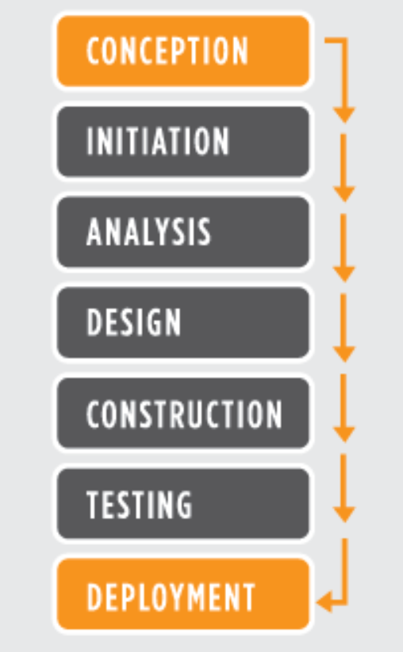
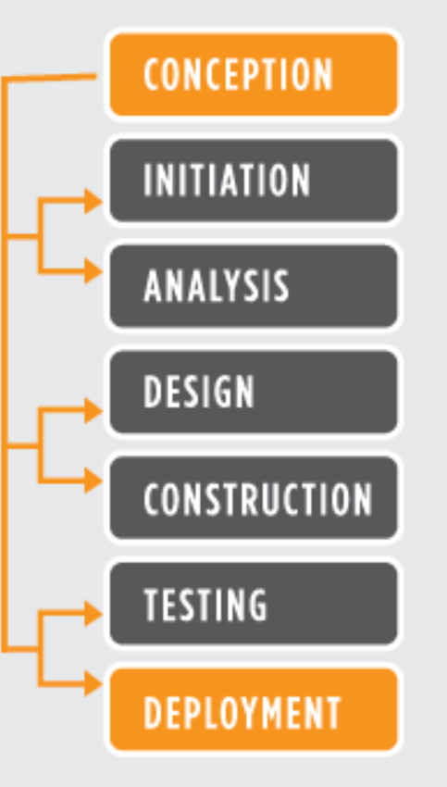
Software Development Management
Water Fall
Gather and document requirements
Design
Code and unit test
Perform system testing
Perform user acceptance testing (UAT)
Fix any issues
Deliver the finished product
Agile
Team-based approach
Often implemented using Scrum framework
Frequent developments, demo, testing and requirement gathering
High level of customer involvement throughout the project
More flexible to address changes in the scope/requirements
www.seguetech.com
Notes:
In a true Waterfall development project, each of these represents a distinct stage of software development, and each stage generally finishes before the next one can begin. There is also typically a stage gate between each; for example, requirements must be reviewed and approved by the customer before design can begin.
Agile is an iterative, team-based approach to development. This approach emphasizes the rapid delivery of an application in complete functional components. Rather than creating tasks and schedules, all time is “time-boxed” into phases called “sprints.” Each sprint has a defined duration (usually in weeks) with a running list of deliverables, planned at the start of the sprint. Deliverables are prioritized by business value as determined by the customer. If all planned work for the sprint cannot be completed, work is reprioritized and the information is used for future sprint planning.

Slide 8
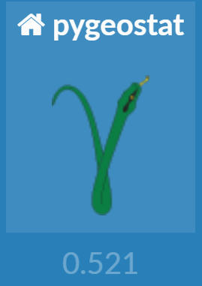
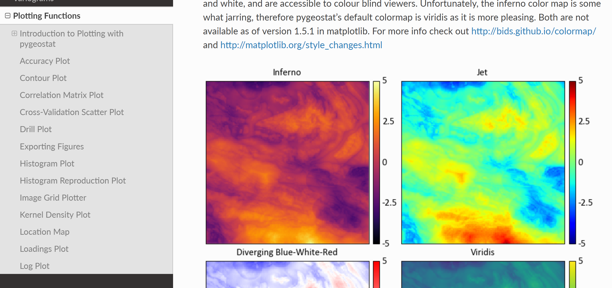
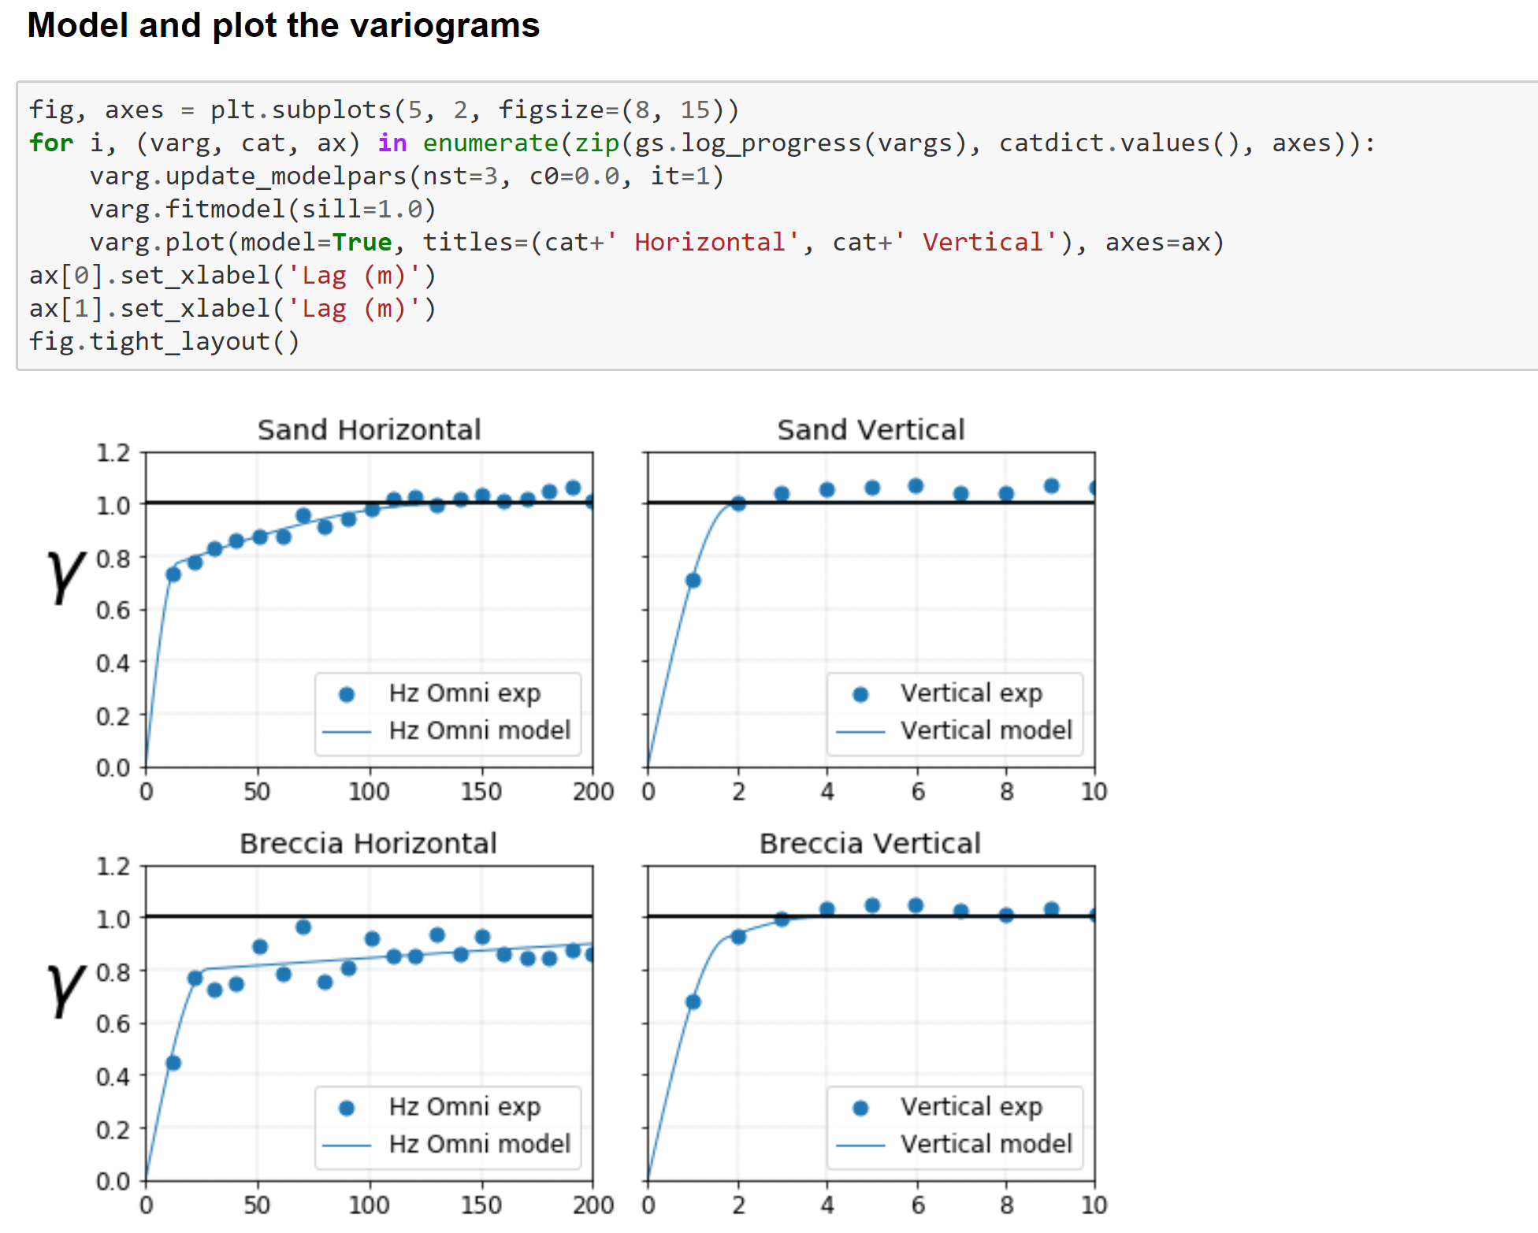
Pygeostat
A Python package for Geostatistical modeling
Powerful tool for visualization
Jupyter notebook is a great IDE for implementing, documenting and archiving modeling work flow
Wrappers to call Fortran executables
Fortran-Python integration using numpy’s F2PY

Slide 9
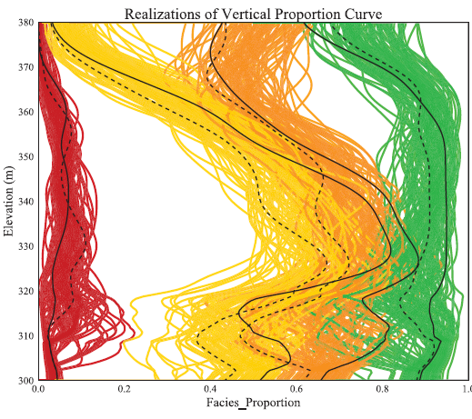
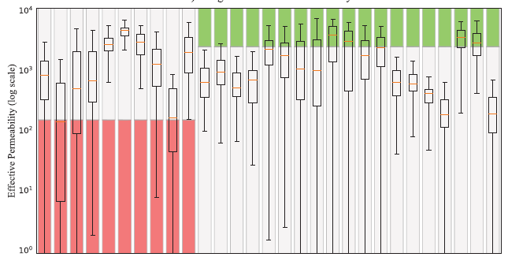
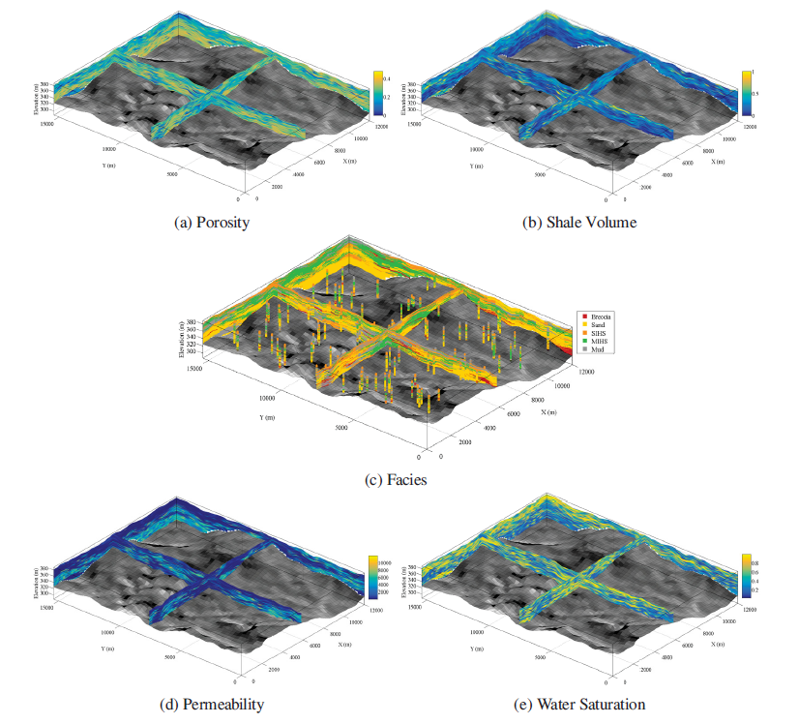
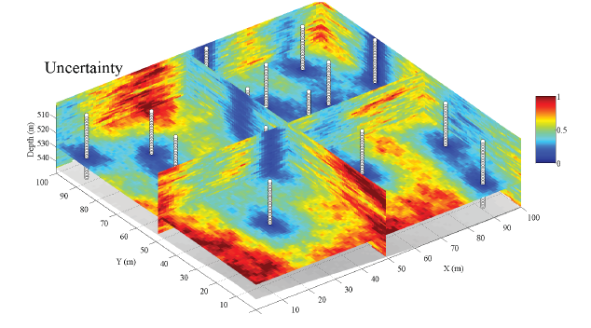
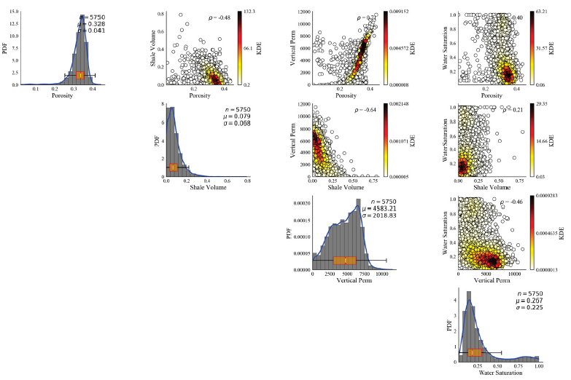
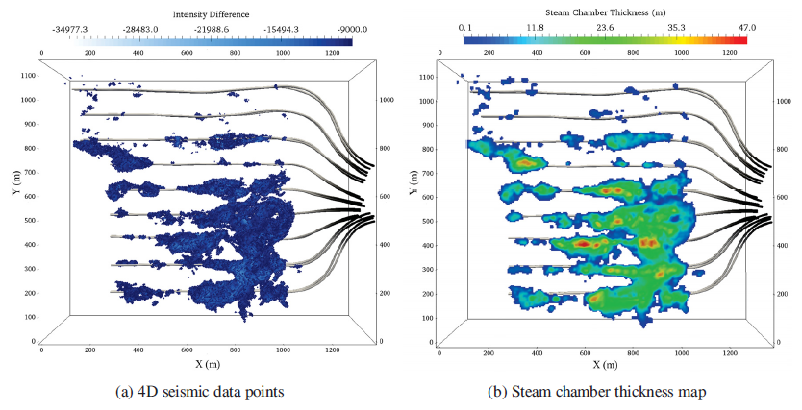
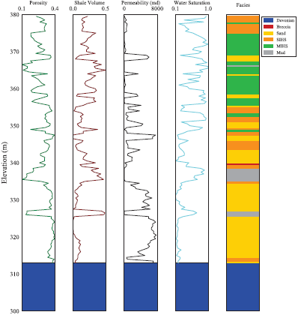
Visualization

Slide 10
Exercise
Start your own git repository:
GitHub
Bitbucket
Microsoft Teams
Start a Fortran Solution and add your Fortran projects
Use a version control management tool (aka git client)
Source tree
Visual Studio
Start using Pygeostat and Python along with Frotran, MATLAB and…
Use Keras to design an simple NN to solve linear regreesion

