Slide 1
Python and Pygeostat Installation Guide
March 2019

Slide 2
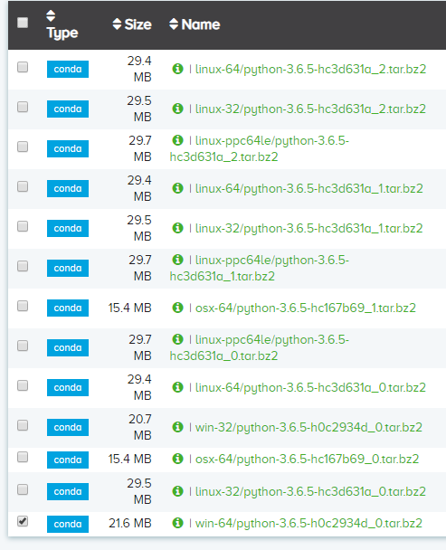
Python Installation (1)
Anaconda is the recommended distribution for Python
Popular Python packages are provided with Anaconda
conda package management system can be used to install and manage python packages
Although Anaconda does not require admin permissions, it is recommended to acquire admin permissions
Installation steps (Python 3.6):
Go to the link below
https://anaconda.org/anaconda/python/files?version=3.6.5
Or use: https://repo.anaconda.com/archive/Anaconda3-5.2.0-Windows-x86_64.exe
https://www.anaconda.com/download/

Slide 3
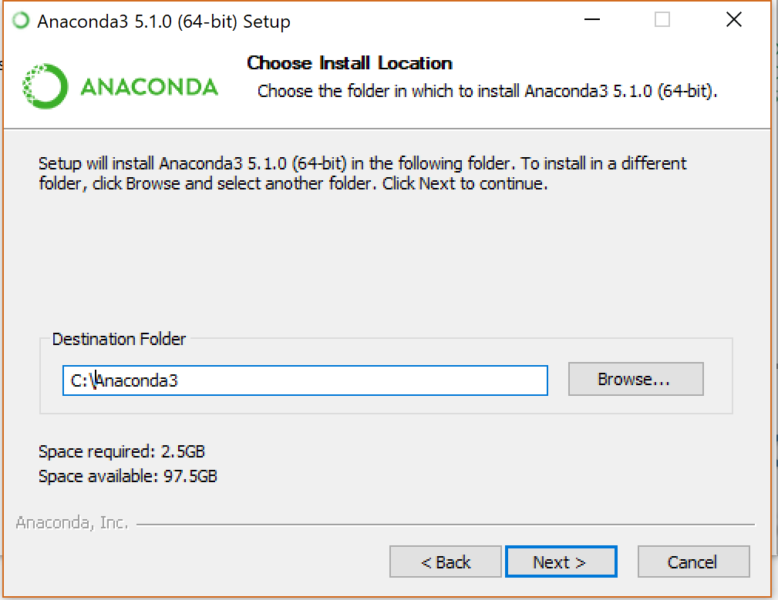
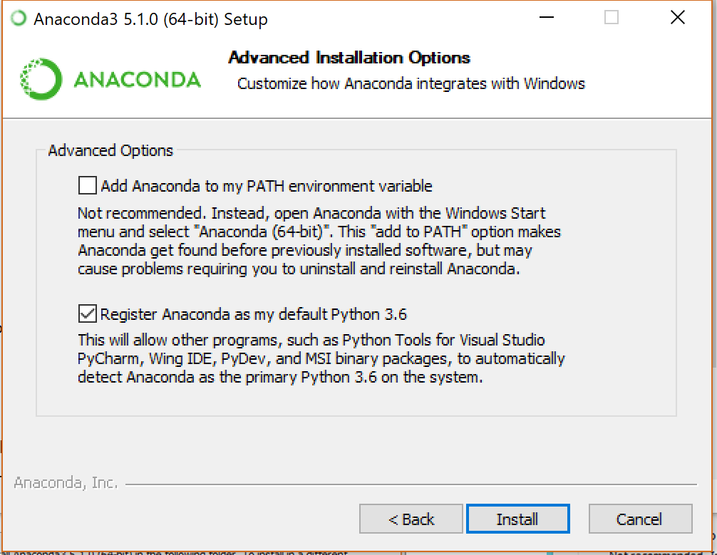
Python Installation (2)
Use the executable file to install Anaconda (important panels in the Installation steps displayed below)
Install to the following destination folder: C:/Anaconda3
Although Anaconda recommends otherwise, we recommend that you select the ‘Add Anaconda to my PATH environment variable’ option
Alternatively, if using the installation path that we display below, add C:\Anaconda3 and C:\Anaconda3\Scripts to your USER PATH manually

Slide 4
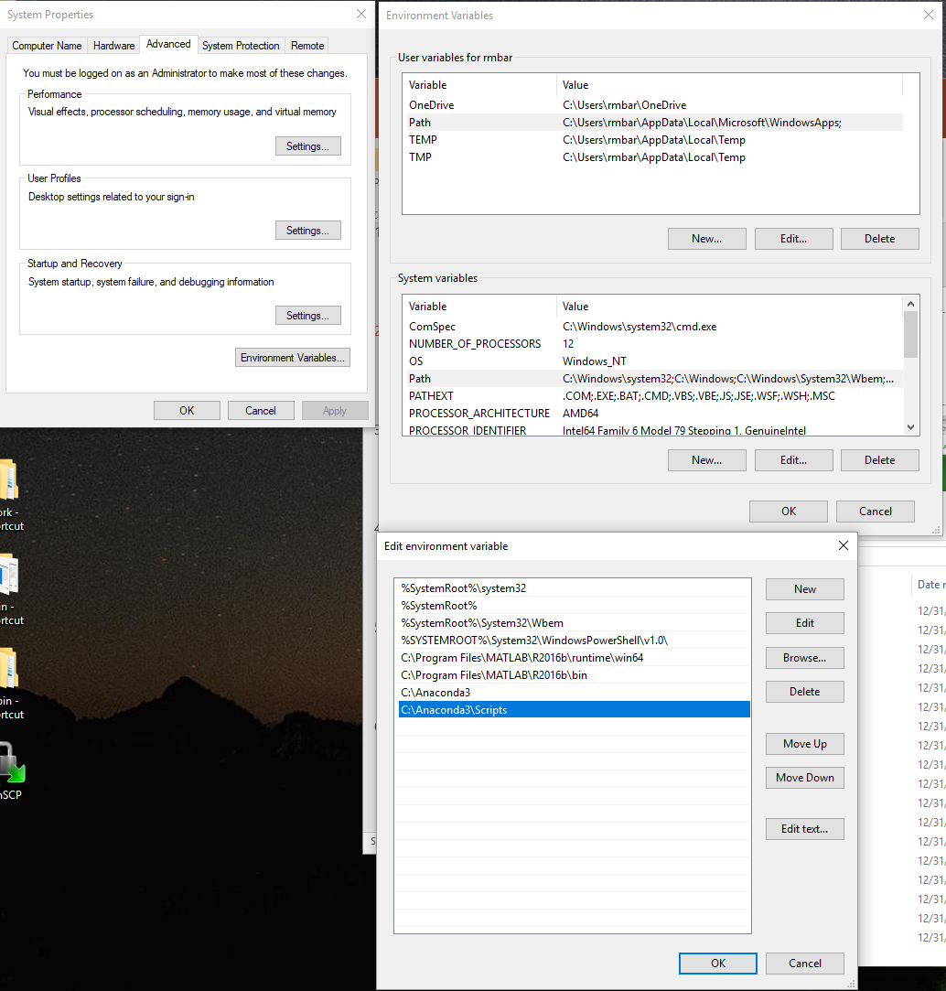
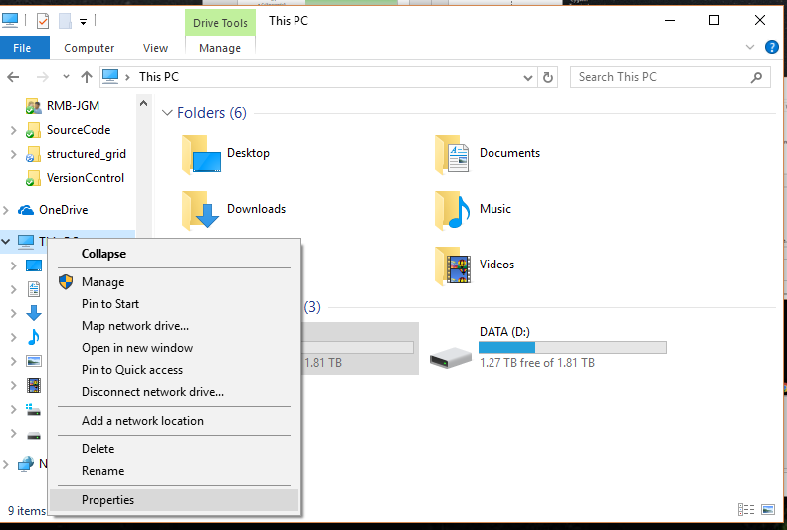
Python Installation (3)
Follow these visual directions to add required directories to your system path (begin by right-clicking on This PC):
C:/Anaconda3/
C:/Anaconda3/Scripts/
3
2
1
4

Slide 5
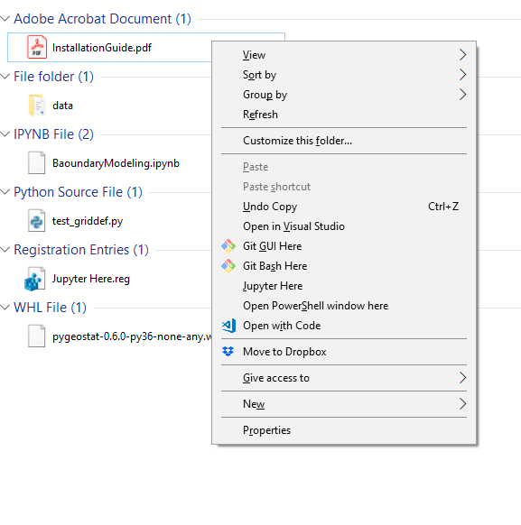
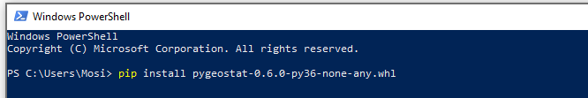
Pygeostat Installation
Pygeostat is a Python package from the Centre for Computational Geostatistics (CCG), providing a suite of tools for resource modeling. Installation steps:
Open a PowerShell window within the target folder where you have the wheel distribution file, by holding shift while right clicking
Execute the following command:
pip install pygeostat-x.x.x-py36-none-any.whl
After the installation completes, ensure that the following line is found in the command line output:
Successfully installed pygeostat-x.xxx.devx

Slide 6
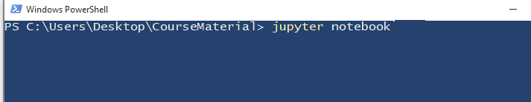
Opening Jupyter Notebooks (1)
Jupyter notebook is a recommended IDE to run Python scripts, which is installed with Anaconda
There are two ways to start a Jupyter notebook in a directory/folder
Option one:
Open a PowerShell window in the directory that you wish to open a script
As described on the previous slide
Execute the following command:
jupyter notebook

Slide 7
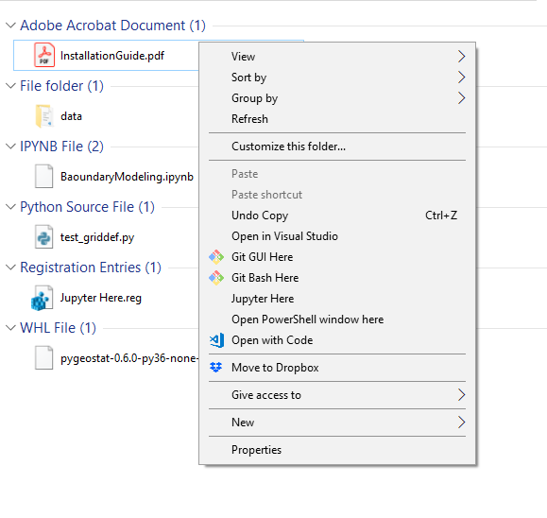
Opening Jupyter Notebooks (2)
Option two (recommended):
Double click the provided utility file in the parent directory (Jupyter Here.reg
Simply right click in the parent directory and then select Jupyter Here

