Slide 1
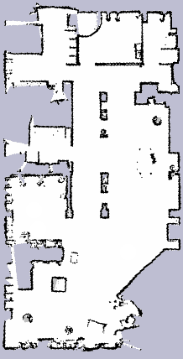
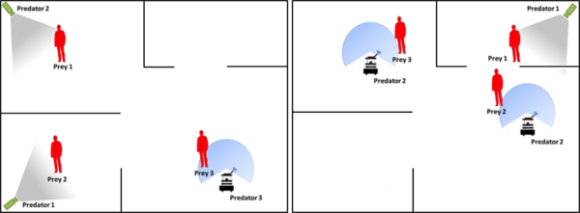
PTracking: Distributed Multi-Agent Multi-Object Tracking through Multi-Clustered Particle Filtering
Fabio Previtali and Luca Iocchi
Department of Computer, Control and Management Engineering
Sapienza University of Rome
Rome, Italy
Distributed Object Tracking
Distributed Object Identification
Tracking accuracy improved when integrating data coming from mobile sensors
Robustness increased when taking into account object estimations provided by mobile sensors close to the tracked objects

