Slide 1
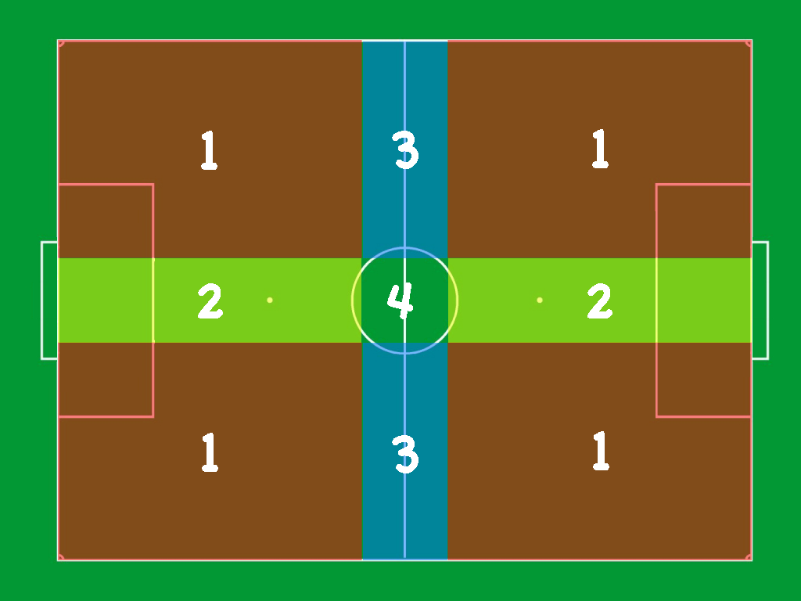
Disambiguating Localization Symmetry through a
Multi-Clustered Particle Filtering
F. Previtali, G. Gemignani, L. Iocchi and D. Nardi
Department of Computer, Control and Management Engineering
Sapienza University of Rome
Rome, Italy
RoboCup Standard Platform League
Distributed knowledge about the position of the ball in the field
Robustness to wrong localized robots through consensus via multi-object tracking of the ball position
Robot flipping problem partially solved thanks to the distributed estimation of the ball position

