Slide 1
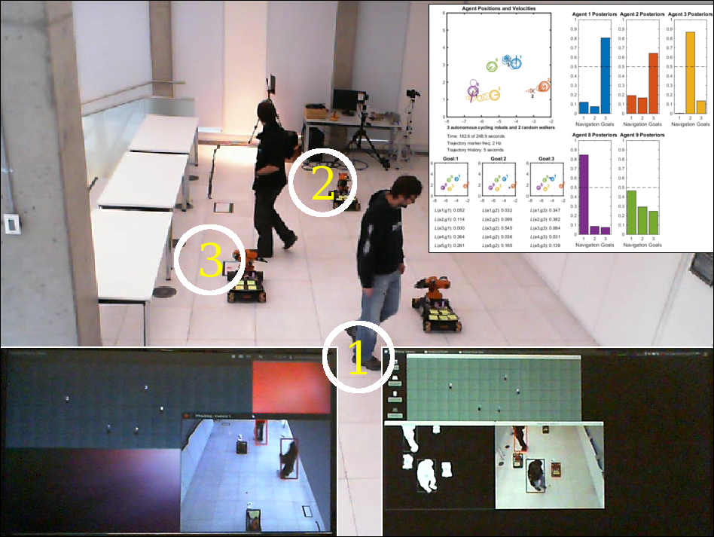
Counterfactual Reasoning about Intent for Interactive Navigation in Dynamic Environments
Alejandro Bordallo Micó¹, Fabio Previtali²,
Nantas Nardelli¹, Subramanian Ramamoorthy¹
¹University of Edinburgh ²Sapienza University
An intention-inference algorithm for dynamic environments
An asynchronous and distributed architecture
Novel clustering technique to ensure Gaussian distributions

