Slide 1
BENCHMARK INTERNACIONAL
PREDICT - 2017

Slide 2
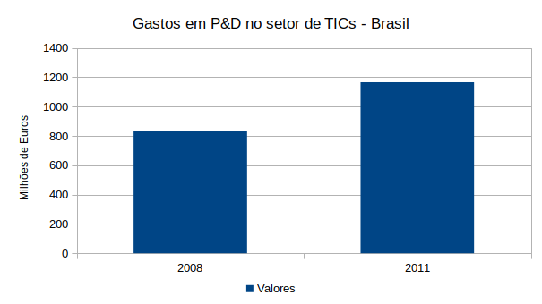
BERD – BUSINESS EXPENDITURES IN R&D (BRAZIL)

Slide 3
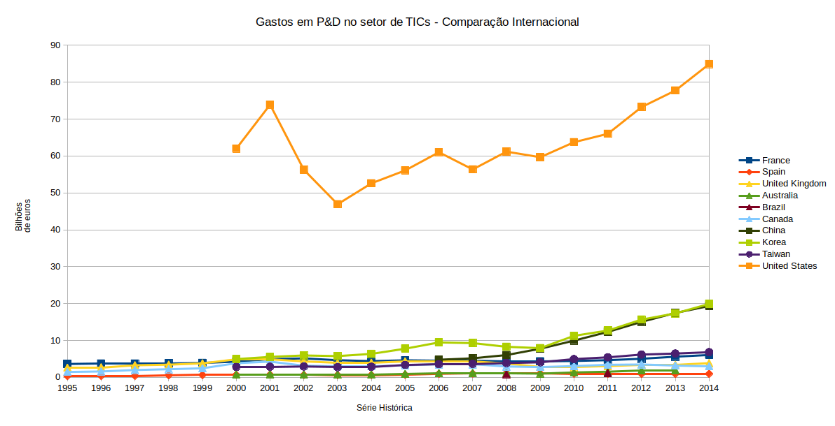
BERD – BUSINESS EXPENDITURES IN R&D

Slide 4
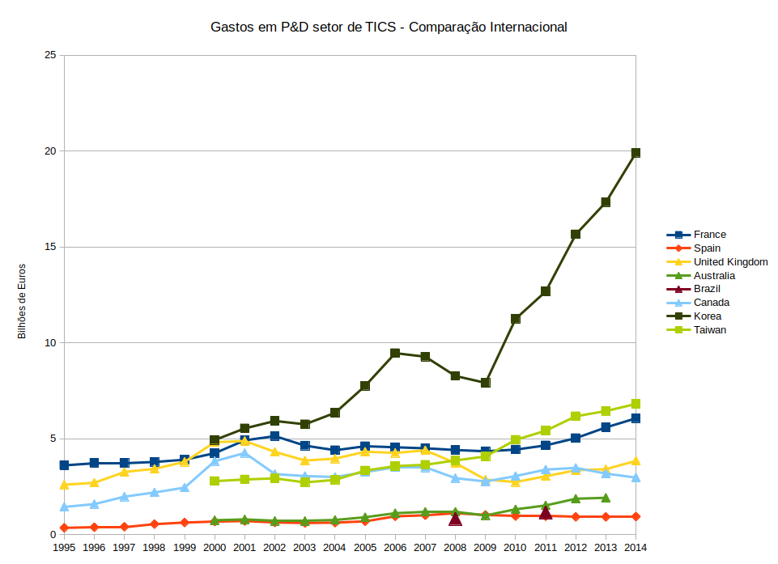
BERD – BUSINESS EXPENDITURES IN R&D

Slide 5
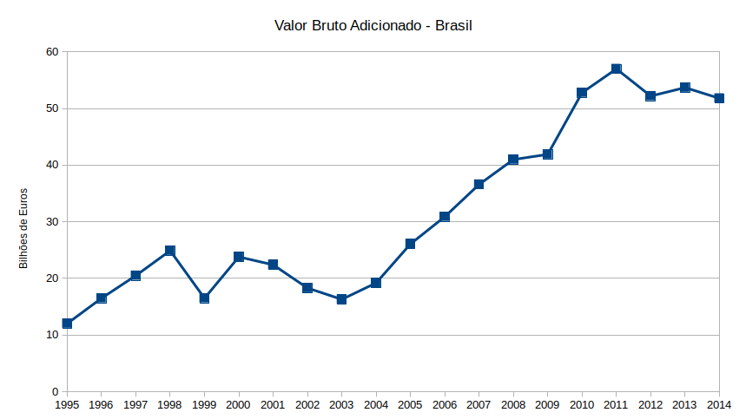
GVA – GROSS VALUE ADDED (BRAZIL)

Slide 6
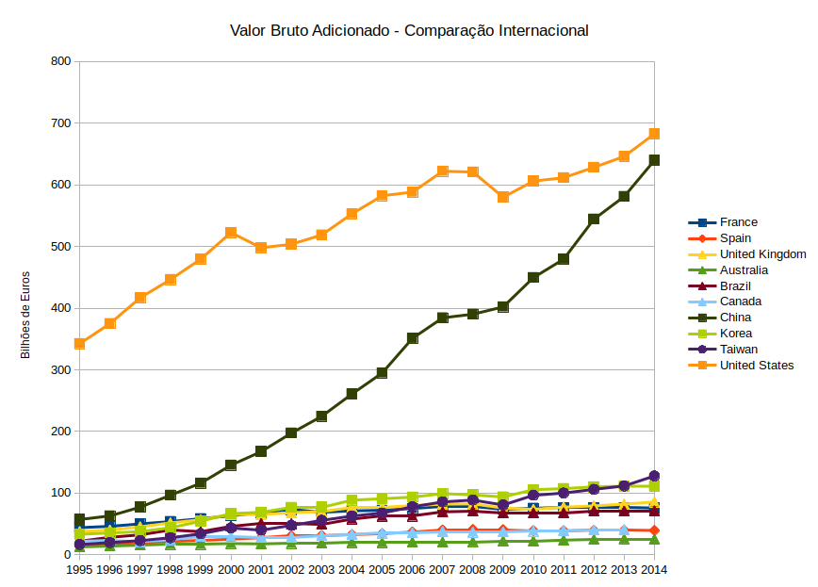
GVA – GROSS VALUE ADDED

Slide 7
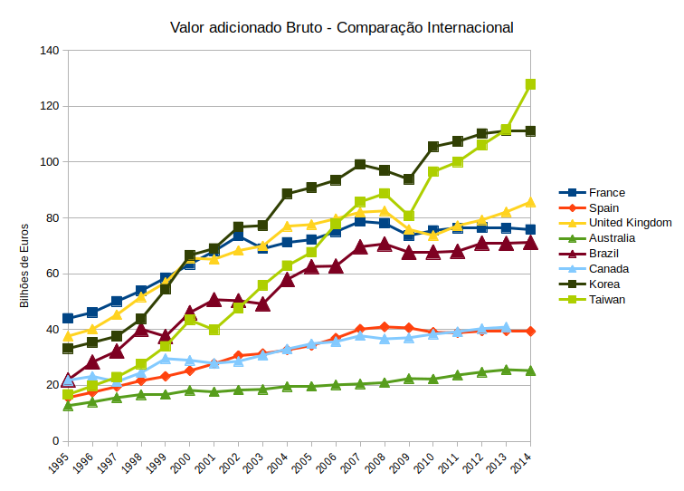
GVA – GROSS VALUE ADDED

Slide 8
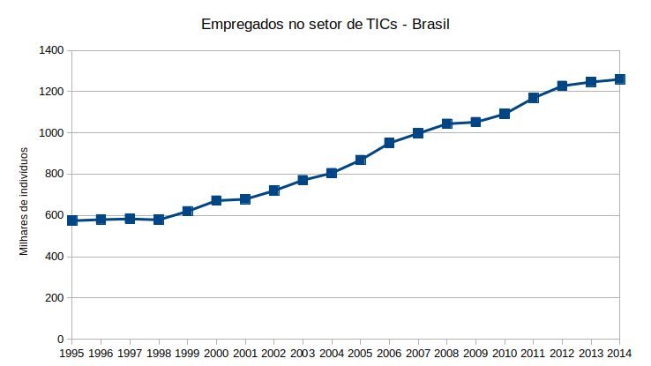
EMPLOYMENT (BRAZIL)

Slide 9
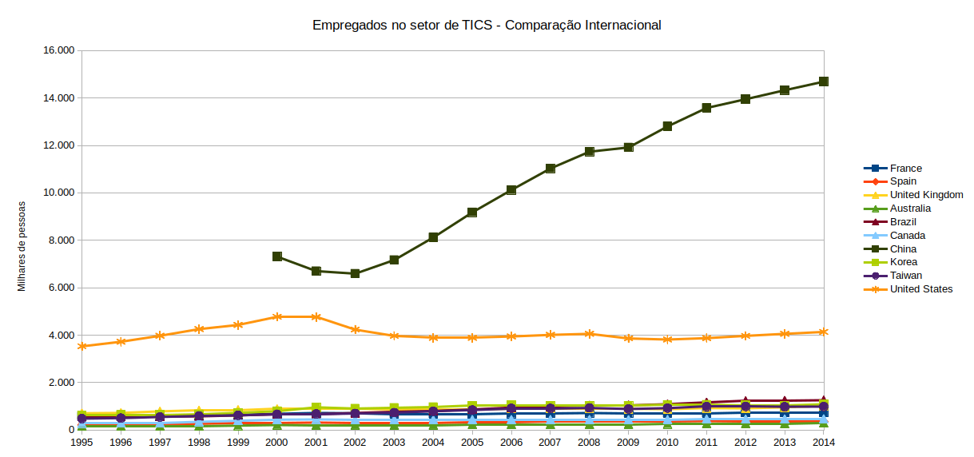
EMPLOYMENT

Slide 10
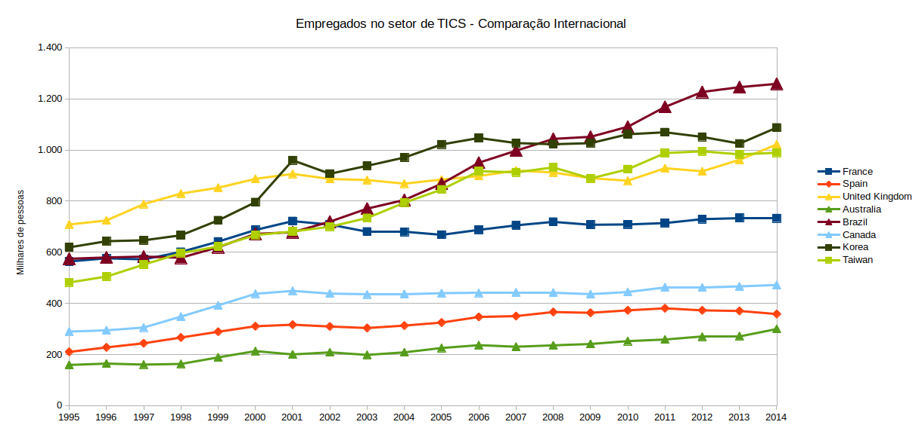
EMPLOYMENT

Slide 11
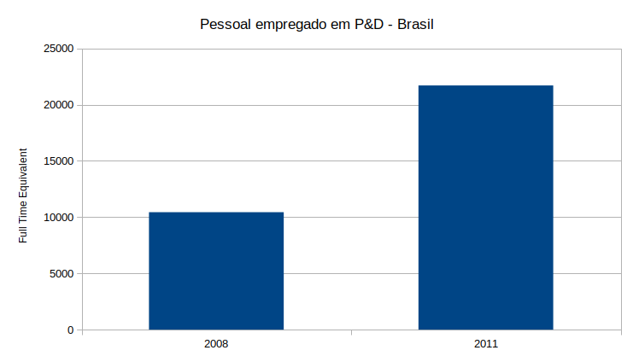
PERSONNEL IN R&D (BRAZIL)

Slide 12
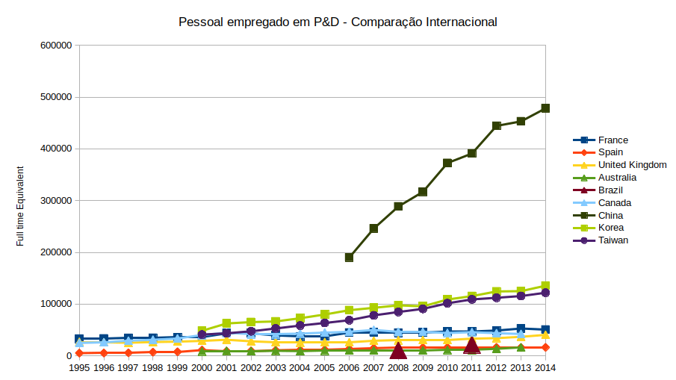
PERSONNEL IN R&D

Slide 13
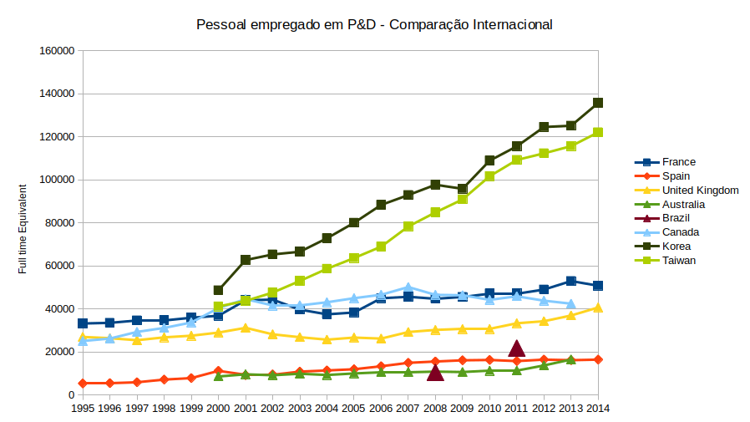
PERSONNEL IN R&D

Slide 14
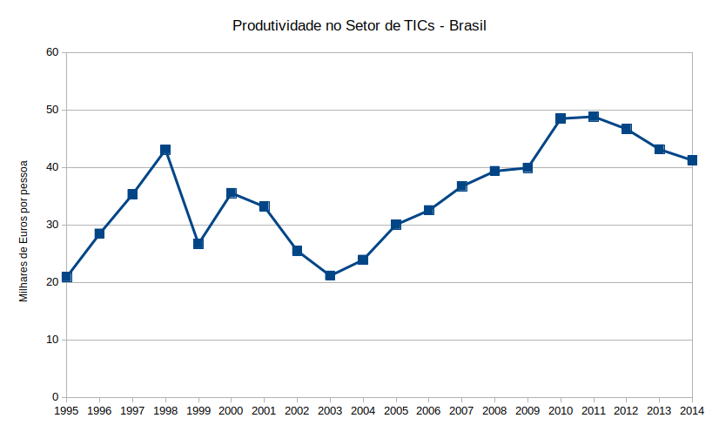
PRODUCTIVITY (BRAZIL)

Slide 15
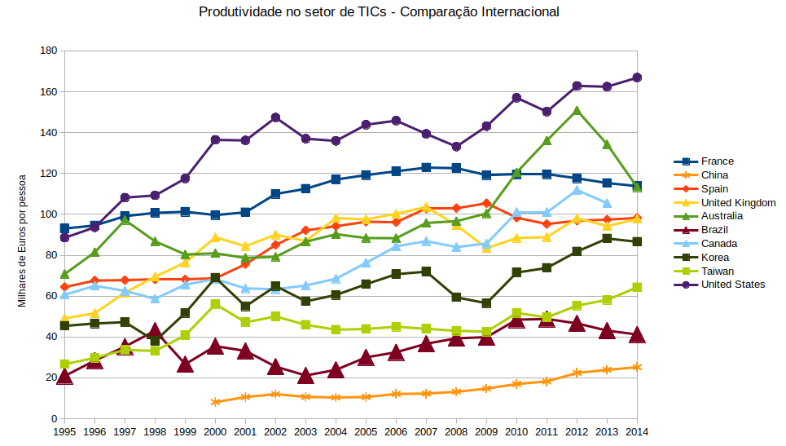
PRODUCTIVITY (BRAZIL)

