Slide 1
European Power Sector BI
End-to-End Business Intelligence Analysis
Electricity Generation, Energy Mix & Emissions | 2015–2024
SQL Server • Power Query • Power BI • DAX
Fabio Sturchio

Slide 2
Project Overview
• Objective: Analyze the evolution of the European power sector
• Period: 2015–2024
• Focus: Electricity generation, energy mix and emissions
• Workflow: Raw Data → SQL Server → Power Query → Star Schema → DAX → Power BI
• Output: Interactive 3-page Power BI dashboard

Slide 3
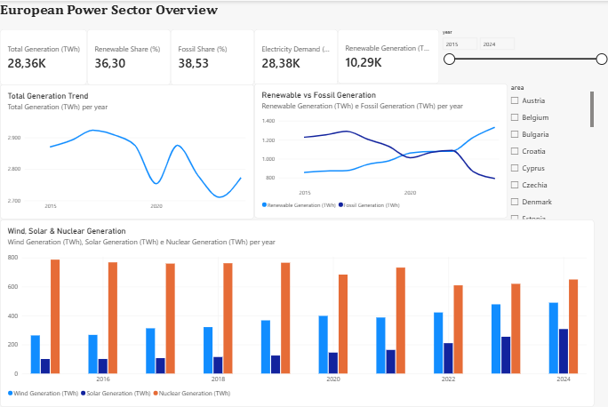
Power BI Dashboard — Overview

Slide 4
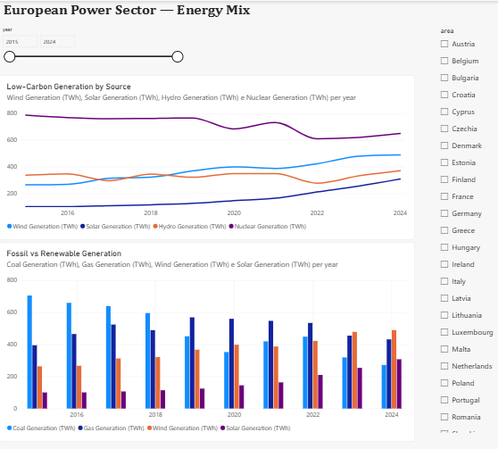
Power BI Dashboard — Energy Mix

Slide 5
Power BI Dashboard — Emissions

Slide 6
Key Insights & Conclusions
• Renewable generation: +55.36% (2015–2024)
• Solar generation: +206.65%
• Wind generation: +85.86%
• Fossil generation: -35.48%
• Power-sector emissions: -41.33%
• Emissions intensity: -39.24%
• Key takeaway: strong shift toward renewable generation and a lower-carbon European power mix.
Key modeling challenge: Overlapping aggregate and detailed source categories required careful KPI design to prevent double counting.

