Slide 1


Action 2.3.2 'Data and Service Linking simplification'
JRC INSPIRE Team
Kick-off Part B. “Remapping of Extended Capabilities” - December 3, 2021

Slide 2
Meeting agenda
Welcome and Approval of the agenda (JRC)
Possible amendments to Part A Consolidated proposal (“Data-service linking simplification”):
Based on Issue #38 (Marie)
Inputs received by email on 02/12 (Heidi).
Discussion on the Remapping of Extended Capabilities - Based on Consolidated proposal – Annex B (All)
Way forward for Part B (All)
AOB (All)
The meeting is recorded, and the recording will be made available afterwards upon request.

Slide 3
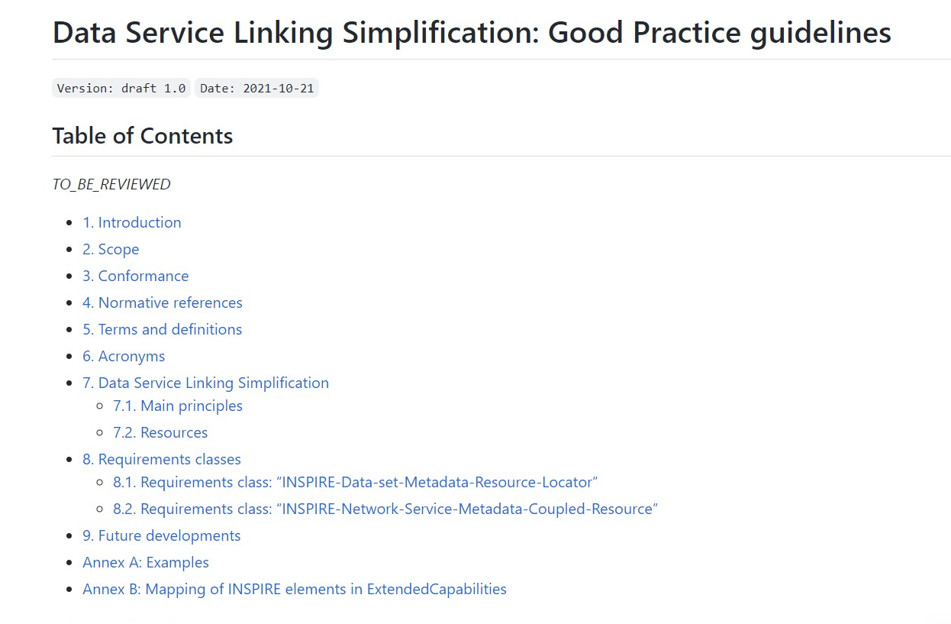
Amendments to Part A - Consolidated proposal
https://github.com/INSPIRE-MIF/gp-data-service-linking-simplification/blob/main/proposals/JRC/ds-linking-simplification-good-practice.md

Slide 4
Amendment #1. Make resource locator URL ISO compliant
Service metadata (external metadata file or “embedded” in the capabilities)
First Proposal – Not ISO compliant
Simplification
Simple use of the dataset metadata URL (e.g., CSW request) for the “Coupled resource” element
Notes:
“Implementation by reference” means that the xlink:href attribute is pointing to an XML document that
contains a gmd:MD_DataIdentification object.
Point to the gmd:MD_DataIdentification element by using the Unique Resource Identifier

Slide 5
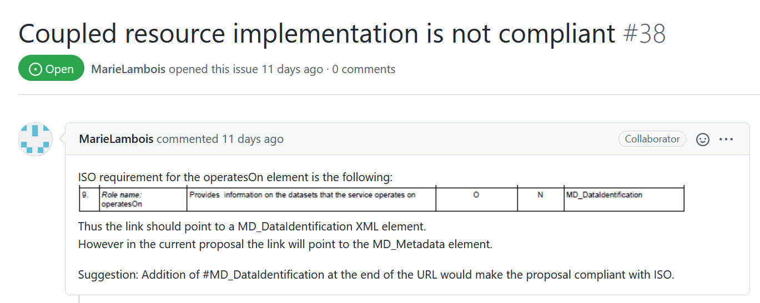
Amendment #1. Make resource locator URL ISO compliant
Proposed amendment: Issue #38 (Marie)
https://github.com/INSPIRE-MIF/gp-data-service-linking-simplification/issues/38
Solution: Append the "#MD_DataIdentification" at the end of the Coupled resource URL.
Notes:
The meeting will be focused on approving the bare minimum requirements/good practices/recommendations included in the proposal, so that this Action can be finally closed. We also anticipate that, in the unfortunate case where no agreement can be found during the meeting, we will have no other option but to handover the leadership of the sub-group to any of you who would be interested.

Slide 6
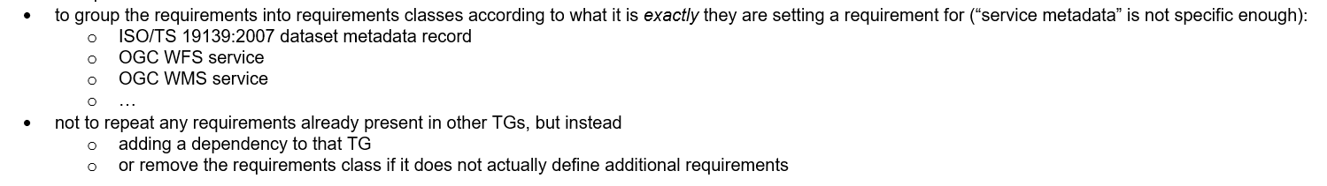
Amendment #2. Inputs received by email on 02/12
Heidi Vanparys
Notes:
The meeting will be focused on approving the bare minimum requirements/good practices/recommendations included in the proposal, so that this Action can be finally closed. We also anticipate that, in the unfortunate case where no agreement can be found during the meeting, we will have no other option but to handover the leadership of the sub-group to any of you who would be interested.

Slide 7
Discussion on the Remapping of Extended Capabilities
New mapping of the INSPIRE elements contained in the service metadata, as described in the Scenario 2 in the INSPIRE Network Service TGs.
Objective: Remove the need for the Extended Capabilities
Based on Consolidated proposal – Annex B.
Notes:
The meeting will be focused on approving the bare minimum requirements/good practices/recommendations included in the proposal, so that this Action can be finally closed. We also anticipate that, in the unfortunate case where no agreement can be found during the meeting, we will have no other option but to handover the leadership of the sub-group to any of you who would be interested.

Slide 8
Discussion on the Remapping of Extended Capabilities
Discussion on Proposal: Consolidated proposal – Annex B.
Notes:
The meeting will be focused on approving the bare minimum requirements/good practices/recommendations included in the proposal, so that this Action can be finally closed. We also anticipate that, in the unfortunate case where no agreement can be found during the meeting, we will have no other option but to handover the leadership of the sub-group to any of you who would be interested.

Slide 9
Next steps – Way forward for Part B
Next steps:
Refine (if needed) the proposed Remapping of Extended Capabilities based on the outcomes from the discussion.
Additional work / actions thread from this discussion:
Identify a well-known list of actions (e.g. identify, enumerate and specify changes needed in TGs - In order to tackle them in the scope of Sub-group 2.3.1 ‘Governance of TGs’).
Split the work between the working-group (volunteers).
Agree on a proposed date next Part B Follow-up (~ late January 2022).
AoB.
Notes:
The meeting will be focused on approving the bare minimum requirements/good practices/recommendations included in the proposal, so that this Action can be finally closed. We also anticipate that, in the unfortunate case where no agreement can be found during the meeting, we will have no other option but to handover the leadership of the sub-group to any of you who would be interested.

Slide 10

Thank you!
JRC-INSPIRE-SUPPORT@ec.europa.eu
© European Union 2021
Unless otherwise noted the reuse of this presentation is authorised under the CC BY 4.0 license. For any use or reproduction of elements that are not owned by the EU, permission may need to be sought directly from the respective right holders.

