Slide 1

Basics of Physical computing:
Maker Lab
Photo (your prototype would be perfect)
TITLE:
FIM
Group #45
Daniel F. Di Bella
Fabio Vitalba
Faculty of Engineering, Free University of Bozen-Bolzano
fvitalba@unibz.it
ddibella@unibz.it
MakerLab Final project
2023-2024

Slide 2
FIM: The Idea
FIM is a tool to reduce food waste in households while providing an overview of the stored items.
IMAGE of List View

Slide 3
FIM: Motivation
Italians produce on average 136kg of food waste per year (Statista 2020)
Work with new (to us) technologies and components
Image of Fridge gone bad
https://www.statista.com/chart/31072/food-wasted-per-capita-in-european-countries/#:~:text=Each%20person%20in%20the%20EU,from%20the%2027%20member%20states.

Slide 4
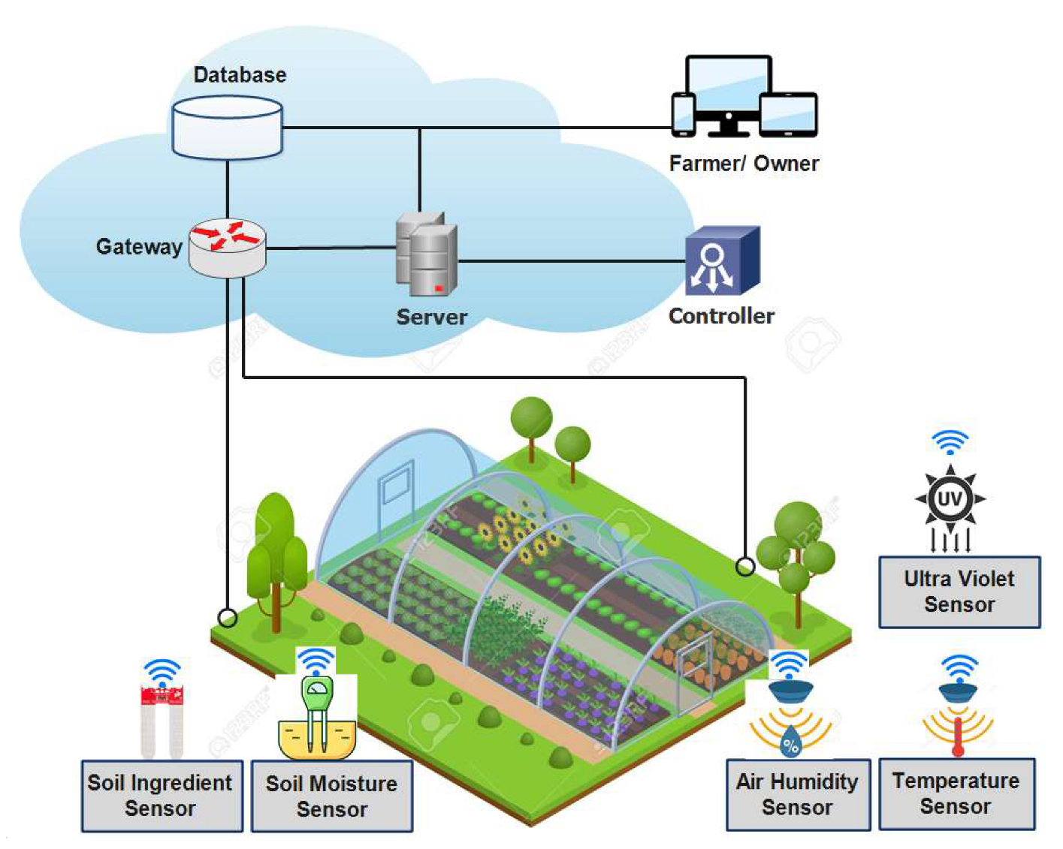
FIM: Overview
This is just an example on how you can give an overview of your project. It is not mandatory to do the same but it is recommended that your project is clear in this slide

Slide 5
FIM: Components
Input:
Touchscreen:
Modes/Commands selection
Scanner:
Inserting data (barcode, quantity, date)
Keyboard:
Inserting data that cannot be represented as a barcode
Adafruit:
Read: persistent storage of items
Output:
Display:
Displaying the different screens
Adafruit:
Write: persistent storage of items

Slide 6
Basics of Physical computing:
Maker Lab
Photo (your prototype would be perfect)
TITLE: ACRONYM
Group #XX
Name Surname 1
Name Surname 2
Faculty of Engineering, Free University of Bozen-Bolzano
Email 1
Email 2
MakerLab Final project
2023-2024

