Slide 1
Homology modeling with Modeller
Bioinformatics II Presentation
June 20, 2012
Taylor Kessinger
Zarin Shakibaei
Fabio Zanini

Slide 2
Outline
Goal: Predict the structure of 1yje:A using homology modeling
Introduction:
What is homology modeling?
What is Modeller?
Methods:
Initial search
Alignment
Structure prediction
Results: Predicted structures and conclusions

Slide 3
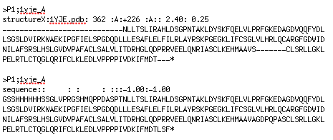
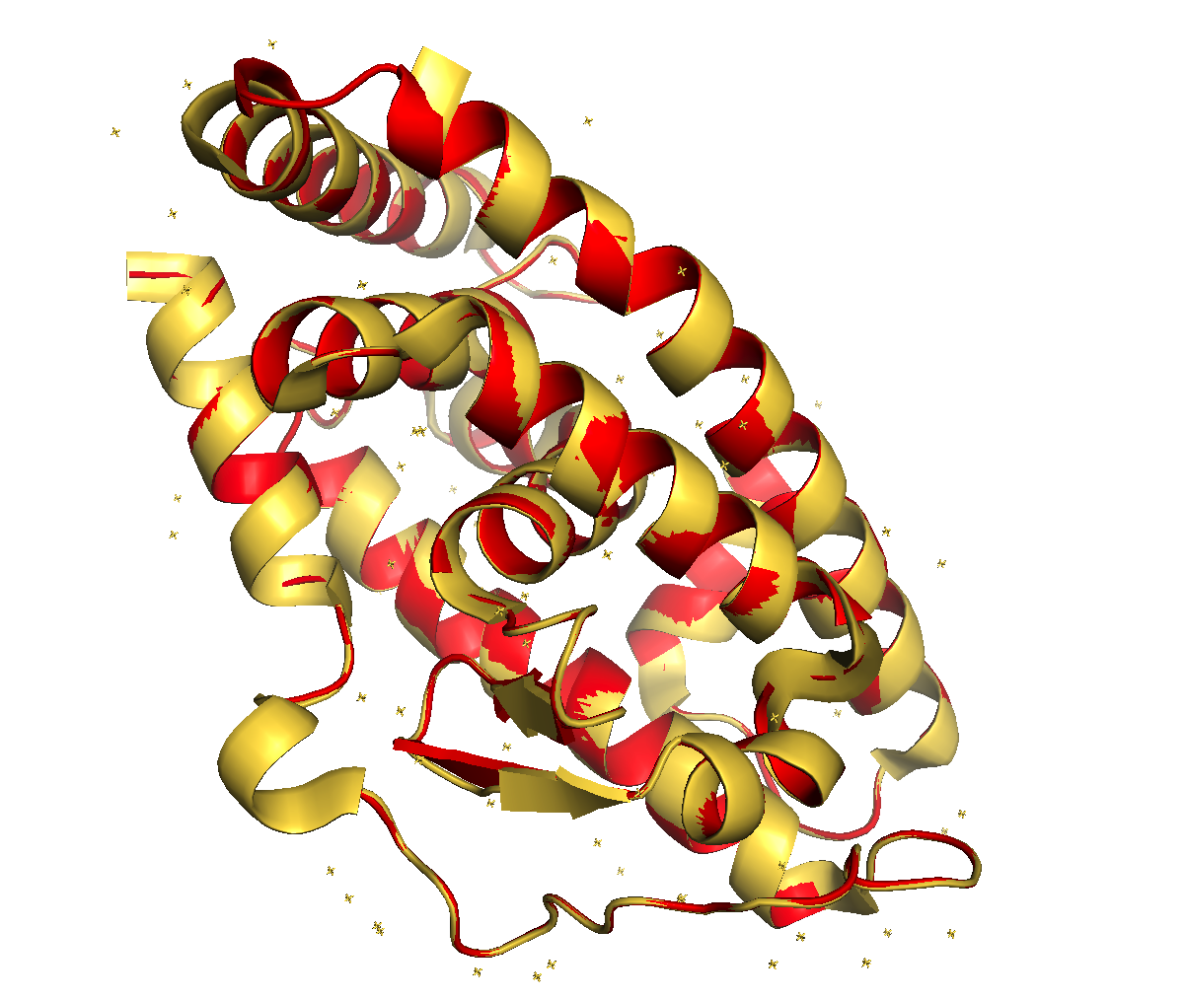
Introduction: Homology modeling
Homologous proteins have similar structures
Many proteins are homologous to something with a known structure
Structure is much more conserved than sequence

Slide 4
Introduction: Modeller
Free Python package due to Sali et al. (1994)
No GUI–knowledge of Python required
Predicts structures by “satisfaction of spatial restraints”
Spatial features common to template structures are globbed
Energy or probability functions are assigned to each spatial feature, imposing restraints
The model that best satisfies these restrains is selected
Examples: molecular PDF, GA341, DOPE (Shen and Sali 2006)

Slide 5
Methods: Initial search
Target (1yje:A) was CSBlasted against the non-redundant PDB
CSBLAST looks for matches by considering the context around amino acids (Biegert et al. 2009)
Hits with e < 0.01 were selected as potential templates
The first subsequent hit was much higher than 0.01, so a clear jump was visible
An initial MSA was generated using MUSCLE (Edgar 2004)

Slide 6
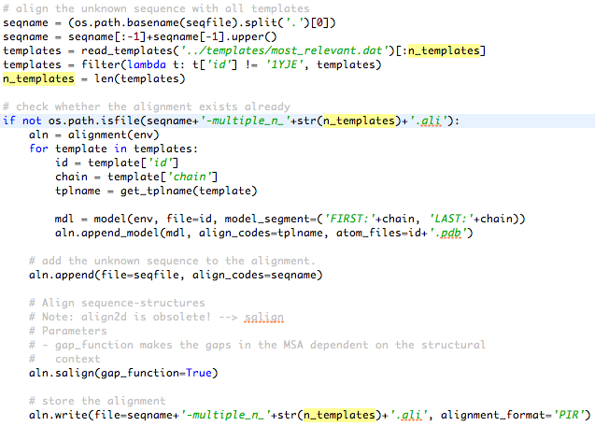
Methods: Alignment
Modeller has its own alignment method
Required inputs: sequence (in PIR format), .pdb files
Gap penalties are lessened outside of secondary structures
High matches were globbed and placed in a multiple sequence alignment

Slide 7
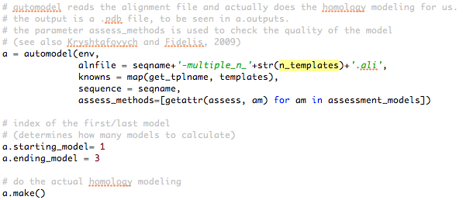
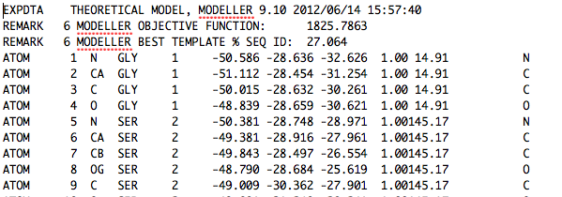
Methods: Structure prediction
MSA was used to predict the structure of 1yje:A
The automodel class makes this easy
More powerful tools available
Select best of three models
Output: .pdb file

Slide 8
Evaluation of prediction quality
…can be performed using some quantitative measures
Assessments like Krystafovych et al. (2009)
molpdf, GA341 and DOPE (all built-in)
…can be done visually in PyMOL
With true structure (Flaig et al. 2005)
Without

Slide 9
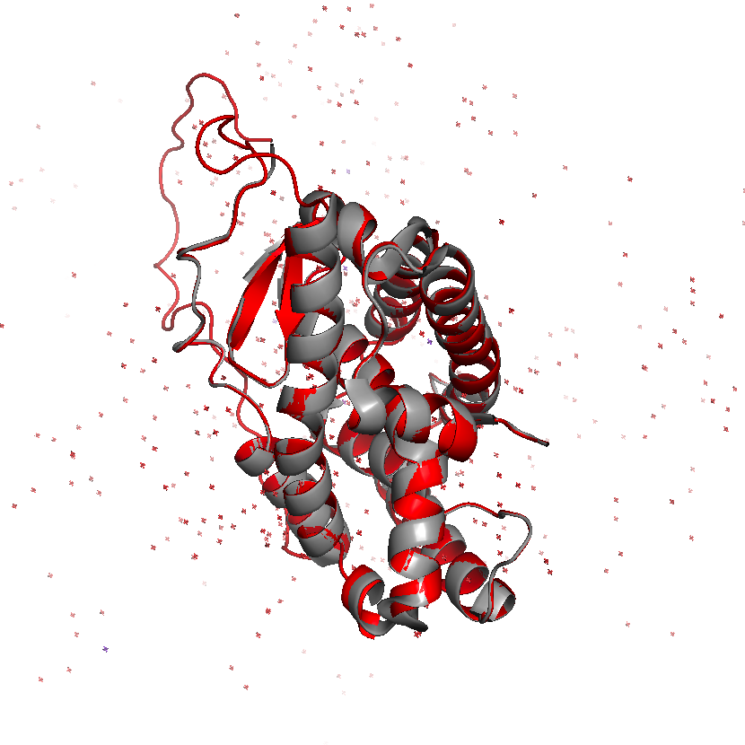
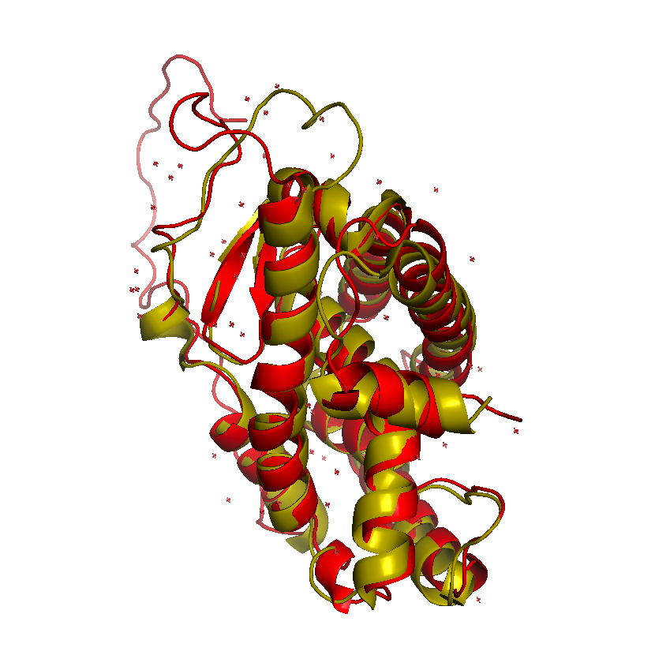
Results: Prediction checks
Top: 1yje:A (red) fitted onto one template (1ovl:A)
Bottom: Predicted structure (red) compared to real one
Note poor fitting of loops, but overall good prediction of secondary structures
DOPE score: -31212

Slide 10
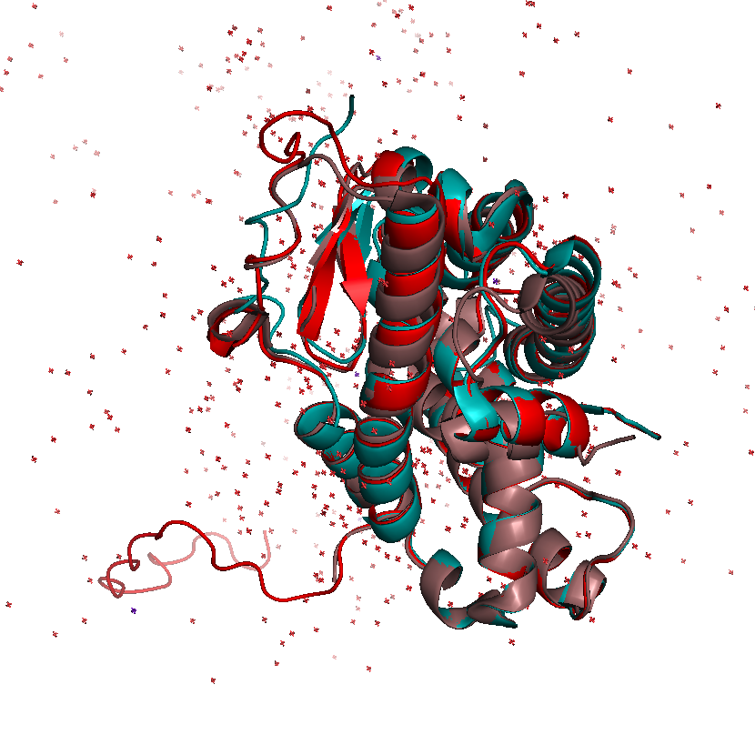
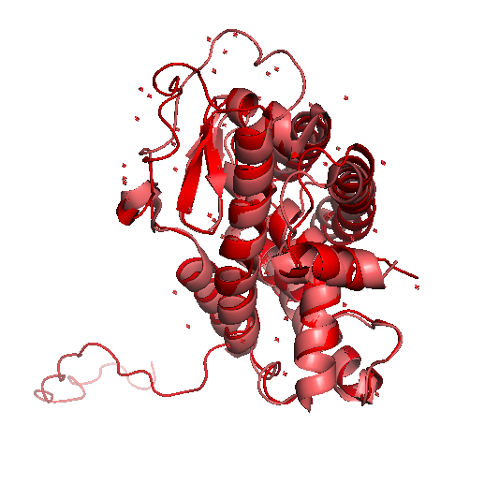
Results: Prediction checks
Top: 1yje:A (red) fitted onto two templates (1ovl:A and 1pdu:A)
Bottom: Predicted structure (red) compared to real one
Loop fitting appears to have improved slightly
DOPE score: -31385

Slide 11
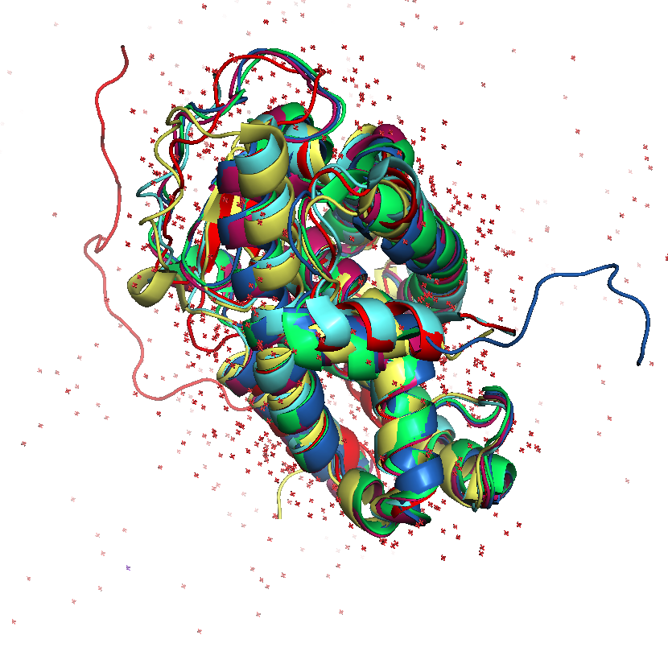
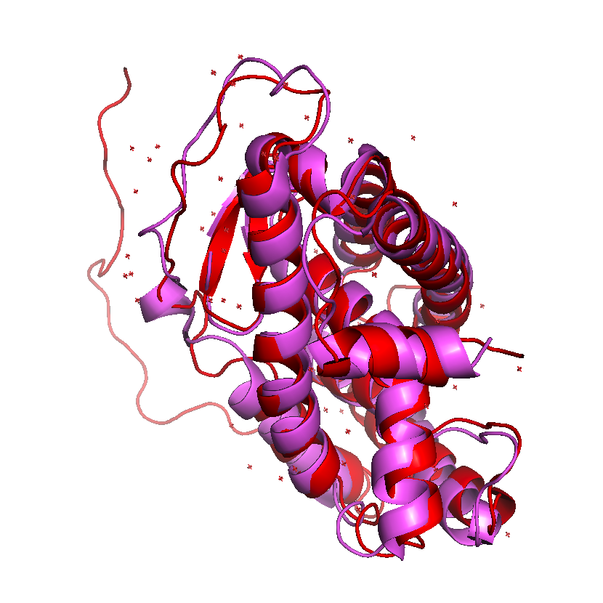
Results: Prediction checks
Top: 1yje:A (red) fitted onto five templates
Bottom: Predicted structure (red) compared to real one
Loop fitting is now pretty good, overall
DOPE score: -30780

Slide 12
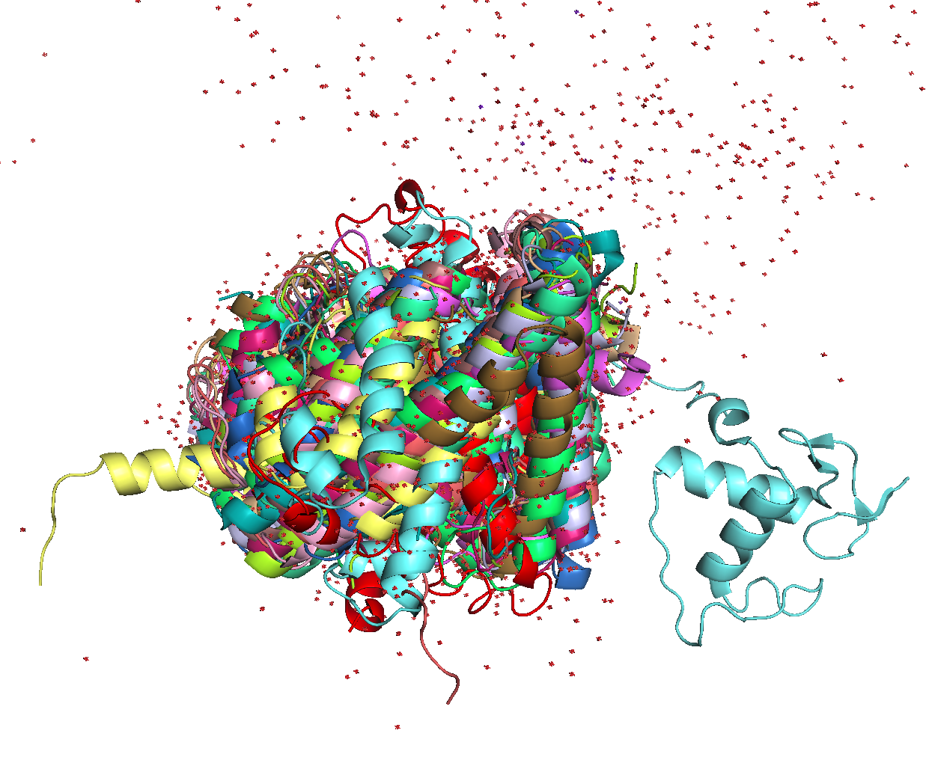
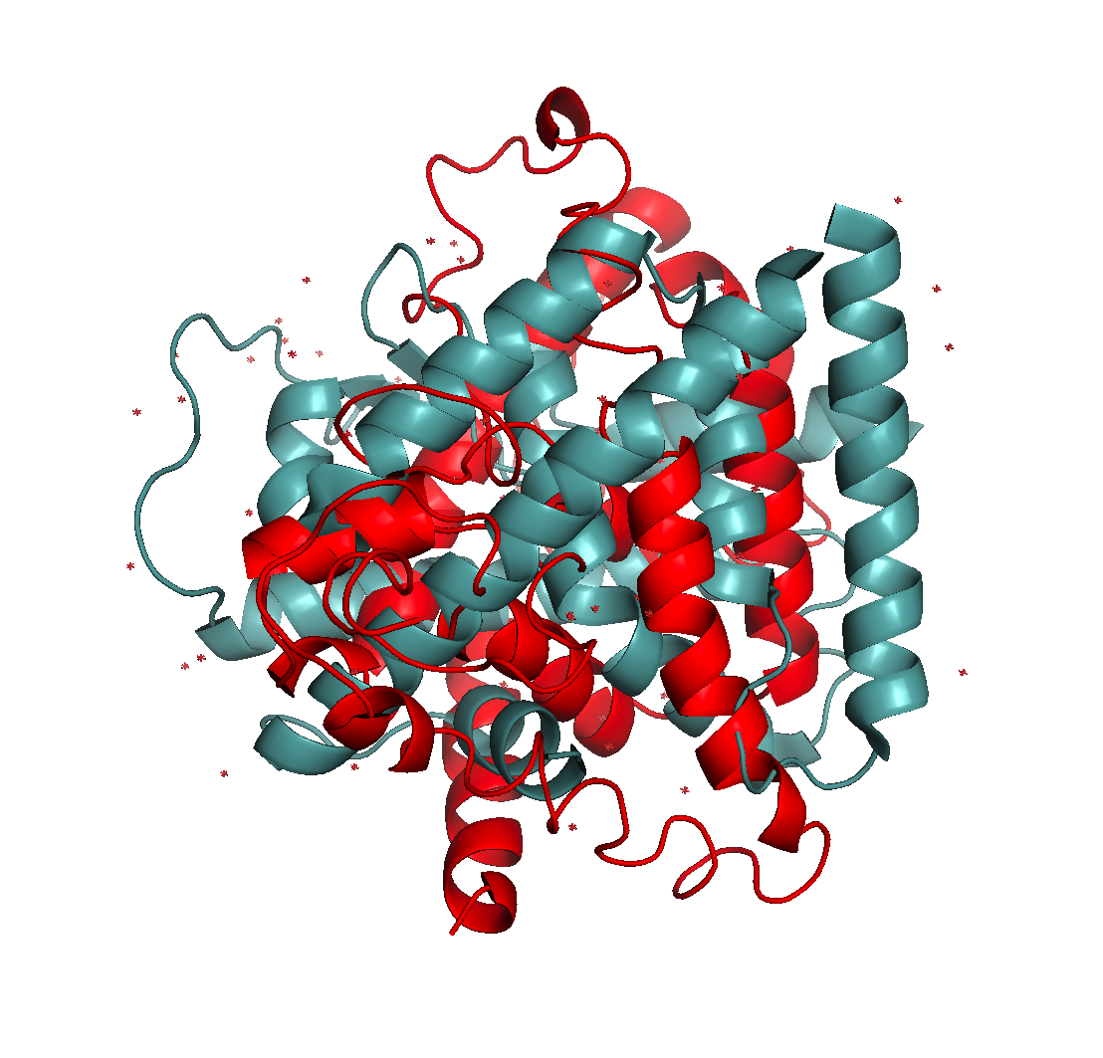
Results: Prediction checks
Top: 1yje:A (red) fitted onto fifteen templates
Bottom: Predicted structure (red) compared to real one
There appear to be diminishing returns
DOPE score: -21209
Notice the jump!

Slide 13
Conclusions
Modeller can accurate predict secondary structures and even loop regions
Performs well when it doesn’t get confused
Some level of skill is needed in selecting matches
Current PDB may be enough to solve structure prediction problem (Zhang 2005)
Homology modeling may be the way of the future; alignment and selection are limiting
Just a bit too ambitious

Slide 14
Acknowledgments
Dr. Sven Nahnsen
Remainder of the Bio II class

Slide 15
References
Stephen F. Altschul, Warren Gish, Webb Miller, Eugene W. Myers, and David J. Lipman. Basic local alignment search tool. Journal of Molecular Biology, 215(3):403 – 410, 1990.
A. Biegert and J. Söding. Sequence context-specific profiles for homology searching. Proceedings of the National Academy of Sciences, 106(10):3770– 3775, 2009.
R.C. Edgar. Muscle: multiple sequence alignment with high accuracy and high throughput. Nucleic acids research, 32(5):1792–1797, 2004.
Ralf Flaig, Holger Greschik, Carole Peluso-Iltis, and Dino Moras. Structural basis for the cell-specific activities of the ngfi-b and the nurr1 ligand- binding domain. Journal of Biological Chemistry, 280(19):19250–19258, 2005.
Andriy Kryshtafovych and Krzysztof Fidelis. Protein structure prediction and model quality assessment. Drug Discovery Today, 14(78):386 –393, 2009.
A. Sali and TL Blundell. Comparative protein modelling by satisfaction of spatial restraints. Protein Structure by Distance Analysis, 64:C86, 1994.
Andrej Sali, Liz Potterton, Feng Yuan, Herman van Vlijmen, and Martin Karplus. Evaluation of comparative protein modeling by modeller. Proteins: Structure, Function, and Bioinformatics, 23(3):318–326, 1995.
Schrödinger, LLC. The PyMOL Molecular Graphics System, Version 1.2r3pre.
Min-yi Shen and Andrej Sali. Statistical potential for assessment and prediction of protein structures. Protein Science, 15(11):2507–2524, 2006.
Y. Zhang and J. Skolnick. The protein structure prediction problem could be solved using the current pdb library. Proceedings of the National Academy of Sciences of the United States of America, 102(4):1029, 2005.

