Slide 1
Homology modeling with Modeller
Bioinformatics II Presentation
Taylor Kessinger
Zarin Shakibaei
Fabio Zanini

Slide 2
Outline
The Goal: Predict the structure of 1yje:A using homology modeling
What is homology modeling?
What is Modeller?
Using Modeller:
Initial search
Alignment
Structure prediction
Evaluation of prediction quality

Slide 3
Homology modelling
Homologous proteins have similar structures
Many proteins are homologous to something with a known structure
Structure is much more conserved than sequence

Slide 4
Modeller
Free Python package
No GUI
Modeller predicts structures by “satisfaction of spatial restraints”
This means: look at the

Slide 5
Initial search
Target (1yje:A) was CSBLASTed against the non-redundant PDB
CSBLAST looks for matches by considering the context around amino acids
Hits with e < 0.01 were selected as potential templates
The first subsequent hit was much higher than 0.01, so a clear jump was visible
An initial MSA was generated using MUSCLE

Slide 6
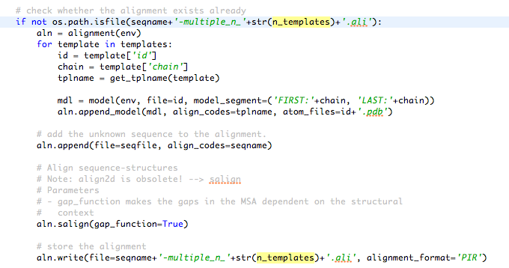
Alignment
Modeller has its own alignment method
Required inputs: sequence (in PIR format), .pdb file
Gap penalties are lessened outside of secondary structures
High matches were globbed and placed in a multiple sequence alignment

Slide 7
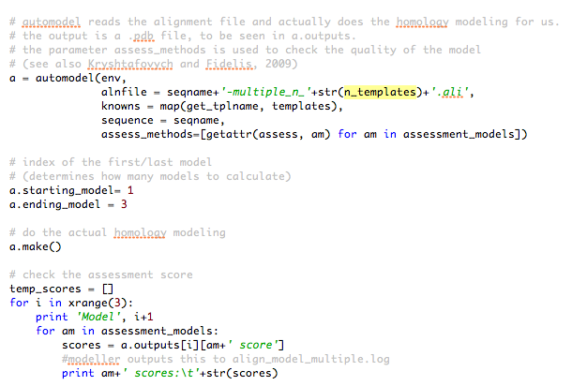
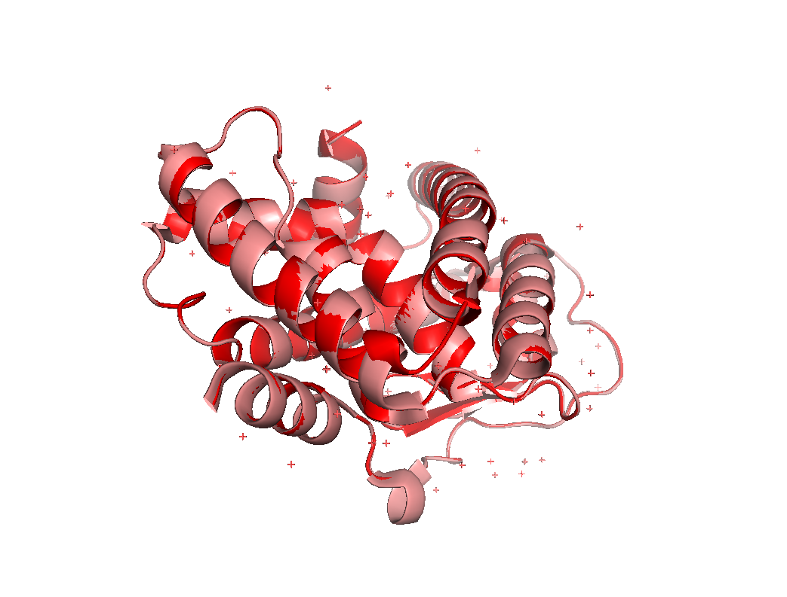
Structure prediction
MSA was used to predict the structure of 1yje
The automodel class makes this easy
More powerful tools available: can also model loops, hydrogens, water, etc.
Not necessary for our purposes

Slide 8
Evaluation of prediction quality
…can be performed using some quantitative measures:
Krystafovych et al.
GA341 and DOPE
…can be done visually in PyMol
With true structure (sanity check)
Without

Slide 9
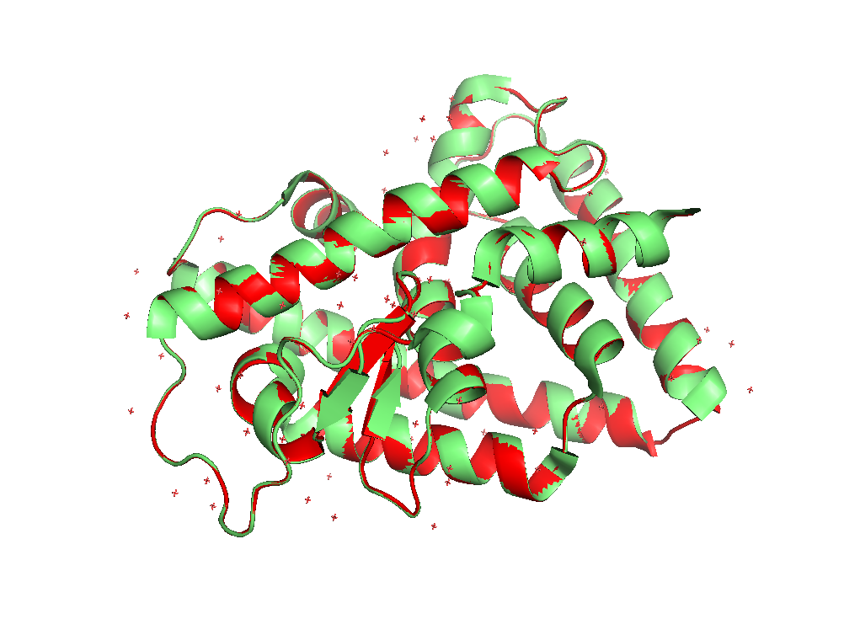
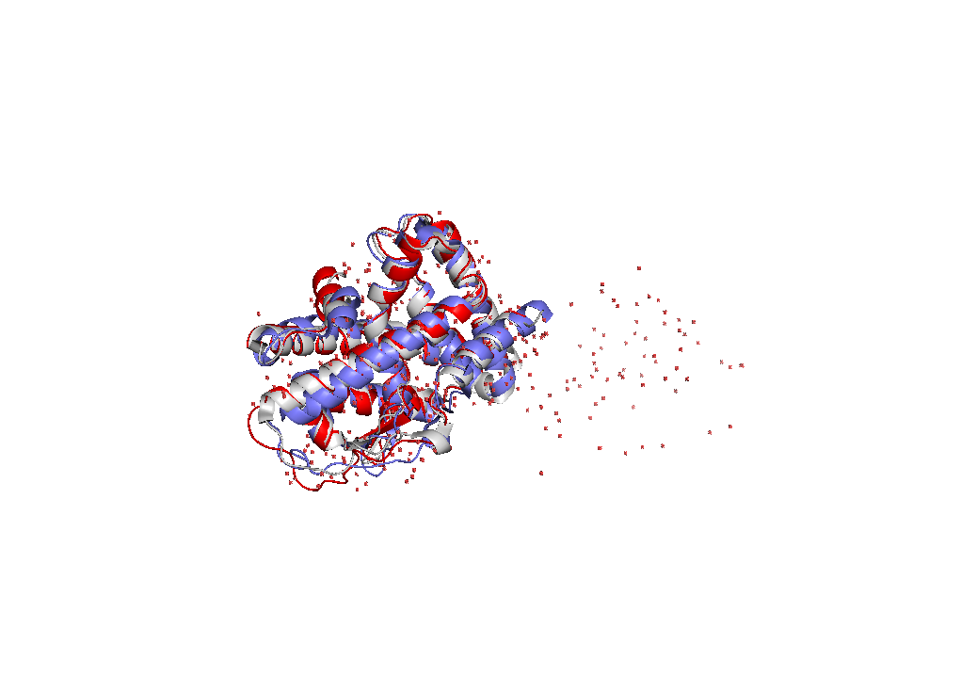
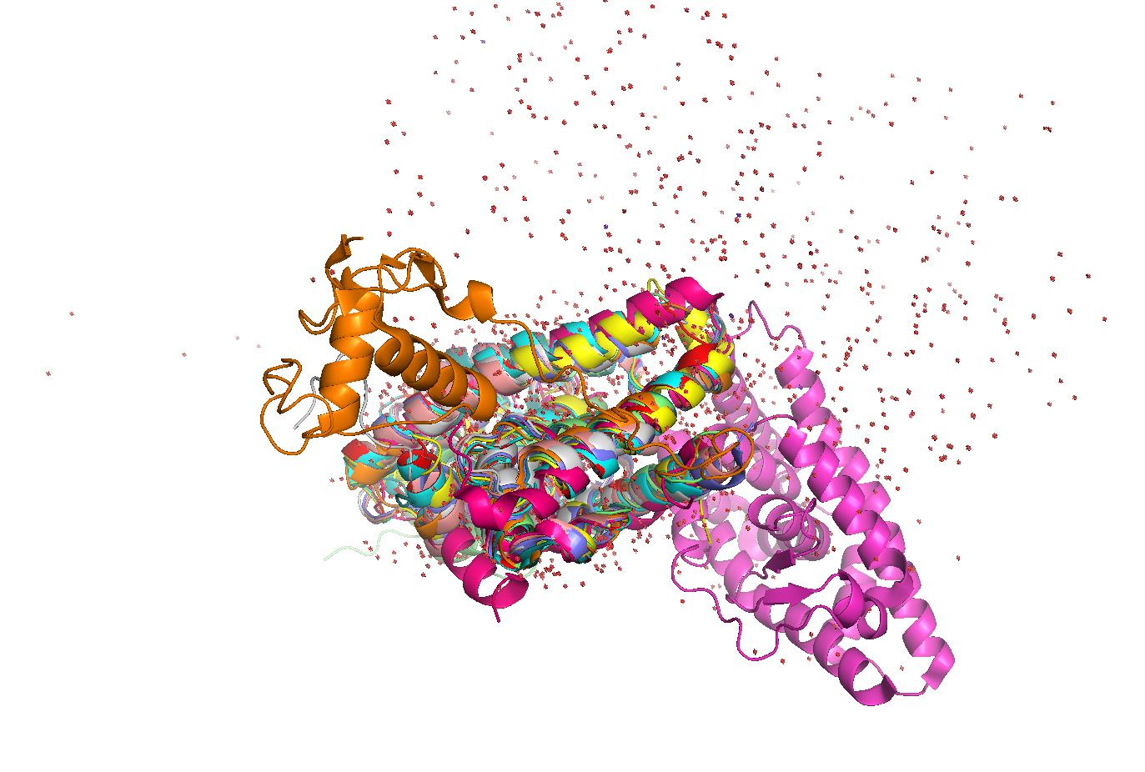
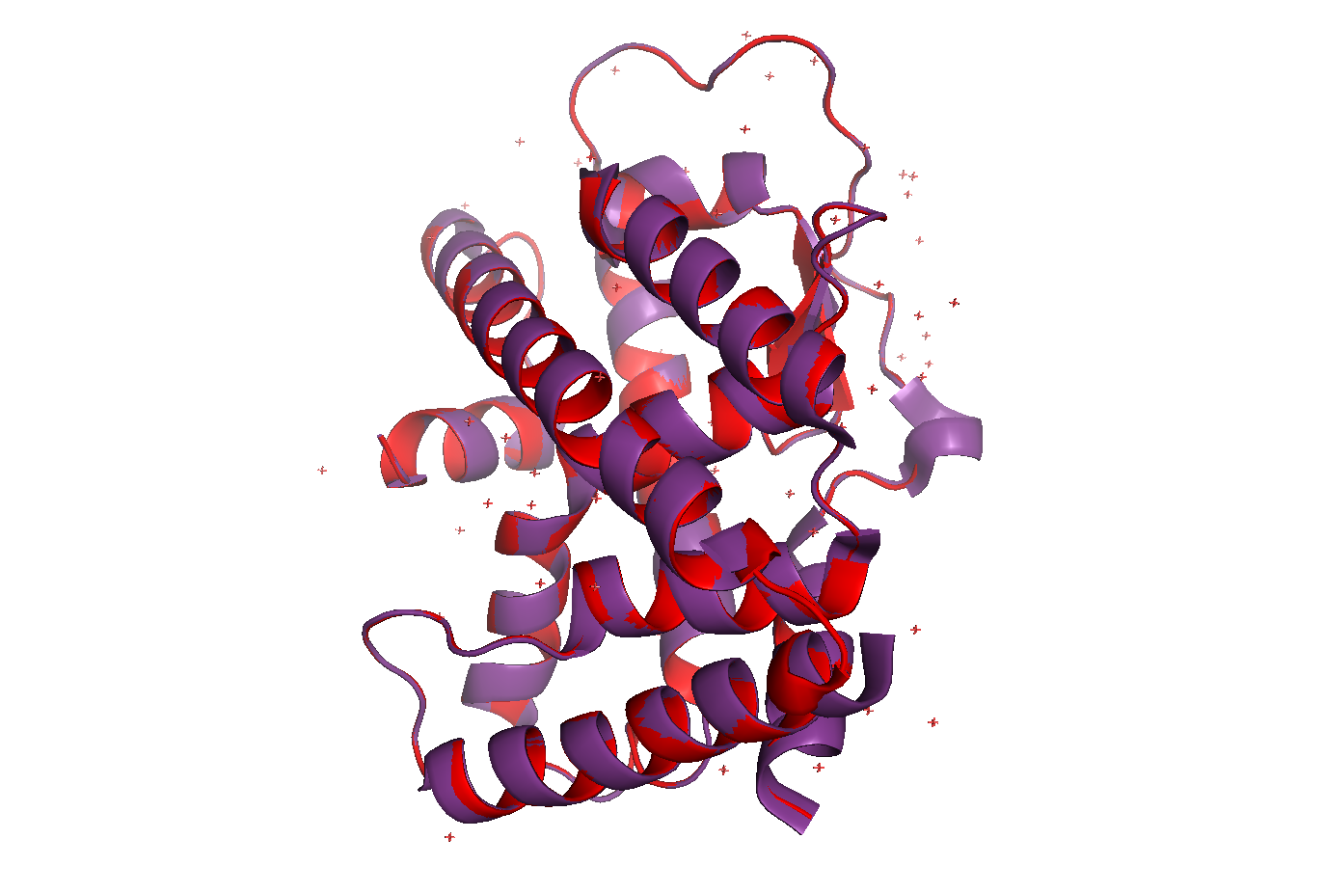
Prediction checks

Slide 10
Summary
Modeller can accurately predict structures
Effective even when few good matches are used
Homology modelling may be the way of the future
“Current PDB may be enough to solve structure prediction problem” (Zhang 2005)

Slide 11
Acknowledgments
Prof. Dr. Oliver Kohlbacher
Dr. Sven Nahnsen, Johannes Junker
Remainder of the Bio II class

