Slide 1
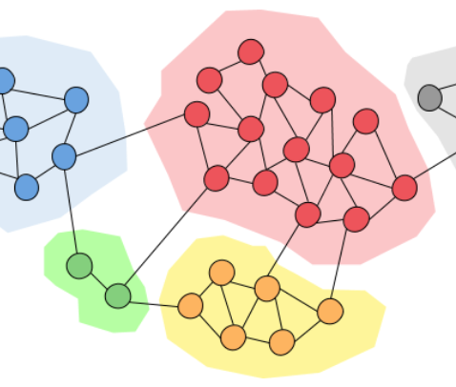
Community detection algorithms for real and artificial networks
Fábio Cruz, 96957
Luís Fernandes, 97018

Slide 2
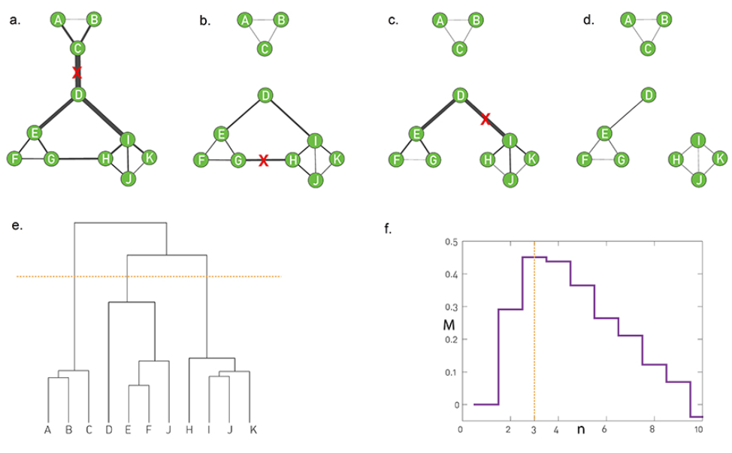
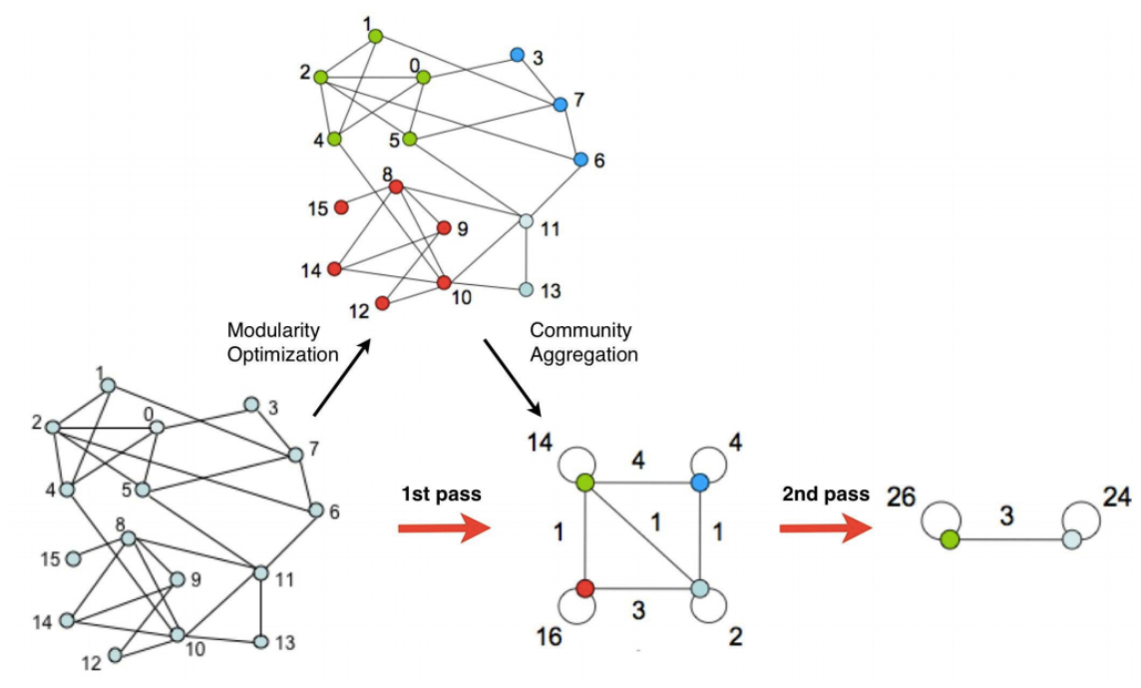
Algorithms
Girvan-Newman
Louvain
Leiden
Infomap
Girvan-Newman
Louvain

Slide 3
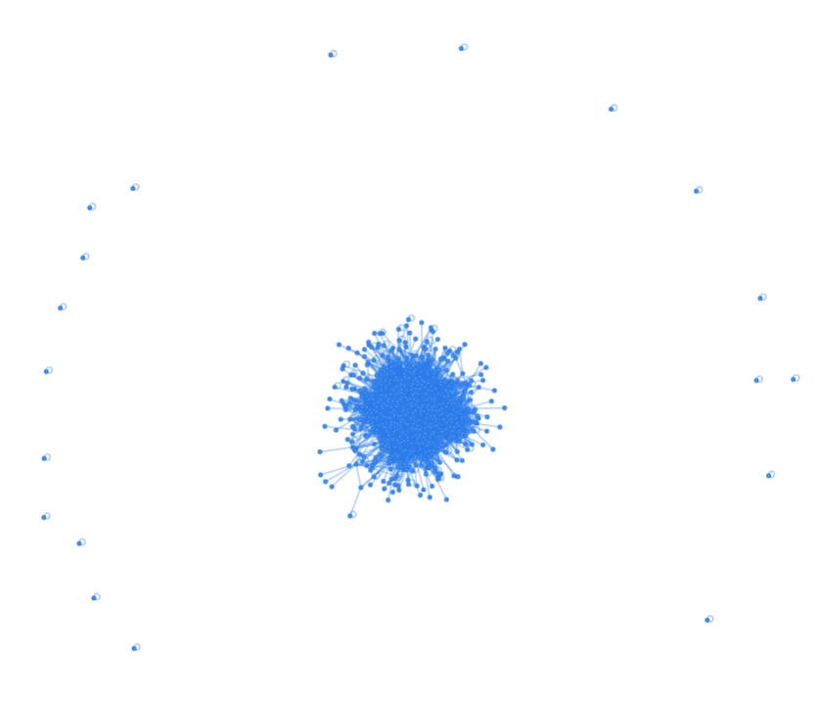
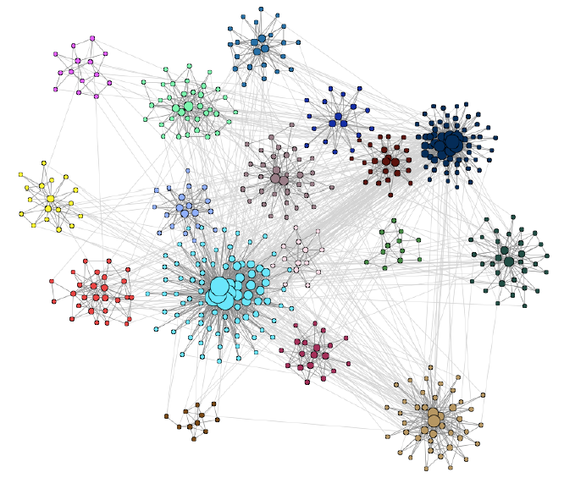
Networks
LFR benchmark
SBM benchmark
Email network
DBLP network
Email
LFR

Slide 4
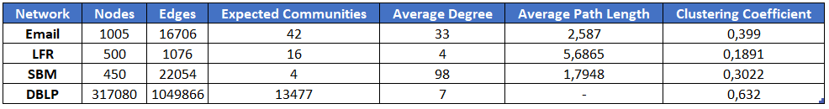
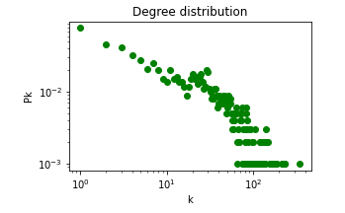
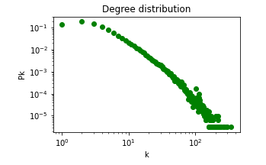
Networks
LFR benchmark
SBM benchmark
Email network
DBLP network
Email
DBLP

Slide 5
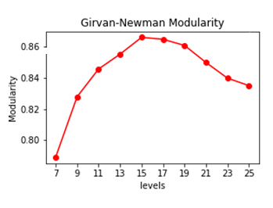
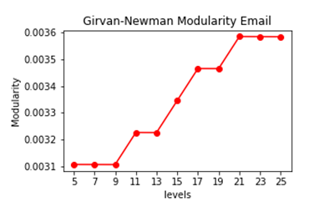
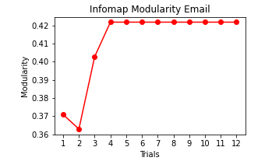
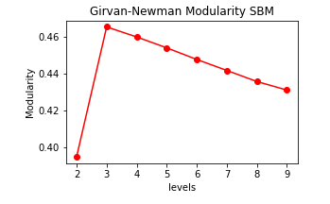
Girvan-Newman and Infomap parameters
Girvan-Newman dendrogram level to cut
Infomap number of trials

Slide 6
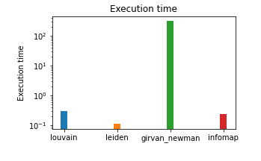

Running Times
O(m²n) - Girvan-Newman
O(n) - Louvain
O(log(n)) - Leiden
O(n) - Infomap

Slide 7
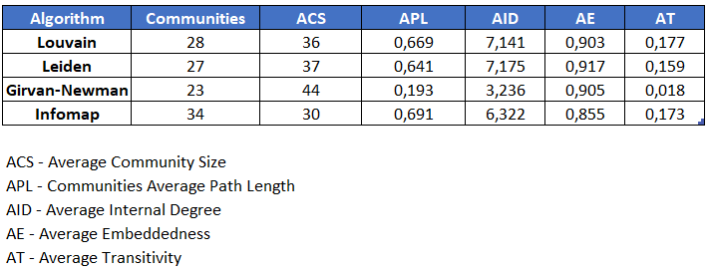
Internal Properties

Slide 8

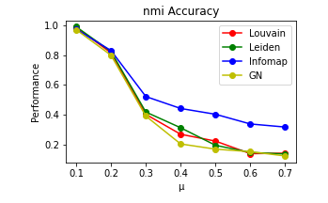
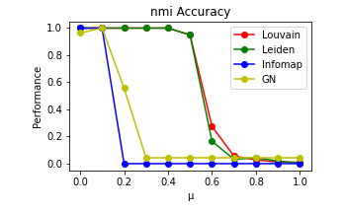
Accuracy Normalized Mutual Information
LFR
SBM

Slide 9
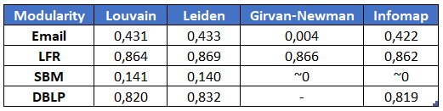
Girvan-Newman Modularity

Slide 10
Conclusion and Future Work
Leiden is the most efficient algorithm
Louvain, Leiden and Infomap give similar accuracy results for the networks tested
Girvan-Newman was the slowest and least accurate for the Email and SBM networks
Try different types of algorithms (Overlapping)
Robustness Modularity
Image References:
Barabási, A. L. (2013). Network science. Philosophical Transactions of the Royal Society A: Mathematical, Physical and Engineering Sciences, 371(1987), 20120375. https://doi.org/10.1098/rsta.2012.0375

