Slide 1
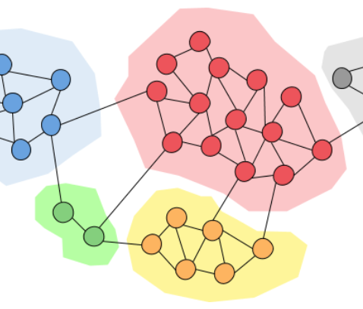
Community detection algorithms for real and artificial networks
Fábio Cruz, 96957
Luís Fernandes, 97018

Slide 2
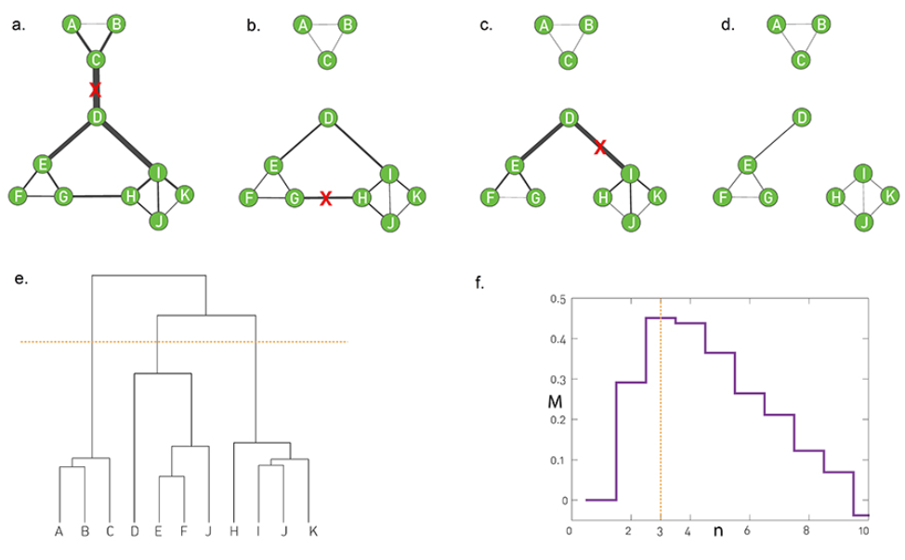
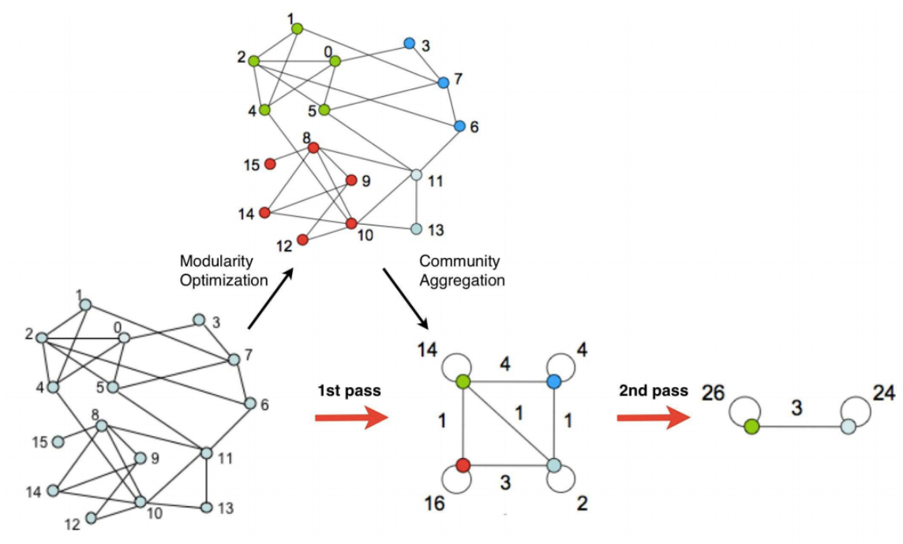
Algorithms
Girvan-Newman
Louvain
Leiden
Infomap
Girvan-Newman
Louvain

Slide 3
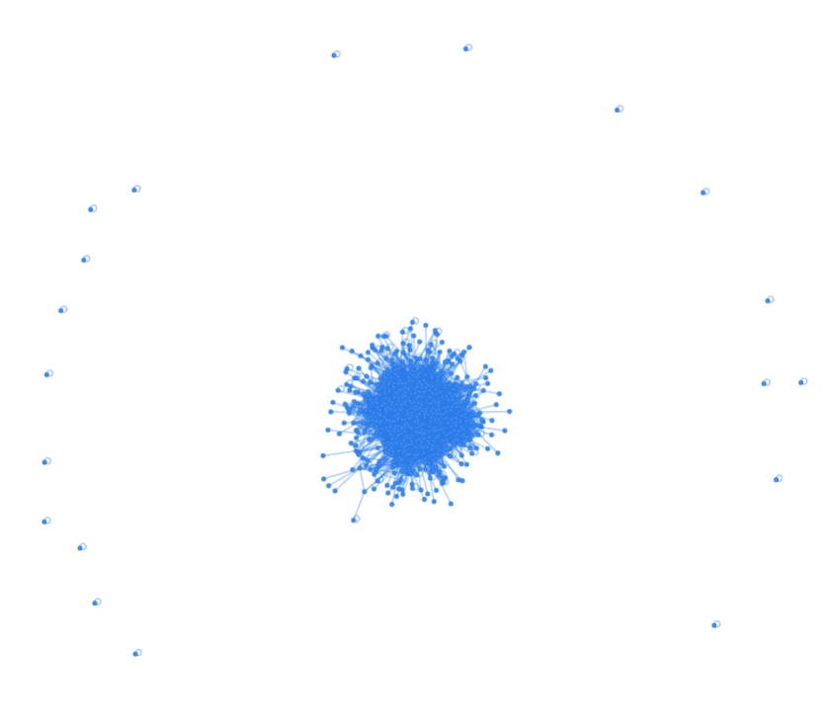
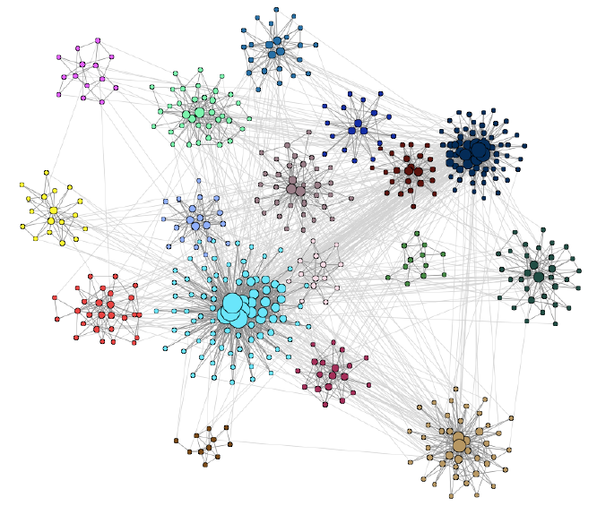
Networks
LFR benchmark
SBM benchmark
Email network
DBLP network
Email
LFR

Slide 4
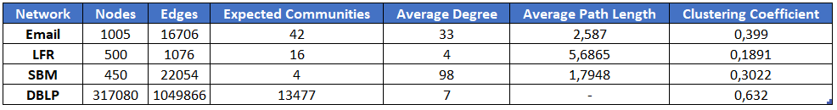
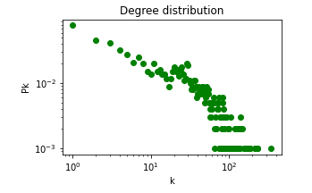
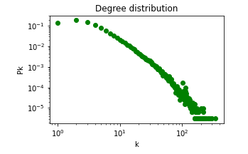
Networks
LFR benchmark
SBM benchmark
Email network
DBLP network
Email
DBLP

Slide 5
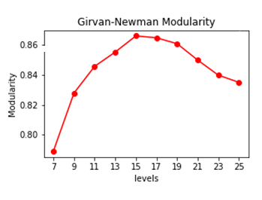
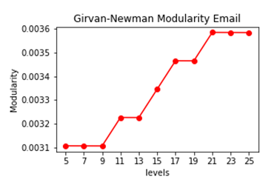
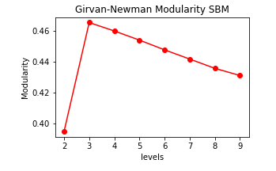
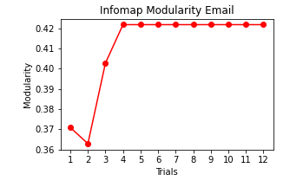
Girvan-Newman and Infomap parameters
Girvan-Newman dendrogram level to cut
Infomap number of trials

Slide 6
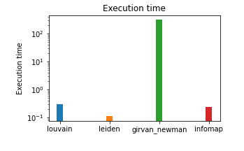

Running Times
O(m²n) - Girvan-Newman
O(n) - Louvain
O(log(n)) - Leiden
O(n) - Infomap

Slide 7
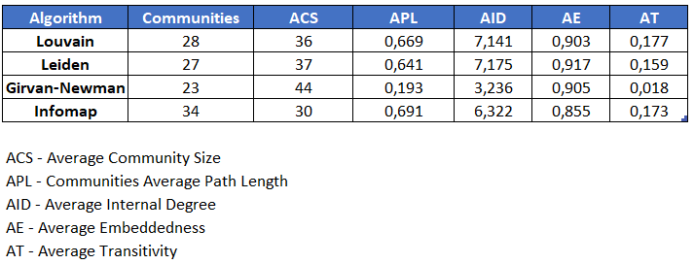
Internal Properties

Slide 8
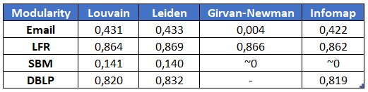
Modularity

Slide 9

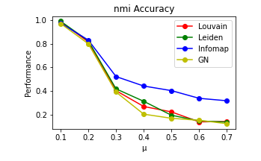
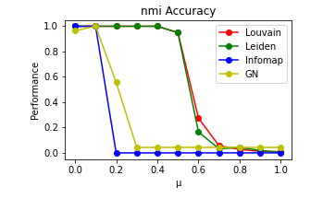
Accuracy

Slide 10
Conclusion and Future Work
Leiden fastest and similar accuracy to Louvain and Infomap
Girvan-Newman not cool
Maybe try Overlapping method?
Maybe try method that considers nodes that dont belong to any community
Robustness Modularity

