Slide 1
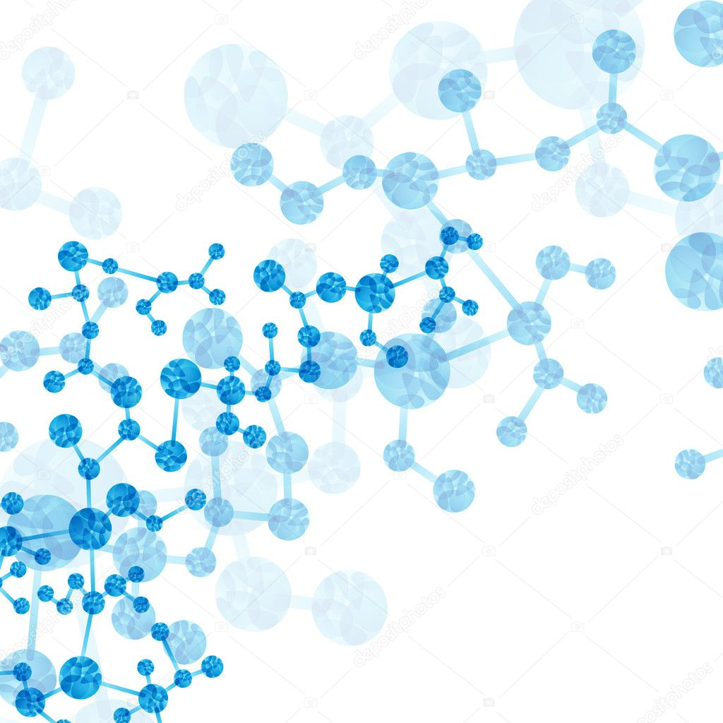

Community detection and motifs discovery for the characterization of transcriptional regulatory networks of yeast species

Slide 2
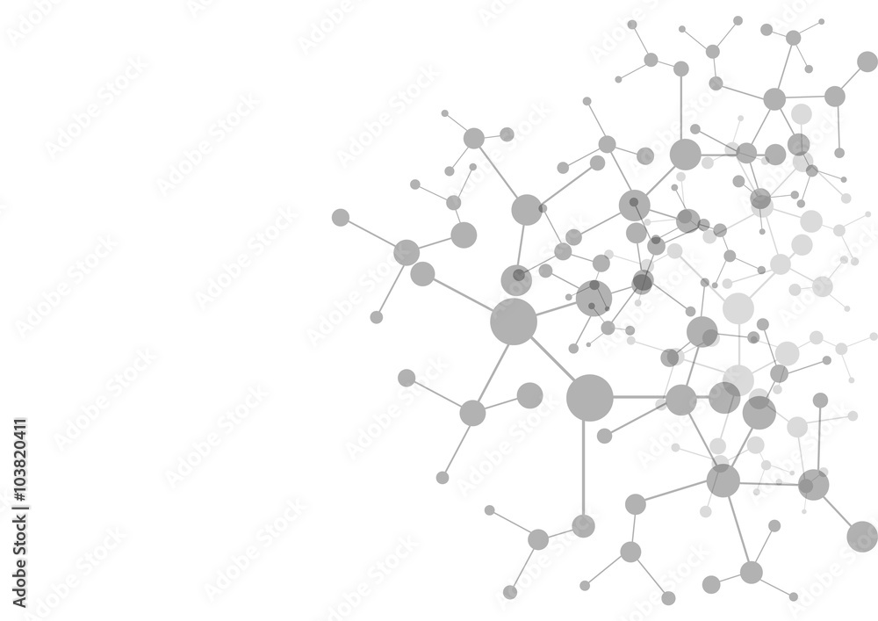
Introduction
1
Motivation and Objectives

Slide 3
Introduction
Motivation
Transcriptional regulation is an important mechanism for the control of gene expression
Transcription factors (TFs) and other proteins are responsible for this regulation by activating/repressing target genes (TGs)
These interactions can be represented by transcriptional regulatory networks

Slide 4
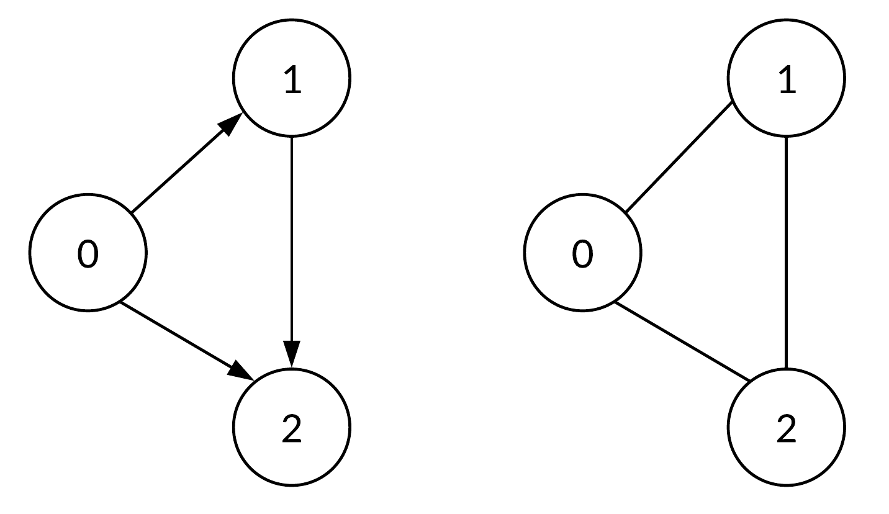
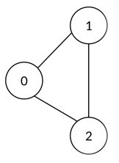
Introduction
Directed
Undirected
Network science
Complex systems can be represented as networks/graphs
Nodes connected through edges represent interactions between the entities of the system
Graphs can be directed, weighted and/or signed
Weighted
Signed
1
+
2
-
3
+

Slide 5
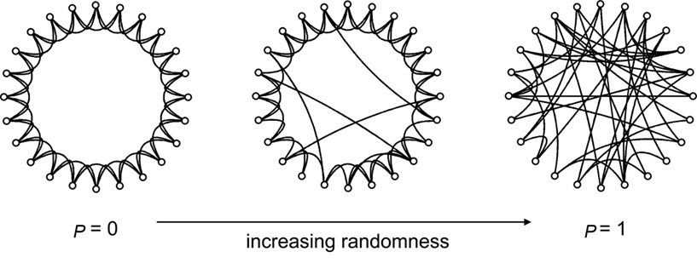
Introduction
Network science
Graphs can also be characterized by several properties
Random networks can be used to study properties of real systems
Watts-Strogatz random network

Slide 6

Introduction
Objectives
Characterize the transcriptional regulatory networks of 10 closely-related yeast species, provided by the YEASTRACT+ platform
Network science approaches to learn important biological information from the structure of:
Individual networks
Multilayer networks
Relevant subnetworks

Slide 7
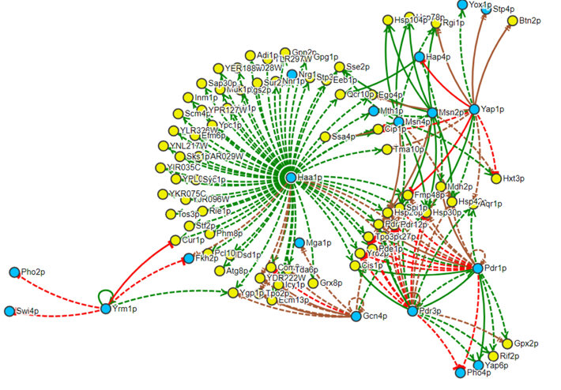
Yeast networks
Directed networks
Origin nodes are TFs
Destination nodes are TGs
Links can be Positive, Negative or Dual/Unknown

Slide 8
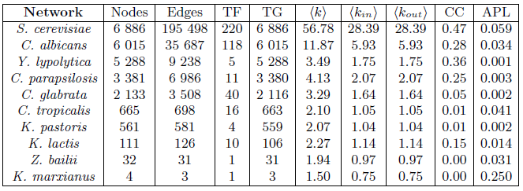
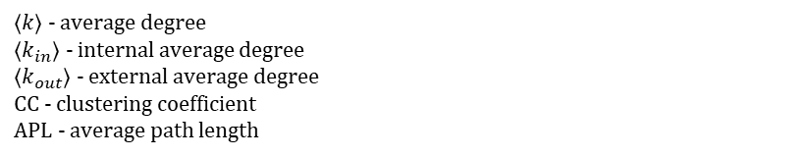
Yeast networks
⟨$k$⟩ - average degree
⟨$k_{in}$⟩ - internal average degree
⟨$k_{out}$⟩ - external average degree
CC - clustering coefficient
APL - average path length

Slide 9
Related work
2
Community detection and motifs discovery

Slide 10
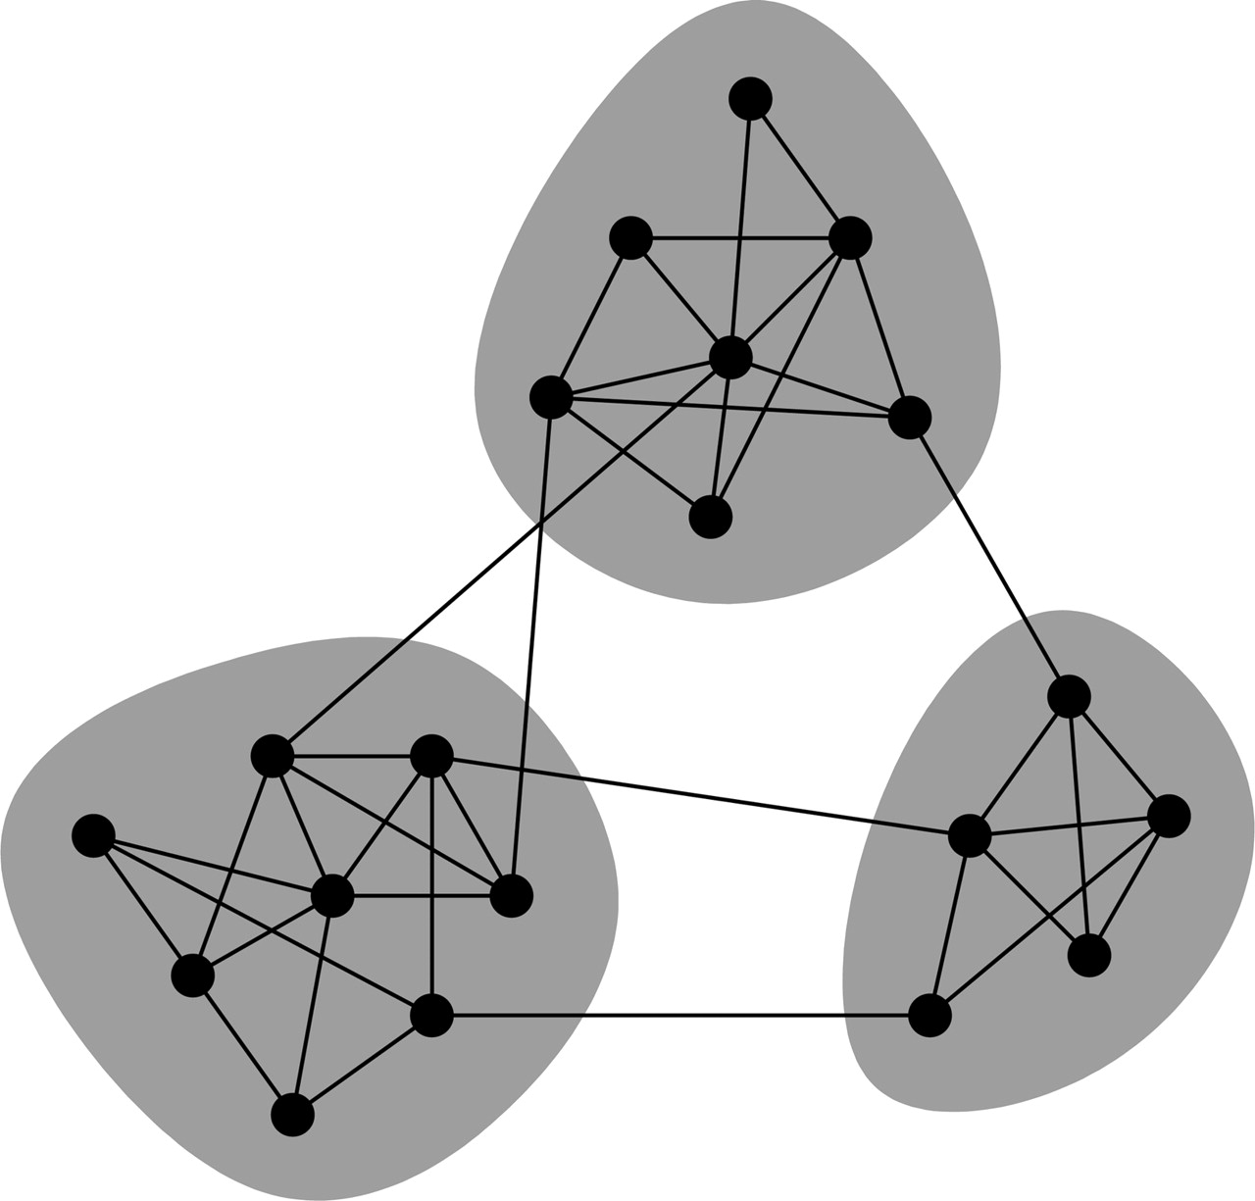
Community detection methods
Communities are groups of nodes that are more likely to connect with each other than to nodes of different communities

Slide 11
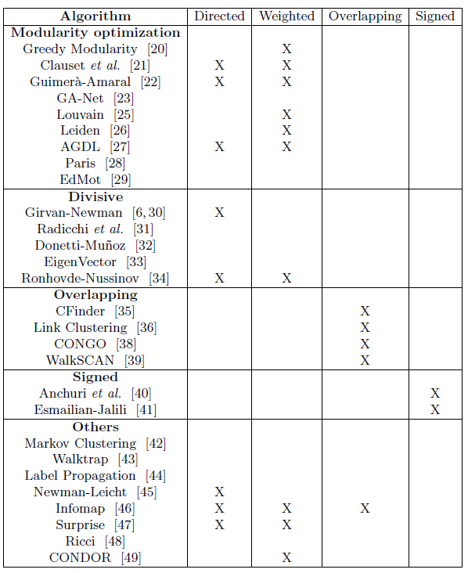
Community detection methods
There is a big collection of algorithms that were proposed in recent years to detect these communities, having different principles and applications

Slide 12
Evaluation metrics
Internal evaluation
Measures to summarize the community properties retrieved from a single algorithm
Modularity, Significance…
External evaluation
Measures to compare the performance of different algorithms on the same network
Mutual Information, Rand Index…
Benchmark networks
Networks with known and well-defined community structure used to compare diferente solutions
Girvan-Newman, LFR, SBM

Slide 13
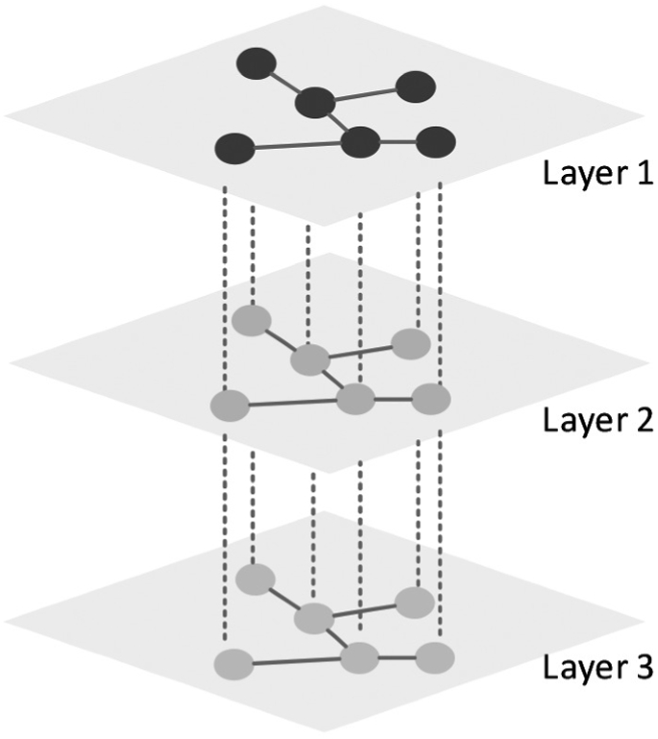
Multilayer approaches
Networks composed by layers that can represent different types of relations of complex systems

Slide 14
Multilayer approaches
Flattening methods
Information of layers is merged into one, and then traditional community detection methods are applied on the resulting network
Aggregation methods
Detection of communities in each individual layer, and then merge the resulting modules using some aggregation mechanism
Direct methods
Application of community detection methods directly in the multilayer network by optimizing some quality function

Slide 15
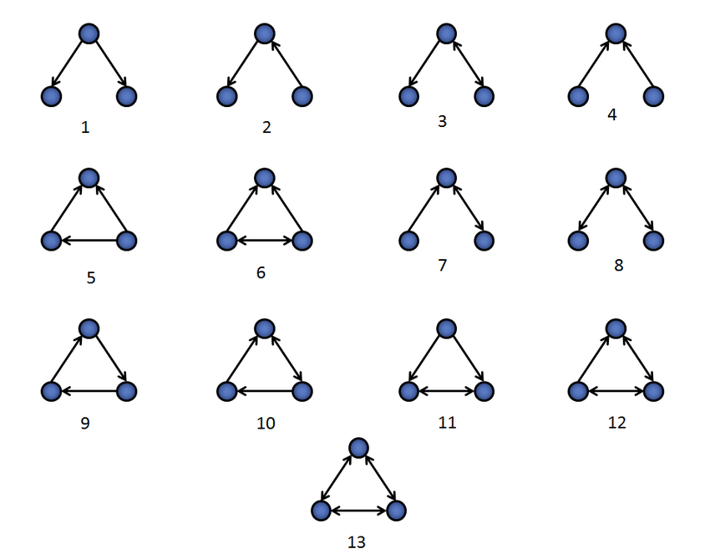
Motifs discovery
Recurrent and statistically significant subgraphs or patterns of a larger graph
3-node connected subgraphs
(triads)

Slide 16
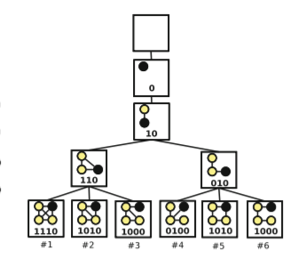
Motifs discovery
MFinder
FanMod
Grochow-Kellis
G-Tries
G-trie representing 6 undirected graphs

Slide 17
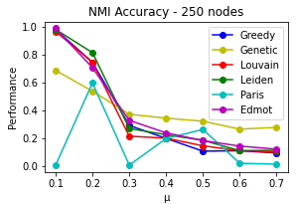
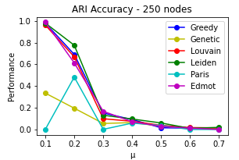
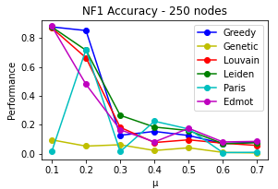
Preliminary results
LFR network with 250 nodes

Slide 18
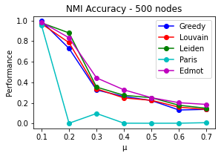
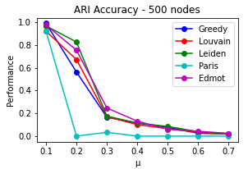
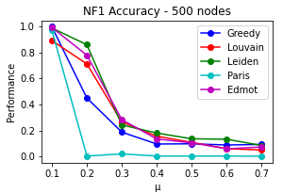
Preliminary results
LFR network with 500 nodes

Slide 19
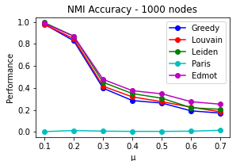
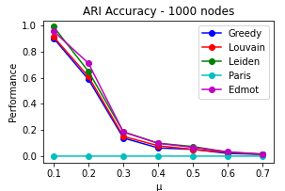
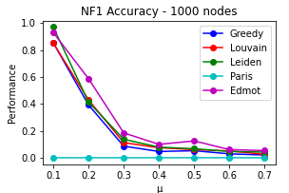
Preliminary results
LFR network with 1000 nodes

Slide 20
Solution proposal
3
Methodology and evaluation

Slide 21
Solution proposal
Community detection
Multilayer approach
Motifs discovery

Slide 22



Solution proposal
Community detection
Testing the algorithms on networks with ground-truth communities
Comparison of performance using external evaluation metrics
Afterwards, evaluation of chosen methods on the yeast networks
Evaluation of the methods using internal metrics and annotated biological functions of the species

Slide 23
Solution proposal
Multilayer approach
Detection of structure and biological function across different species, each representing a different network layer
Available mapping of associations through species
Focus on aggregation and direct methods, since flattening methods are not compatible with our networks

Slide 24

Solution proposal
Motifs discovery
Discovery of motifs with significant representation in the identified communities of the networks
Use of the gtrieScanner tool and g-trie data structure to find the overrepresented subgraphs
Evaluation of significance with the normalized Z-score

Slide 25
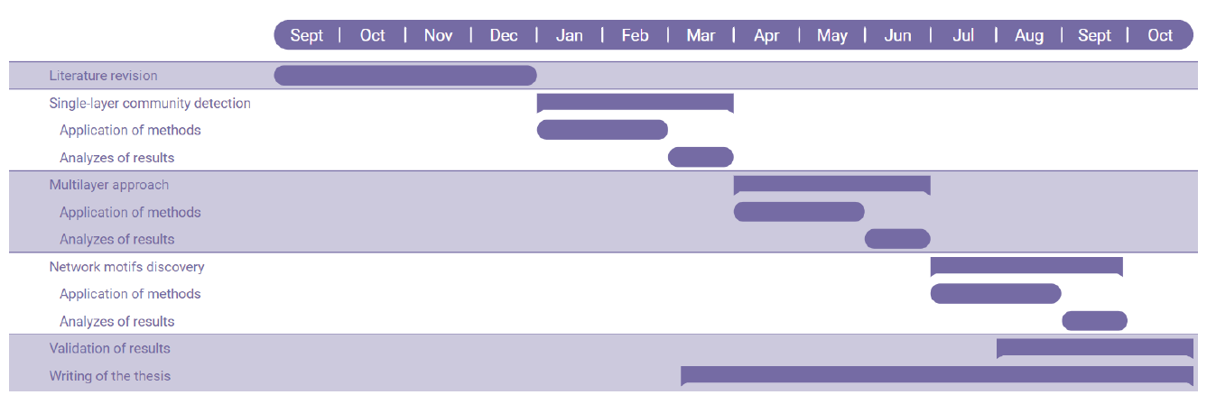
Work schedule

Slide 26

THANKS!
Any questions?

