Slide 1
SPRINT SELECTOR
Choose Your Improvement Sprint
Every improvement opportunity starts with one question: what needs to improve?
What needs to improve?
THIS KIT
OTHER SPRINT OPTION
Workflow Improvement Sprint
Capability Enhancement Sprint
Improve how work gets done.
Improve the quality of the work produced.
Run this sprint when...
Run this sprint when...
The work is repetitive
The work needs stronger thinking
It takes too long
The quality could be higher
There is unnecessary friction
Better decisions are needed
People keep starting from scratch
Better ideas are needed
SUCCESS LOOKS LIKE
SUCCESS LOOKS LIKE
The same work takes less effort next time.
The work itself is better than before.
AI is the tool. The improvement goal determines the sprint.
Manager Activation
CONFIDENTIAL
1
Notes:
Use this slide to help managers decide which sprint is the right fit. The key distinction is not which AI tool to use. The key distinction is the improvement goal: improve how work gets done, or improve the quality of the work produced.

Slide 2

DO NOT PRESENT
Workflow Improvement Sprint: Leader Brief
A 60-minute working session that helps each person improve one repeatable workflow with AI.
YOUR ROLE
HOW TO RUN THE SPRINT
Facilitate the canvas - not the technology.
Tee up each canvas section
1
✓
Keep the team moving
2
Set the timer for independent work
✓
Push from tasks to repeatable workflows
3
Bring everyone back quickly
✓
Help people define the job for AI before building
4
Do a light check-in, then move on
✓
Treat unfinished work with a clear next step as a win
Facilitator Action: Tee up each section, time the work, bring everyone back, check in briefly, then move to the next section.
Optional: Before your sprint with your team, review the Workflow Mapping Field Guide
CONFIDENTIAL 1
Notes:
Purpose: Prepare the manager to run the sprint with minimal prep. Timing: Review 10-15 minutes before the session. Script: You do not need to be an AI expert to lead this. Your job is to help the team slow down just enough to understand the work, identify where AI can add value, and create a first solution they can use or finish soon.

Slide 3
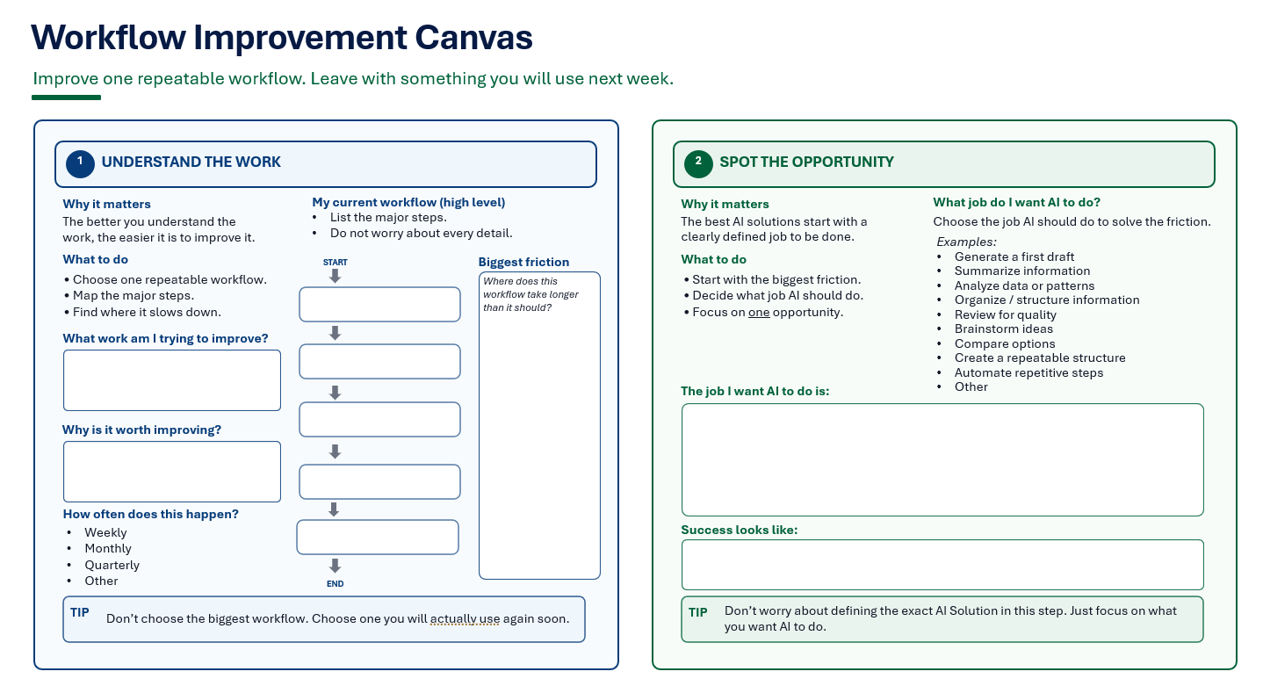
Today is a working session, not a training.
60 minutes · Improve one repeatable workflow with AI
You will use the Workflow Improvement Canvas to work through one real workflow from start to finish.
WORKING AGREEMENT
✓
Focus on one workflow.
✓
Progress over perfection.
✓
Build something you will actually use.
How today works: tee up > independent work > quick check-in > next section.
You will work independently through each section, check in briefly as a group, then share what you created at the end.
CONFIDENTIAL 2
Notes:
Script: Welcome everyone. Today is different from a typical AI session. We are not here to learn features or become AI experts. We are going to work on one real workflow each of us already does. The canvas will guide the session from understanding the work to identifying the opportunity, choosing a solution, creating a first draft, and committing to a next step.

Slide 4
The canvas turns AI exploration into a simple improvement process.
We will work through five steps. One workflow. One solution. One next step.
1
2
3
4
5
Understand
Spot
Choose
Create
Commit
Choose one workflow and find where it slows down or could be improved.
Identify the job you want AI to do.
Pick the simplest solution that solves the problem.
Use an approved AI tool to build a first draft.
Leave with a next step to use or finish it.
By the end you should have momentum, not perfection.
CONFIDENTIAL 3
Notes:
Script: The Workflow Improvement Canvas guides everything today. We are not redesigning our whole job. We are improving one workflow. Some people will leave with a finished solution. Others will leave with a strong first draft and a clear plan to finish it. Both are successful outcomes.

Slide 5

Use AI to improve the work, not just finish the task.
That is the mindset shift for today.
FROM
TO
Finish today’s task
Improve next week’s workflow
•
Solve today’s problem
•
Reduce future effort
•
Create one output
•
Create something reusable
•
Work faster once
•
Work better every time
Today’s question: “How can AI improve this workflow every time it comes back?”
CONFIDENTIAL 4
Notes:
Script: Most of us already use AI to draft, summarize, brainstorm, or review. Those are useful. Today we are thinking differently. Instead of asking how AI can help us complete today's task, we are asking how AI can improve the workflow every time it comes back.

Slide 6
First, understand the work before thinking about AI.
Workflow Improvement Canvas
Understand
Spot
Choose
Create
Commit
10–12 MINUTES
COMPLETE SECTION 1
1
Choose one repeatable workflow
2
Map the major steps at a high level
3
Find the biggest friction point
Canvas Section 1
What to do now: Work independently on Section 1. We will come back for a quick check-in when time is up.
CONFIDENTIAL 5
Notes:
Timing: 10-12 minutes. Script: We are going to spend the next few minutes understanding one workflow you already do. Do not think about prompts or AI yet. The goal is to understand how the work happens today and where it becomes frustrating, repetitive, or inefficient.

Slide 7
The best AI solutions start with a clear job to be done.
Workflow Improvement Canvas
✓
Understand
Spot
Choose
Create
Commit
10 MINUTES
Key question: What job do I want AI to do?
COMPLETE SECTION 2
Start with the friction
Draft
Summarize
1
2
Decide what job AI should do
Analyze
Organize
3
Focus on one opportunity
Review
Brainstorm
Compare
Automate
What to do now: Work independently on Section 2. If you get stuck, use the Think with AI Quick Start Card.
CONFIDENTIAL 6
Notes:
Script: Now that you understand the workflow, identify the opportunity. This is the most important part of the sprint. Do not jump straight to building a prompt or asking AI for an answer. Start with the friction. Then ask: what job do I want AI to do here? Pick one opportunity.

Slide 8
Choose the simplest solution that will help every time.
Workflow Improvement Canvas
✓
✓
Understand
Spot
Choose
Create
Commit
5–7 MINUTES
SOLUTION LADDER
COMPLETE SECTION 3
Prompt
repeat the same thinking
1
Start simple
Template
same format each time
2
Select the best fit
Checklist / SOP
repeatable steps
Dashboard / Tool
visualize or track
3
Write why this solution fits
Custom GPT
specialized assistant
Automation
steps happen automatically
Move up only when a simpler solution will not solve the problem.
What to do now: Work independently on Section 3. Choose the simplest solution you will actually use next week.
CONFIDENTIAL 7
Notes:
Script: Not every workflow needs automation. Often a reusable prompt or simple template creates more value than a complicated automation. The goal is not to build the most sophisticated solution. The goal is to build the most useful one.

Slide 9
Now move from thinking to creating a usable first draft.
Workflow Improvement Canvas
✓
✓
✓
Understand
Spot
Choose
Create
Commit
15–20 MINUTES
Canvas context
Approved AI tool
First draft
Upload or paste the completed sections
Use ChatGPT, Claude, or approved tool
Build and save something you can test
WHAT TO CREATE
Prompt · template · checklist/SOP · automation outline · dashboard concept · custom GPT instructions · other useful solution
What to do now: Build independently. Save your first draft so you can share the headline with the group.
CONFIDENTIAL 8
Notes:
Script: Use your canvas as context. If your AI tool lets you upload files, upload your completed canvas. If not, copy and paste the workflow, friction, job for AI, and solution type. If you are not sure how to start, use the Build with AI Quick Start Card. Your goal is a first draft good enough to test or improve.

Slide 10
Share quickly, then listen for what is worth reusing.
This is pattern recognition, not a long debrief.
8–10 MINUTES
ROUND-ROBIN: EACH PERSON SHARES
TEAM SCAN: LISTEN FOR
1
Workflow improved
✓
Similar workflows across people
2
AI job selected
Solutions others could reuse
✓
3
First solution created or started
✓
One prompt, template, or SOP worth standardizing
4
Reuse potential for the team
What to do now: Round-robin share in about 60 seconds: workflow, AI job, solution, and reuse potential.
CONFIDENTIAL 9
Notes:
Script: Let's do a quick round-robin, about one minute each. Share the workflow, the job you wanted AI to do, what you created or started, and whether it could help anyone else. As we listen, look for patterns. If nothing obvious emerges, that is fine. Momentum is the main outcome.

Slide 11
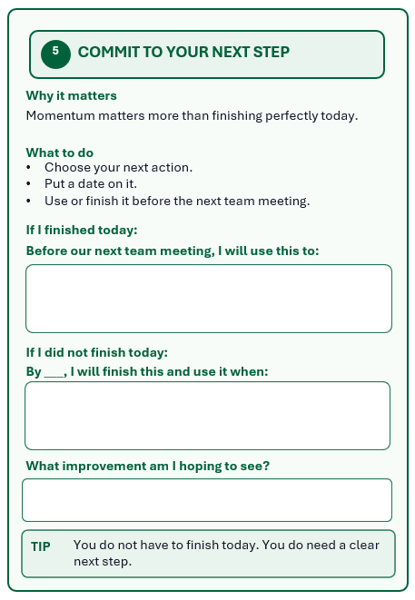
The sprint ends with a clear next step, not a perfect solution.
Workflow Improvement Canvas
✓
✓
✓
✓
Understand
Spot
Choose
Create
Commit
5 MINUTES
COMPLETE SECTION 5
1
Choose your next action
2
Put a date on it
Canvas Section 5
3
Define the improvement you hope to see
Examples: use it · finish it · test it · share it
What to do now: Complete Section 5 independently. Write a concrete next step, date, and expected improvement.
CONFIDENTIAL 10
Notes:
Script: The final step is simple, but it creates lasting value. If you finished your solution, commit to using it with real work before your next team meeting. If you did not finish, decide when you will finish it and the first opportunity you will have to use it. The goal is momentum.

Slide 12
Great work improves one workflow at a time.
Every solution gets better through use.
Use it
Try it with real work
Share it
Learn from it
Help someone else
What worked? What did not?
Improve it
Refine the solution
Keep asking: “How can I make this workflow a little better next time?”
CONFIDENTIAL 11
Notes:
Script: Today's workshop is not about building the perfect AI solution. It is about starting a new habit. The first version you created today is a first version. The real learning happens when you use it with actual work. Use it, learn from it, improve it, and share it if it helps.

