Slide 1

BATTLE OF NEIGHBORHOODS
APPLIED DATA SCIENCE CAPSTONE
BY SAKSHAM MIDHA

Slide 2
INTRODUCTION
DELHI IS KNOWN as the food capital of India. The city is famous for a variety of foods, dishes, and restaurants. It was recently named “Best Destination For Food/Drink in India”.

Slide 3
DATA
To solve the above business problem, we shall need the following data:-
A list of neighborhoods in Delhi.
Latitude and Longitude data of neighborhoods-Latitude and longitude data could be extracted using the Geocoder package.
Venue-related data- Venue related data could be extracted using the Foursquare API.

Slide 4
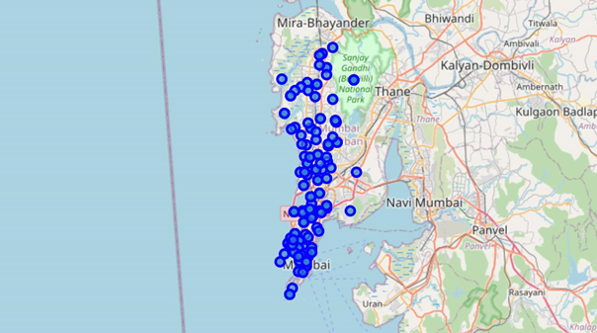
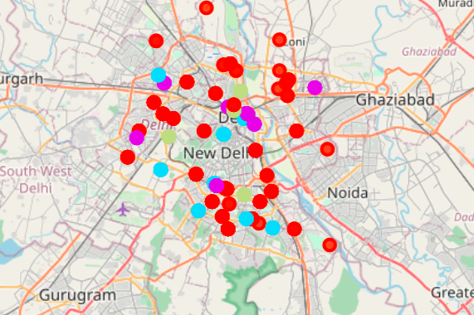
RESULT SECTION
BEFORE CLUSTERING
AFTER CLUSTERING
Cluster 0, Cluster 1, Cluster 2, Cluster 3

Slide 5
RESULT SECTION(CONTD.)
As we can see below, cluster 0 has 0 Indian Restaurants, therefore it would be considered as the best area to open, a new Indian restaurant.
Location | Indian Restaurant | Cluster Labels | Pincode | Latitude | Longitude | Venue_Name | Venue_Latitude | Venue_Longitude | Venue_Category

Slide 6
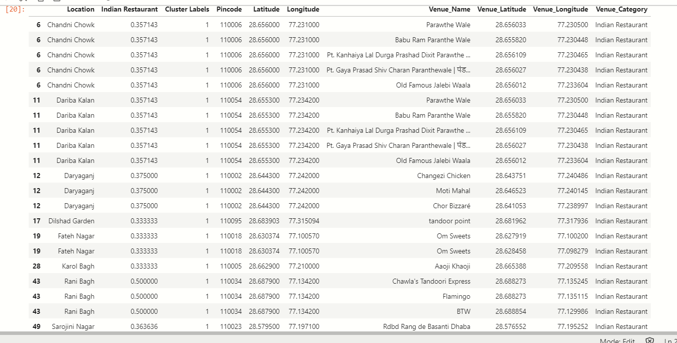
RESULT SECTION(CONTD.)
Cluster 1 has the most amount of Indian Restaurants, therefore opening a new Indian Restaurant over there would not be ideal.

Slide 7
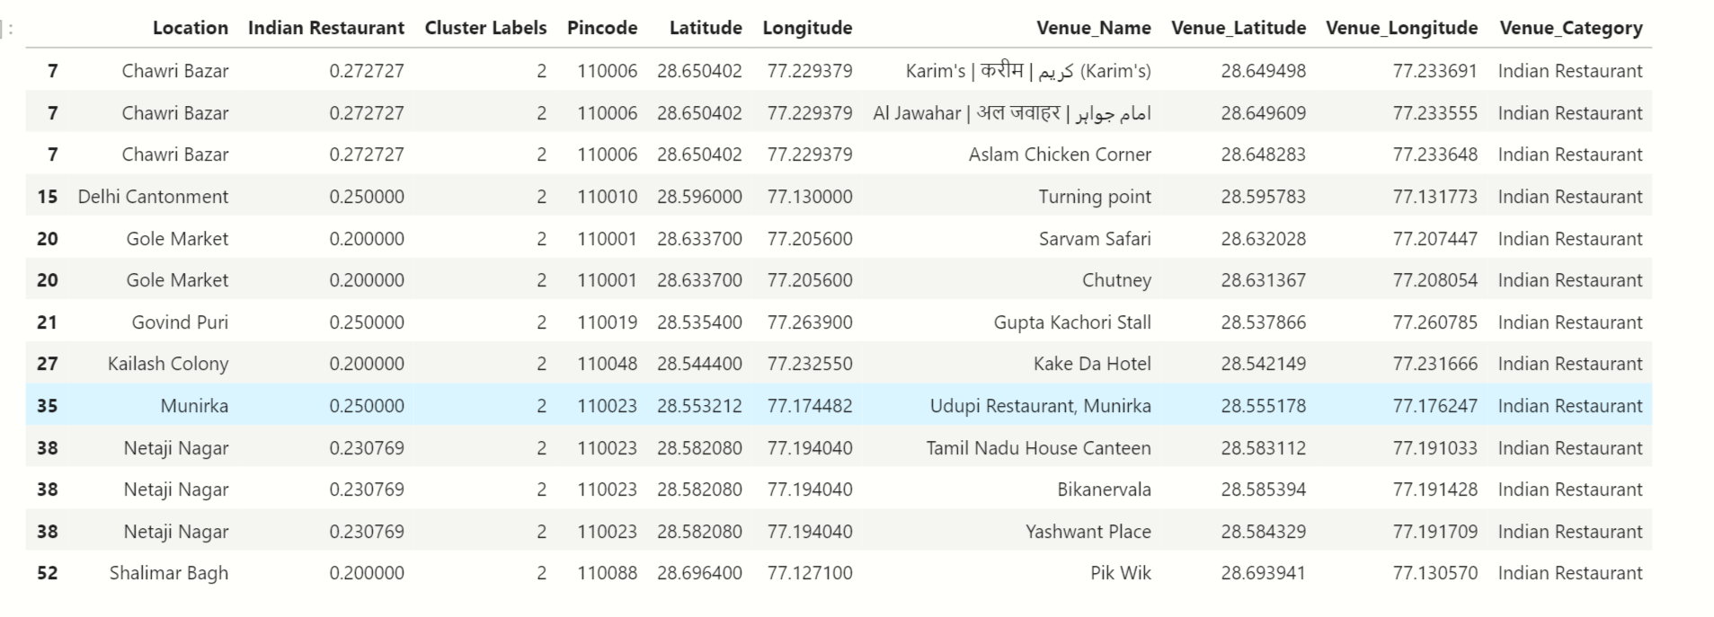
RESULT SECTION(CONTD.)
Cluster 2 has moderate number of Indian Restaurants, therefore it won’t be the most ideal area to open a new Indian Restaurant.

Slide 8
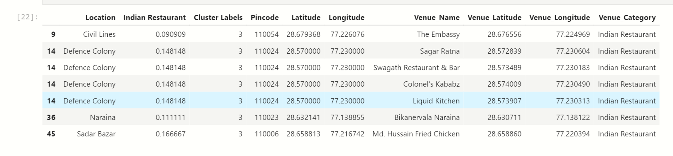
RESULT SECTION(CONTD.)
Cluster 3 has a moderate number of Indian Restaurants, therefore it won’t be the most ideal area to open a new Indian restaurant.

Slide 9
CONCLUSION
The accuracy of determining the best places to open an Indian Restaurant can be improved by not just taking the number of Indian Restaurants into consideration, but also taking into consideration the demographic of a certain area, and determining the food preferences of the people in a certain neighbourhood. Since, that data is not readily available, and can only be gathered through a widespread survey, for the time being only the number of restaurants have been used to find a solution to the posed Business problem. In the future, when such data is available we can update our findings by further incorporating the extra data.
Thus to conclude the study, one can say that there is always, scope for more improvement, by finding more relevant data and increase its accuracy to narrow down the study.

