Slide 1
Knit workshop.
We present two experiments.

Slide 2
Experiment 1

Slide 3
Motivation
We want to connect three nodes to a bridge.
The bridge will use vlan tags to isolate two paths between the nodes.
One node will have a path to each of the other two nodes. And it will act as a router between them.

Slide 4
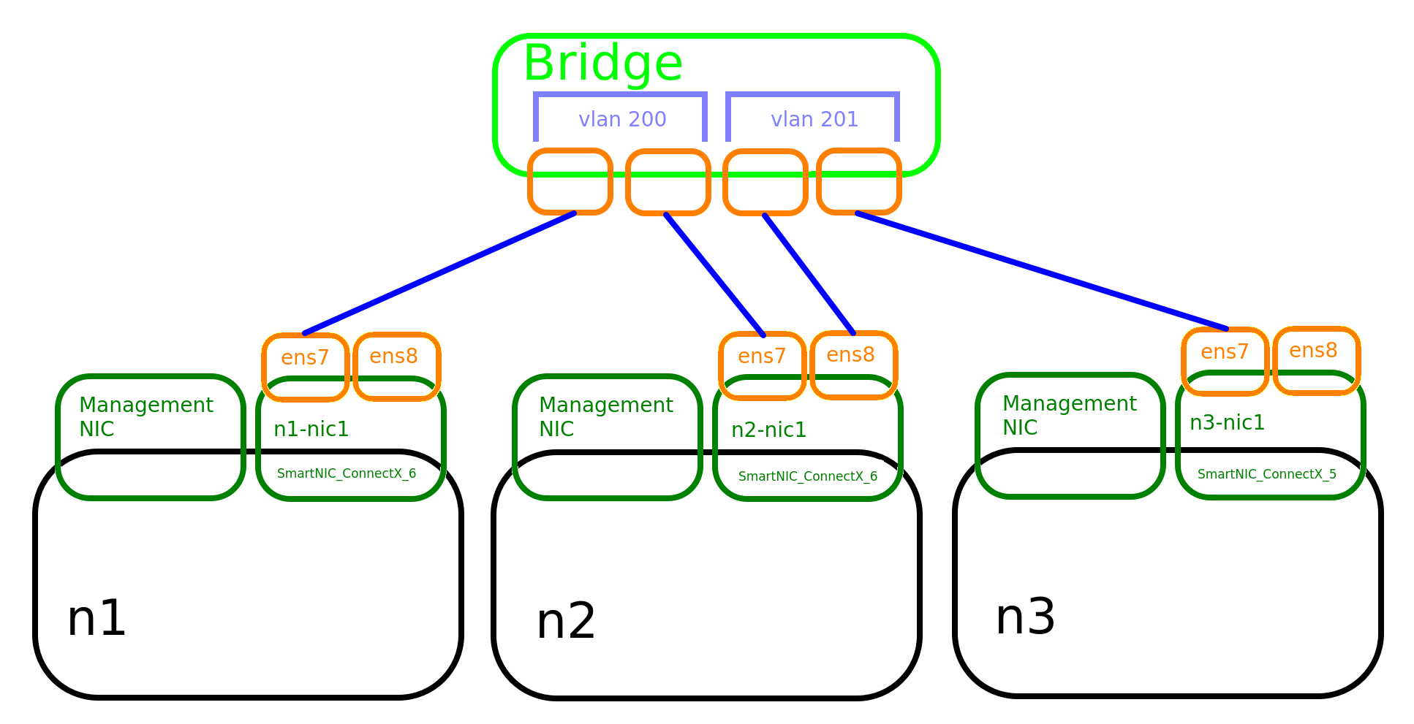
We reserve the following topology

Slide 5
The topology consists of 3 nodes, each having an extra nic.
The three NICs are connected to a bridge.
The path between the n1 and n2 NICs is isolated with a vlan tag (200), and the path between the n2 and n3 NICs is isolated with another vlan tag (201).
n2 will act as a router between n1 and n3. n1 and n3 are going to send traffic through n2.

Slide 6
Code Walkthrough

Slide 7
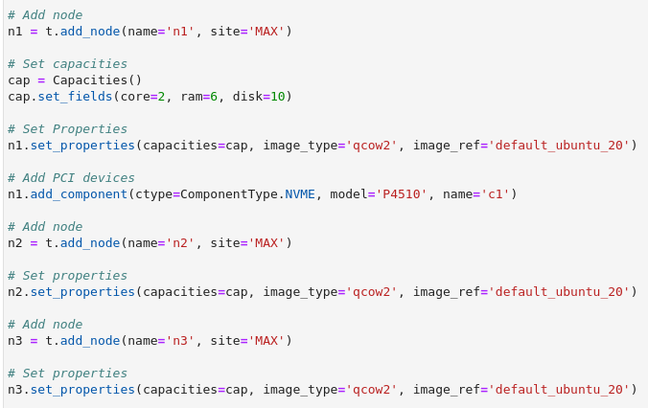
First we reserve the nodes

Slide 8

Then we add the NICs to them.

Slide 9
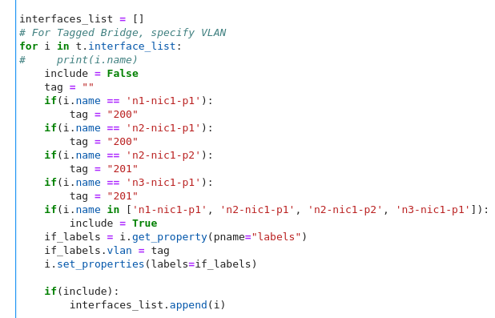
And we specify the vlan tags.

Slide 10
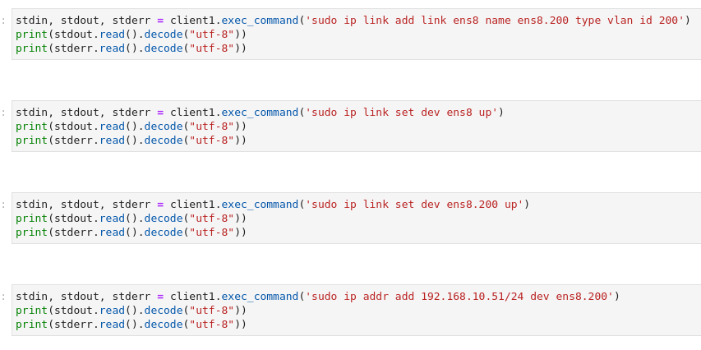
We create a virtual interface, activate the interfaces, and give the NICs IPs.

Slide 11
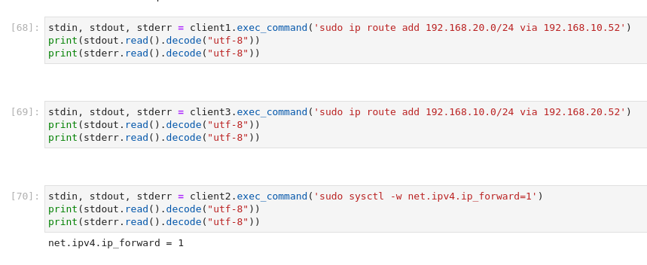
We setup routes, and enable packet forwarding.

Slide 12
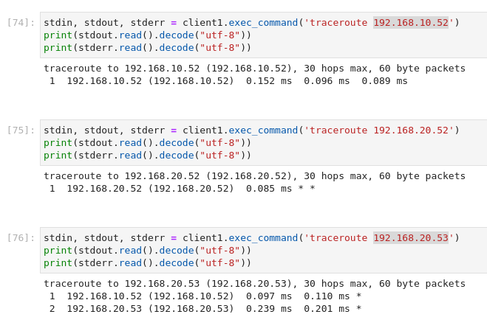
Now everything is configured. We can do a traceroute to see the paths packets take. Now the nodes can ping each other.

Slide 13
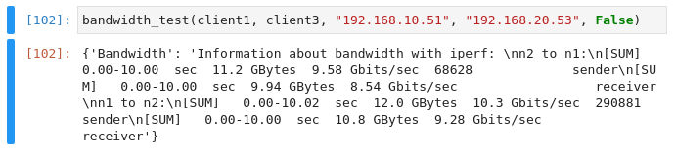
We can also do a bandwidth test with a code module that we made.
We get a performance of around 10 Gbits/sec.

Slide 14
Experiment 2

Slide 15
Motivation
We want to collect metrics about network paths between sites.
We will reserve nodes at the site “MAX”, and nodes at the site “UTAH”.
We are going to connect MAX to UTAH through three different sites in the middle. “STARLIGHT”, “NCSA” and “TACC”.
We will use layer 2 point to point links to connect MAX to one of the three sites to UTAH.

Slide 16
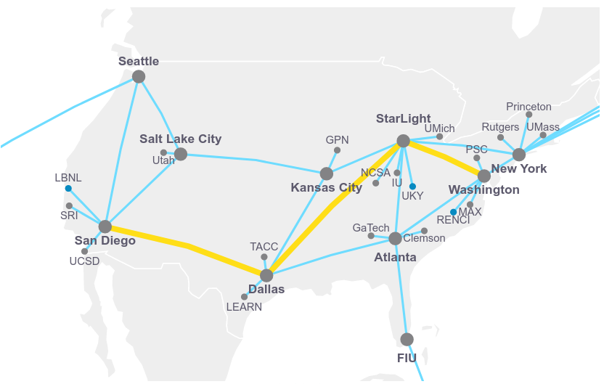

Slide 19
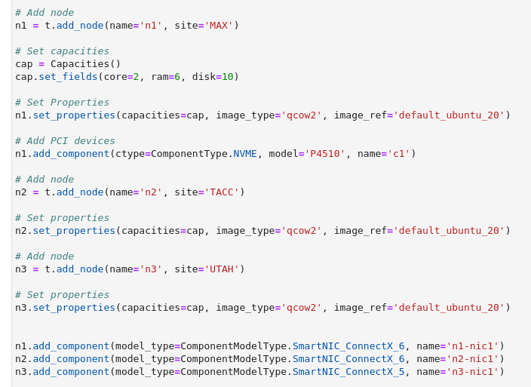
The code is very similar to the previous experiment. We reserve nodes with NICs.

Slide 20
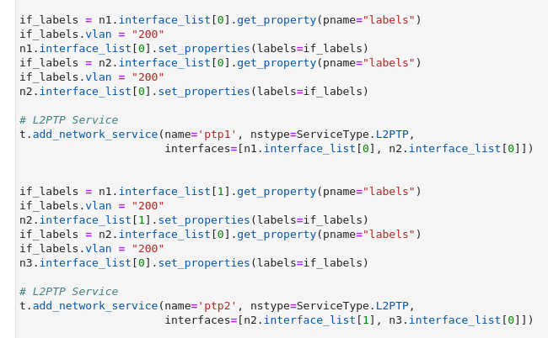
We add vlan tags and point to point links
Then we can connect to the nodes, activate the network interfaces, assign IPs to them and setup routes and port forwarding.

Slide 21
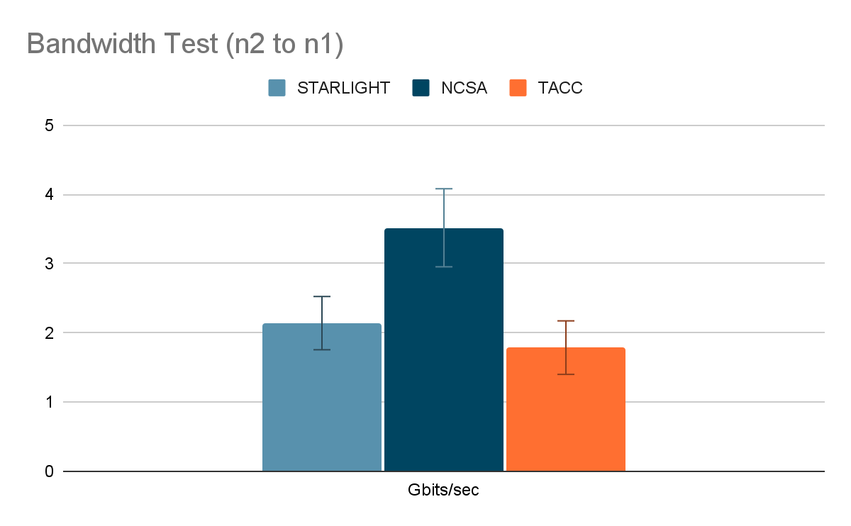
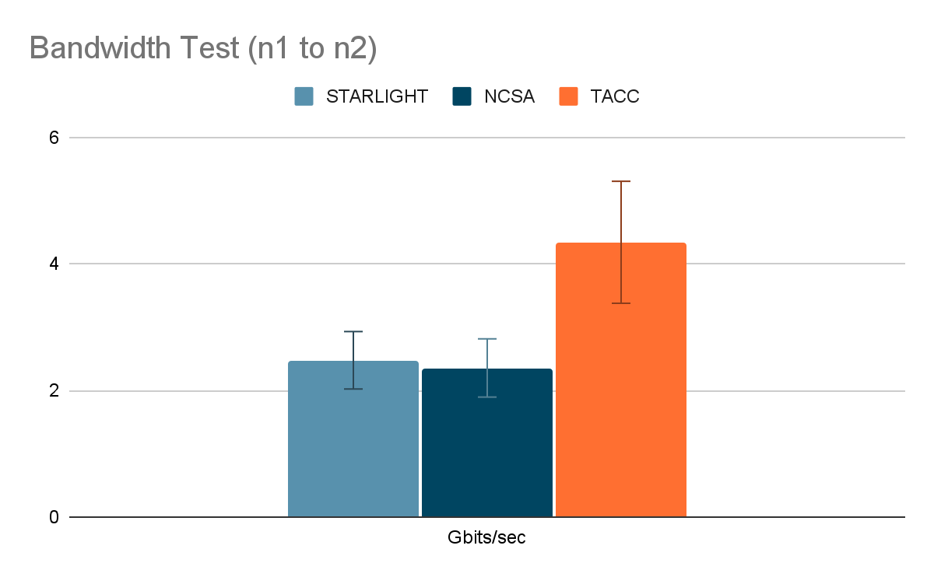
Bandwidth Test
This shows the bandwidth over both directions of the paths. 10 measurements were taken.

Slide 22
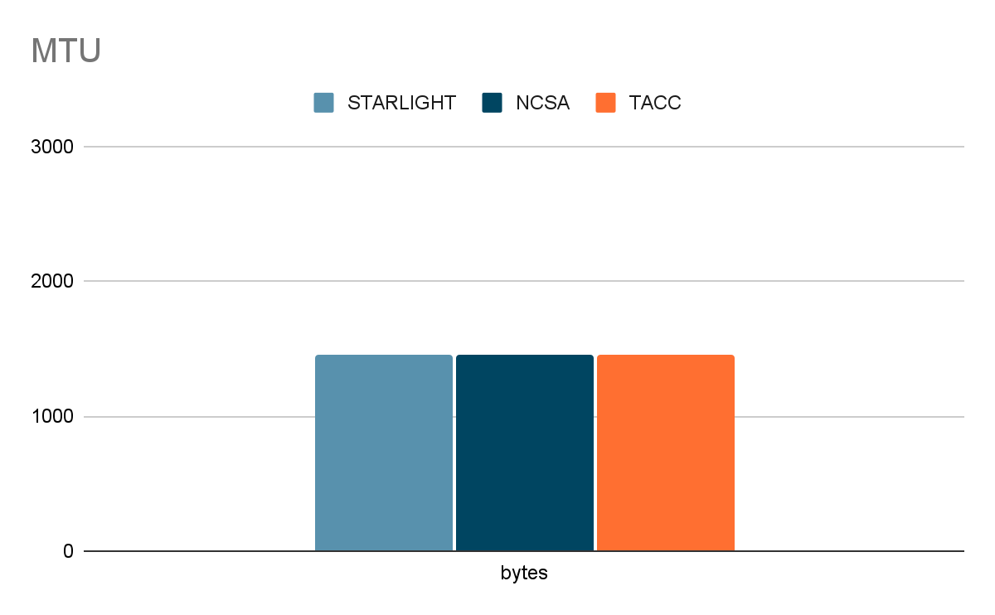
MTU
All paths have the same MTU size. The standard 1500 bytes MTU.

Slide 23
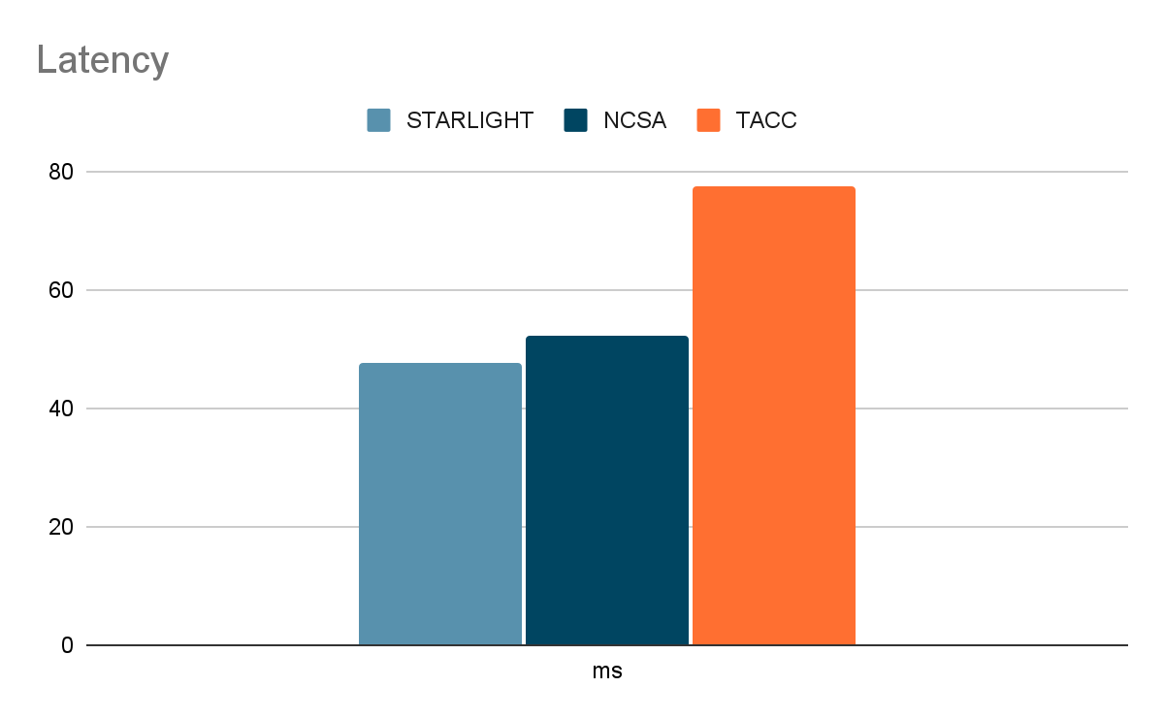
Latency
These are latency measurements with ping. 25 measurements were taken. No significant variability.

Slide 24
Conclusion
We reserved different topologies using VMs, bridges and point to point links.
We can use bridges to connect nodes on one site. We can isolate connections with vlan tags.
Point to point links allow us to connect nodes over multiple sites. We were able to collect data about the paths between these sites.
Code modules for the latency test, mtu test and bandwidth test were used to design a test harness that we can use internally periodically to check the hardware and the network paths.
Thank you.

