Slide 1


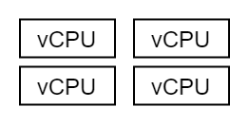
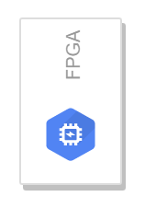

MyNode
vCPU
vCPU
Management
vNIC
100G
Application
vCPU
vCPU
vCPU
vCPU

Slide 2
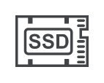

Node1
vCPU
vCPU
Management
vNIC
100G
Application
vCPU
NVMe
vCPU
vCPU
vCPU
ConnectX-6
(SR-IOV VF)
RTX6000

Slide 3
Node2
vCPU
vCPU
vCPU
vCPU
Management
vNIC
200G
Application
vCPU
vCPU
vCPU
Tesla T4
vCPU
ConnectX-5
(PCI Passthrough)
ConnectX-5
(PCI Passthrough)
NVMe

Slide 4
vCPU
Node3
vCPU
vCPU
vCPU
vCPU
vCPU
Management
vNIC
vCPU
vCPU
500G
Application
NVMe
ConnectX-6
(SR-IOV VF)
Tesla T4

Slide 5
vCPU
vCPU
vCPU
vCPU
vCPU
Node2
vCPU
Node3
vCPU
Node1
vCPU
vCPU
vCPU
vCPU
vCPU
vCPU
100G
200G
vCPU
500G
Application
Application
Application
NVMe
NVMe
Tesla T4
ConnectX-6
(SR-IOV VF)
ConnectX-5
(PCI Passthrough)
ConnectX-5
(PCI Passthrough)
ConnectX-6
(SR-IOV VF)
RTX6000
Tesla T4

