Slide 1


Regularization : L2 and Dropout
Predictive Modeling
Kerneur - Mlili - Lee - Martin - Lacourt
Notes:
Ed

Slide 2
Summary
In what context was this method proposed?
What problem was it intended to solve?
Explain briefly how it works
When is it most likely to help?
When is it known to be unhelpful?
What are its main drawbacks?
What is a typical range for this parameter?
Are there some best practices concerning how to tune them?
QCM
Summary Cards
Notes:
Ed

Slide 3
In what context was this method proposed?
What problem was it intended to solve?
Regularization : mid-2000’s but regularizations L1 and L2 didn’t totally tackle the overfitting issue
Dropout : 2012 by Hinton & al good part of deep learning ascribed to dropout
Dropout : overcome overfitting in neural networks
Dropout and L2 regularization reduce the error gap between training and test data.
Notes:
Arnaud

Slide 4
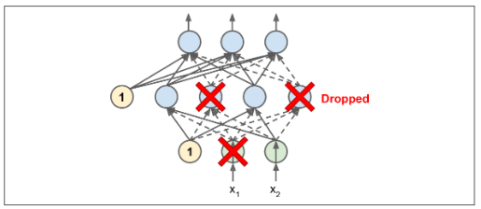
Explain briefly how it works
dropout: randomly selected neurons “dropped out”
no weights related to dropped neurons are refreshed on the backward pass
Generic steps:
Generate a dropout mask with bernoulli variables (example 1.0*(np.random.random((size))>p)
Use the mask to the inputs disconnecting some neurons.
Use this new layer to multiply weights and add bias
Put the result in the activation function
L2 regularization: constraint a neural network’s connection weights
Notes:
Arnaud

Slide 5
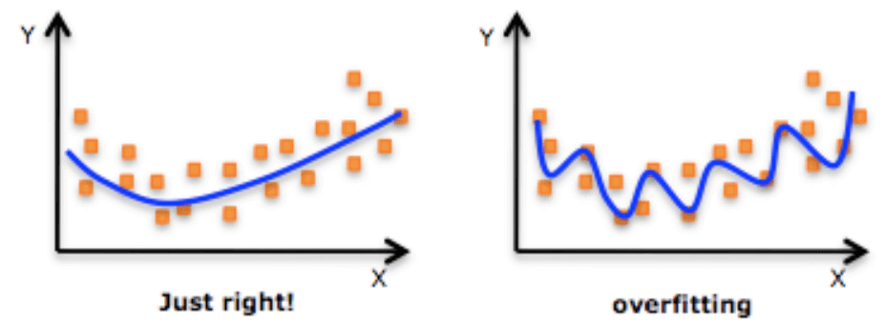
When is it most likely to help?
If the model is overfitting
If there is an error gap between training and test data
When you do not have a large dataset.
Dropout can be omitted if using batch normalization technique because it already reduces the generalization error.
Notes:
Fab

Slide 6
When is it known to be unhelpful?
Is it known for being conflicting with another common technique?
Have a dropout before BatchNormalization layers
The dropout modify the weights, thus variance and esperance also and the BN normalize using both.
Way to overcome:
apply Dropout after all BN layers a
modify the formula of Dropout and made it less sensitive to variance
Requires Separate Tuning
other parameters, rate too low or high impact outcome
Risk of Omitting Important Data Trends
Slow Convergence
rate higher, slow
Notes:
Fab

Slide 7
What are its main drawbacks?
Add hyperparameters
Dropout add hyperparameters rate for each layer of neurons
Computation time during training/interference
Applying dropout increases computation during training.
=> The model is train constantly with a lower number of nodes and requires more integrations to converge
Notes:
JH

Slide 8
What is a typical range for this parameter?
Dropout rate typically set between 10% and 50%
Closer to 20%-30% in recurrent neural nets
Closer to 40%-50% in convolutional neural networks
For Lambda L1-L2 => 0.01 default keras value
Notes:
JH

Slide 9

Are there some best practices concerning how to tune them?
The dropout rates can be optimized by utilizing grid search
Generally, using a small dropout value of 20%-50% provide a great beginning point
Increasing the number of hidden units in the deep learning algorithm (since all units have an equivalent probability to be excluded)
Notes:
Titou

Slide 10
QCM - Q1
Dropout consist in :
a. Randomly drop neurons independently for each forward pass
b. drop a choosen neurons independently of the other for each forward pass
c. drop a choosen layers independently for each training case in each minibatch.
d. Randomly drop neurons independently for each training case in each minibatch.

Slide 11
QCM - Q2
When should you not use dropout :
a. When you do not have a large dataset
b. When there is a large error gap between training/testing
c. When using batch normalization technique
d. When the model is overfitting

Slide 12
QCM - Q1 Answer
Dropout consist in :
a. Randomly drop neurons independently for each forward pass
b. drop a choosen neurons independently of the other for each forward pass
c. drop a choosen layers independently for each training case in each minibatch.
d. Randomly drop neurons independently for each training case in each minibatch.

Slide 13
QCM - Q2 Answer
When should you not use dropout :
a. When you do not have a large dataset
b. When there is a large error gap between training/testing
c. When using batch normalization technique
d. When the model is overfitting

Slide 14


Cheat cheat : L2-Regularisation & Dropout
What is it ? Introduced early in the history of ML, they are methods to reduce overfitting, help generalisation and reduce error gap between train and test dataset, especially with small datasets.
How it works ? Both technics reduce model complexity: Dropout : Randomly deactivate neurons while training Regularisation : Adds a penalty to the loss function for having large weights
❌ Don’t use dropout before batch normalization ❌ Requires more tuning ❌ Slower convergence ❌ Risk missing trends
How to use it in keras ?
Dropout :
L2 :
👉 Dropout ~ 20-50% 👉 Regularisation ~ 1-5%

Slide 15

Do you have any questions on regularization ?

