Slide 1
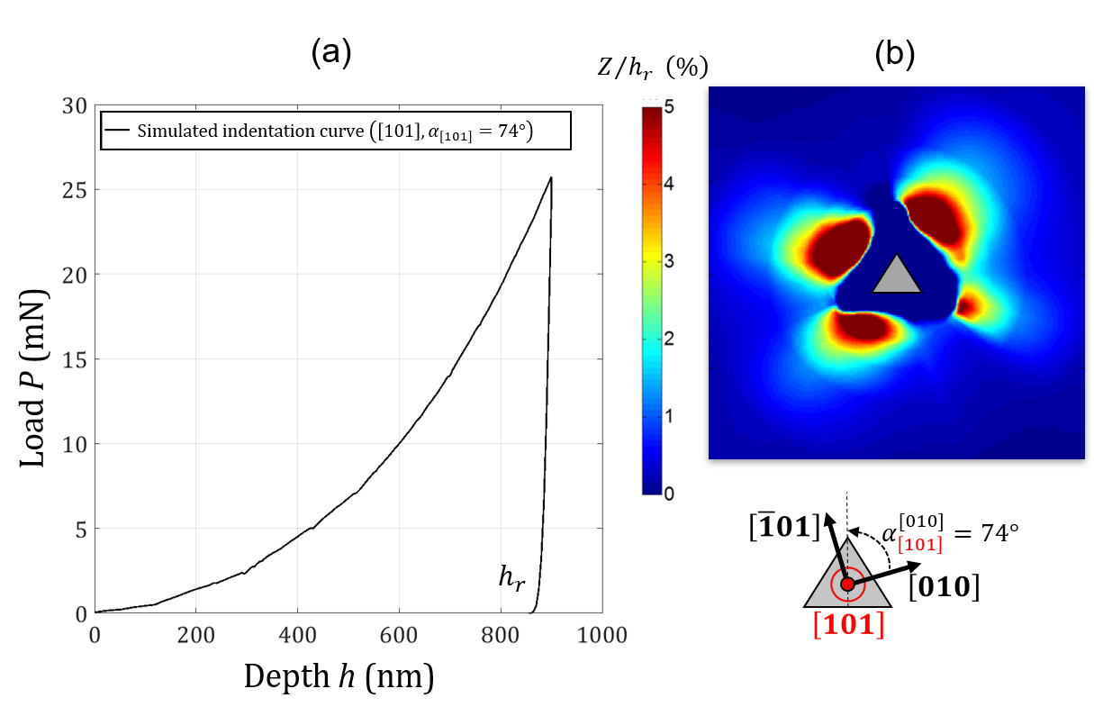
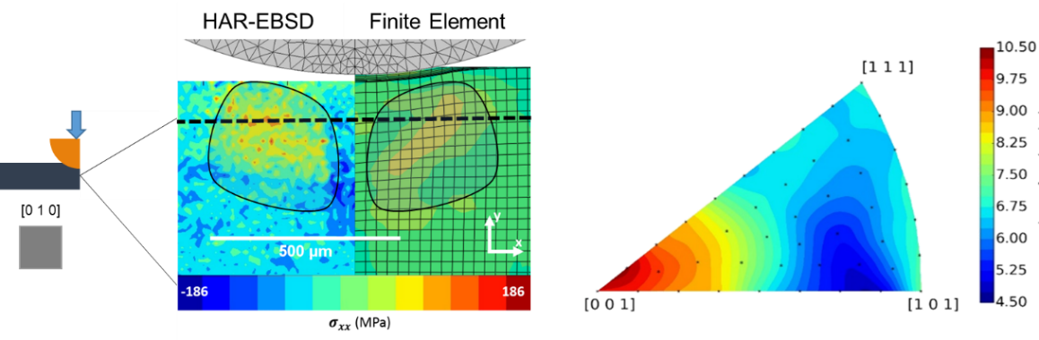
The NOTIFICATION project targets the robust and quick identification of the parameters driving the interaction matrix of a crystal plasticity law using nanoindentation and some associated metrology. The project focuses on pure FCC nickel and copper, but the approach is intended to be applicable to any crystalline material and will be will therefore be tested on nickel-based superalloys.
Left - residual stress measurement over a spherical indentation cross-section using HR EBSD and comparison with CPFEM. Right: effect of crystal orientation (Inverse Pole Figure) on the volume fraction of elements under tensile residual stress
Nanoindentation CPFEM simulation performed in the $\left[101\right]$ grain orientation with azimuth $α$ using a virtual material: (a) indentation curve (b) residual topography
E. Renner, A. Bourceret, Y. Gaillard, F. Amiot, P. Delobelle, F. Richard, 2020. Identifiability of single crystal plasticity parameters from residual topographies in Berkovich nanoindentation on FCC nickel, Journal of the Mechanics and Physics of Solids, vol. 138 , InPress
Breumier, S., Villani, A., Maurice, C., Lévesque, M., Kermouche, G., 2019. Effect of crystal orientation on indentation-induced residual stress field: Simulation and experimental validation. Materials & Design 169, 107659

