Slide 1
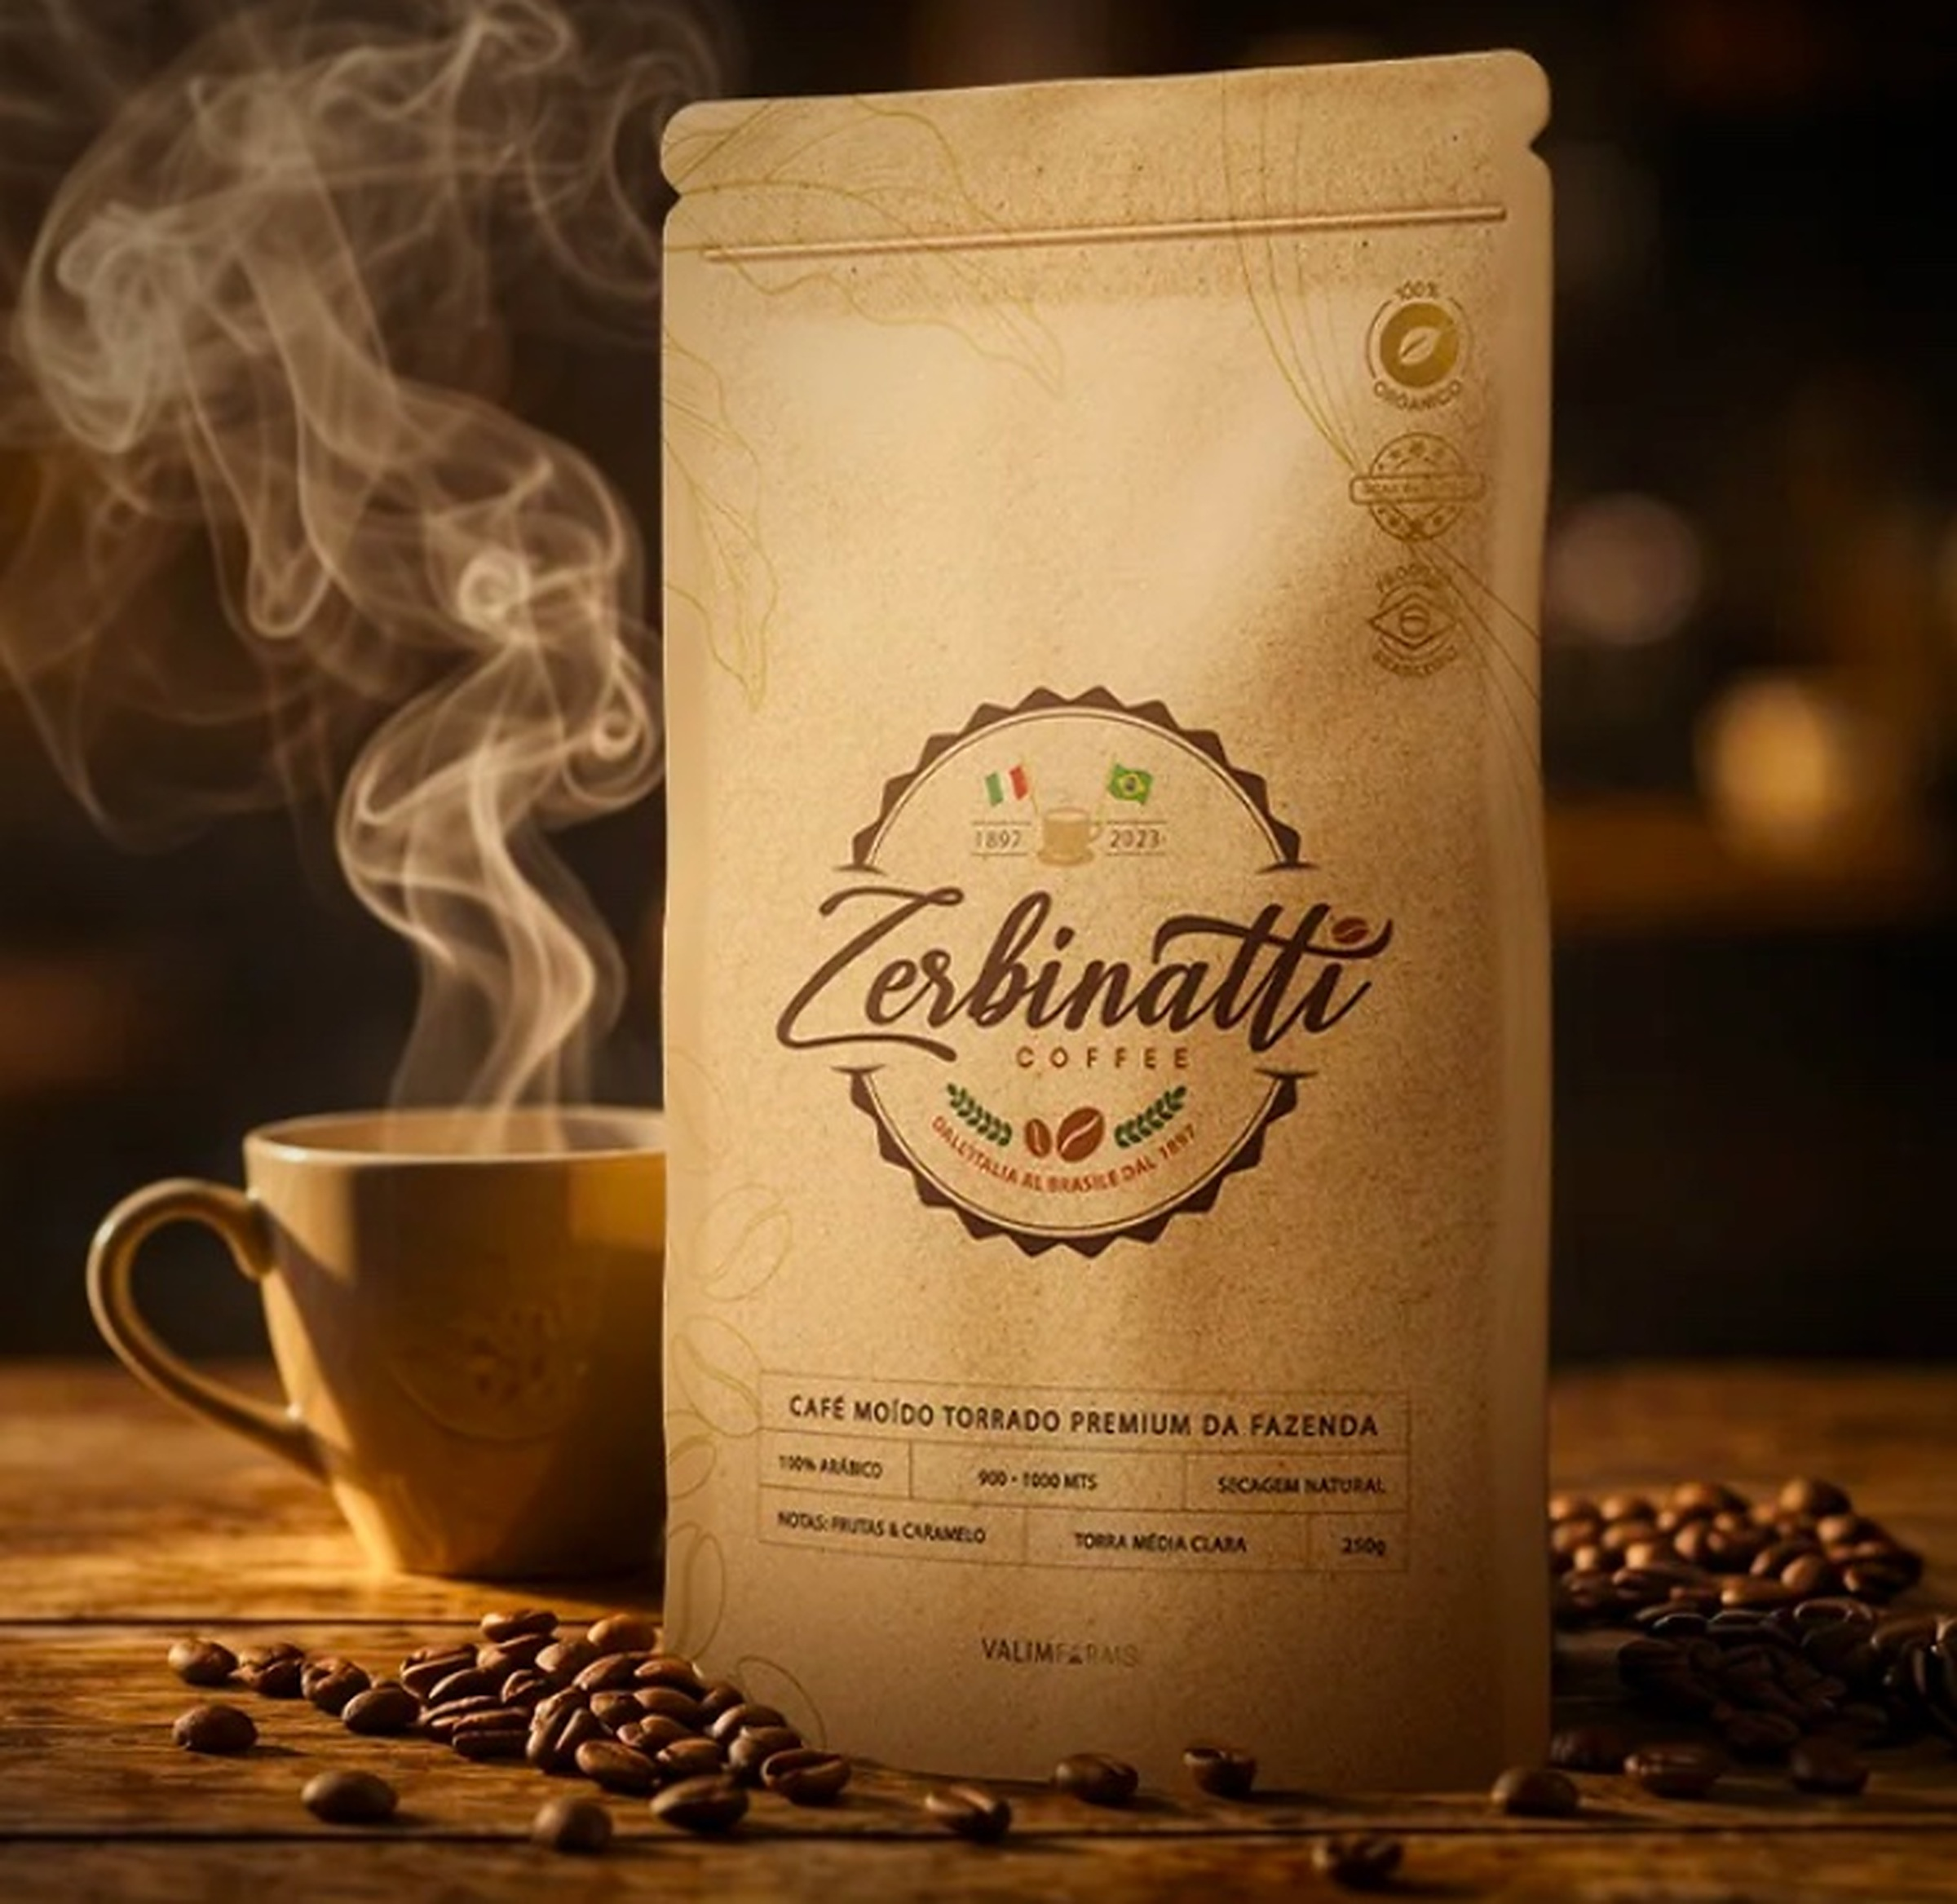


VALIM FARMS · SÃO PAULO · BRAZIL
WILSON LUIZ VALIM ZERBINATTI · THIRD GENERATION · 1897

Slide 2
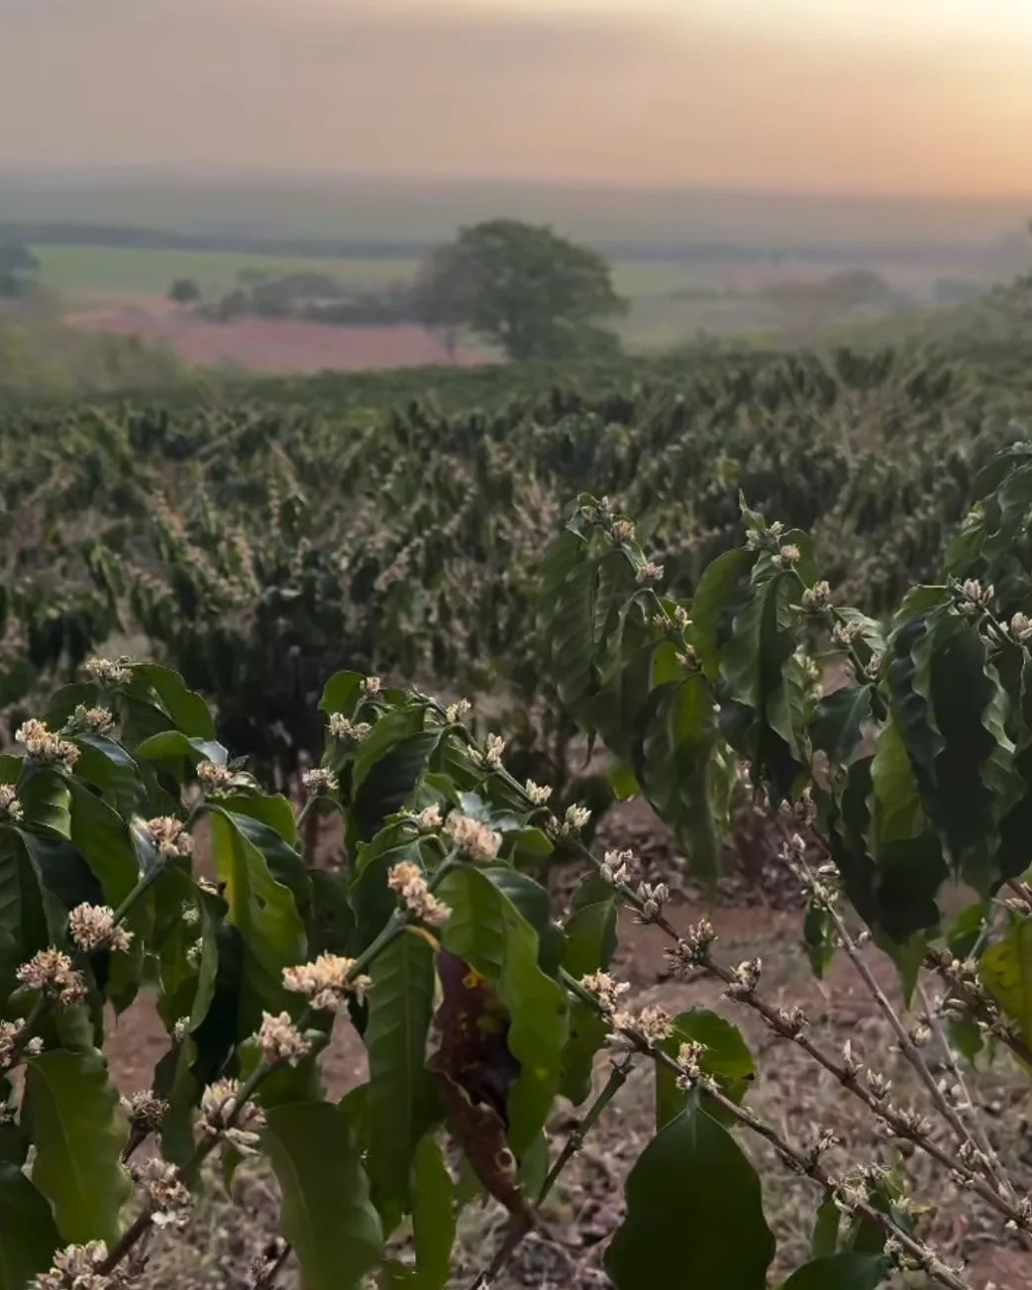
— LINEAGE
Three generations.
One land.
One coffee.
An Italian family arrived in São Paulo in 1897. They planted. They waited. They learned. Today I am Wilson Luiz Valim Zerbinatti — the third to walk these coffee fields. The Zerbinatti surname became a brand, but it’s still what it always was: people who listen to the land.
129 YEARS · THREE GENERATIONS · ONE ORIGIN

Slide 3

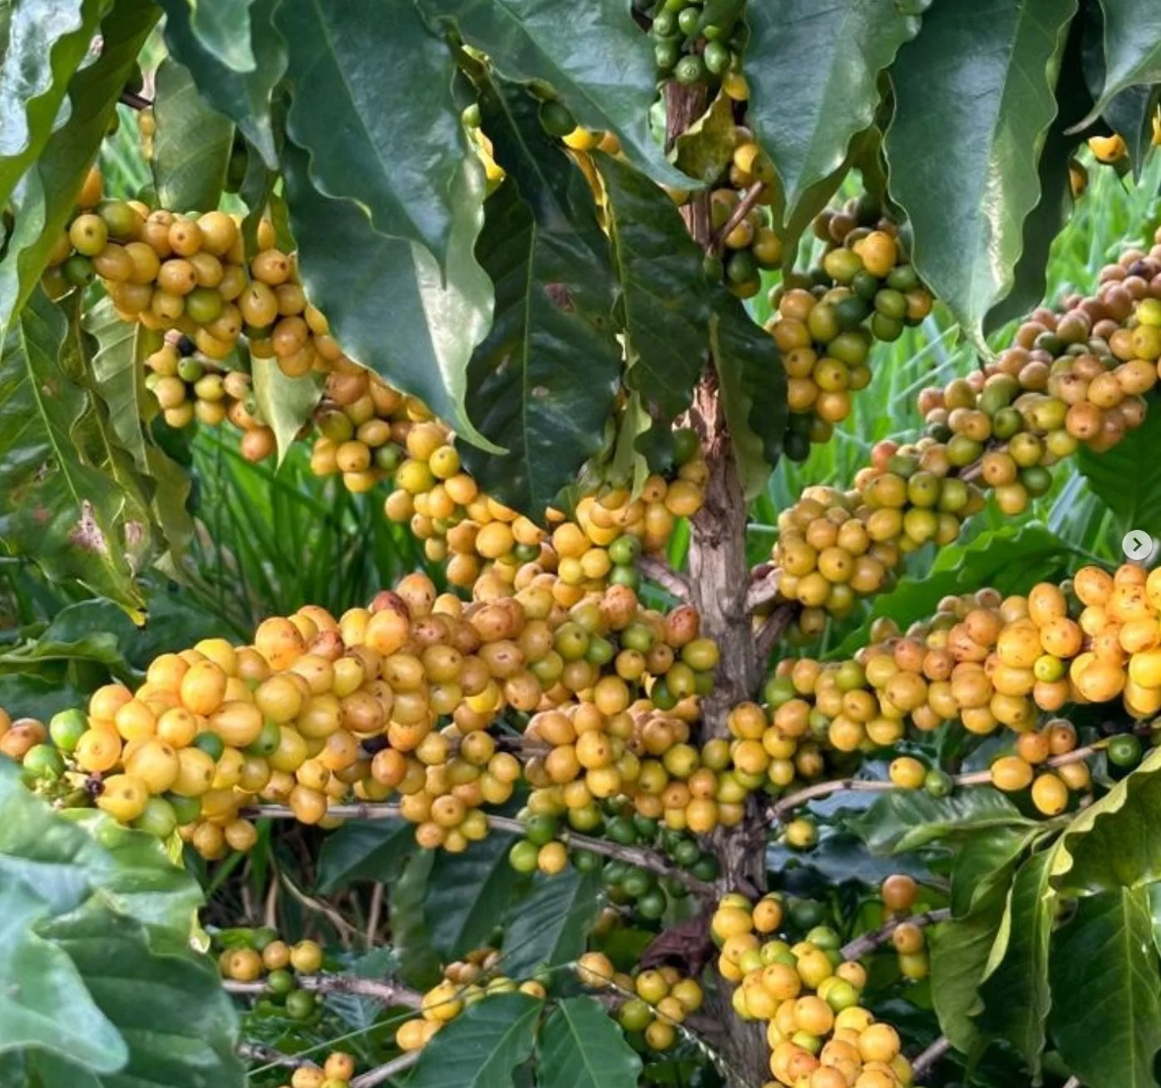

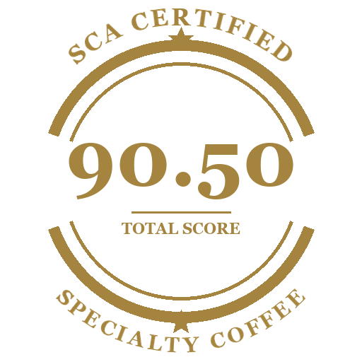


— THE LAND
Where everything
happens on its own.
LOCATION
Valim Farms, SP
ALTITUDE
640 – 760 m
SOIL
Volcanic
VARIETIES
Arara · Paraiso 2
PROCESS
Natural, sun-dried
HARVEST
Hand-picked, ripe cherry
— CERTIFICATIONS

Slide 4
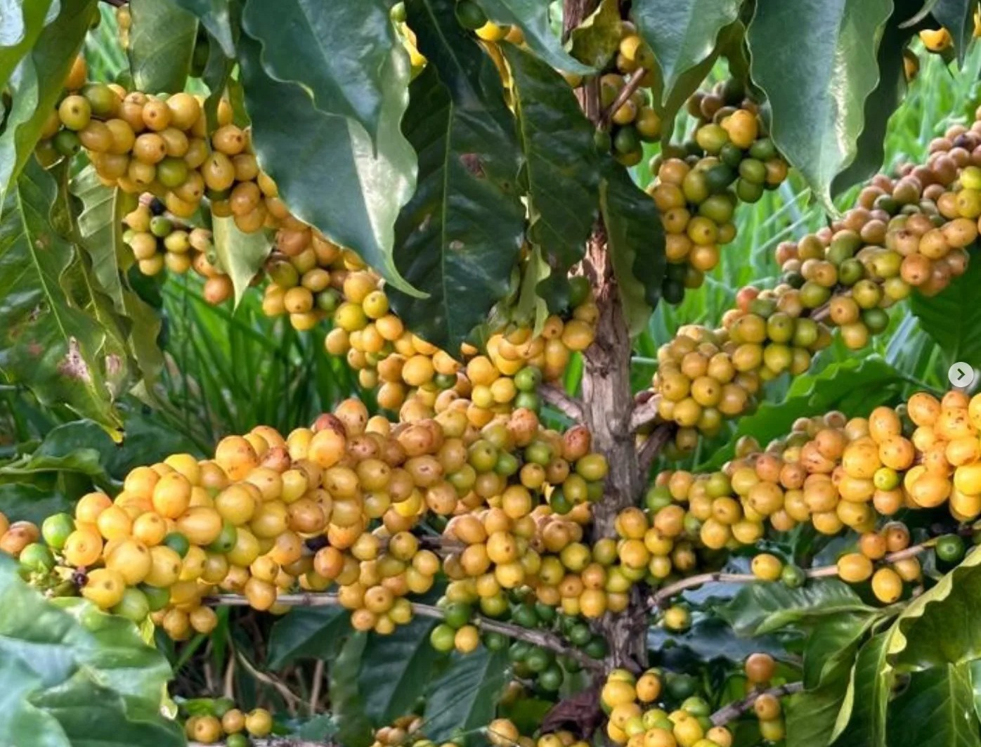
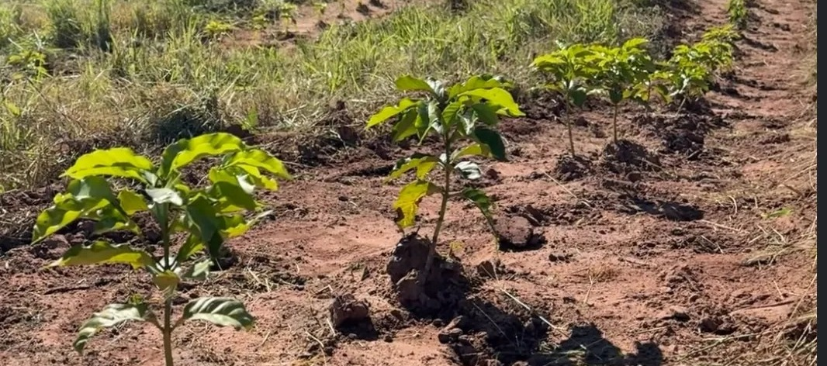
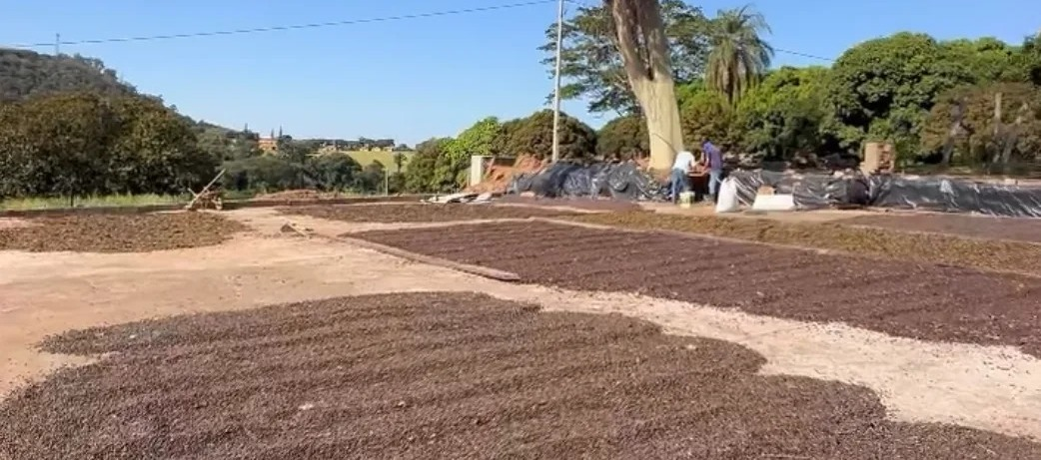
ZERBINATTI · BRAND PORTFOLIO
Famiglia · since 1897
— VALIM FARMS · TERROIR
One farm.
A whole climate.
Valim Farms sits on natural terraces between 640 and 760 meters, with deep volcanic soil, dry winters and a long, slow ripening window. Two Arabica varieties — Arara and Paraíso 2 — are planted by hand and harvested only when the cherry is fully ripe.
The terroir.
Volcanic soil, terraced slopes, cool mornings, dry winters. The land does most of the work — we just stay out of its way.
760m
02
PEAK ALTITUDE
VARIETIES
100%
May-Sep
ARABICA
HARVEST

Slide 5
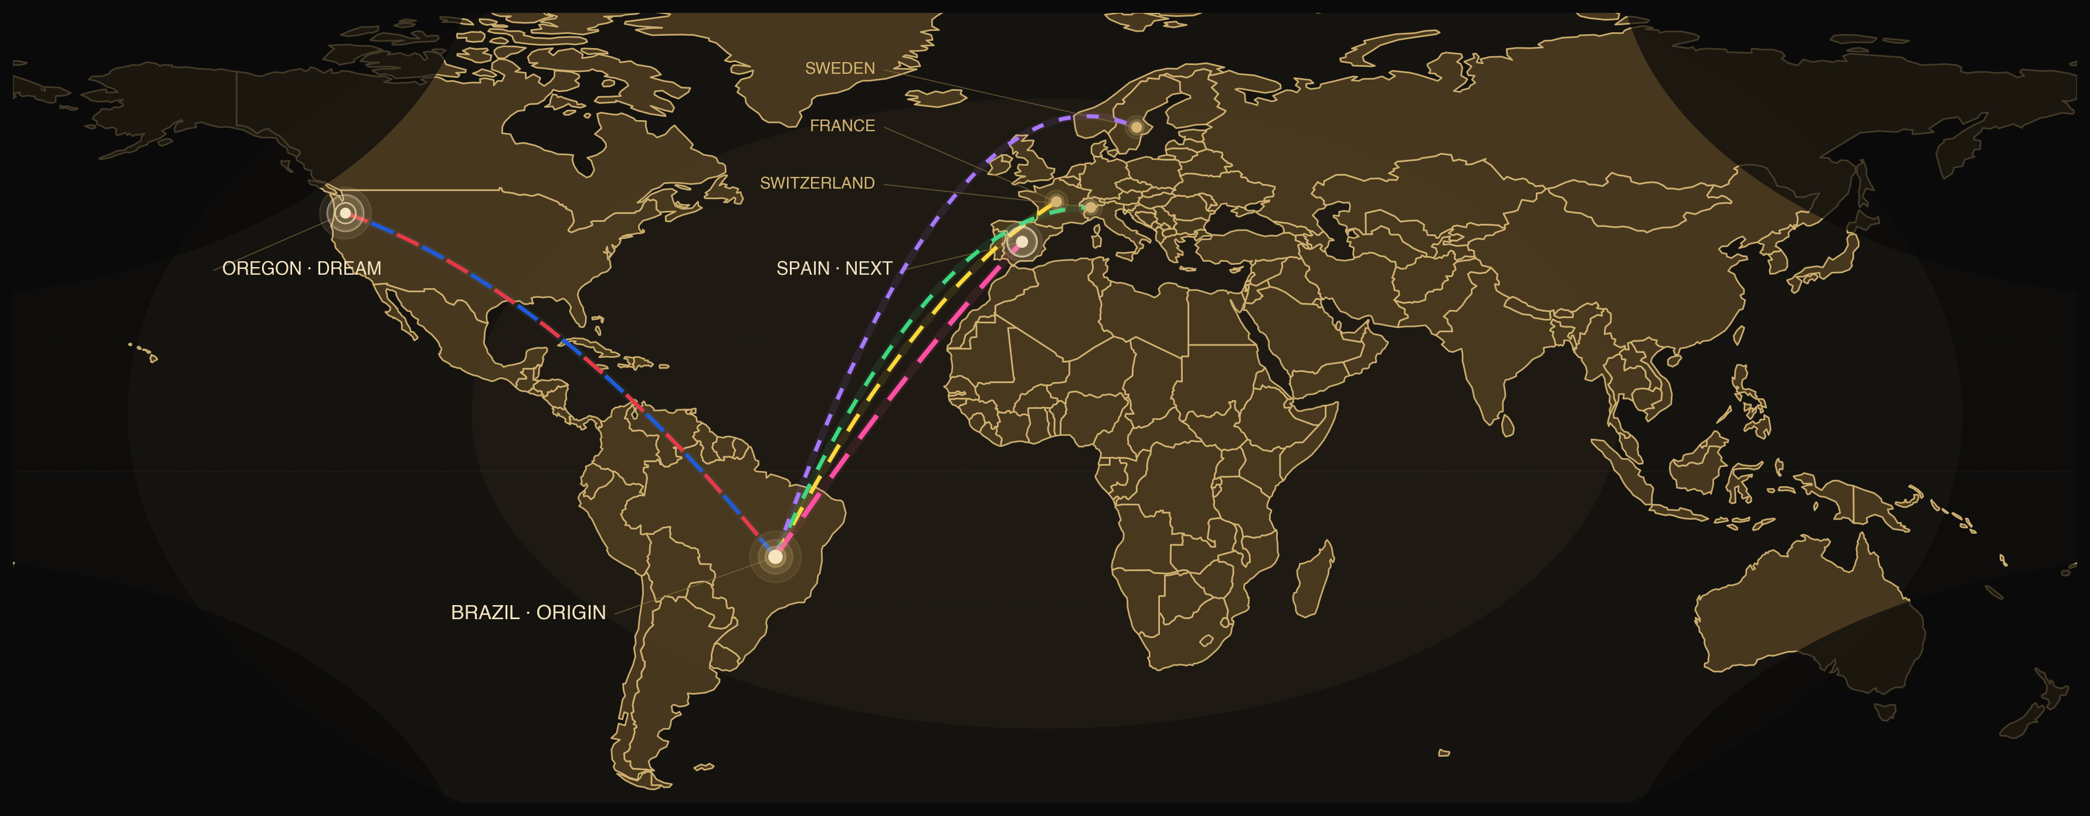
— THE COFFEE ALREADY CROSSES OCEANS
Three flags today.
The dream is Oregon.
PRESENCE · EXPANSION · 2026

Slide 6

— THE PROOF
The numbers
that matter.
[ ___ ]
20 CONTAINERS
SPAIN SHIPMENT · 2026
Scheduled shipment
[ __ ]
SCAA SCORE
Cup rating
100%
BAGS / YEAR
2026 production
TRACEABLE MICROLOT
Origin guaranteed

Slide 7
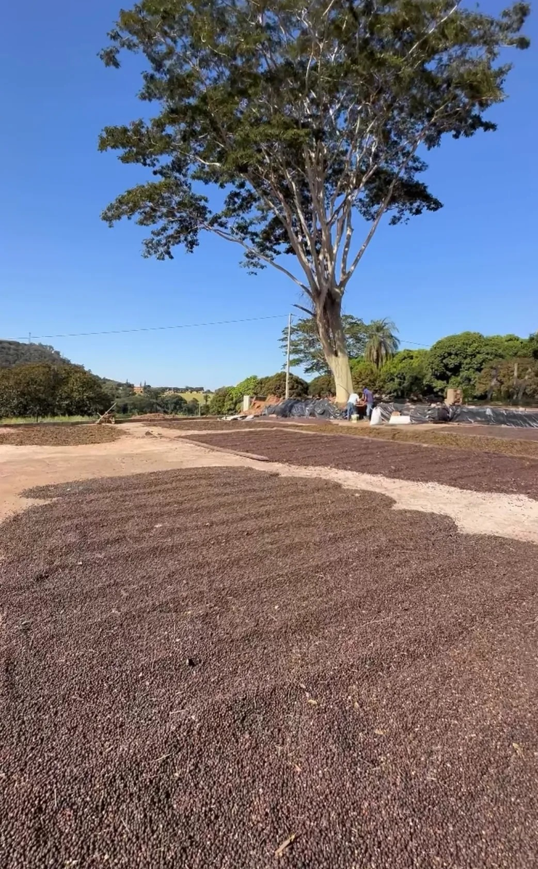
— MY NEXT DESTINATION
United States.
I would stop exporting to Europe
to finally arrive here.
WILSON LUIZ VALIM ZERBINATTI · 2026

Slide 8
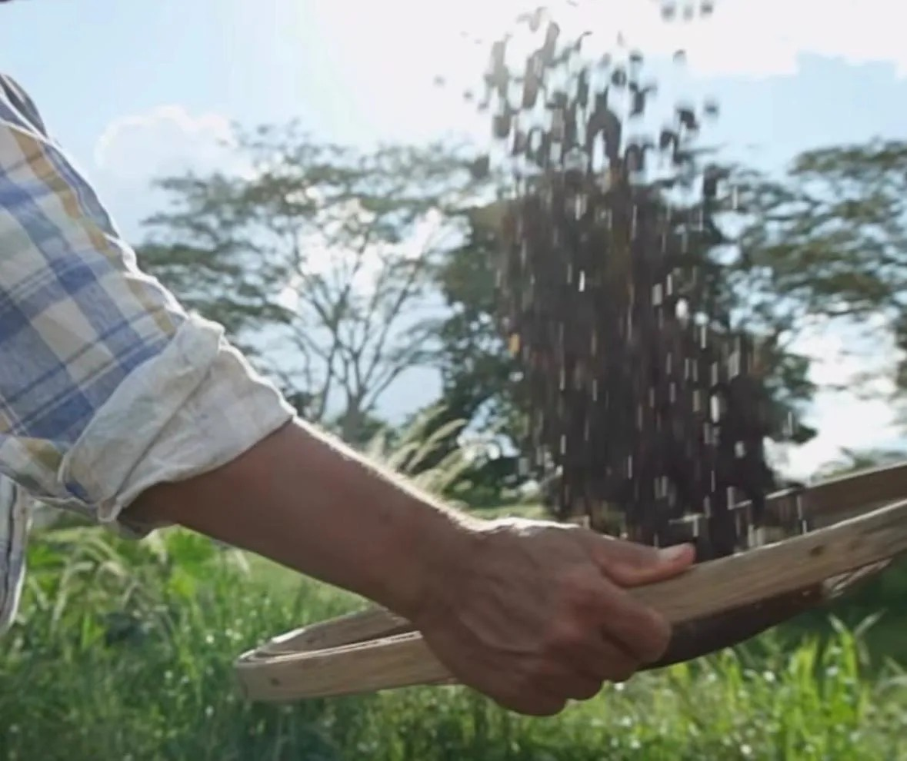

“The land teaches, the sun decides,
we just observe.”
— WILSON LUIZ VALIM ZERBINATTI · THIRD GENERATION
@ZERBINATTICOFFEE · ZERBINATTICOFFEE.COM

