Slide 1

Volume
Persistent Volume
Persistent Volume Claim
Storage Class

Slide 2
Volume
awsElasticBlockStore
emptyDir
gcePersistentDisk
hostPath
nfs

Slide 3
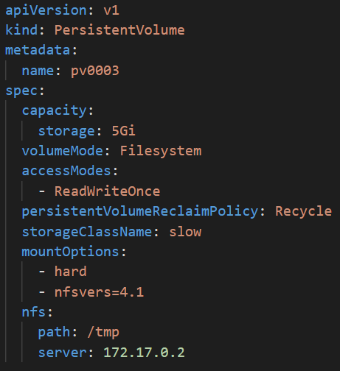
Persistent Volume

Slide 4
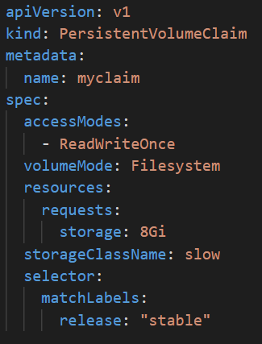
Persistent Volume Claim

Slide 5
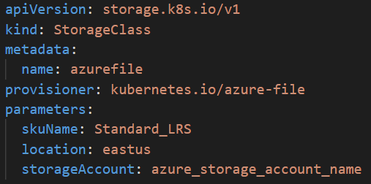
Storage Class

Slide 6

Persistent Volume Claim
Persistent Volume
Volume
/files

Slide 7
Persistent Volume Claim
Storage Class
Persistent Volume
Volume
/files

Slide 8
AKS
Azure File
Azure Disk

Slide 9


Wordpress
MariaDB
Service
Service

Slide 10
Wordpress
MariaDB
Service
Service

Slide 11
Wordpress
MariaDB
Service
Service

