Slide 1

A Anatomia de um Deploy no Kubernetes

Slide 2




Fabrício Veronez
Arquiteto de Soluções
YouTube – https://www.youtube.com/c/fabricioveronez Facebook - http://www.facebook.com/fabricioveronezdev/
Linkedin - http://www.linkedin.com/in/fabricioveronez
Instagram - fabricioveronez
Telegram - fabricioveronez

Slide 3
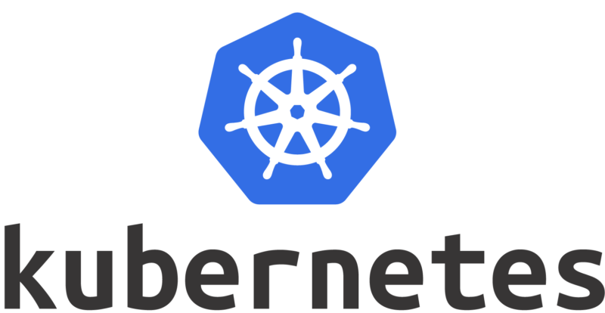

Slide 4
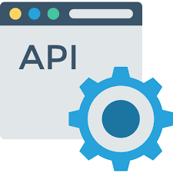

Proposta

Slide 5
Objetos em um deploy Kubernetes
Pod
Services
Labels
Selectors
Deployment
ReplicaSet

Slide 6
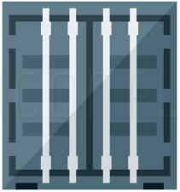
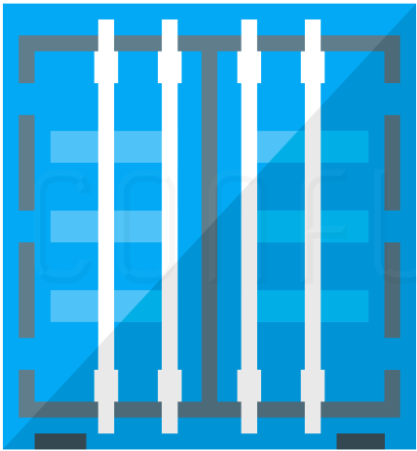
Pod
10.10.10.3

Slide 7
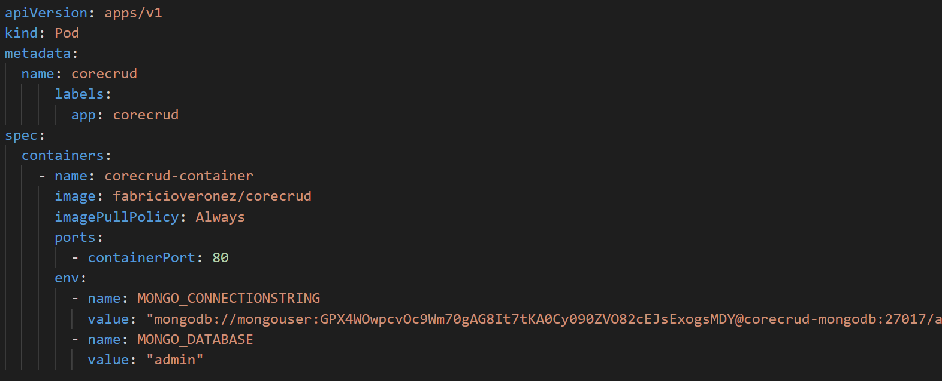

Slide 8
Pod
10.10.10.3
WebApi
MongoDB

Slide 9
10.10.10.3
10.10.10.6
Service
WebApi
MongoDB

Slide 10
Services
ClusterIP
NodePort
LoadBalancer
ExternalName

Slide 11
ClusterIP
Cluster Kubernetes
Pod A
Service
Pod B
Pod B
Pod B

Slide 12
NodePort
Cluster Kubernetes
Pod A
Service Port: 3000
Pod A
Pod A

Slide 13
Load Balancer
Load Balancer
Cluster Kubernetes
Service
Pod A
Pod A
Pod A

Slide 14
External Name
Cluster Kubernetes
External Service
Pod A
Service

Slide 15
Labels e Selectors
Selector App=MongoDB
10.10.10.3
10.10.10.6
Label App=MongoDB
Service
WebApi
MongoDB

Slide 16
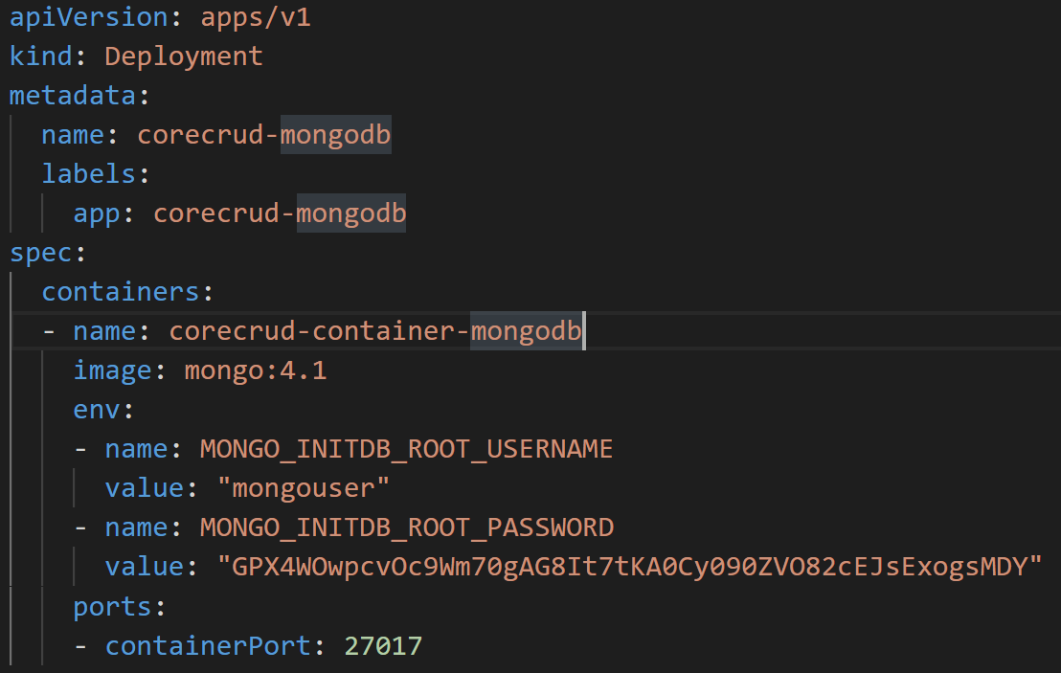

Slide 17
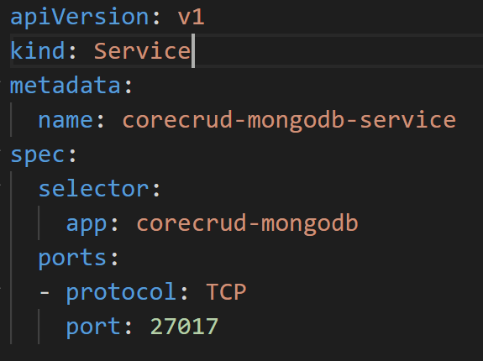

Slide 18
Deployment
Deployment
Cluster Kubernetes
ReplicaSet A
Pod A
Pod A
Pod A

Slide 19
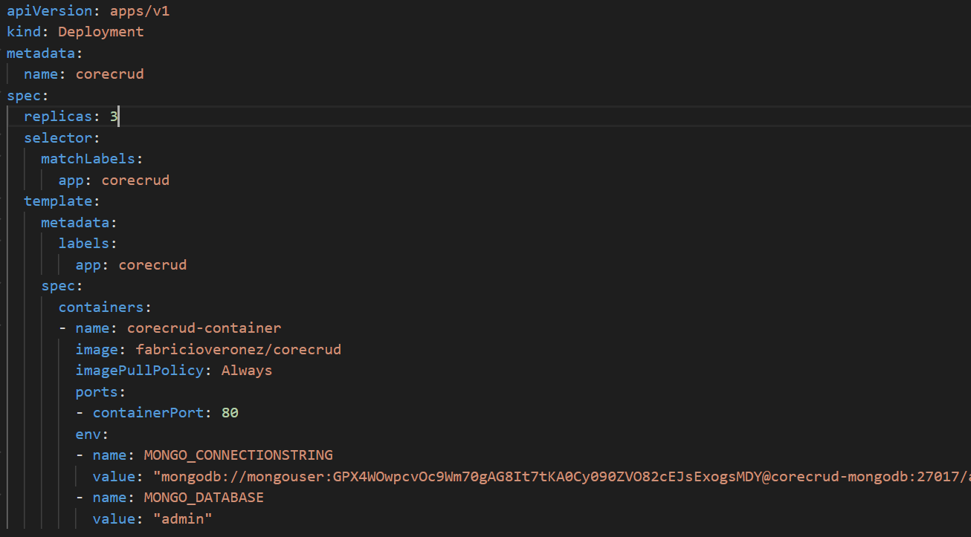

Slide 20
10.10.10.5
Label App=corecrud
10.10.10.4
10.10.10.7
Label App=MongoDB
Label App=corecrud
Service
Service
Selector App=MongoDB
Selector App=corecrud
10.10.10.3
Label App=corecrud

Slide 21
DEMO

Slide 22

Quer saber mais?
http://bit.ly/news-veronezdev

