Slide 1

AKS-Conhecendo o Kubernetes no Azure

Slide 2
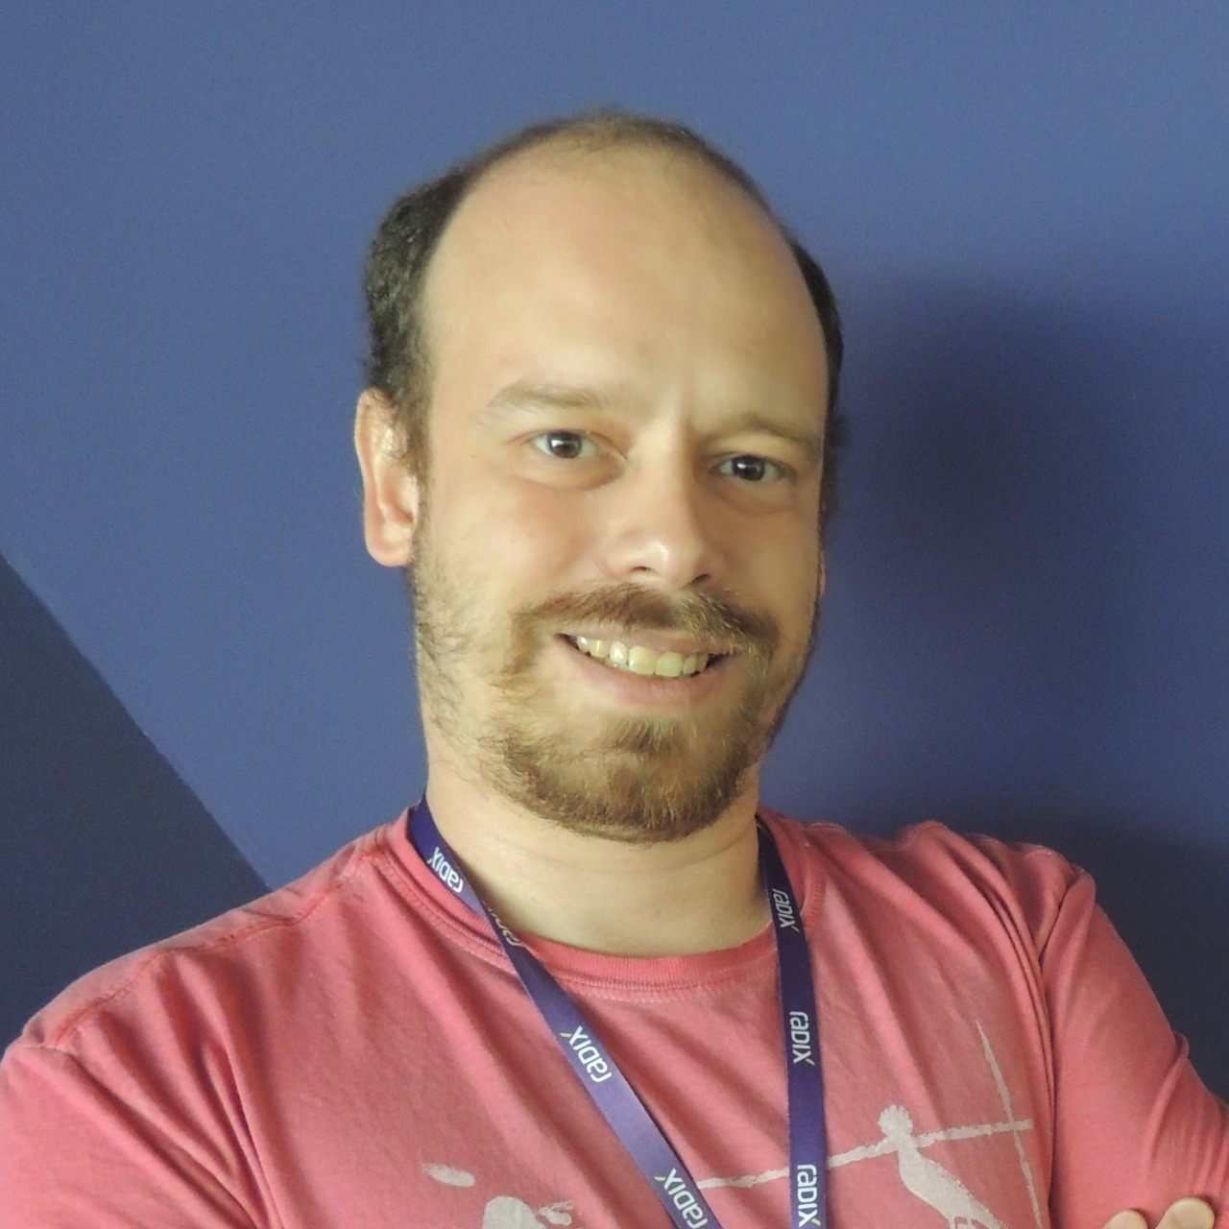
Fabrício Veronez
Arquiteto de Software
http://www.fabricioveronez.net
Email - fabricioveronez@gmail.com
Linkedin - http://www.linkedin.com/in/fabricioveronez
Telegram - fabricioveronez

Slide 3

Orquestrador de Containers
Extensivel
Escalável
Agnóstico
Open Source

Slide 4
Objetos em um deploy Kubernetes
Pod
Labels
Selectors
ReplicaSet
Deployment
Services

Slide 5
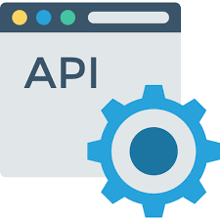

Proposta

Slide 6

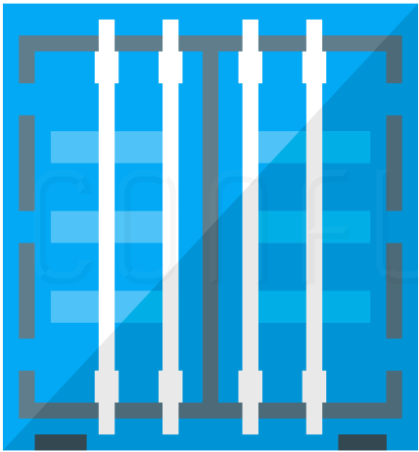
Pod
10.10.10.3
WebApi
MongoDB

Slide 7
Labels

Slide 8
Selectors

Slide 9
ReplicaSet

Slide 10
Deployment
Deployment
Cluster Kubernetes
ReplicaSet A
Pod A
Pod A
Pod A

Slide 11
10.10.10.3
10.10.10.4
10.10.10.5
Service
App=mongo
10.10.10.6
10.10.10.7
App=mongo
App=mongo

Slide 12
Services
ClusterIP
NodePort
LoadBalancer
ExternalName

Slide 13
ClusterIP
Cluster Kubernetes
Pod A
Service
Pod B
Pod B
Pod B

Slide 14
NodePort
Cluster Kubernetes
Pod A
Service Port: 3000
Pod A
Pod A

Slide 15
Load Balancer
Load Balancer
Cluster Kubernetes
Service
Pod A
Pod A
Pod A

Slide 16
External Name
Cluster Kubernetes
External Service
Pod A
Service

