Slide 1

Como fazer deploy corretamente da sua aplicação no Kubernetes

Slide 2
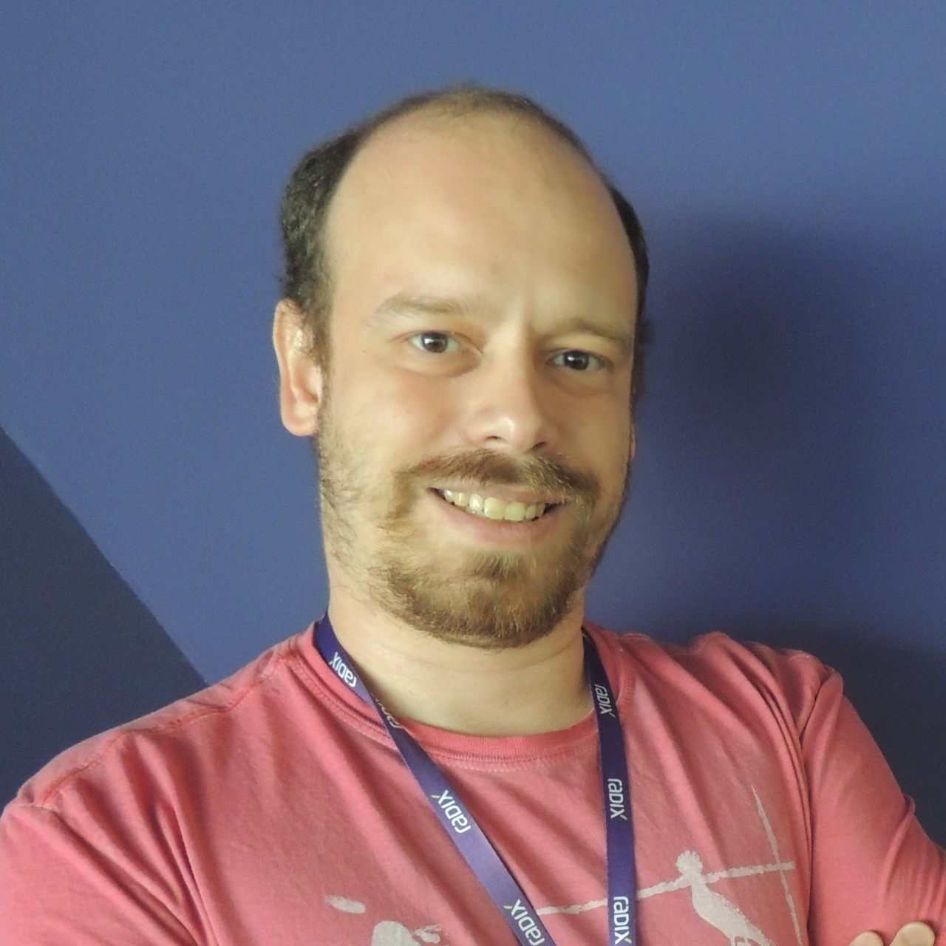


Fabrício Veronez
Arquiteto de Soluções
YouTube – https://www.youtube.com/c/fabricioveronez Facebook - http://www.facebook.com/fabricioveronezdev/
Linkedin - http://www.linkedin.com/in/fabricioveronez
Instagram - fabricioveronez
Telegram - jornadakubernetes

Slide 3
Deployment
Cluster Kubernetes
ReplicaSet A
Pod A

Slide 4
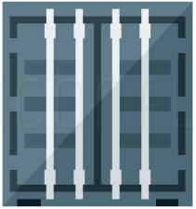
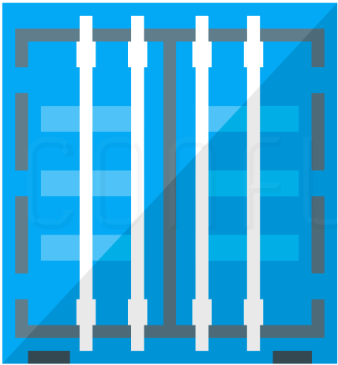
Pod
10.10.10.3

Slide 5
ReplicaSet
ReplicaSet A
Pod A
Pod A
Pod A

Slide 6
Deployment
Deployment
Cluster Kubernetes
ReplicaSet A
Pod A
Pod A
Pod A

Slide 7
Services
ClusterIP
NodePort
LoadBalancer
ExternalName

Slide 8
ClusterIP
Cluster Kubernetes
Pod A
Service
Pod B
Pod B
Pod B

Slide 9
NodePort
Cluster Kubernetes
Pod A
Service Port: 3000
Pod A
Pod A

Slide 10
Load Balancer
Load Balancer
Cluster Kubernetes
Service
Pod A
Pod A
Pod A

Slide 11
External Name
Cluster Kubernetes
External Service
Pod A
Service

