Slide 1

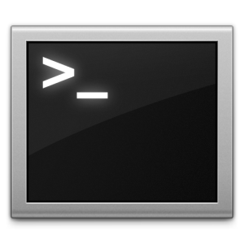
Publicação no Kubernetes
kubectl create
YAML

Slide 2
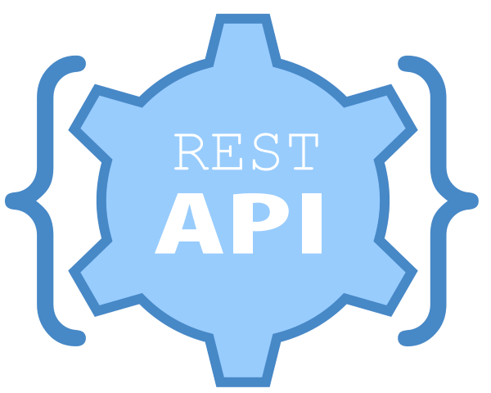

Publicação no Kubernetes

Slide 3
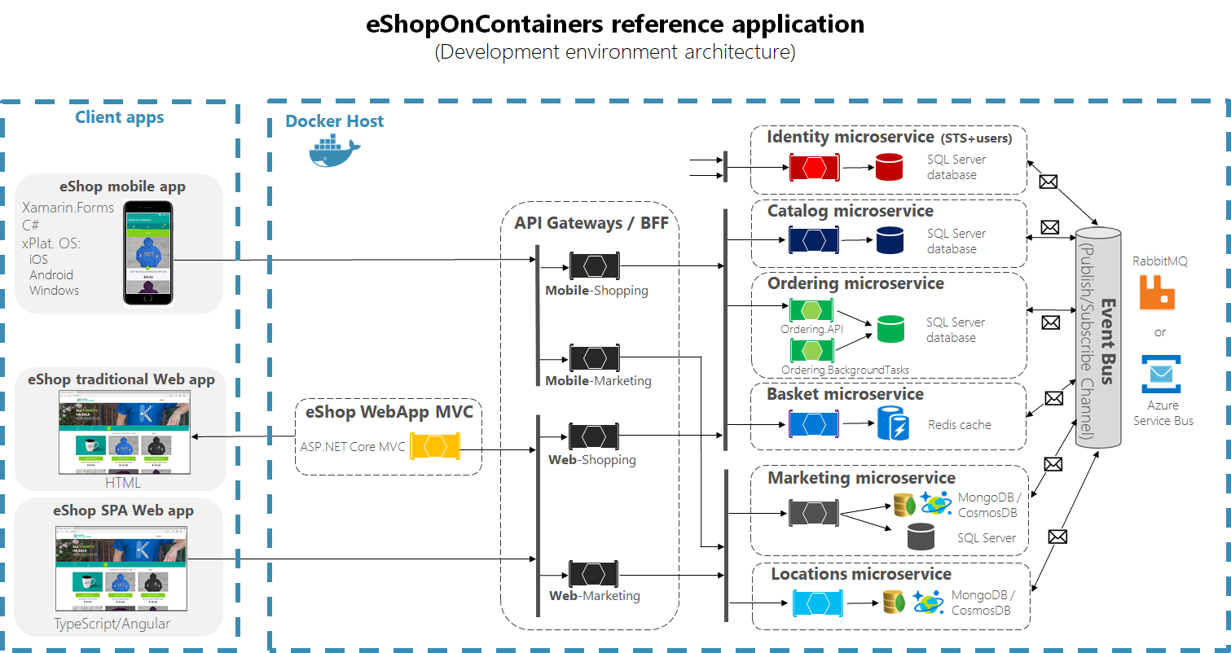

Slide 4


Slide 5


Slide 6



apt-get install
apt-get remove
apt-get update
apt-get search
yum install
yum remove
yum update
yum search
apk add
apk del
apk upgrade
apk search

Slide 7

helm repo add
helm search repo
helm install
helm upgrade
helm rollback
helm create
helm status

Slide 8
Helm v2
Repositories
Helm CLI
Tiller

Slide 9
Helm v3
Repositories
Helm CLI
Kube-Api

Slide 10
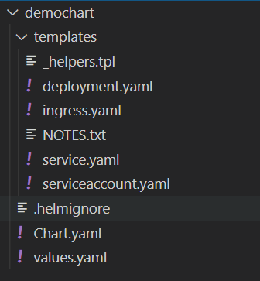
Chart
Chart.yaml
Values.yaml
Templates
Arquivos tpl
NOTES.txt

Slide 11
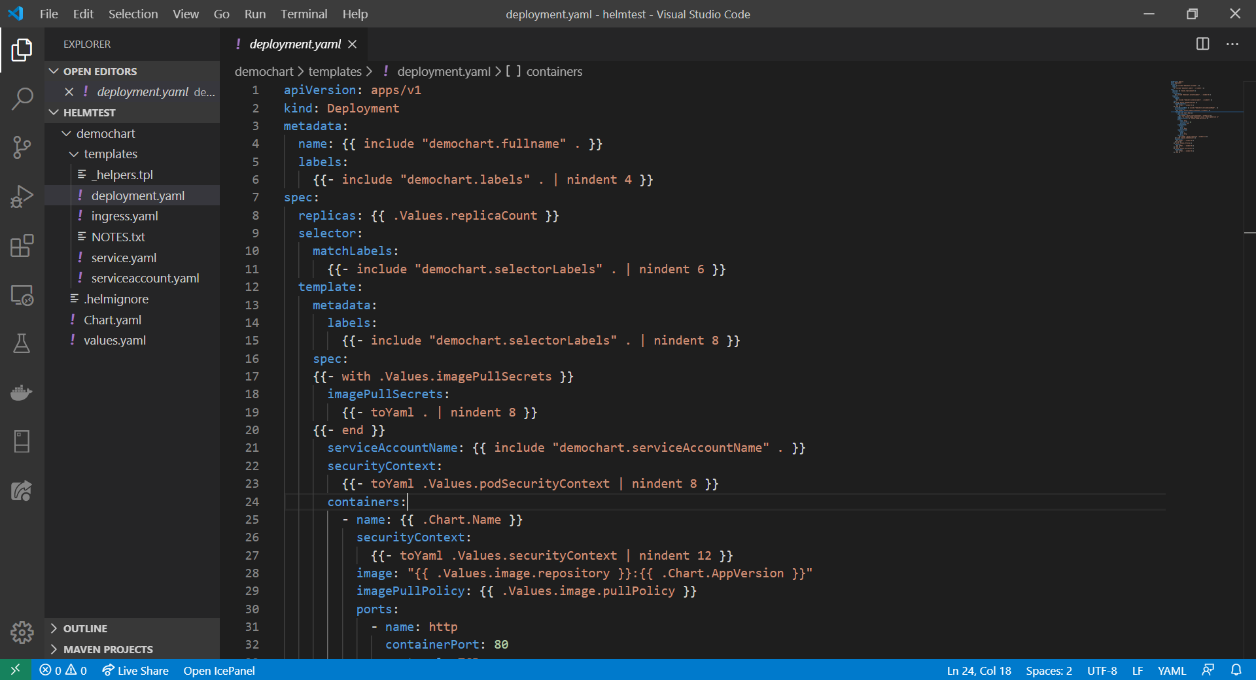

Slide 12
