Slide 1
Implementando Métricas e Healthcheck

Slide 2

Quem sou eu ?
Fabrício Veronez
Arquiteto de Software – Radix Engenharia e Software
http://www.fabricioveronez.net
Email – fabricioveronez@gmail.com

Slide 3
Tópicos
Métricas
Healthcheck
Persistencia dos dados
Dashboard
Demo
Bônus

Slide 4
Desafio
Quantas requisições minha aplicação recebe ?
Quantas requisições geraram erro ?
Sua aplicação está no ar nesse momento ?

Slide 5
Tipos de Métricas
Métricas do Sistema
Quantidades de requisições
Quantidade de erros
Consumo de recursos
APIs mais acessadas
Tempo de acesso a um recurso
Métricas de Negócio
Usuários acessando a aplicação
Boletos emitidos
Compras de um produto

Slide 6
Healthcheck
Testar a integridade da aplicação
Healthy, degraded or unhealthy

Slide 7
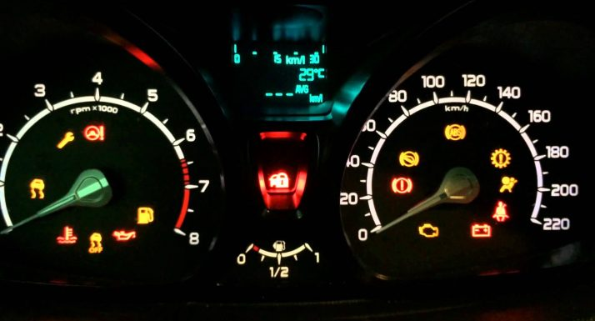
Métricas de um automóvel
Consumo de combustível
Rotações do motor
Temperatura do motor
Alerta de bateria

Slide 8

Open Source
.NET Core e .NET Full
Abstração da base de dados
Otimização do envio das métricas
Middlewares para aplicações ASP.NET Core
Possibilidade de criar suas próprias métricas

Slide 9

Dados dimensionais
Múltiplas formas de visualização
Configuração de alertas

Slide 10

Open Source
Multiplataforma
Múltiplas bases de dados
Alertas
Extensível através de plugins

Slide 11




Fluxo

Slide 12
DEMO

Slide 13
Instructions for use
EDIT IN GOOGLE SLIDES
Click on the button under the presentation preview that says "Use as Google Slides Theme".
You will get a copy of this document on your Google Drive and will be able to edit, add or delete slides.
You have to be signed in to your Google account.
EDIT IN POWERPOINT®
Click on the button under the presentation preview that says "Download as PowerPoint template". You will get a .pptx file that you can edit in PowerPoint.
Remember to download and install the fonts used in this presentation (you’ll find the links to the font files needed in the Presentation design slide)
More info on how to use this template at www.slidescarnival.com/help-use-presentation-template
This template is free to use under Creative Commons Attribution license. You can keep the Credits slide or mention SlidesCarnival and other resources used in a slide footer.

Slide 14
Transition headline
1
Let’s start with the first set of slides

Slide 15
Quotations are commonly printed as a means of inspiration and to invoke philosophical thoughts from the reader.

Slide 16
BIG concept
Bring the attention of your audience over a key concept using icons or illustrations

Slide 17
BIG concept
Bring the attention of your audience over a key concept using icons or illustrations

Slide 18
You can also split your content
White
Is the color of milk and fresh snow, the color produced by the combination of all the colors of the visible spectrum.
Black
Is the color of coal, ebony, and of outer space. It is the darkest color, the result of the absence of or complete absorption of light.

Slide 19
In two or three columns
Yellow
Is the color of gold, butter and ripe lemons. In the spectrum of visible light, yellow is found between green and orange.
Blue
Is the colour of the clear sky and the deep sea. It is located between violet and green on the optical spectrum.
Red
Is the color of blood, and because of this it has historically been associated with sacrifice, danger and courage.

Slide 20
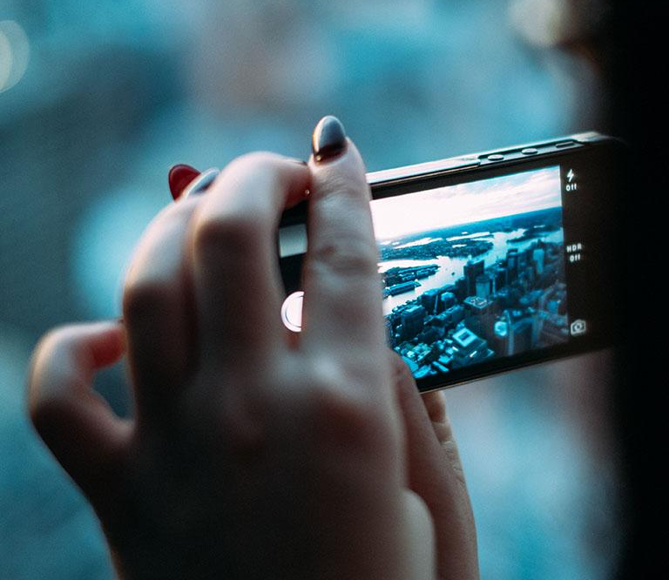
A picture is worth a thousand words
A complex idea can be conveyed with just a single still image, namely making it possible to absorb large amounts of data quickly.

Slide 21
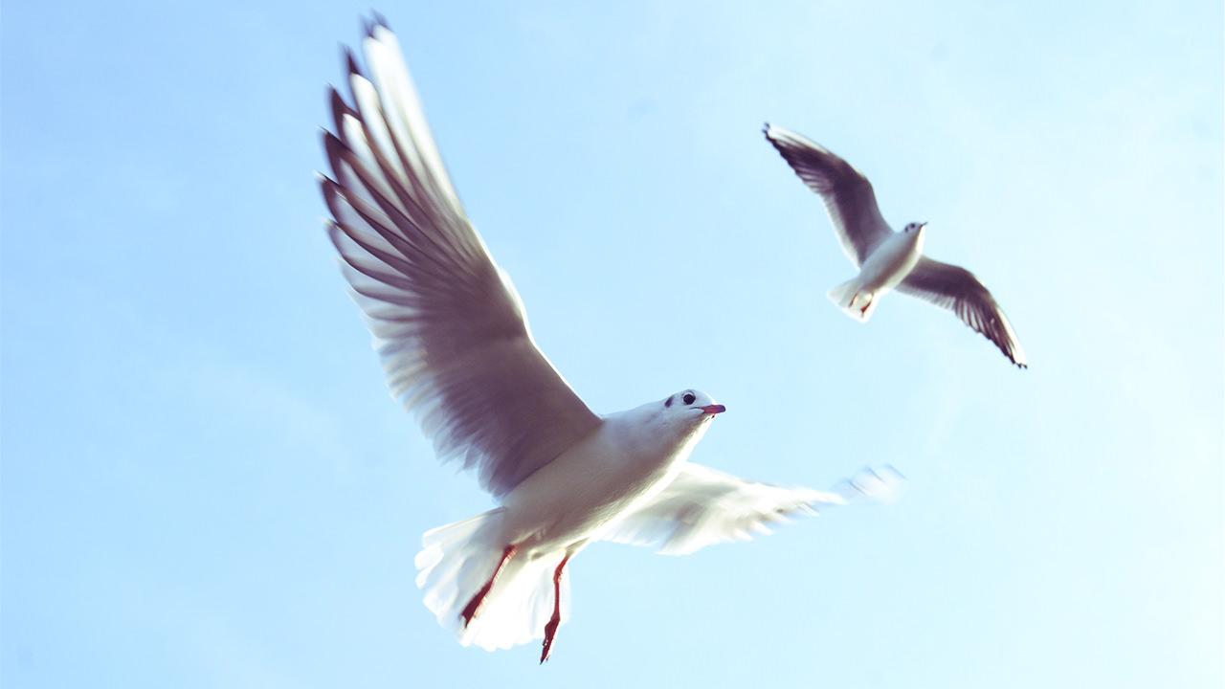
Want big impact?
Use big image.

Slide 22
Use charts to explain your ideas
White
Gray
Black

Slide 23
And tables to compare data
 | A | B | C
Yellow | 10 | 20 | 7
Blue | 30 | 15 | 10
Orange | 5 | 24 | 16

Slide 24
Maps
our office

Slide 25
89,526,124
Whoa! That’s a big number, aren’t you proud?

Slide 26
89,526,124$
185,244 users
100%
That’s a lot of money
And a lot of users
Total success!

Slide 27
Our process is easy
first
second
last

Slide 28
Our sales funnel
20%
40%
60%
80%
Diagram featured by http://slidemodel.com
100%

Slide 29
Let’s review some concepts
Yellow
Is the color of gold, butter and ripe lemons. In the spectrum of visible light, yellow is found between green and orange.
Blue
Is the colour of the clear sky and the deep sea. It is located between violet and green on the optical spectrum.
Red
Is the color of blood, and because of this it has historically been associated with sacrifice, danger and courage.
Yellow
Is the color of gold, butter and ripe lemons. In the spectrum of visible light, yellow is found between green and orange.
Blue
Is the colour of the clear sky and the deep sea. It is located between violet and green on the optical spectrum.
Red
Is the color of blood, and because of this it has historically been associated with sacrifice, danger and courage.

Slide 30
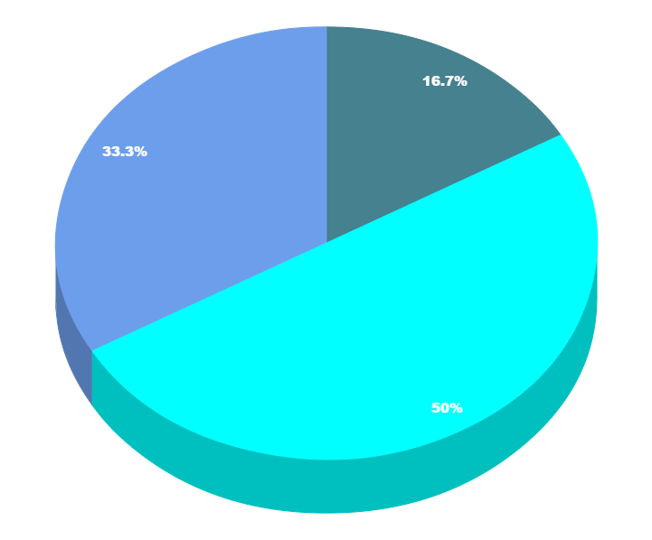
You can copy&paste graphs from Google Sheets

Slide 31
Place your screenshot here
Android project
Show and explain your web, app or software projects using these gadget templates.

Slide 32
Place your screenshot here
iPhone project
Show and explain your web, app or software projects using these gadget templates.

Slide 33
Place your screenshot here
Tablet project
Show and explain your web, app or software projects using these gadget templates.

Slide 34
Place your screenshot here
Desktop project
Show and explain your web, app or software projects using these gadget templates.

Slide 35
Thanks!
Any questions?
You can find me at:
@username
user@mail.me

Slide 36
Credits
Special thanks to all the people who made and released these awesome resources for free:
Presentation template by SlidesCarnival
Photographs by Unsplash

Slide 37
Presentation design
This presentation uses the following typographies and colors:
Titles: Nixie One
Body copy: Muli
You can download the fonts on this page:
https://www.fontsquirrel.com/fonts/nixie-one
https://www.fontsquirrel.com/fonts/muli
Aquamarina #00e1c6 / Turquoise #19bbd5 / Skyblue #2c9dde /
Light gray #c6daec / Dark blue #0e293c
You don’t need to keep this slide in your presentation. It’s only here to serve you as a design guide if you need to create new slides or download the fonts to edit the presentation in PowerPoint®

Slide 38
SlidesCarnival icons are editable shapes.
This means that you can:
Resize them without losing quality.
Change fill color and opacity.
Change line color, width and style.
Isn’t that nice? :)
Examples:

Slide 39
😉
Now you can use any emoji as an icon!
And of course it resizes without losing quality and you can change the color.
How? Follow Google instructions https://twitter.com/googledocs/status/730087240156643328
✋👆👉👍👤👦👧👨👩👪💃🏃💑❤😂😉😋😒😭👶😸🐟🍒🍔💣📌📖🔨🎃🎈🎨🏈🏰🌏🔌🔑 and many more...

