Slide 1
Digital Image Processing
Introduction

Slide 2
image – digital image
An image is a two-dimensional function f(x,y), where x and y are the spatial (plane) coordinates, and the amplitude of f at any pair of coordinates (x,y) is called the intensity of the image at that level.
If x,y and the amplitude values of f are finite and discrete quantities, we call the image a digital image. A digital image is composed of a finite number of elements called pixels, each of which has a particular location and value.

Slide 3
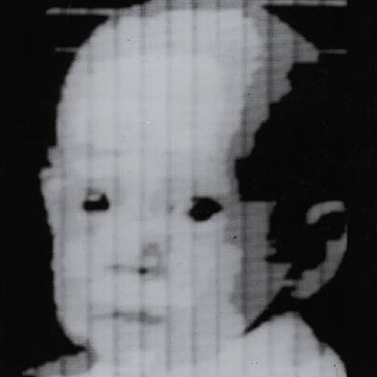
First Digital Photograph
© 2002 R. C. Gonzalez & R. E. Woods

Slide 4
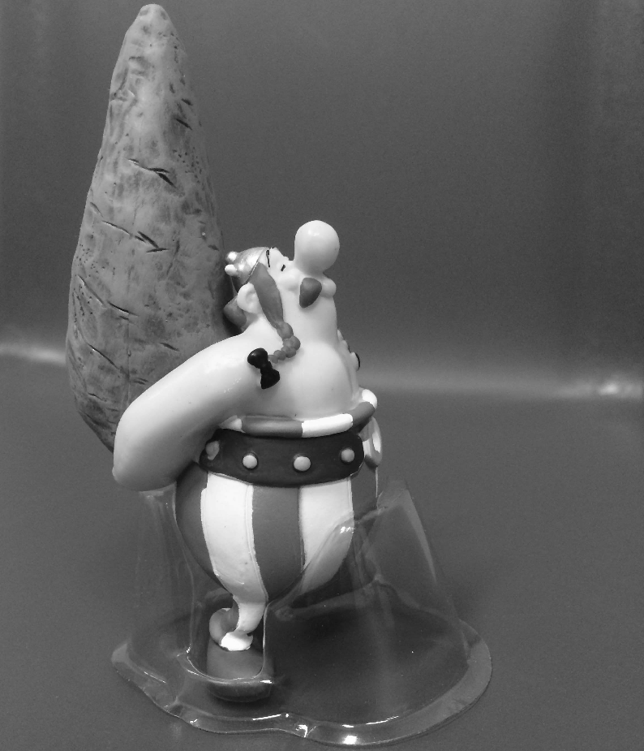
Consider the following image (2724x2336 pixels) to be 2D function or a matrix with rows and columns
Pixel intensity value
f(1,1) = 103
Pixel location
In 8-bit representation
Pixel intensity values change between 0 (Black) and 255 (White)
rows
columns
f(645:650,1323:1328) =
83 82 82 82 82 82
82 82 82 81 81 81
82 82 81 81 80 80
82 82 81 80 80 79
80 79 78 77 77 77
80 79 78 78 77 77
f(2724,2336) = 88

Slide 5


Remember digitization implies that a digital image is an approximation of a real scene
One pixel

Slide 6


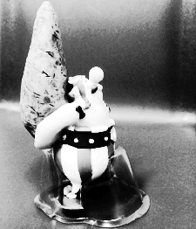


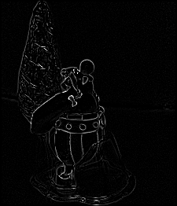

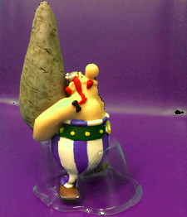
Digital Image Processing

Slide 7
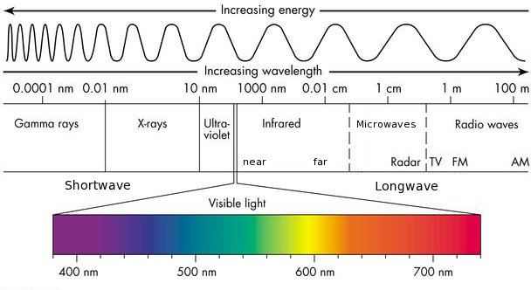
Sources of Digital Images
The principal source for the images is the electromagnetic (EM) energy spectrum.

Slide 8
Gamma rays
© 2002 R. C. Gonzalez & R. E. Woods

Slide 9
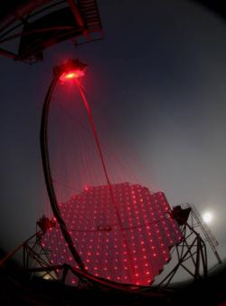
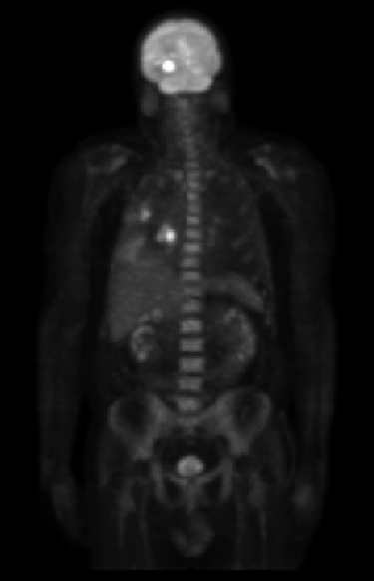
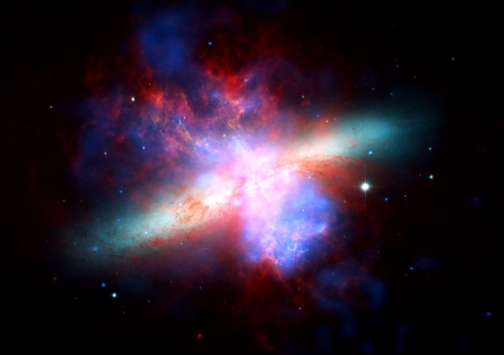
Gamma rays
Gamma-Ray imaging of
A starburst galaxy about 12 million light-years away
Gamma-Ray Imaging
Cherenkov Telescope
Gamma-Ray Imaging
İn nuclear medicine
© 2002 R. C. Gonzalez & R. E. Woods

Slide 10
X- rays
© 2002 R. C. Gonzalez & R. E. Woods

Slide 11
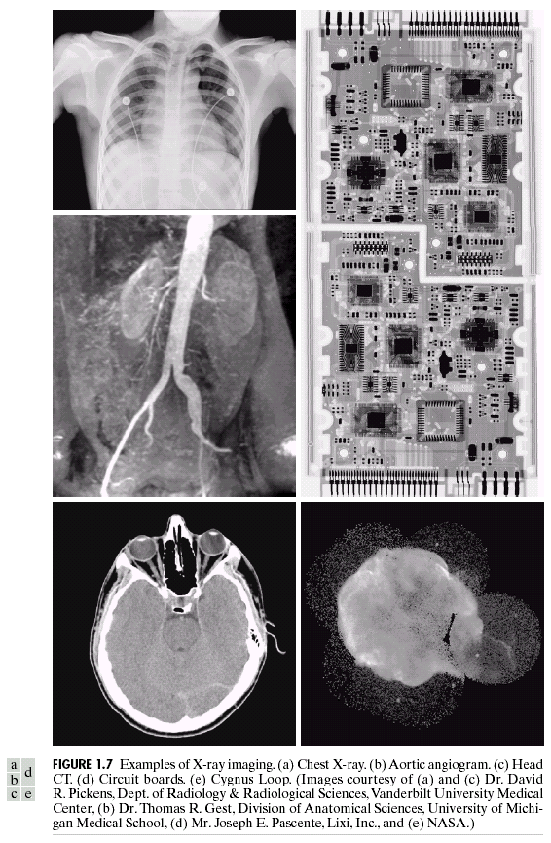
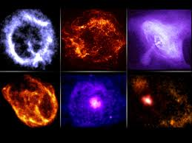
X- rays
X-ray images from the space
The Chandra X-Ray Observatory
© 2002 R. C. Gonzalez & R. E. Woods

Slide 12
Ultra-violet
© 2002 R. C. Gonzalez & R. E. Woods

Slide 13
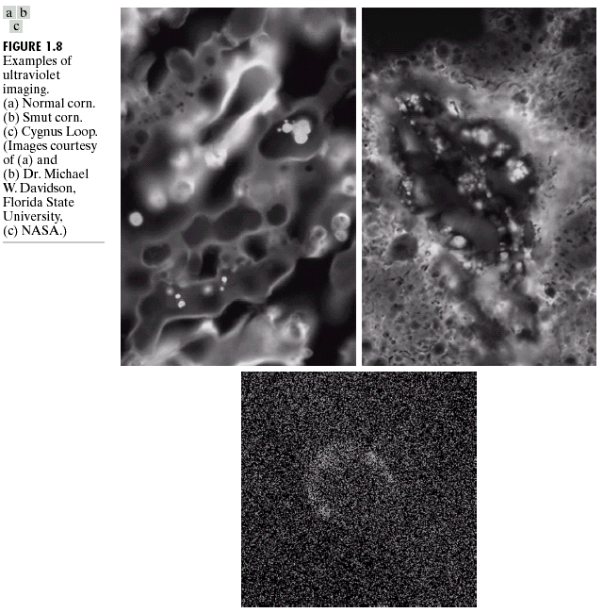
Ultra-violet
© 2002 R. C. Gonzalez & R. E. Woods

Slide 14
Visible light

Slide 15
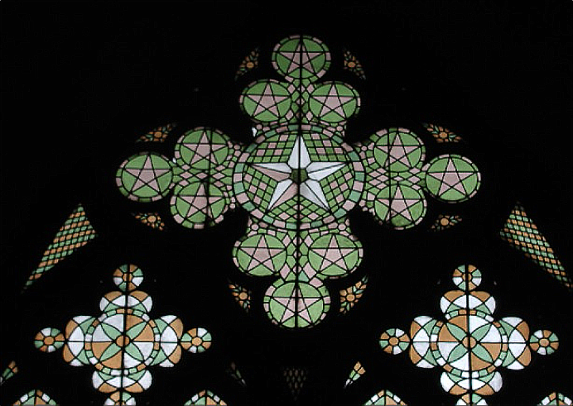




Visible light
R
G
B

Slide 16
Infrared
© 2002 R. C. Gonzalez & R. E. Woods

Slide 17
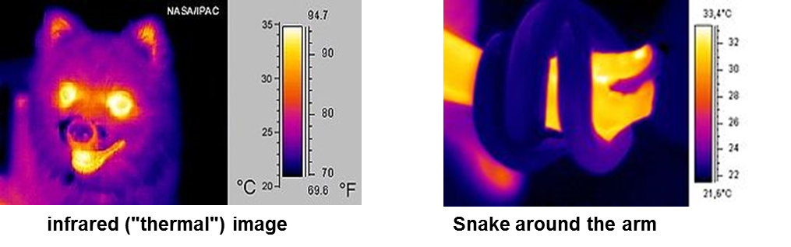
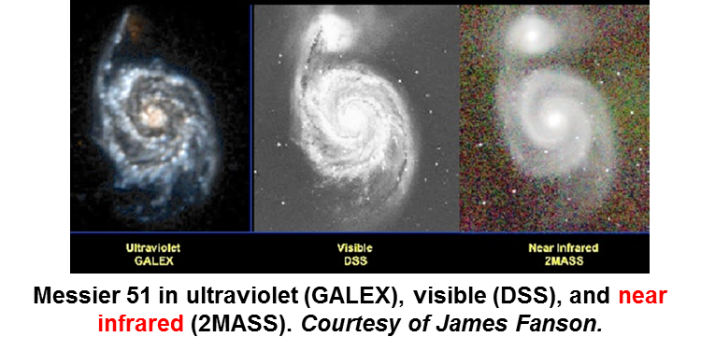
Infrared
© 2002 R. C. Gonzalez & R. E. Woods

Slide 18
Microwaves
© 2002 R. C. Gonzalez & R. E. Woods

Slide 19
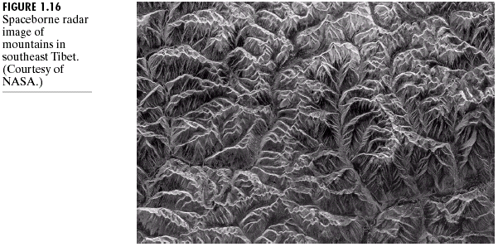
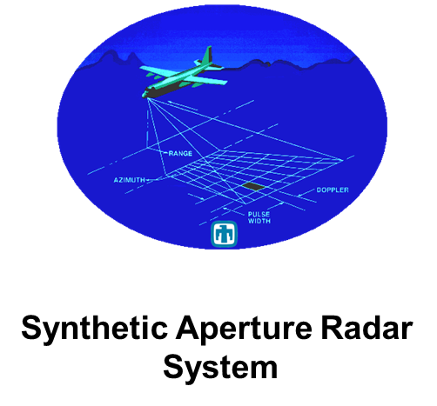
Microwaves
© 2002 R. C. Gonzalez & R. E. Woods

Slide 20
Radio Waves
© 2002 R. C. Gonzalez & R. E. Woods

Slide 21
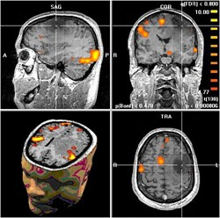
Radio Waves
MRI image slices from the brain
© 2002 R. C. Gonzalez & R. E. Woods

Slide 22
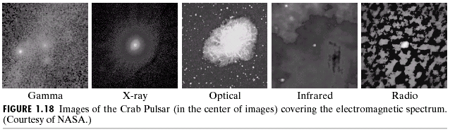
Digital Images based on the EM Spectrum
An example showing Imaging in all of the bands
Visible light
© 2002 R. C. Gonzalez & R. E. Woods

Slide 23
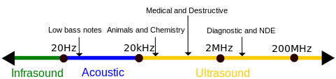
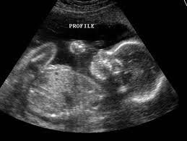
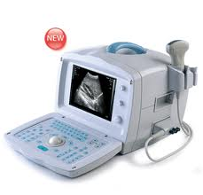
Ultrasound Imaging
Ultrasonic spectrum
Ultrasonic Baby image during pragnancy
Ultrasound image acquisition device
© 2002 R. C. Gonzalez & R. E. Woods

Slide 24
The continuum from image processing to computer vision can be broken up into low-, mid- and high-level processes
Low Level Process
Mid Level Process
High Level Process
Input: Image
Output: Image
Examples: Noise removal, image sharpening
Input: Image
Output: Attributes
Examples: Object recognition, segmentation
Input: Attributes
Output: Understanding
Examples: Scene understanding, autonomous navigation
Notes:
Give the analogy of the character recognition system.
Low Level: Cleaning up the image of some text
Mid level: Segmenting the text from the background and recognising individual characters
High level: Understanding what the text says

Slide 25
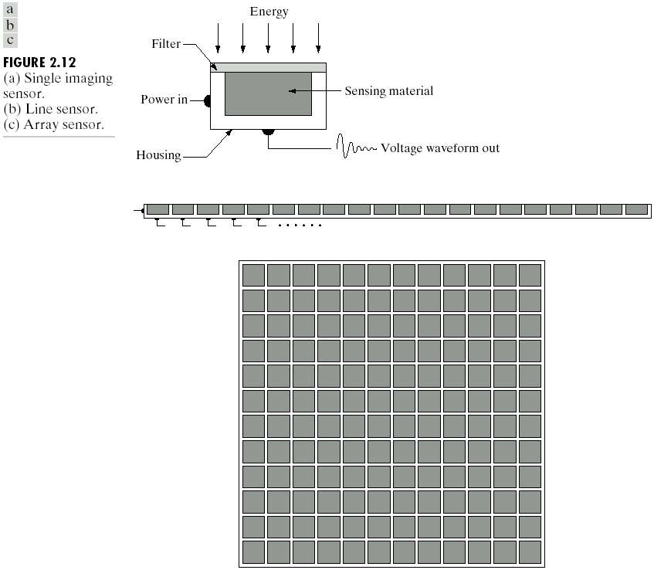
Acquisition of Images
The images are generated by the combination of an illumination source and the reflection or absorption of energy from that source by the elements of the scene being imaged.
Imaging sensors are used to transform the illumination energy into digital images.
© 2002 R. C. Gonzalez & R. E. Woods

Slide 26
Types of Image Sensors
Single Sensor
Line Sensor
Array Sensor
© 2002 R. C. Gonzalez & R. E. Woods

Slide 27
Summary
We have looked at:
  What is a digital image?
  What is digital image processing?
  State of the art examples of digital image processing
  Image acquisition
Next time we will start to see the key
stages in digital image processing and
talk about interpolation

