Slide 1
Network Softwarization Final Project
By,
Harsh Kumar (101910793)
Sriram Thotakura (101881857)
Github link: https://github.com/madhusasaram2021/SDN-ECE595-final-project
Prof. Michael Devetsikiotis & Prof. Fabrizio Granelli

Slide 2
Project Goal
Project n1: To implement in Comnetsemu VM a network slicing strategy to adapt to emergency situation
DETAILS: typically 2 slices are available, equally sharing the total capacity(e.g. 10Mbps divided in 5Mbps+5Mbps) but using only 50% of the respective capacity; a new slice is then built for emergency communications–requiring 4 Mbps, and then the other slices are reduced to 3+3Mbps. Once emergency is gone, capacity is back to the original

Slide 3
Normal Situation
10.0.1.2
10.0.4.2
H4
H1
H1
5 Mbps
5 Mbps
10.0.7.1
10.0.7.2
10.0.2.2
S2
10.0.5.2
H2
5 Mbps
10 Mbps
5 Mbps
H5
S1
Link to be sliced
10.0.3.2
10.0.6.2
H3
H6
Maximum bandwidth is 5Mbps but configured to be at 2.5Mbps (50% capacity)

Slide 4
Normal Scenario
- To achieve the goal of the project, we used network slicing topology.
- Example with 4 slices were create initially.
- 2 switches were used to work as router using a controller.
- Python script was used by ryu-manager to make switches work as routers.
- All the hosts and routers were assigned with IP adresses for ping reachability.
- 4 hosts were available and connected via slices for this normal scenario.
- 5Mbps capacity was allocated for 2 active slices.
- Both the slices were designed to work at 50% of their capacity.

Slide 5
Emergency Situation
10.0.1.2/24
10.0.4.2/24
H4
H1
H1
3 Mbps
3 Mbps
10.0.7.1
10.0.7.2
10.0.2.2/24
S2
10.0.5.2/24
H2
3 Mbps
10 Mbps
3 Mbps
H5
S1
Link to be sliced
10.0.3.2/24
10.0.6.2/24
H3
4 Mbps
4 Mbps
H6

Slide 6
Emergency Scenario
- Python script was used to make 1 more slice available in the emergency condition.
- For making this to happen, the same topology(as in the normal scenario) was used.
- As per the requirement of the project, respective bandwidth was allocated to the ‘
3rd slice, i. e., 4Mbps.
- The rest 2 slices from the previous case were defined now to work at 3Mbps each.

Slide 7
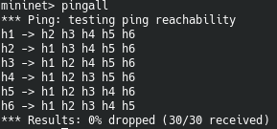
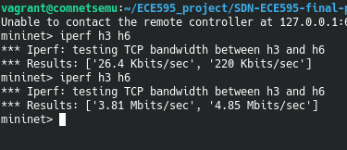
Verifying the result

Slide 8
Thank you!

