Slide 1
Final Project
Jake Lindop, Fabrizio DeAgostini, George Barnacle and Thinesh Aruleeswaran

Slide 2
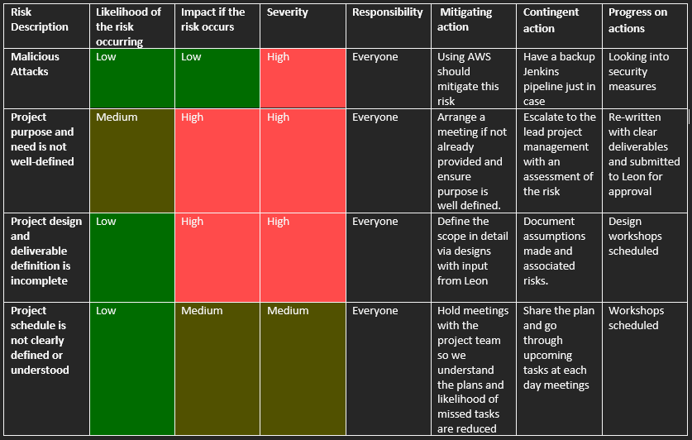
Risk Assessment

Slide 3
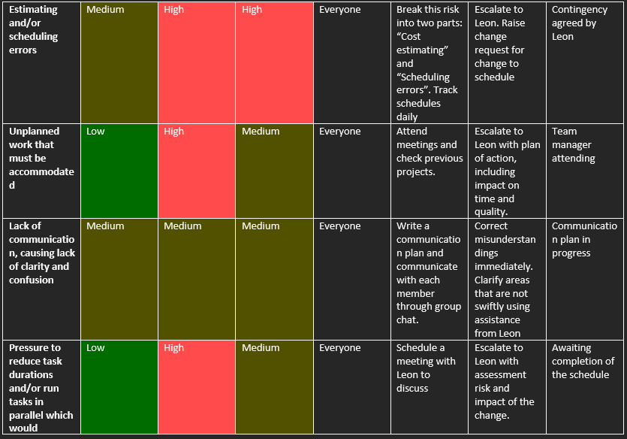
Risk Assessment cont.

Slide 4
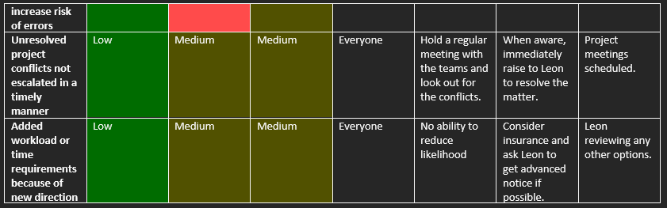
Risk Assessment cont.

Slide 5
Cost of the Project
Deploying the software requires at least a t2.small vm.
T2.small machine costs £0.017 an hour.
£0.41 a day.
Roughly £12.24 a month.
We would require 4 machines to deploy the application
Total maximum cost - £48.96 a month.

Slide 6
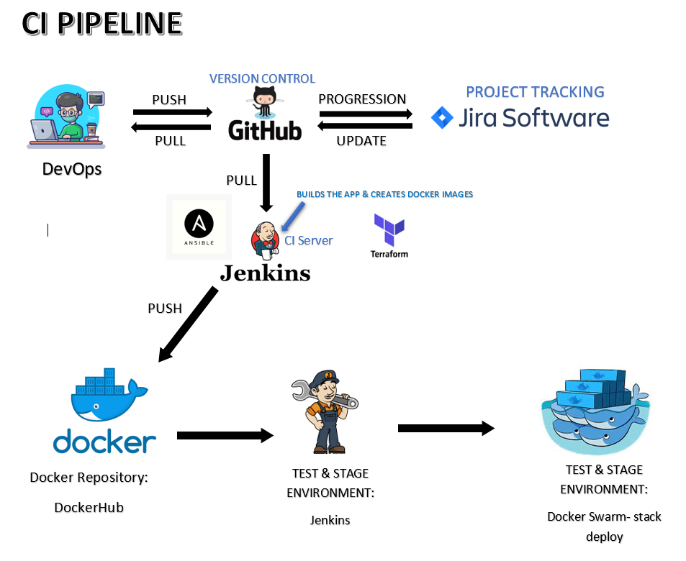
CI Pipeline

Slide 7
AWS
We used AWS to host our virtual machines.
We installed and got the application running manually first.
Makes for a remote site to host that is accessible to all of the developers to work on.

Slide 8
Jenkins Build
Jenkins is used to automatically update the application.
Updates when commits are made to the main branch.
Easier deployment and version control.

Slide 9
Ansible
Used to automate work throughout the infrastructure.
Invaluable to a system admin.
We specifically used the playbook.yaml.

Slide 10
Terraform
A tool to control infrastructure on a cloud service provider.
Means that environments will stay up to date.
Commonly used for; multi-tier applications, software demos, disposable environments and multi-cloud deployments.
Used it to set up and configure our vms in AWS.
Outputs an inventory.yaml containing vm IP addresses.

Slide 11
Docker
Container management software.
Used to create images, and containers.
Uses dockerfiles to automate this
We’ve used Docker to create and use images.

Slide 12
Docker Swarm
Docker swarm allows for multiple containers across multiple hosts.
Means that rolling updates can be applied.
We have used it for that purpose.

Slide 13
NGINX
Used for:
Web serving
Reverse proxying
Caching
Load balancing

Slide 14
Thank you for Listening

