Slide 1
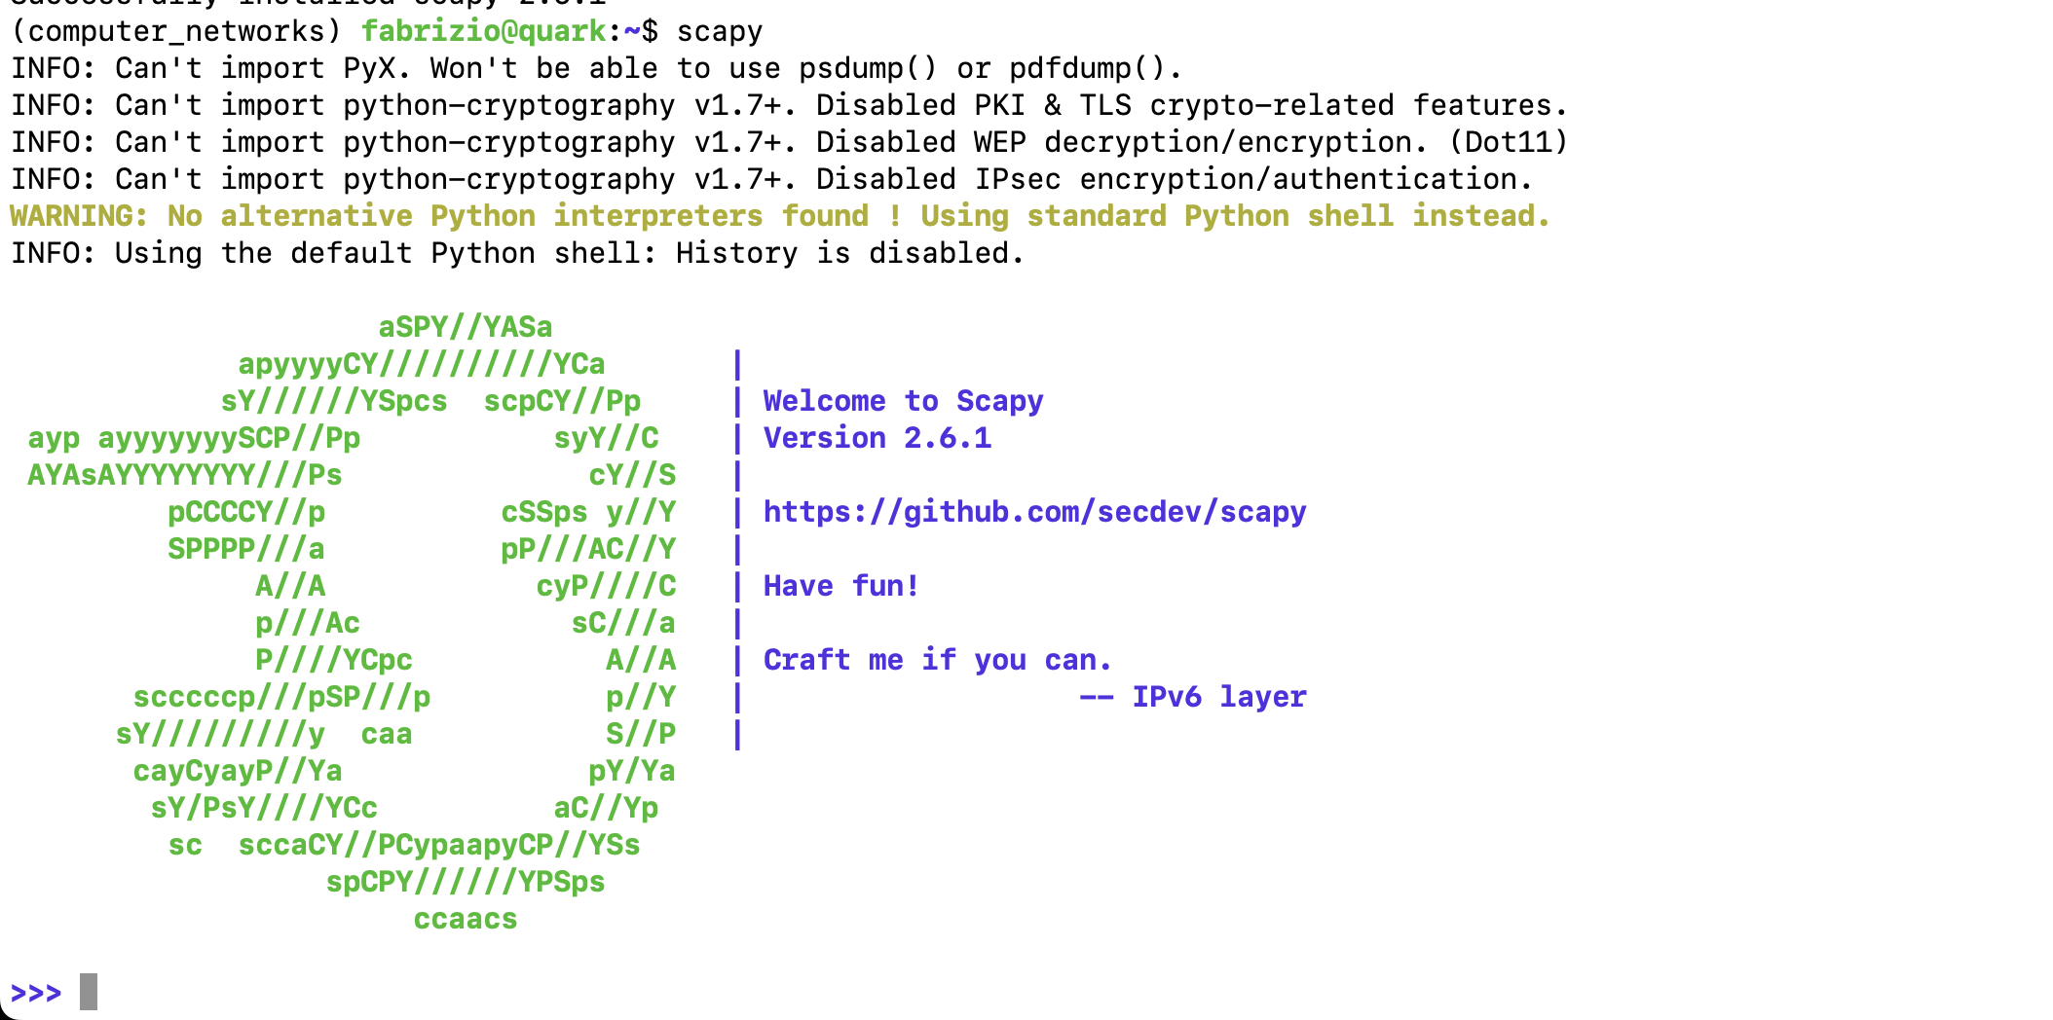
SCAPY
ref: https://scapy.readthedocs.io/en/latest/introduction.html

Slide 2
Objective
Explore python scapy package:
  Scapy network stack
  sniff (receive) packets
  send packets
  manipulate packets

Slide 3
Scapy Stack
Scapy maintains its own network stack
independent from the one of your operating system.
It possesses its own interfaces list, routing table, ARP cache, IPv6 neighbour cache, nameservers config… and so on, all of which is configurable.

Slide 4

Getting started
Insall scapy
pip install scapy
run scapy
# scapy

Slide 5
First example: Forge UDP packet (datagram ☺ )
Concept: help programmer to “see the stack”
First step: Packet forging
pkt = IP(dst="127.0.0.1") / UDP(dport=8888) / Raw(load=b”Hello World!!")
APP
UDP
IP

Slide 6
First example: send UDP packet (datagram ☺ )
Easy (too much easy…)
send(pkt)
?
APP
UDP
IP
SENDER

Slide 7
Sniffer (receiver)
Simply open another terminal (or a new tab in tmux)
easlily:
sniff(
iface="lo",
prn=lambda pkt: pkt.summary(),
filter= "udp dst port 8888”
)

Slide 8
Notes
for Linux users:
scapy works with admin privileges
a simple trick (if you’re working with conda)
$ conda activate your_env
$ sudo $(which scapy)

Slide 9
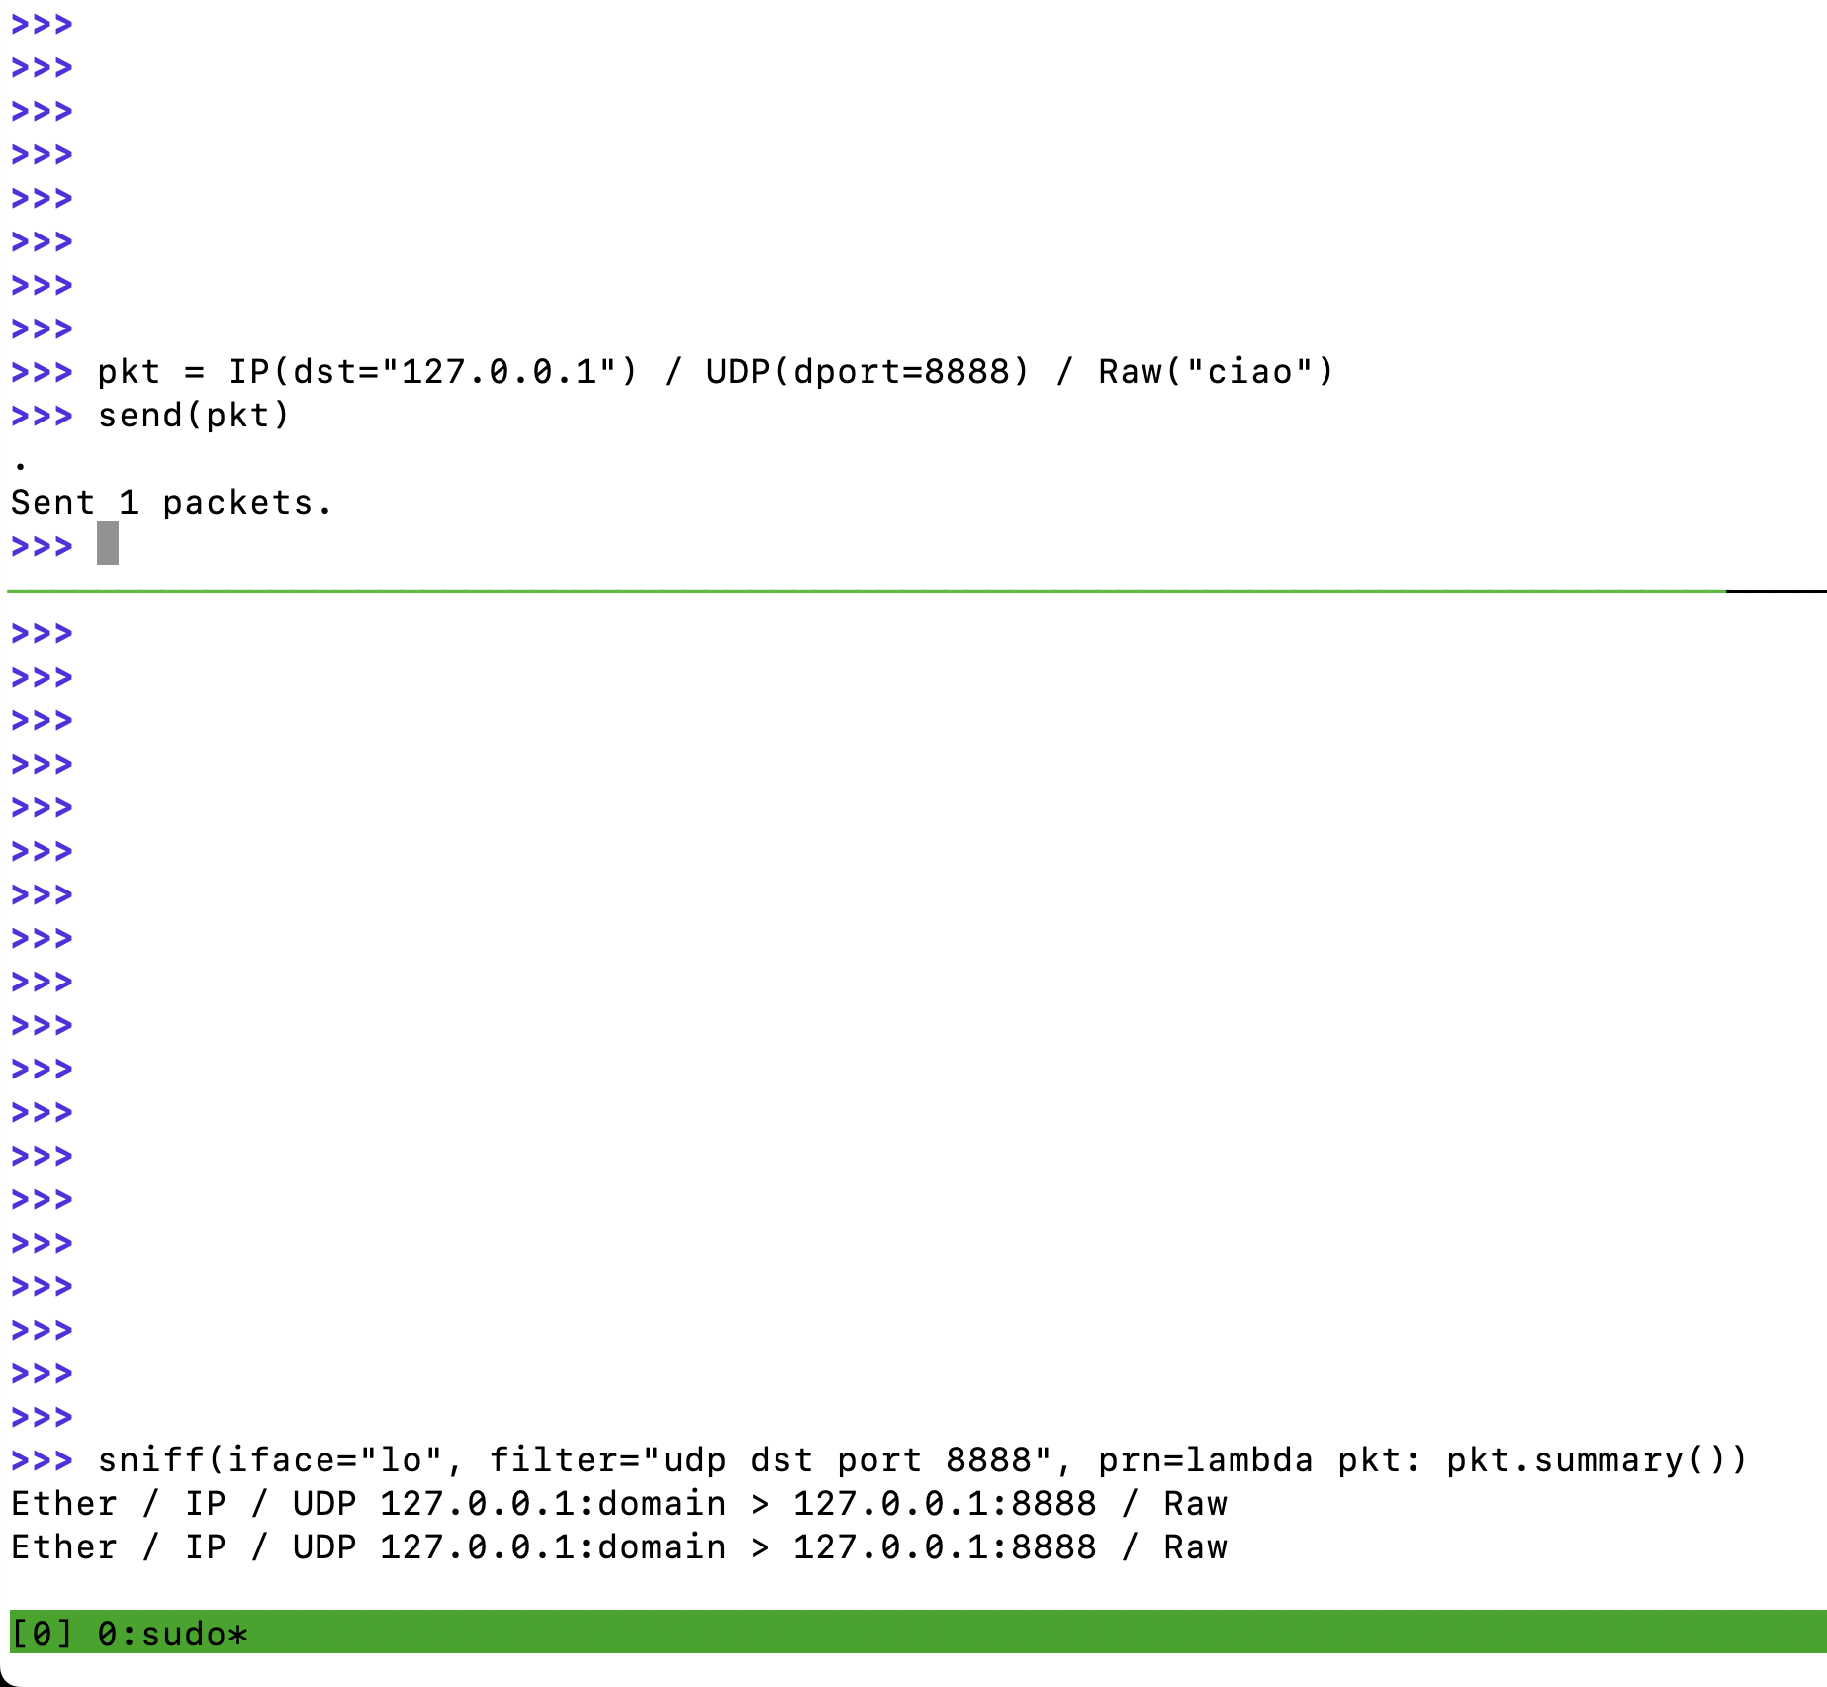
Try it!
Sent 1 packet…
Received 2 packets?
Q: why?
A: something under the hood

Slide 10
Exercise 1
On client side (sender)
build a UDP packet over IP
inspect useful fields (e.g. port header in UDP )
explore functionalities such as ls(), build(), show()
exploit some low-level trick (e.g. change on byte level an IP address)
create custom Application level payload
On server side (receiver)
Recycle what we did in 05_SOCKET

Slide 11
Exercise 2: Create a DNS request
Packet “idea”: IP(<something here…>) / UDP(…) / DNS ()
scapy DNS docs: scapy.readthedocs.io/en/latest/api/scapy.layers.dns.html
forge the DNS request
send a single “Send and Recive” (scapy has a function for this)

Slide 12
Exercise 3 – Custom Traceroute
Implement a scapy-based traceroute!
here we just need to exploit ”ttl” fields in IP level
TTL = TIME TO LIVE == max packet hops allowed
outcome expected:

