Slide 1
MIMIC-IV Dataset
QA Benchmark for Coverage
Diversity in RAG Retrieval

Slide 2
Outline
1. Why build a benchmark on medical data?
2. Coverage: Facility-Location objective
3. Ideal dataset for diversity
4. MIMIC-IV dataset
Overview
Motivations for coverage suitability
5. Experimental pipeline for building QA benchmark
2

Slide 3
Why Build a Benchmark on medical data?
▸ Need to show coverage wins when candidate pools have multi-cluster structure
▸ Medical data is multi-faceted
Aspects: diagnosis, treatment, complications, comorbidities
▸ Example of queries:
"How is pneumonia managed in elderly patients with CKD (Complex Kidney Disease)?“
“What are the symptoms of stroke, and how does the treatment differ if the patient has a prior history of myocardial infarction?"

Slide 4
Ideal Dataset for Diversity
Given a query, the ideal document pool candidates should have:
▸ Redundant central cluster: dominant topic, many similar documents
▸ Complementary cluster(s): other relevant aspects for the query
▸ Niche cluster: smaller set of relevant data points
▸ Outliers: noise, or genuine isolated points relevant to the query

Slide 5

Coverage: Facility-Location Objective
▸ Objective function
$$f\left(S\right)=λ\sum_{i ∈ S}{utility(i)}+ \left(1−λ\right)\sum_{i ∈ D}{\max_{j ∈ S}{sim(i, j)}}$$
Every item in the candidate pool D has a representative in S
Respects data distribution rather than maximizing spread between items
▸ Theoretical guarantees
g(S) is monotone submodular
Greedy selection gives (1 − 1/e) ≈ 0.632 approximation w.r.t. optimal solution
No such guarantee exists for dispersion (NP-hard)

Slide 6
MIMIC-IV Dataset Overview
▸ MIMIC-IV: tabular clinical data (diagnoses, procedures, meds, labs, measurements)
▸ MIMIC-IV-Note: free-text data
Discharge Summaries (~330K): in-depth notes which overview a patient’s history and course throughout a hospitalization
Radiology Reports (~2.3M): reports spanning x-ray, CT, MRI, and ultrasound
▸ Discharge summaries allow for design of multi-aspect queries requiring synthesis across patients
▸ Structured info in MIMIC-IV used for document pool construction and patient usable data
▸ All PHI removed/replaced with ___ placeholders

Slide 7
Ideal Dataset for Coverage: MIMIC-IV?
Cluster Type | Possible MIMIC-IV candidates
Redundant central cluster | Common conditions → hundreds of similar notes
Complementary cluster(s) | Comorbidity combos (pneumonia + CKD + diabetes) → distinct management sub-groups
Niche cluster | Rare complications (e.g., hemorrhagic stroke transformation) → few notes, unique reasoning
Outliers | ICD mismatches, boilerplate copies, de-id artifacts

Slide 8
MIMIC-IV-Note Discharge Summaries
Section | Content | QA Value
Brief Hospital Course | Clinical reasoning per problem | High
History of Present Illness | Symptom narrative, temporal progression | High
Pertinent Results | Labs, imaging, micro interpretations | High
Discharge Diagnosis | Diagnostic labels (linkable to ICD) | High
Chief Complaint | 1–2 lines, reason for admission | High (as embedding metadata)
Past Medical History | Comorbidities list | Medium
Surgical / Invasive Procedure Social / Family History Discharge Medications Physical Exams | Other minor pieces of information | Low

Slide 9
MIMIC-IV Structured Data
hosp module
Table | Content | Our use
diagnoses_icd | ICD-9/10 codes per admission, with seq_num priority | Ground truth labels + query scaffolding
d_icd_diagnoses | ICD code definitions (text descriptions) | Condition names for query templates
patients | Gender, age, date of death | Demographic prefix for embeddings
admissions | Admission type, insurance, race, discharge location | Demographic prefix for embeddings

Slide 10
Discharge summaries: what data to retain?
▸ Brief Hospital Course has highest QA value, but only for complex medicine admissions with # sub-problem lists
Complex cases: management reasoning, drug choices with justifications, differentials
▸ Surgical/simple cases: formulaic procedural timelines, nearly content-free
These are noise in any candidate pool: no clinical reasoning
▸ History of Present Illnesses complements BHC: presentation context, symptom timeline, risk factors that BHC presupposes
▸ Pertinent Results: mostly raw lab noise, but imaging interpretations can be high-value

Slide 11
Experimental Pipeline
corpus construction → embeddings → query generation → evaluation

Slide 12
Phase 1: Corpus Construction
Select conditions Query diagnoses_icd for ICD groups with ≥ N admissions
Parse and chunk documents Split Discharge Summaries by section header
Attach metadata Per chunk: section name, all ICD codes, demographics, admission type and details
Deduplicate
Output
Per-condition candidate pool D

Slide 13
Phase 2: Embeddings Generation
▸ Raw chunks are too patient-specific for condition-level queries
▸ Add context before chunks to capture full semantics
▸ MIMIC metadata is structured → deterministic template to build context
Chunk example
Elderly male, White, admitted for Sepsis (SOFA 14).
Chief complaint: fever, hypotension.
Comorbidities: CHF, CKD, COPD.
Section: Brief Hospital Course
<section_content>
▸ Alternative: whole-document embeddings via long-context embedding models, depending on which kind of queries we want to construct
“find patients similar to this case” rather than “what are the symptoms of X and how do they differ with Y”

Slide 14

Phase 3: Query Generation via LLM
▸ Pick primary condition + 1–2 modifier axes to ensure multi-aspect
Comorbidity: co-occurring ICD codes (e.g. stroke + diabetes)
Demographic: age group, gender, race, etc.
Complication: post-surgical, recurrent, or secondary diagnoses
▸ LLM prompt: generate clinical management question requiring modifier knowledge
▸ Pre-filter: only keep queries where coverage ≠ top-k
assess overall suitability of coverage approaches for this dataset with this embedding strategy
$Jaccard(S_{cov} ,{ S}_{top−k}) ≈ 1$ → skip
$g\left(S_{cov}\right)− g\left(S_{top−k}\right)<threshold$ → skip
▸ Gold answer generation: LLM cites source chunks, each tagged with facet label

Slide 15
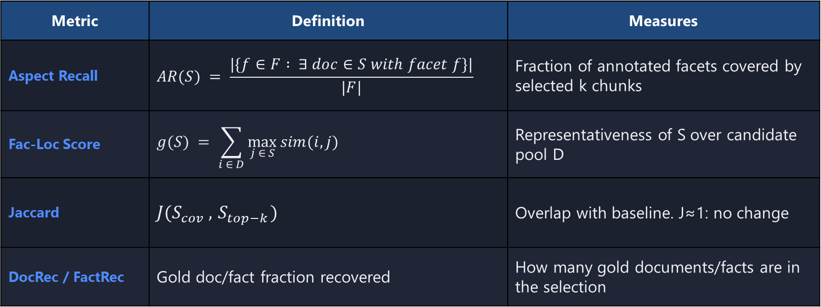
Phase 4: Evaluation
Metric | Definition | Measures
Aspect Recall | $$AR(S) = \frac{|\{f∈F : ∃ doc∈S with facet f\}|}{|F|}$$ | Fraction of annotated facets covered by selected k chunks
Fac-Loc Score | $$g(S) = \sum_{i ∈ D}{\max_{j ∈ S}{sim(i, j)}}$$ | Representativeness of S over candidate pool D
Jaccard | $$J(S_{cov} ,{ S}_{top−k})$$ | Overlap with baseline. J≈1: no change
DocRec / FactRec | Gold doc/fact fraction recovered | How many gold documents/facts are in the selection
Methods: top-k (baseline), MMR, gMMR, facility-location

Slide 16
Pros & Cons
Pros
Multi-aspect queries tailored to coverage hypothesis
Dataset seems suitable for coverage
Gold sets with facet labels enable granular evaluation metrics
Cons
Discharge notes may be complex to parse and interpret
De-identification detrimental for semantics
No guarantee about embedding distribution with the contextual prefix
Query is still LLM-generated
LLM gold annotation is expensive and noisy
Facet labels depend on LLM judgment
Local inference (DUA). Slower, smaller models
Many moving parts before first result
No existing benchmark to compare against
human validation?

Slide 17
End

Slide 18
Extras

Slide 19
Pipeline Overview
Phase | Name | Key Actions | Output
1 | Corpus Construction | Select ICD conditions, chunk notes by section + # markers, attach metadata, deduplicate | Per-condition candidate pools with metadata
2 | Embeddings Generation | Prepend metadata prefix (age, gender, ICD, chief complaint) before embedding | Contextualized chunk vectors
3 | Query Generation via LLM | LLM generates multi-aspect clinical questions; gold answers via map-reduce with facet labels | QA pairs with gold chunk sets
4 | Evaluation | Aspect recall, Fac score, Jaccard, DocRec/FactRec | Coverage vs. dispersion comparison

Slide 20
Key Parameters
Parameter | Meaning | Notes
λ | Relevance–diversity tradeoff | λ=1: pure top-k, λ=0: pure coverage
N | Candidate pool size for re-ranking | Too small: no room to diversify; too large: noise enters
k | Number of chunks to select | Final selection size
T_max | Token budget | Constrains total context length for LLM
chunk_tokens / stride | Chunk size and overlap | Controls granularity of information units

Slide 21
Gold Response Generation via LLMs
Map
▸ Split candidate pool into batches of ~50 chunks (~10K tokens)
▸ LLM extracts facts relevant to the query from each batch
▸ Each fact is cited back to its source chunk(s)
Reduce
▸ Merge pass synthesizes across all batches
▸ Deduplicate facets, resolve conflicting citations
▸ Final gold answer with citations + facet labels per chunk
Facet labels: Each gold chunk tagged with aspect (e.g., general_symptoms, cardiac_confounding, treatment_difference) → enables aspect recall metric
Quality verifier: Separate reader-LLM attempts top-k answer; if it succeeds → query too easy → discard

Slide 22
Computational Feasibility
▸ Full corpus: ~3M chunks → O(|D|·k²) facility-location is impractical
▸ Two-stage pipeline: HNSW retrieves N ≫ k candidates, then re-rank
▸ Re-ranking on N=100–1000 candidates is fast
▸ N is a tunable parameter alongside λ and k

Slide 23
Cluster Validation Approaches
▸ UMAP + HDBSCAN pipeline on embeddings
▸ Validate with DBCV, cluster size/density ratios, noise fraction
▸ Cross-reference clusters with ICD sub-codes for semantic meaning
▸ Simpler alternative: Jaccard divergence + facility-location gap + aspect recall
▸ Full clustering may not be necessary - downstream metrics are the real validation

Slide 24
Phase 2: Embedding models for medical domain
Model | Dim | Context
BioLORD-2023 | 768 | 512
MedEmbed (large) | 1024 | 512
BioClinical ModernBERT | 768 | 8,192

