Slide 1
MIMIC-IV Dataset
QA Benchmark for Coverage
Diversity in RAG Retrieval

Slide 2
Outline
Why build a benchmark on medical data?
Ideal dataset for diversity
Coverage: Facility-Location objective
MIMIC-IV dataset
Overview
Motivations for coverage suitability
Experimental pipeline for building QA benchmark
2

Slide 3
Why Build a Benchmark on medical data?
▸ Need to show coverage wins when candidate pools have multi-cluster structure
▸ Medical data is multi-faceted
Aspects: diagnosis, treatment, demographics, comorbidities
▸ Example of queries:
"How is pneumonia managed in elderly patients with CKD (Complex Kidney Disease)?“
“What are the symptoms of stroke, and how does the treatment differ if the patient has a prior history of myocardial infarction?"

Slide 4
Ideal Dataset for Diversity
Given a query, the ideal document pool candidates should have:
▸ Redundant central cluster: dominant topic, many similar documents
▸ Complementary cluster(s): other relevant aspects for the query
▸ Niche cluster: smaller set of relevant data points
▸ Outliers: noise, or genuine isolated points relevant to the query

Slide 5

Coverage: Facility-Location Objective
▸ Objective function
$$f\left(S\right)=λ\sum_{i ∈ S}{utility(i)}+ \left(1−λ\right)\sum_{i ∈ D}{\max_{j ∈ S}{sim(i, j)}}$$
Every item in the candidate pool D has a representative in S
Respects data distribution rather than maximizing spread between items
▸ Theoretical guarantees
g(S) is monotone submodular
Greedy selection gives (1 − 1/e) ≈ 0.632 approximation w.r.t. optimal solution
No such guarantee exists for dispersion (NP-hard)

Slide 6
MIMIC-IV Dataset Overview
▸ MIMIC-IV: tabular clinical data (diagnoses, procedures, meds, labs, measurements)
▸ MIMIC-IV-Note: free-text data
Discharge Summaries (~330K): in-depth notes which overview a patient’s history and course throughout a hospitalization
Radiology Reports (~2.3M): reports spanning x-ray, CT, MRI, and ultrasound
▸ Discharge summaries allow for design of multi-aspect queries requiring synthesis across patients
▸ Structured info in MIMIC-IV used for document pool construction and patient usable data
▸ De-identification: all PHI removed/replaced with ___ placeholders

Slide 7
Ideal Dataset for Coverage: MIMIC-IV?
Cluster Type | Possible MIMIC-IV candidates
Redundant central cluster | Common conditions → hundreds of similar notes
Complementary cluster(s) | Comorbidity combos (pneumonia + CKD + diabetes) → distinct management sub-groups
Niche cluster | Rare complications → few notes, unique reasoning
Outliers | ICD mismatches, boilerplate copies, noisy de-id artifacts

Slide 8
MIMIC-IV-Note Discharge Summaries
Section | Content | QA Value
Brief Hospital Course | Clinical reasoning per problem | High
History of Present Illness | Symptom narrative, temporal progression | High
Pertinent Results | Labs, imaging, micro interpretations | High
Discharge Diagnosis | Diagnostic labels (linkable to ICD) | High
Chief Complaint | 1–2 lines, reason for admission | High (as embedding metadata)
Past Medical History | Comorbidities list | Medium
Surgical / Invasive Procedure Social / Family History Discharge Medications Physical Exams | Other minor pieces of information | Low

Slide 9
MIMIC-IV Structured Data
hosp module
Table | Content | Our use
diagnoses_icd | ICD-9/10 codes per admission, with seq_num priority | ICD labels + query scaffolding
d_icd_diagnoses | ICD code definitions (text descriptions) | Condition names for query templates
patients + admissions | Gender, age, date of death, admission type, insurance, race, discharge location | Patient data for additional context

Slide 10
Discharge summaries: what data to retain?
▸ Brief Hospital Course has highest QA value for complex medicine admissions with # sub-problem lists
Complex cases: management reasoning, drug choices with justifications, differentials
▸ Surgical/simple cases: formulaic procedural timelines, nearly content-free
These are noise in any candidate pool: no clinical reasoning
▸ History of Present Illnesses complements BHC: presentation context, symptom timeline, risk factors that BHC presupposes
▸ Pertinent Results: mostly raw lab noise, but imaging interpretations can be high-value

Slide 11
Experimental Pipeline
corpus construction → embeddings → query generation → evaluation

Slide 12
Phase 1: Corpus Construction
Select conditions Query diagnoses_icd for ICD groups with ≥ N admissions
Parse and chunk documents Split Discharge Summaries by section header
Attach metadata Per chunk: section name, all ICD codes, demographics, admission type and details
Deduplicate
Output
Per-condition candidate pool D

Slide 13
Phase 2: Embeddings Generation
▸ Raw chunks are too patient-specific for condition-level queries
▸ Add context before chunks to capture full semantics
▸ MIMIC metadata is structured → deterministic template to build context
Chunk example
Elderly male, White, admitted for Sepsis (SOFA 14).
Chief complaint: fever, hypotension.
Comorbidities: CHF, CKD, COPD.
Section: Brief Hospital Course
<section_content>

Slide 14

Phase 3: Query Generation via LLM
▸ Pick primary condition + 1–2 modifier axes to ensure multi-aspect
Comorbidity: co-occurring ICD codes (e.g. stroke + diabetes)
Demographic: age group, gender, race, etc.
Complication: post-surgical, recurrent, or secondary diagnoses
▸ LLM prompt: generate clinical management question requiring modifier knowledge
▸ Pre-filter: only keep queries where coverage ≠ top-k
assess overall suitability of coverage approaches for this dataset with this embedding strategy
$Jaccard(S_{cov} ,{ S}_{top−k}) ≈ 1$ → skip
$g\left(S_{cov}\right)− g\left(S_{top−k}\right)<threshold$ → skip
▸ Gold answer generation: LLM cites source chunks, each tagged with facet label

Slide 15
[
"In patients with Type 2 diabetes and advanced kidney disease, how do clinicians manage the transition between pharmacological management of glycemic control and the initiation of renal replacement therapy, such as dialysis, and what specific lab values or symptoms typically trigger these changes?",
{
"fact": "Clinicians discontinue or hold oral hypoglycemics like metformin and glipizide in the setting of renal failure or decreased renal clearance to avoid complications such as lactic acidosis or hypoglycemia.",
"facet_label": "pharmacological_transition_renal_failure",
"chunk_ids": [ 50962, 101542, 32657… ]
]
},
{
"fact": "Insulin doses are downtitrated or reduced when renal failure is present due to decreased renal clearance of insulin, which increases the risk of hypoglycemia.",
"facet_label": "insulin_dose_adjustment_renal_failure",
"chunk_ids": [ … ]
},
{
"fact": "Some patients completely cease the use of insulin or other diabetes medications upon the initiation of dialysis.",
"facet_label": "dialysis_impact_on_glycemic_management",
"chunk_ids": [ … ]
},
{
"fact": "Specific triggers for adjusting diabetes medications include severe hypoglycemia (e.g., BG 27-40), acute kidney injury (elevated creatinine), and the initiation of renal replacement therapy.",
"facet_label": "triggers_for_medication_change",
"chunk_ids": [ … ]
}
]

Slide 16
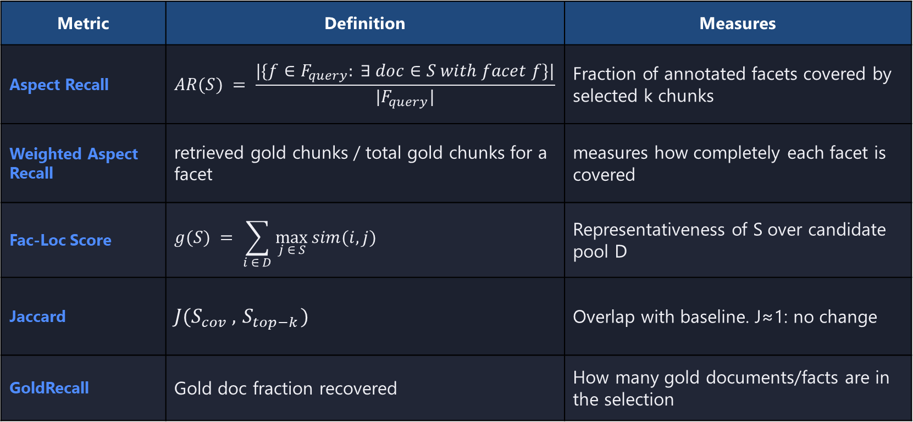
Phase 4: Evaluation
Methods: top-k (baseline), MMR, gMMR, facility-location
Metric | Definition | Measures
Aspect Recall | $$AR(S) = \frac{|\{f∈F_{query}: ∃ doc∈S with facet f\}|}{|F_{query}|}$$ | Fraction of annotated facets covered by selected k chunks
Weighted Aspect Recall | retrieved gold chunks / total gold chunks for a facet | measures how completely each facet is covered
Fac-Loc Score | $$g(S) = \sum_{i ∈ D}{\max_{j ∈ S}{sim(i, j)}}$$ | Representativeness of S over candidate pool D
Jaccard | $$J(S_{cov} ,{ S}_{top−k})$$ | Overlap with baseline. J≈1: no change
GoldRecall | Gold doc fraction recovered | How many gold documents/facts are in the selection

Slide 17
Pros & Cons
Pros
Multi-aspect queries tailored to coverage hypothesis
Dataset seems suitable for coverage
Gold sets with facet labels enable granular evaluation metrics
Cons
Discharge notes may be complex to parse and interpret
De-identification detrimental for semantics
No guarantee about embedding distribution with the contextual prefix
Query is still LLM-generated
LLM gold annotation is expensive and noisy
Facet labels depend on LLM judgment
Local inference (DUA). Slower, smaller models
Many moving parts before first result
No existing benchmark to compare against
human validation?

Slide 18
End

Slide 19
Extras

Slide 20
Pipeline Overview
Phase | Name | Key Actions | Output
1 | Corpus Construction | Select ICD conditions, chunk notes by section, attach metadata, deduplicate | Per-condition candidate pools with metadata
2 | Embeddings Generation | Prepend metadata prefix before embedding | Contextualized chunk vectors
3 | Query Generation via LLM | LLM generates multi-aspect clinical questions; gold answers with facet labels | QA pairs with gold chunk sets
4 | Evaluation | Aspect recall, Fac score, Jaccard, DocRec/FactRec | Coverage vs. dispersion comparison

Slide 21
Key Parameters
Parameter | Meaning | Notes
λ | Relevance–diversity tradeoff | λ=1: pure top-k, λ=0: pure coverage
N | Candidate pool size for re-ranking | Too small: no room to diversify; too large: noise enters
k | Number of chunks to select | Final selection size
T_max | Token budget | Constrains total context length for LLM
chunk_tokens / stride | Chunk size and overlap | Controls granularity of information units

Slide 22
Gold Response Generation via LLMs
Map
▸ Split candidate pool into batches of ~50 chunks (~10K tokens)
▸ LLM extracts facts relevant to the query from each batch
▸ Each fact is cited back to its source chunk(s)
Reduce
▸ Merge pass synthesizes across all batches
▸ Deduplicate facets, resolve conflicting citations
▸ Final gold answer with citations + facet labels per chunk
Facet labels: Each gold chunk tagged with aspect (e.g., general_symptoms, cardiac_confounding, treatment_difference) → enables aspect recall metric
Quality verifier: Separate reader-LLM attempts top-k answer; if it succeeds → query too easy → discard

Slide 23
Computational Feasibility
▸ Full corpus: ~3M chunks → O(|D|·k²) facility-location is impractical
▸ Two-stage pipeline: HNSW retrieves N ≫ k candidates, then re-rank
▸ Re-ranking on N=100–1000 candidates is fast
▸ N is a tunable parameter alongside λ and k
▸ Alternative: build sub-corpuses with limited scope, adding also distractors (like HotpotQA and 2WikiMultihopQA)

Slide 24
Cluster Validation Approaches
▸ UMAP + HDBSCAN pipeline on embeddings
▸ Validate with DBCV, cluster size/density ratios, noise fraction
▸ Cross-reference clusters with ICD sub-codes for semantic meaning
▸ Simpler alternative: Jaccard divergence + facility-location gap + aspect recall
▸ Full clustering may not be necessary - downstream metrics are the real validation

Slide 25
Phase 2: Embedding models for medical domain
Model | Dim | Context
BioLORD-2023 | 768 | 512
MedEmbed (large) | 1024 | 512
BioClinical ModernBERT | 768 | 8,192

