Slide 1
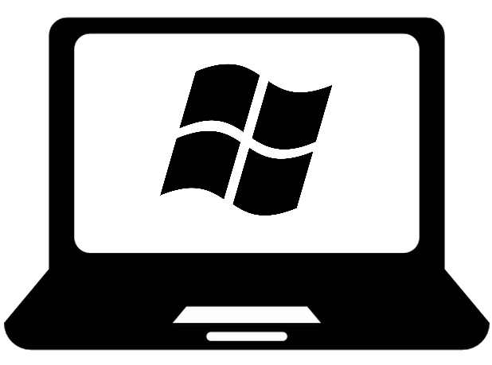
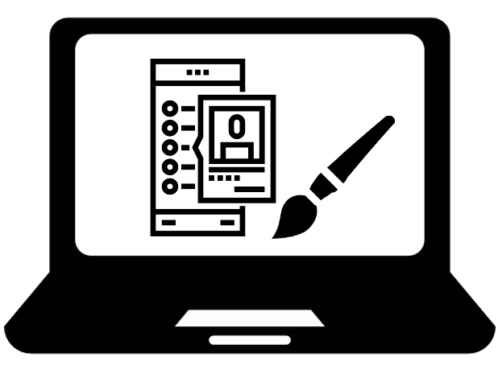





Qwirk - MVC Pattern
Clients
View
Controller
Controller
Model
Request
Queries
Server
Data or Errors
Notify

