Slide 1


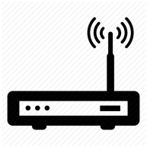


New York DC
Physical Topology
Client
Internet
Toronto DC
Dallas DC

Slide 2


Client
Active/Passive
IP Cluster
Active/Active
IP Cluster
ny-frontend
ny-node1
Synced
Protocol C
Internet
Stacked
Protocol A
tx-frontend
tx-node1
Logical Topology

