Slide 1
HIBI Overview
Heterogeneous IP Block Interconnection
Tampere University of Techonoloy
Erno Salminen, November 2009

Slide 2
Contents
Objectives
HIBI in a nutshell
Connecting IP to HIBI network
Summary

Slide 3
HIBI objectives - Implementation
Lowest level data transfer mechanisms simple and efficient
  Perform all high-level operations above basic mechanisms
Use identical HW modules to build the network
  Syntesiable (soft core IP itself)
(Re)configurable
  Fit to all communication needs
    peripherals, processors, I/O…
  Change properties on the fly

Slide 4
HIBI objectives – At system design time
Fit network to application requirements
  Profiles, model analyses
Optimize & set non-reconfigurable parameters
  Topology, network segment widths,…
Initialize/fix run-time configurable parameters
  Quality of Service and other transfer parameters

Slide 5
HIBI objectives - At system runtime
Make network aware of application(s) phases
Utilize knowledge of predictable communication events if available
  Guaranteed QoS in transfers
Monitor communication
  Change QoS parameters if required
  Totally change mode of operation if required

Slide 6
HIBI in a nutshell

Slide 7
HIBI identical interconnection modules
HIBI wrapper is the only building block used everywhere in interconnection
  Between network and IP-blocks
  Between network segments
Wrapper is parametrizable, modular, and configurable
Asyncronous FIFO buffering
HIBI network
HIBI
wrapper
HIBI
Wrapper
HIBI
Wrapper
HIBI
Wrapper
HIBI
Wrapper
HIBI
Wrapper
HIBI
Wrapper
FIFO interface
P₁
...
P_{N}
Mem₁
...
Mem_{N}
Acc₁
...
Acc_{N}
IP

Slide 8
HIBI network
HIBI network consists of bus segments and bridges
  Transfers in segment synchronous circuit switched
  Transfers across bridges asynchronous packet switched
  Scales from serial point-to-point link to an arbitrary topology
Identical signals between wrappers in network side
  No dedicated point-to-point signals
    All signals shared within network segment
  Wrapper layout is independent of the number of agents
Totally distributed arbitration
  No central arbiter
  Each wrapper is aware of communication details

Slide 9
HIBI network example
IP BLOCK
IP BLOCK
IP BLOCK
IP BLOCK
HIBI
Wrapper
HIBI
Wrapper
HIBI
Wrapper
HIBI
Wrapper
Bridge
HIBI
Wrapper
HIBI
Wrapper
HIBI
Wrapper
HIBI
Wrapper
HIBI
Wrapper
HIBI
Wrapper
HIBI
Wrapper
HIBI
Wrapper
IP BLOCK
IP BLOCK
IP BLOCK
IP BLOCK
IP BLOCK
IP BLOCK
HIBI
Wrapper
HIBI
Wrapper
HIBI
Wrapper
Clock domain
Two point-to-point wrappers are actually removed to or replaced by synchronizing FIFOs
Notes:
ANIMAATIO

Slide 10
HIBI wrapper structure
IP’s tx signals
IP’s rx signals
High prior data is optional
HI prior
tx FIFO
LO prior
tx FIFO
HI prior
rx FIFO
LO prior
rx FIFO
Mux
Demux
Config
mem
Addr
decoder
Tx FSM
Rx FSM
bus signals out
bus signals in

Slide 11
Bus signals (network side)
Signal | Width | Dir. | Meaning
data | generic | i+o | Data and address are multiplexed into single set of wires
av | 1 | i+o | Address valid. Notifies when address is transmitted
cmd | 3 | i+o | Command: read or write, data or configuration etc.
full | 1 | i+o | Target wrapper is full and cannot accept the data. Current transfer must be repeated later
lock | 1 | i+o | Bus is reserved
All outputs from wrappers are ”ORed” together
OR-gates’ outputs are connected to all wrappers’ inputs

Slide 12
Basic transfer
Burst transfers: 1 address + n data words
  Max. n in wrapper-specific
No wait cycles allowed in the bus, but IP can write data in any pace it wishes
Transfer is pipelined with arbitration
Split-transactions: separate reqeust and response
HIBI bus signals
av
cmd
data/addr
Colors denote different IP blocks
rd
rd
wr
wr
wr
wr
wr
...
rq addr
ret addr
w addr
w data
w data
ret addr
rq data
...
t
split transaction

Slide 13
Arbitration
Arbitration decides current bus owner
Multiple policies
  Fixed priority, Round-robin
  Dynamically adaptive arbitration (DAA)
  Time-division multiple access (TDMA)
  Random, Combination of above
Distributed: all wrappers decides by themselves, when to access
  No req/grant siganlling or central arbiter
Bus is ”offered” to one wrapper on each cycle

Slide 14
Connecting IP to HIBI network

Slide 15
Signals at HIBI
More or less the same signals at IP (=or agent) and bus side
All signals are unidirectional. Either
  From IP to wrapper or from wrapper to IP
  From wrapper to bus or from bus to wrapper
The side and direction are marked into signal name in VHDL
  agent_data_in, agent_data_out,
  bus_data_in, bus_data_out

Slide 16
Signal categories at IP interface
Data (and address/av)
  Driven by both IP and HIBI
  May have high and low priotities
Control signals: command, write enable, read enable
  Driven by IP
Status signals
  Driven by HIBI
  Always used: FIFO full and FIFO empty
  Can be used: one data left at FIFO, one place left at FIFO

Slide 17
Signals at IP interface
All output signals of the wrapper come from registers
Interface signals are connected to FIFO buffers inside the wrapper
Simplified view:
n+3
data + cmd
IP (aka. agent)
HIBI wrapper
Tx signals: IP sends data to network
address valid
write enable
full
bus
data, cmd
n+3
Rx signals: IP receives data from network
address valid
read enable
empty

Slide 18
HIBI signals on IP side
Signal | Width [bits] | Dir. | Meaning
rst_n | 1 | i | Active low reset
clk | 1 | i | Clock, active on rising edge. Same for all wrappers inside one segment
data | gen. | i+o | Data and address are multiplexed into single set of wires
av | 1 | i+o | Address valid. Notifies when address is transmitted
cmd | 3 | i+o | Command: read or write, data or configuration etc.
re | 1 | i | Read enable. Removes the first data from RX FIFO
we | 1 | i | Write enable. Adds the data from IP to TX FIFO
full | 1 | o | Tx FIFO is full
empty | 1 | o | Rx FIFO is empty
one_p | 1 | o | Tx FIFO is almost full; only one place is left
one_d | 1 | o | Rx FIFO is almost empty; only one data is left

Slide 19
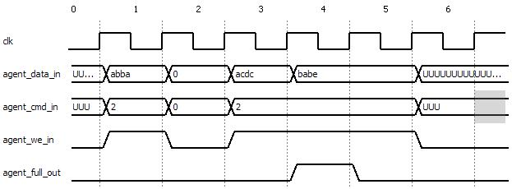
Basic signal timing when transmitting
IP checks that tx FIFO is not full
IP sets data, command, addr/av, and write_enable=1 for one clk cycle
Addr/AV not shown in figure
1st data written to TX FIFO
3rd data written to TX FIFO
2nd data written to TX FIFO, FIFO becomes full
FIFO is now full, nothing written

Slide 20
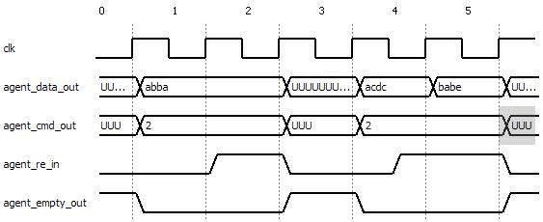
Basic signal timing when receiving
IP checks that rx FIFO is not empty
IP captures data, command, and addr/av
IP sets read_enable=1 for one clk cycle
Addr/AV not shown in figure
1st data arrives
2nd data arrives and IP sets re combinatorially
3rd data arrives and it is read immediately, FIFO is now empty again
1st data removed from rxFIFO, FIFO becomes empty

Slide 21
Notes on signal timing
Very easy to write/read on every other cycle
Almost as easy to write/read on every cycle
  Needs more care with checking empty and full
Signal FIFO full comes from register
  It goes high on the next cycle after the write, if at all
  For example, writing 0xacdc filled the FIFO
Setting we=1 when FIFO is full has no effect
Setting re=1 when FIFO is empty has no effect

Slide 22
Notes on signal timing (2)
Received data, addr/av and command appear to interface, if FIFO was empty before
  IP can use them directly
  They are removed only when read enable is activated
  Checking empty==0 ensures validity
Data and command values are undefined when FIFO is empty
  Most likely the old values remain
IP may keep we=1 and re=1 continuously
  Change/store data according to full/empty

Slide 23
Common pitfalls
Not noticing that tx FIFO fills while writing
  Consequence: Some data are lost (not written to FIFO)
Write enable remains 1 for one cycle too long
  Undefined data written to FIFO, or the same data is written twice
  In both of above, the likely cause is not acocunting to output register of the IP.

Slide 24
Common pitfalls
Not noticing that rx FIFO goes empty while reading
  Data consumed by IP is undefined
Read enable remains 1 for one cycle too long
  Next data is accidentally read away from the FIFO unless FIFO was empty
Not noticing that rx data changes only after the clock edge when re=1
  IP uses the same data twice

Slide 25
VHDL example
Simple example code can be found in SVN
  /release_1/lib/hw_lib/ips/computation/image_xor/tb/tb_image_xor_linemaker.vhd
It shows how to
  send address and data
    However, address sending does not check FIFO full
  read the received data
not (two_lines_sent)
OK and all_read
OK and not (all read)
always
start
always
send_lines
two_lines_sent
verify_result
not (OK)
done
Write the dst address
Send test data to XOR
Read the results
Do nothing

Slide 26
VHDL example (2)
Sometimes the output registers of the IP may cause unexpected behavior
  Even if FIFO is not full, IP cannot necesarily write new data. That happens if it is already writing and there is only one place left at the FIFO
Remember to check if IP is already writing!
  if (we_r =’1’ and one_p_in=’1’) or full_in =’0’ then
    we_r <= ’0’; //FIFO becoming or already full
  else
    we_r <= ’1’; // There is room in FIFO
    data_r <= new_value;

Slide 27
VHDL example (3)
HIBI wrapper shows the data as soon as it comes from the bus
  Same data might get used (counted) twice, if IP only checks the empty signal
Remember to check if IP is already reading!
  if (re_r = '1' and one_d_in = '1') or empty_in = '1' then
    re_r <= '0'; // Stop reading
  else
    re_r <= '1'; // Start or continue reading
  end if;
  if re_r = '1' then
    if hibi_av_in = '0' then
      // handle the incoming address
    else
      // handle the incoming data

Slide 28
IP interface variants
There are 4 variants of the interface
Depending on how to handle
  high/low priority data: one or two interfaces
  address and data: separate interfaces or one multiplexed
r1: a) 2 interfaces hi+lo; b) muxed a/d
r2: a) 1 interface hi/lo; b) separate a+d
r3: a) 2 interfaces hi+lo; b) separate a+d
r4: a) 1 interface hi/lo; b) muxed a/d

Slide 29
IP interface variants (2)
IP
IP
data
cmd
empty
re
data
cmd
empty
re
hi
lo
hi
lo
av
one_d
hi
lo
hi
lo
one_d
addr
hibi_wrapper_r1
hibi_wrapper_r3
All wrapper types contain r1 inside them
IP
IP
lo
lo
lo
lo
data
cmd
empty
re
data
cmd
empty
re
hibi_wrapper_r2
addr
one_d
one_d
hibi_wrapper_r4
av
r4 is the most common in TUT

Slide 30
HIBI commands
Source IP sets the command
Most commands are forwarded to the receiving IP
8 commands possible with 3 bits
  (4 bits command has been planned in order to have complete set)
Most common
  Write data - regular send operation
  Read request
    Split-transaction, the requested data is returned later with regular write command
    Read request in always: 1 dst address + 1 address where to return the requested data

Slide 31
HIBI commands (2)
Less common
  Idle – IPs never use this command, but this appears on the bus when no-one sends anything
  Write hi-prior data – bypasses lo-prior data in the wrappers, otherwise just like regular send operation
  Write config, read config – access the configuration memories inside the wrappers. Not forwarded to the IP at the receiving end
  Multicast data, multicast hi-prior data – send the same data to multiple targets

Slide 32
Addressing
Every transfer starts with single address
Every wrappers has a set of addresses
  Set with a VHDL generic
  Wrappers may have varying address space sizes
  E.g. UART has only 2 addresses, memory has 16K addresses
Addresses go through the receiving wrapper to the receiving IP
  IP can identify the incoming data by its address
Two ways to set them
  manually
  use tcl script to calculate

Slide 33
Addressing (2)
Based on bit masks
Wrappers compare only the uppermost bits of the incoming address
  Number of mask bits is wrapper-specific
  More mask bits, less addresses and vice versa
  The size of the mask defines the lowermost ’1’-bit on wrapper’s own address
Example:
HIBI wrapper
bus side
IP side
IP gets only the data that are preceeded by an address within range 0xF000-0XFFF. Hence, this IP’s address space is 12 bits, 0xFFF = 4096 addresses
data/addr
own_addr_g 0xF000
data/addr
Address bits are 0b111100...0. Hence, the 4 uppermost bits are compared
data/addr
data/addr

Slide 34
Addressing and bursts
IP may write arbitrarily long bursts to wrapper
  Perhaps only one address in the beginning followed by arbitrary number of data words. There can be any number of idle cycles between data words
Bursts that wrappper sends to bus do not necessarily have the same length as those from IP
  Wrapper may send many short IP-transfers consecutively at one turn
  Wrapper may split long IP-transfer into multiple bus transfers

Slide 35
Addressing and bursts (2)
Consequence1:
  Bursts from multiple source IP will be interleaved
Consequence2:
  Destination may get different number of addresses than sender
Due to multiplexed addr/data lines, it is beneficial to send many data into single address
  In contrast to ”traditional” memory accesses, with address and data at the same time
  The destination IP should keep track of received data count
    E.g. TUT’s SDRAM controller can do this to avoid excess transmitting addr + data pairs
Destination does not know the sender unless it is separately encoded into data or address

Slide 36
Generic values of a wrapper
Wrappers have many generic parameters
Stuctural
  Widths of interface ports: data, command, debug port
  Widths of internal signals: address, wrapper identifier field, counters
  Sizes of tx and rx FIFOs, both lo and hi priorities
    Use 0, 2, 3 etc.
  Run-time configuration: number of cfg pages,
Synchronization
  Type of the synchronizing FIFO buffers
  Relative frequencies of IP and bus

Slide 37
Generic values of a wrapper (3)
Functional
  Identifier, own address
    For bridges: base identifier, inverted address space ’
  Arbitration: type, priority, how many words to at one turn, number of agents in the same segment
    For TDMA: number of time slots, how to handle unused slots (keep/give away)
  Enable/disable multicast functionality
  Enable/disable runtime configuration functionality (affects structure=area as well)

Slide 38
Special clocking
HIBI can support may clock domains
Domain border can be
  between IP and wrapper
  in the middle of a bridge
HIBI supports many syncronization styles for clock domain crossing
  Synchronous multi-clock
  GALS (globally asynchronous, locally synchronous)
  Gray FIFO
  Mixed clock pausible
  User must set few generic parameters

Slide 39
Special clocking (2)
Synchronous multi-clk:
  Clock frequencies are integer-multiples of each other
  Clocks are in the same phase
  Easy to use with FPGA’s PLLs
GALS
  No assumptions about relations between clocks
  Has longer synch. latency than synch.multiclock
Gray
  FIFO depth limited to power of two (=2^n)
Mixed clock pausible

Slide 40
Summary

Slide 41
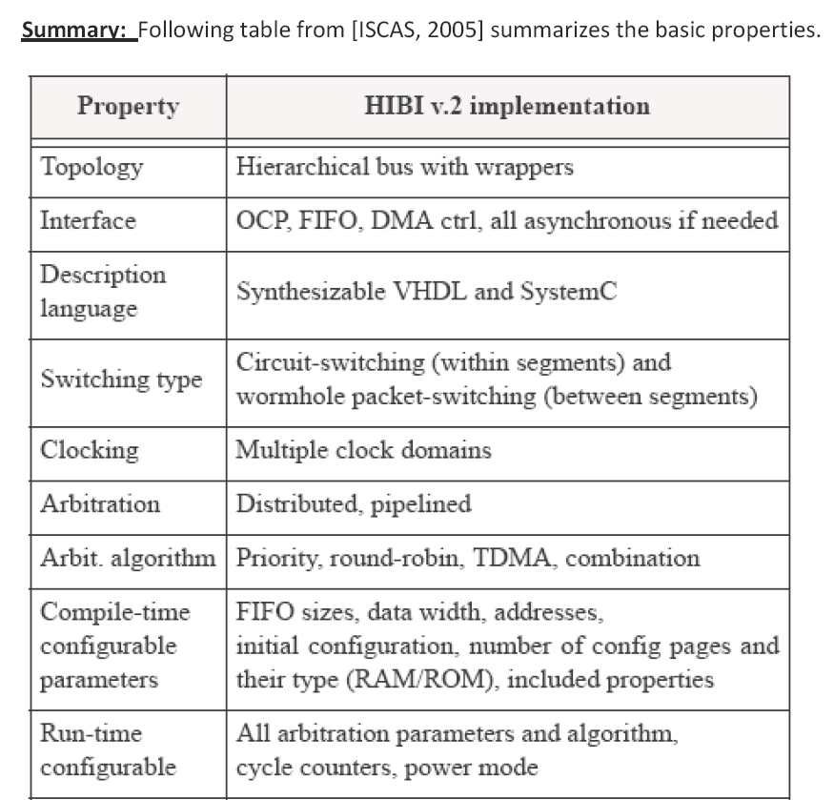

Slide 42
