Slide 1
High-Throughput Pipelined Mergesort
Kermin Fleming
Myron King
Man Cheuk Ng
Asif Khan
Muralidaran Vijayaraghavan
6/6/2008

Slide 2

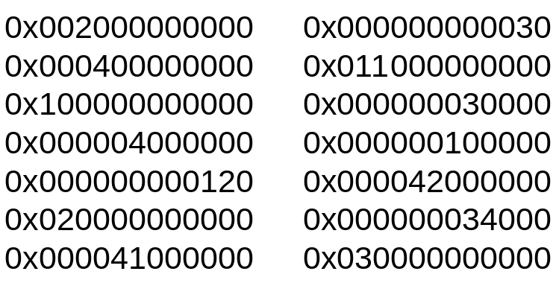
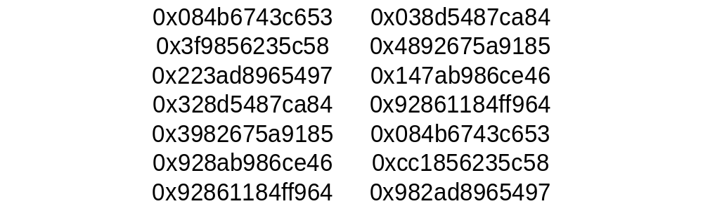
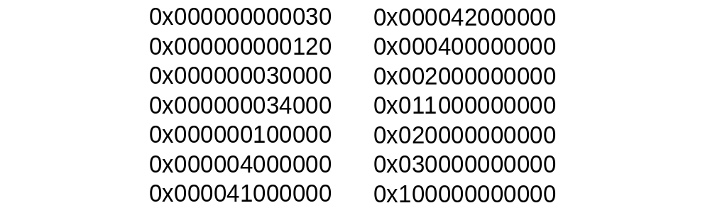
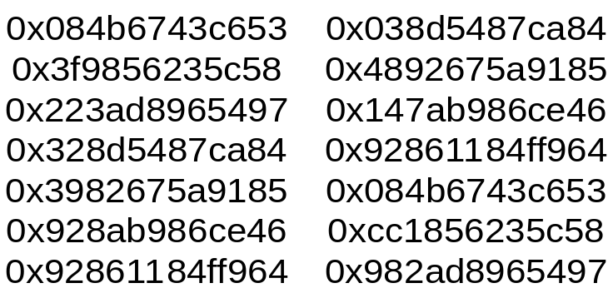
Problem Description
Cryptosorter
Encrypted Records in External Memory
Sort Records in Ascending Order
Decrypt Database with AES
Encrypt Sorted Records with AES
6/6/2008

Slide 3
Rapid IP Development
Reuse Existing IP
  MEMOCODE Submission ’07
  AES core from OpenCores
Latency Insensitive Interface
  Decoupled Request-Response for all interfaces
  Deadlock prevention: guaranteed Response proccessing
Parametric module design
  Bottlenecks unclear
  Tune design quickly
6/6/2008

Slide 4
IP Reuse: System ‘07
PLB
Highlight features:
  PLB Master supports long-burst transfers
  PPC sends commands to FU via Feeder
Working device drivers
Can we reuse most of the components?
PPC
PLB
Master
DRAM
Feeder
Function Unit:
Matrix
Multiplier
Xilinx IP
Our IP
6/6/2008

Slide 5
IP Reuse: System ‘08
PLB
Everything except the FU is reused
  PLB Master fetches 128b database records
  PPC informs FU size of databse via Feeder
  Testing infrastructure for PLB and Feeder
PPC
PLB
Master
DRAM
Feeder
Function Unit:
Crypto-Sort
Tree
Xilinx IP
Reused IP
New IP
6/6/2008

Slide 6
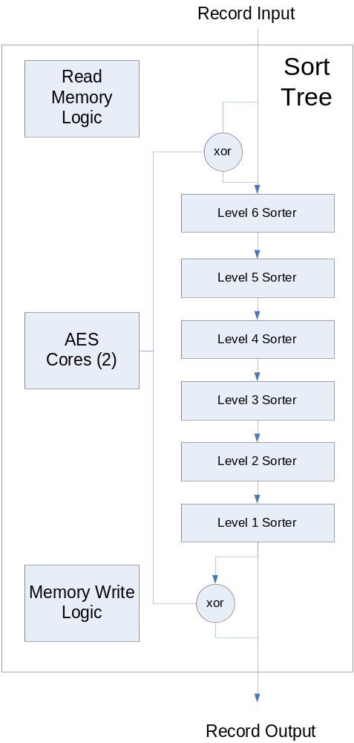
System ‘08
PLB
PPC
PLB
Master
DRAM
Feeder
Function Unit:
Sort Tree
Xilinx IP
Reused IP
New IP
6/6/2008

Slide 7
System ‘08
Algorithm: Merge Sort
  O(nlogn) complexity
  Simple control
Main challenge: deep tree
  Exploit on-chip data locality
    Log2^{k}(n) passes if k-deep
  Serious engineering problems for lower-level
6/6/2008

Slide 8
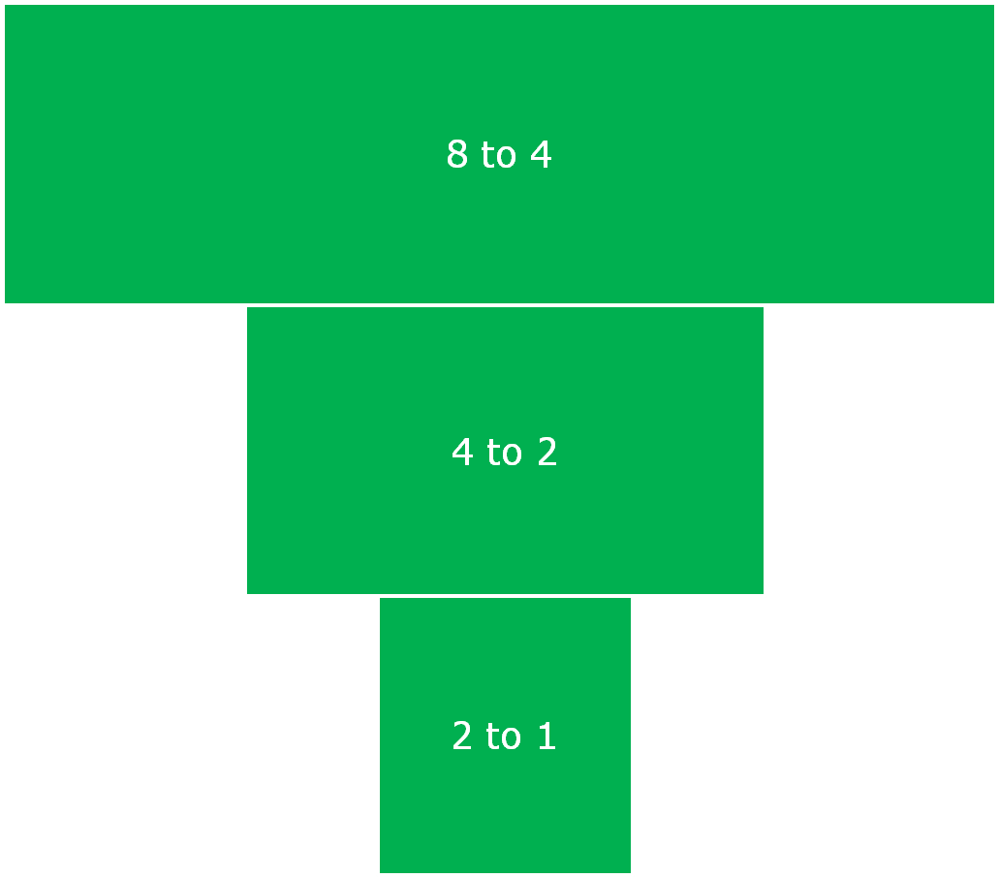
Engineering the Merge Tree
<
<
<
<
Each level merges 2n streams into n streams
Easy to para-meterize and build tree
<
<
<
6/6/2008

Slide 9
Refining the Module
Naïve implementation: exponential resource usage
  Each comparator takes 3% of slices
  At most fit 4-levels
Key observation:
  Throughput is rate-limited by final 2-to-1 merge step
This means each level only needs to perform one comparison per cycle
6/6/2008

Slide 10


Sharing the Comparator: Idea
Loop:
Choose non-empty input pair corresponding to output fifo with room (scheduling)
Compare the fifo heads
Dequeue the smaller one and put it on output fifo
<
We save area by having one comparator per level
But we introduce a comparator scheduling problem
6/6/2008

Slide 11
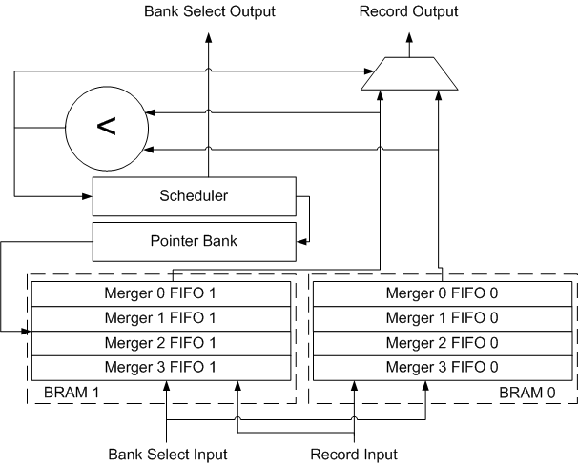
Sharing the Comparator: Physical Implementation Issues
Not enough BRAMs
  Each BRAM contains multiple FIFOs
Aggressive clock
  Single cycle scheduling is impossible
Enq happens several cycles after scheduling
  Credit based flow control
6/6/2008

Slide 12
Scheduling the Comparator
Round Robin: Failed Attempt
  Data is random, FIFOs may run out of data
  FIFO Pairs can be used in a very lopsided manner
Greedy Dynamic Schedule (Priority Queue)
  Choose first non-empty FIFO pair with vacancy in corresponding output FIFO
  Due to physical constraints, we only approximate greedy
Could we have done better than Greedy?
  Greedy is sub-optimal
  More advanced algorithm too complicated
6/6/2008

Slide 13
Scheduler as a Module Parameter
Level 1 merger: must check 2 input FIFOs
  Scheduler can be combinational
Level 6 merger: must check 64 input FIFOs
  Scheduler must be pipelined
Latency insensitive design aids code reuse
  Scheduler is a parameter of level merger
  Low latency scheduler – improve performance
6/6/2008

Slide 14
Implementation Platform
Xilinx XUP Board
  100 Mhz PPC
  256 MB DDR
  100 Mhz Sort-Tree Core
  120 MHz AES Core
Also tried BEE2 board
  Could not get working
  Clock skew issues
6/6/2008

Slide 15
Performance Speedup
 | RAND Metric | ROT Metric
2⁶ | 672 | 742
2¹⁰ | 1101 | 1089
2¹⁴ | 1178 | 1151
2¹⁸ | 1639 | 1644
Metric
Input Size
Performance Metric: 1102.4
6/6/2008

Slide 16
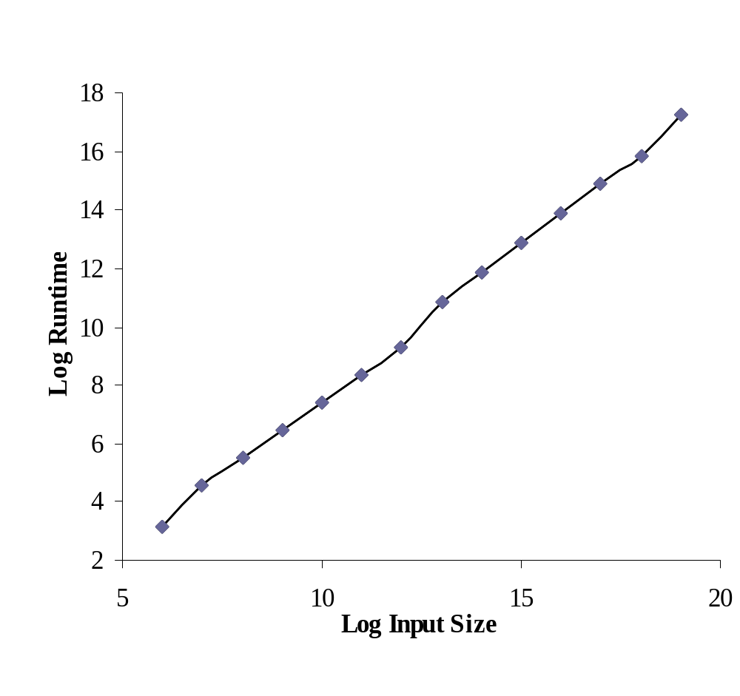
Log Runtime
6/6/2008

Slide 17
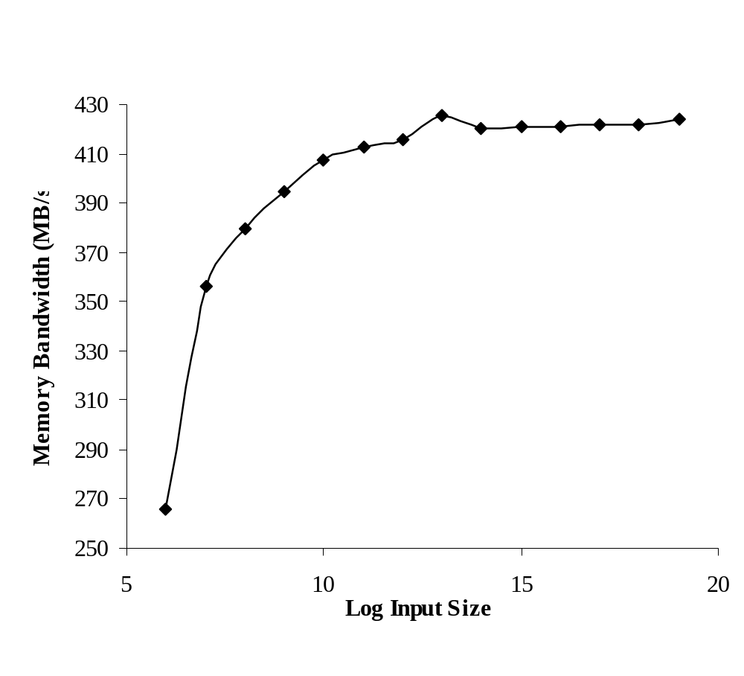
Memory Bandwidth Usage
6/6/2008

Slide 18
How could we make it faster?
Longer memory burst
  Current burst size = 8 records
One comparator multiplexed among several levels
  Current design underutilizes comparators
    Insufficient memory bandwidth to saturate tree
  Complex control may out-weight area saving by reducing no. comparators
6/6/2008

Slide 19
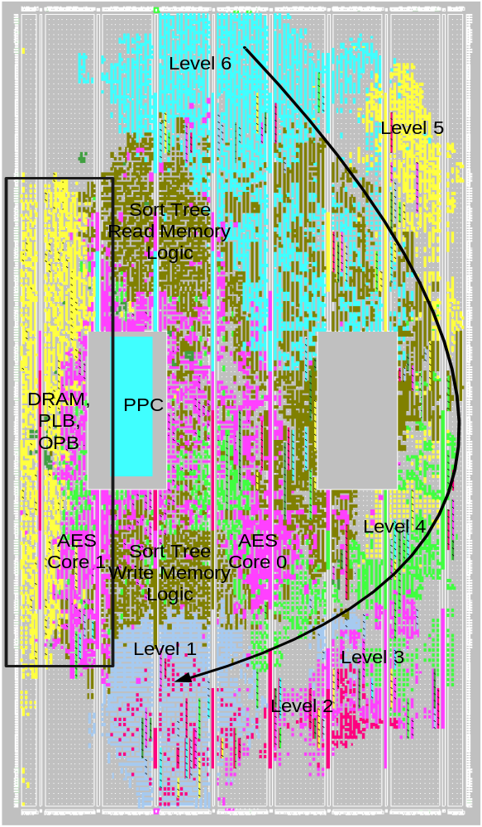
Questions?
6/6/2008

Slide 20
Enabling Design Exploration
Parametric module interfaces
  Allow variations (AES, Sort, Mem controller)
Latency Insensitivity
Concise Bluespec Code (<2000 lines)
Parameterized Modules
  Exploit regularity (e.g. sort tree levels)
Different module designs
  Make “irregular” tradeoffs (pipelining)
6/6/2008

Slide 21
Design Methodology
Get simple system working quickly
Exploit parameterization and LI
  Rapidly explore design variations allowed by parameterizations (numeric and modular)
Keep synthesis time low
  Easy to PAR a design that taking 60% of slices
  Very slow for 80%
  Synthesizing iteratively is fast(2 hours vs. 10 minutes)
6/6/2008

Slide 22
Reusing Infrastructure
Reused testbenches as well as design blocks
  Faster to have confidence that parameterized designs are correct
Made use of previously developed IP blocks (and testbenches)
6/6/2008

Slide 23
XUP Floorplan
Tool Cannot automically PAR design
  Need to floor plan
linear topology of sort pipeline
  Hand placed a few key BRAMs”
  “Seeds” PAR tool
  Tool infers the rest
6/6/2008

Slide 24
Performance (100 MHZ)
 | RAND Metric (us) | ROT Metric (us)
2^6 | 8.9 | 8.9
2^10 | 166.5 | 166.2
2^14 | 3766.0 | 3746.2
2^18 | 59457.9 | 59417.6
Metric
Input Size
Performance Metric: 1056.8
6/6/2008

Slide 25
Performance (AES@120Mhz)
 | RAND Metric (us) | ROT Metric (us)
2^6 | 7.8 | 7.7
2^10 | 161.2 | 161.7
2^14 | 3744.8 | 3737.5
2^18 | 59659 | 59599
Metric
Input Size
Performance Metric: 1102.4
6/6/2008

Slide 26
Performance Analysis
 | RAND Metric in µs (speedup) | ROT Metric in µs (speed up)
2⁶ | 7.8 (672) | 7.7 (742)
2¹⁰ | 161.2 (1101) | 161.7 (1089)
2¹⁴ | 3744.8 (1178) | 3737.5 (1151)
2¹⁸ | 59659 (1639) | 59599 (1644)
Metric
Input Size
Performance Metric: 1102.4
6/6/2008

Slide 27
Perfomance Analysis
Sort Tree
  Throughput depends on “sortedness” of input data
  Worst Case (pre-sorted) Maximum Throughput: 400 MRecords/s
  Extremely difficult to saturate on XUP
Memory Bottleneck
  We achieve 400MB/s (1/4 record/cycle) memory bandwidth
  Rate limiting for input size > 128 records
AES engine
  Fully data parallel -> unlimited bandwidth
  Only able to put two twelve-cycle latency AES cores on board (1/6 record/cycle)
  Bottleneck in case of single memory pass (64 records)
  Counteracted by up-clocking the AES cores
6/6/2008

Slide 28
Sort Tree: Physical Issues
In merge tree levels with large numbers of input FIFOS, checking for ready pairs requires logic which won’t make our aggressive timing target!
Not enough BRAMs
  Each BRAM implements multiple FIFOs
Aggressive clock 100 MHz
  Pipelining
Enq happens several cycles after scheduling
  Credit based flow control
6/6/2008

