Slide 1
Color TFT-LCD Controller
NSYSU CSE
Student: Wei-Yang Tsang
Advisor: Shiann-Rong Kuang

Slide 2
Outline
System Architecture
Block Diagram
Signal Timing
Area Attributes
Display Environment
Future Work
Acknowledge

Slide 3
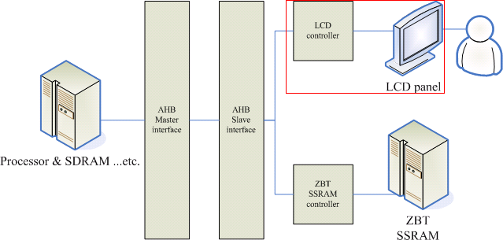
System Architecture

Slide 4
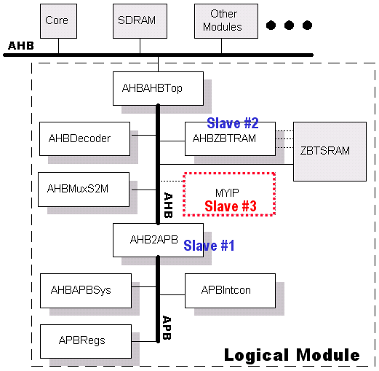
System Architecture (cont)

Slide 5
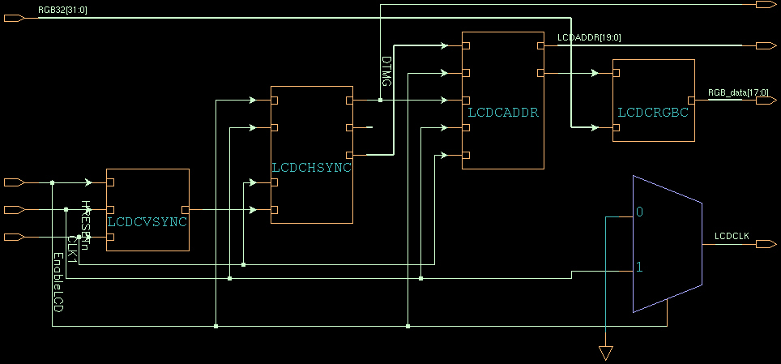
Block Diagram

Slide 6
Signal Timing
AMBA AHB clock
Combined H/V synchronization – DTMG
Data/address signals

Slide 7
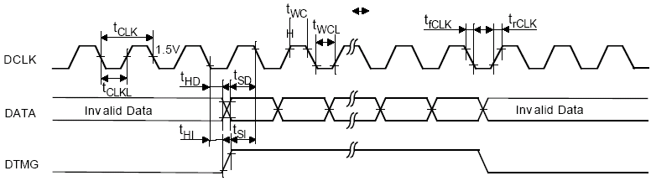
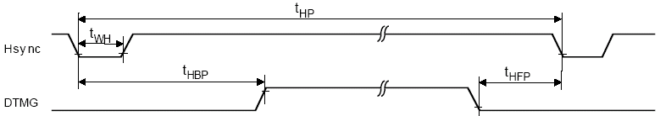
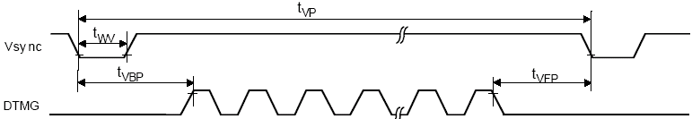
Signal Timing (cont)

Slide 8

Signal Timing (cont)

Slide 9
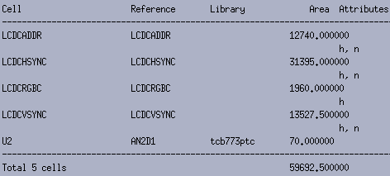
Area Attributes
(designed by synopsys DA)

Slide 10
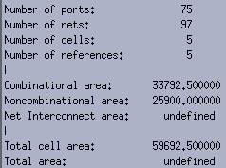
Area Attributes (cont)

Slide 11
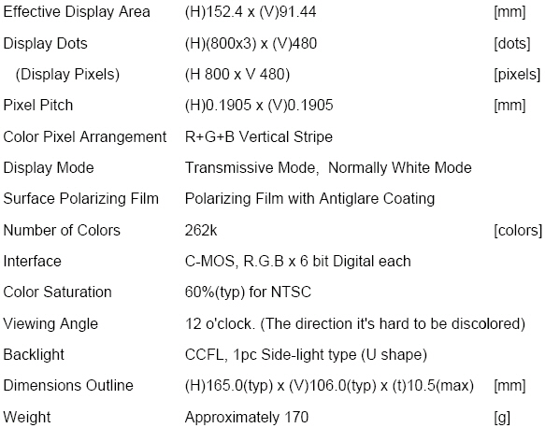
Display Environment
－The Feature of LCD

Slide 12
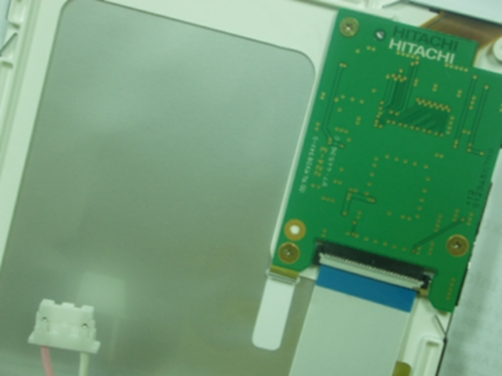
Hitachi LCD (Back Side)

Slide 13
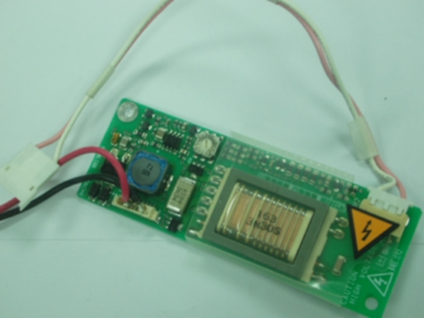
Back-Light Inverter

Slide 14
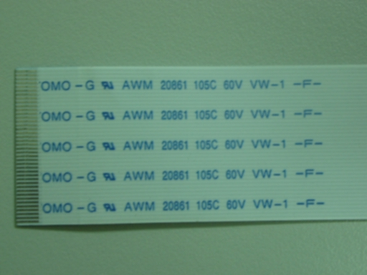
Flexible Print Circuit (FPC)

Slide 15
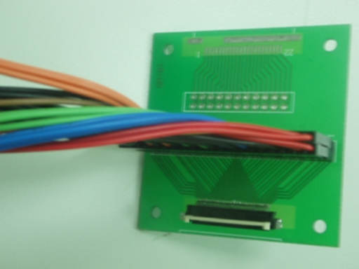
Digital Signal Transfer Interface

Slide 16
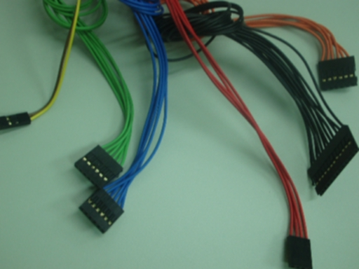
Digital Signal Transfer Interface (cont)

Slide 17
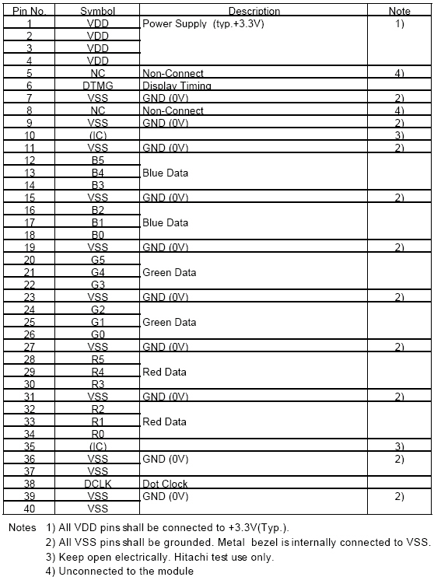
Interface Pin Connection

Slide 18
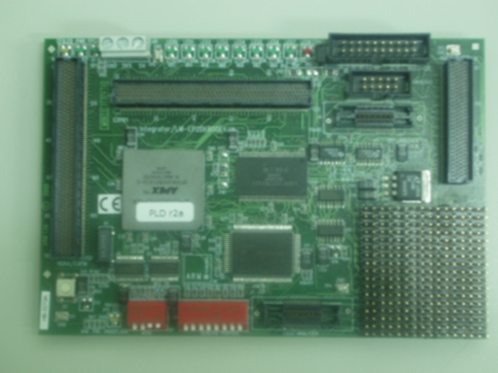
Logic Module

Slide 19
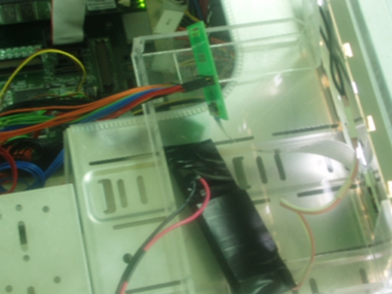
Setting Up

Slide 20
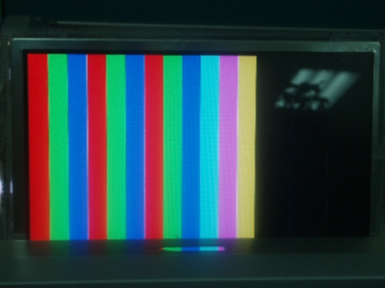
Display 18 non-gray scale Colors

Slide 21
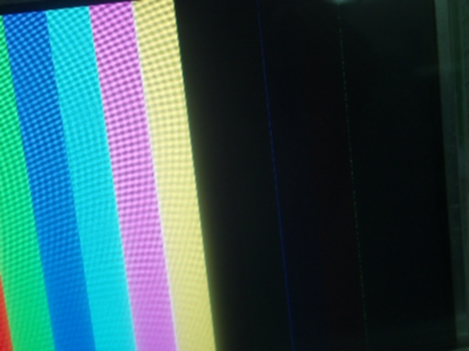
Display 18 non-gray scale Colors
(cont)

Slide 22
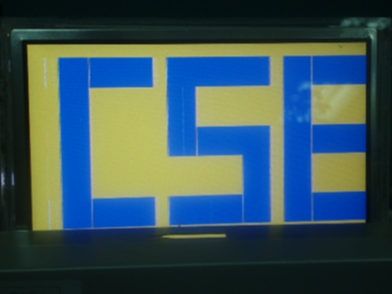
Display Word Blocks－CSE

Slide 23
Future Work
Efficiency of using frame buffer
Join DMA

Slide 24
Acknowledge
美商深特有限公司
高雄日立電子股份有限公司
楠梓電子股份有限公司
好德科技股份有限公司
新生傑世騰電子股份有限公司
Especially thank
積體電路與自動化實驗室全體同仁

Slide 25
The End
Thank you for your listening.

