Slide 1
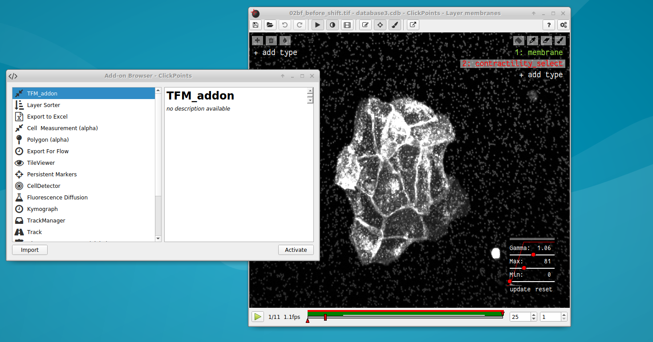
Open the addon browser
Select the TFM_addon
Activate the addon

Slide 2
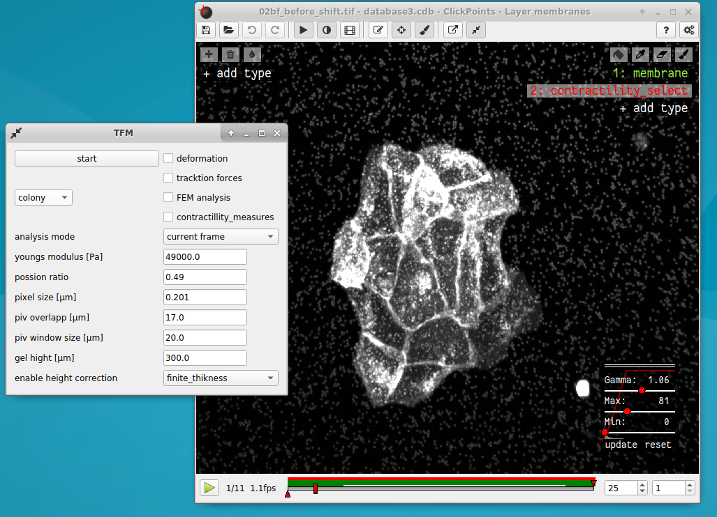
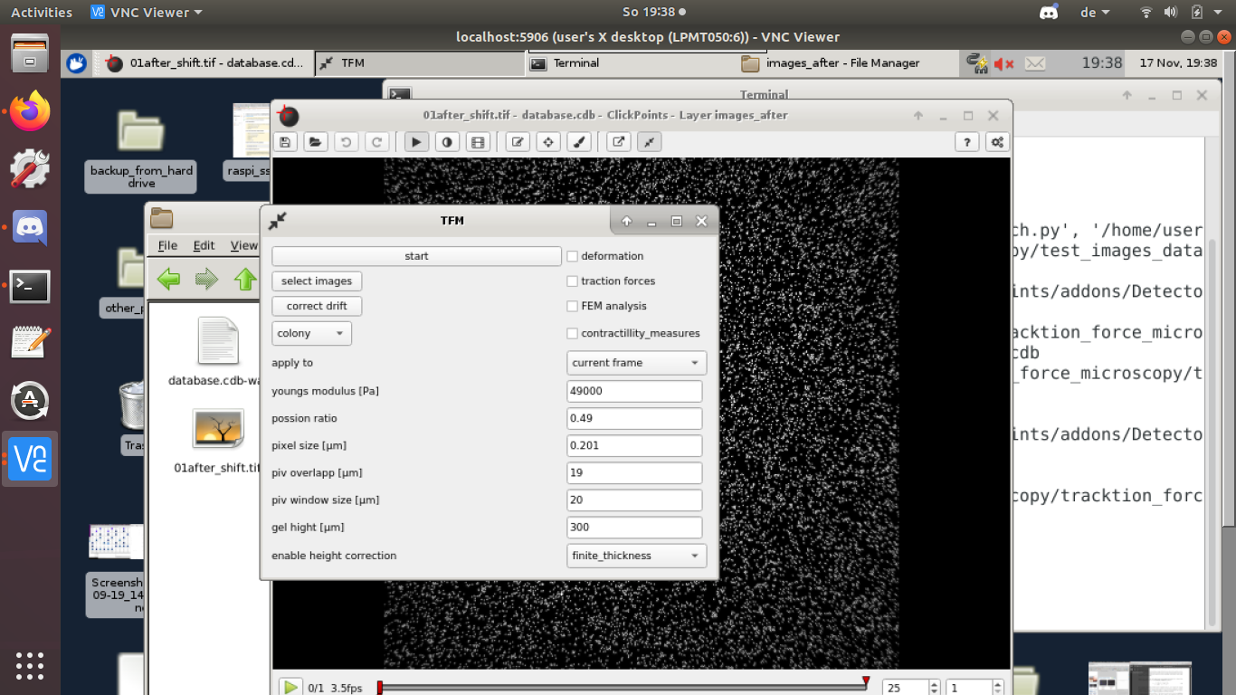
Open the addon window
Addon window
“select images” button

Slide 3
Open the addon window
Addon window
“correct drif” button

Slide 4
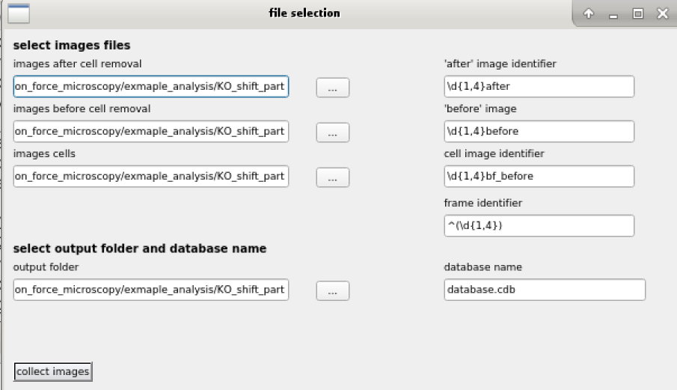
Open a file browser to set a folder
Folders that the program searches for images
Patterns in the image filename that are used to identify the type of the image
Where to find the frame in the image filename
Folder where all output and the database file is saved
Name of the data base file
Build and save the database file

Slide 5
Start the analysis
Open a dialog to select images and the output folder
Select what part of analysis you want to run by ticking these check boxes
Perform drift correction for all frames
Apply the analysis to the current frame or all frames
Switch between “cell layer” and “colony” mode.
Parameters for the analysis

Slide 6
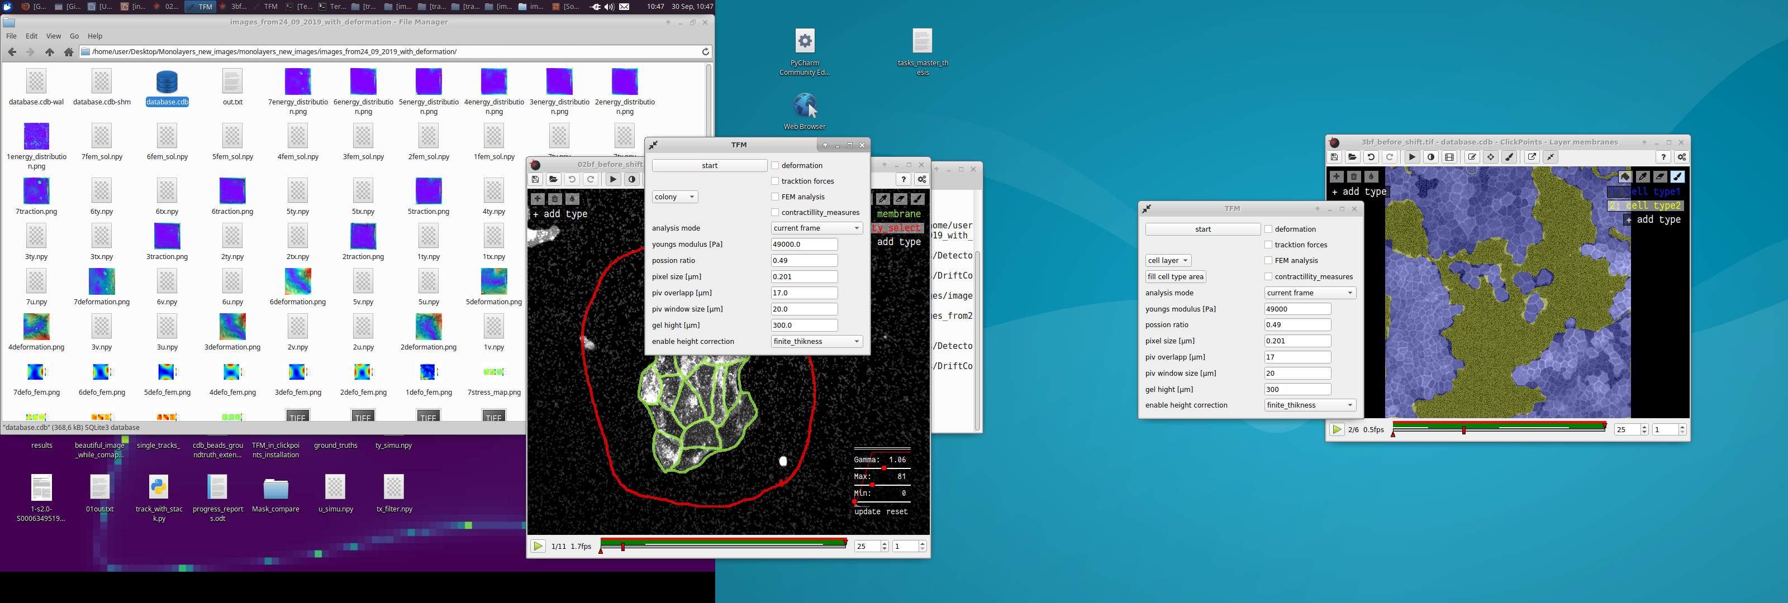
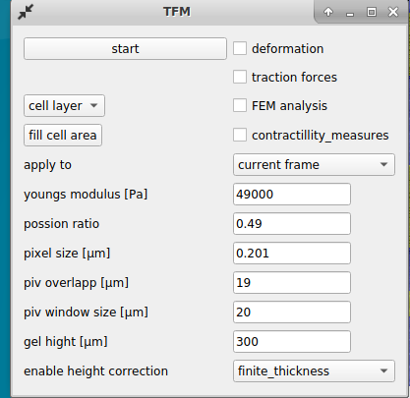
Switch between colony and cell layer mode
Masks for cell types 1 and 2

Slide 7
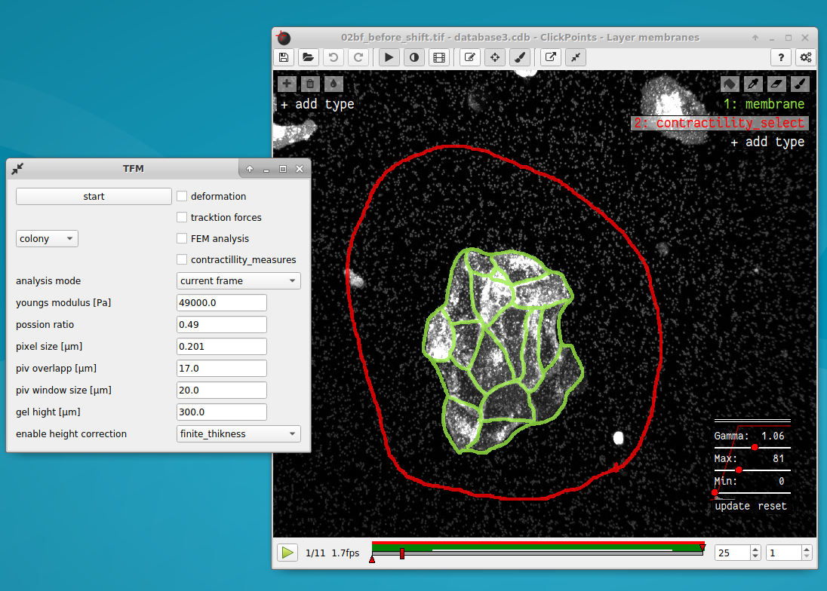
Mask used for the calculation of contractillity
and contractile energy
Mask used for Finite Elements analysis and calculation of the colony area and cell number

Slide 8
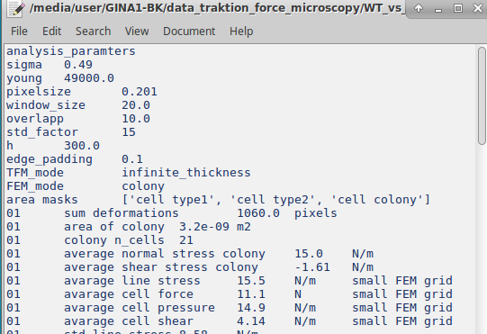
Parameters for this analysis
Frame
Unit (optional)
Warning messages (optional)
Name of the quantity
Value

Slide 9
Open the addon browser
Select the TFM_addon
Activate the addon

Slide 10
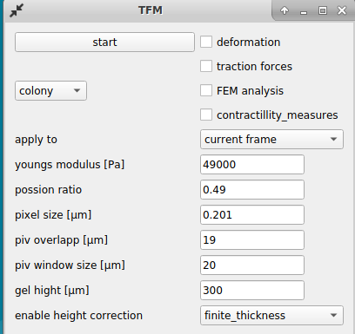
Open the addon window
Addon window

Slide 11
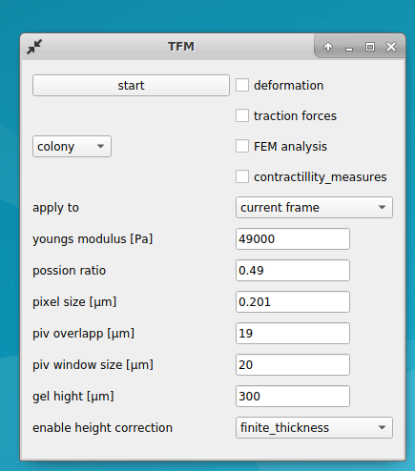
Start the analysis
Select what part of analysis you want to run by ticking these check boxes
Switch between “cell layer” and “colony” mode.
Apply the analysis to the current frame or all frames
Parameters for the analysis

Slide 12
Switch between colony and cell layer mode
Masks for cell types 1 and 2

Slide 13
Mask used for the calculation of contractillity
and contractile energy
Mask used for Finite Elements analysis and calculation of the colony area and cell number

Slide 14
Parameters for this analysis
Frame
Unit (optional)
Warning messages (optional)
Name of the quantity
Value

