Slide 1


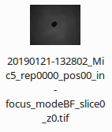



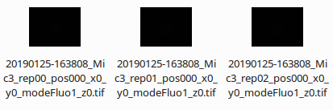
bright field image of the spheroid before invasion
multiple fluorescence images for each spheroid after invasion

