Slide 1
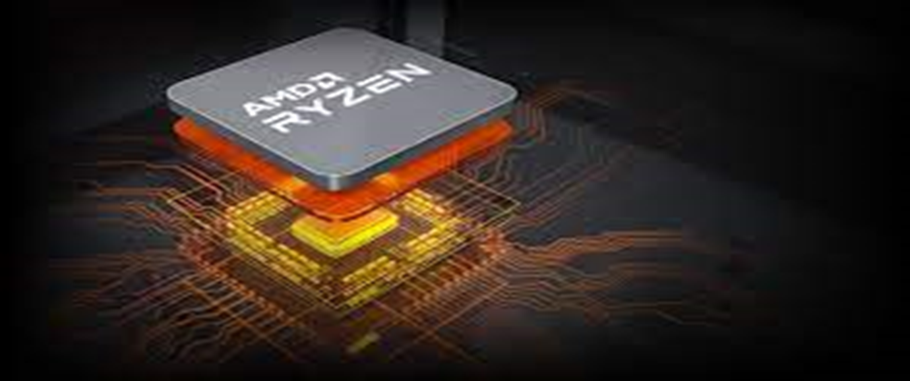
history:
AMD was founded in 1969 by Jerry Sanders and is based in California, United States with presence in Canada, France, Spain, the United Kingdom, China, and more.
The number of stores :
AMD global operations span the world in more than 50 locations
brands owned :
AMD's main products include microprocessors, motherboard chipsets, embedded processors, graphics processors, and FPGAs for servers, workstations, personal computers, and embedded system applications. Advanced Micro Devices, Inc. U.S.
Employees :
AMD total number of employees in 2021 was 15,500, a 23.02% increase from 2020.AMD total number of employees in 2020 was 12,600, a 10.53% increase from 2019.AMD total number of employees in 2019 was 11,400, a 12.87% increase from 2018.AMD total number of employees in 2018 was 10,100, a 13.48% increase from 2017.
Headquarters :
AMD headquarters and office locations AMD is headquartered in Santa Clara, CA and has 40 office locations across 25 countries.
Market position :
AMD has gained market share in notebook, desktop and server processor markets every quarter for the past two years, reaching an overall x86 market share of 15.5% in the fourth quarter of 2019.
finantial results :
AMD Reports First Quarter 2022 Financial Results ― Record quarterly revenue of $5.9 billion grew 71% year-over-year; Gross margin grew 2 percentage points and non-GAAP grossmargin grew 7 percentage points year-over-year

