Slide 1


Slide 2
Building a Face Recognition with One Shot Learning
Ravi Ranjan
@raviranjan0631

Slide 3
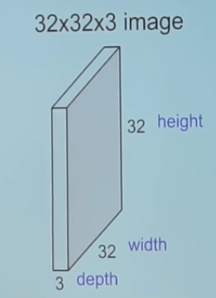
How a Computer reads an image ?

Slide 4
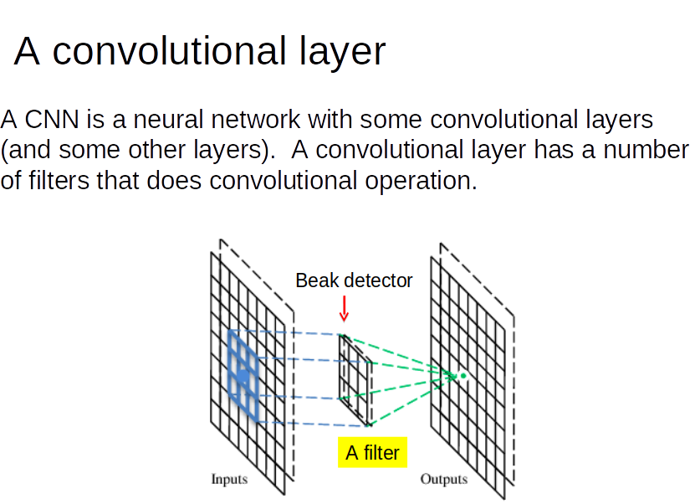

Slide 5
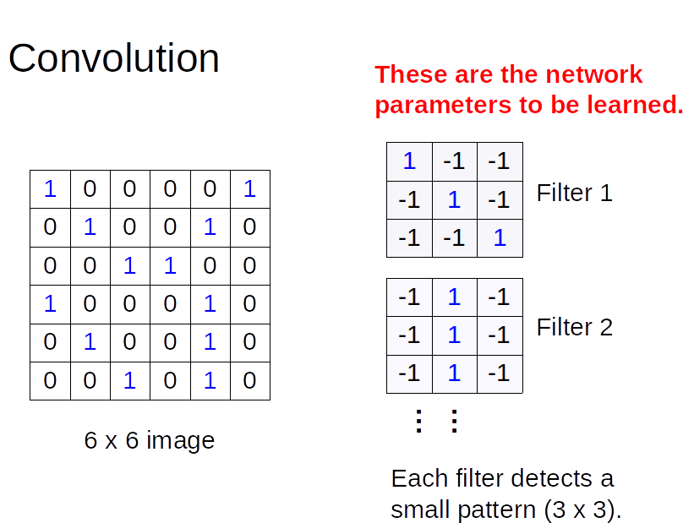

Slide 6
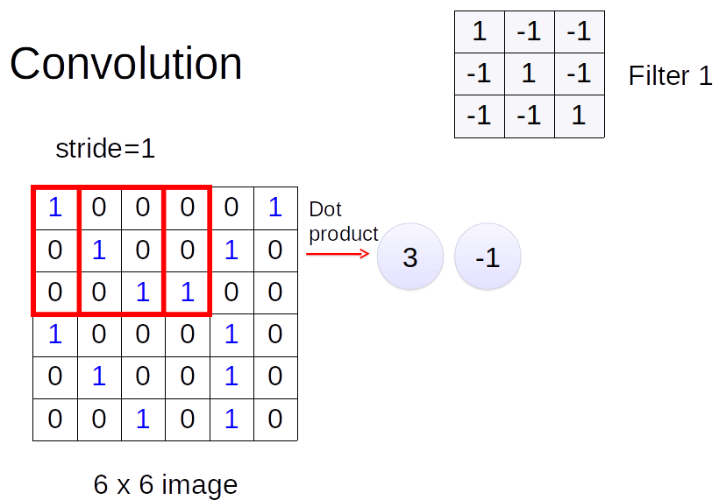

Slide 7
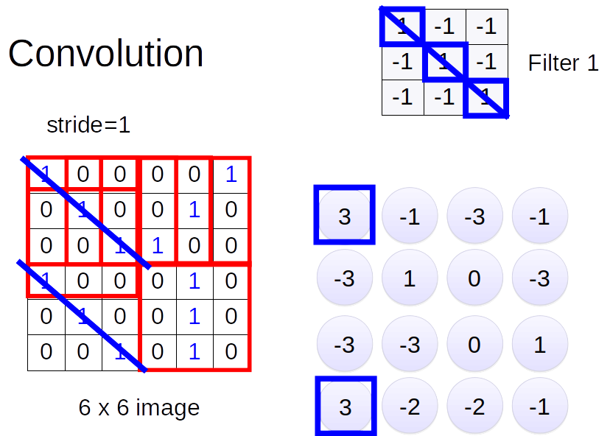

Slide 8
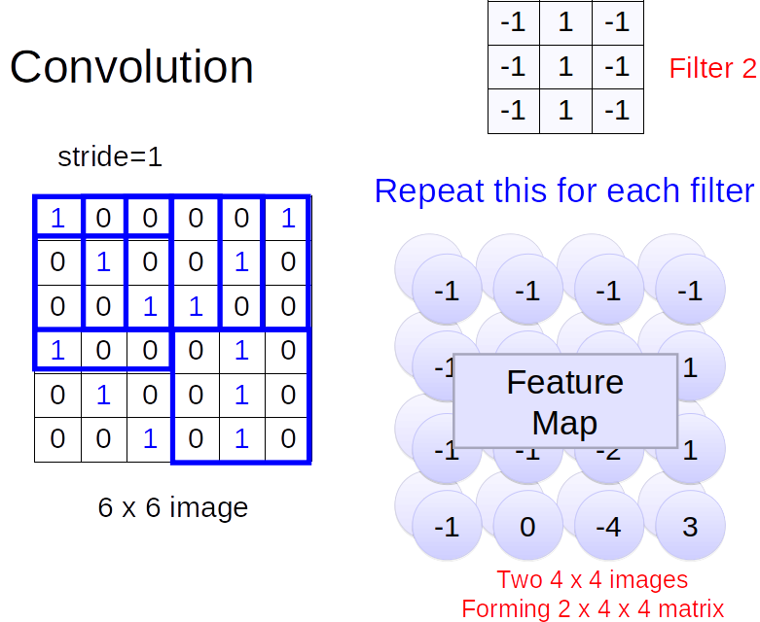

Slide 9
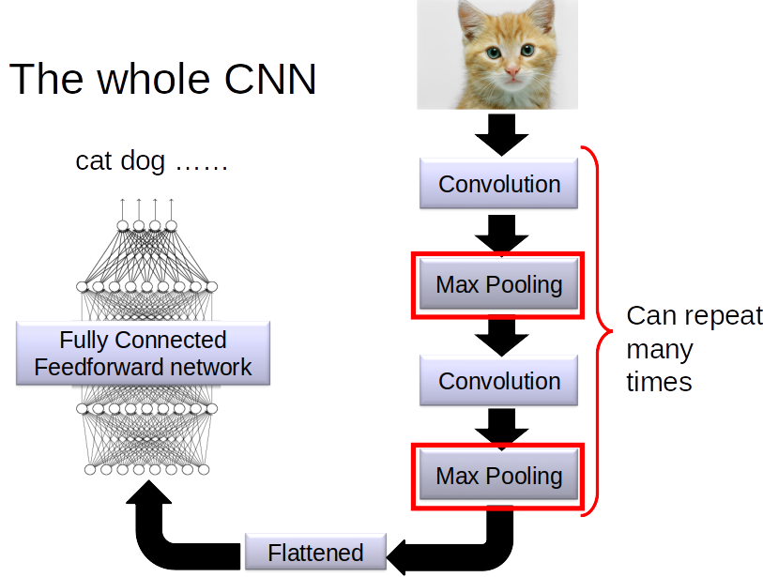

Slide 10
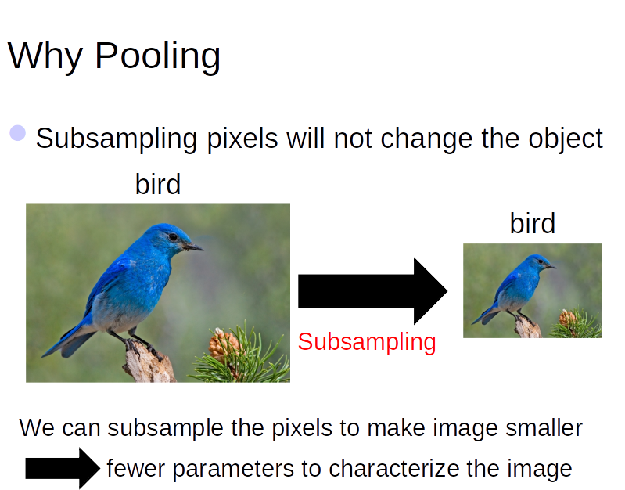

Slide 11
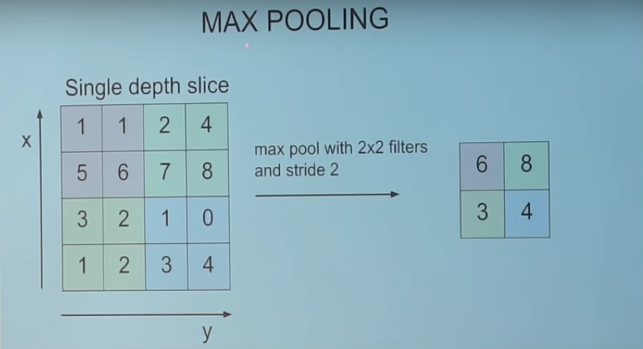
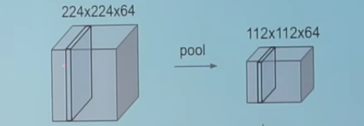

Slide 12
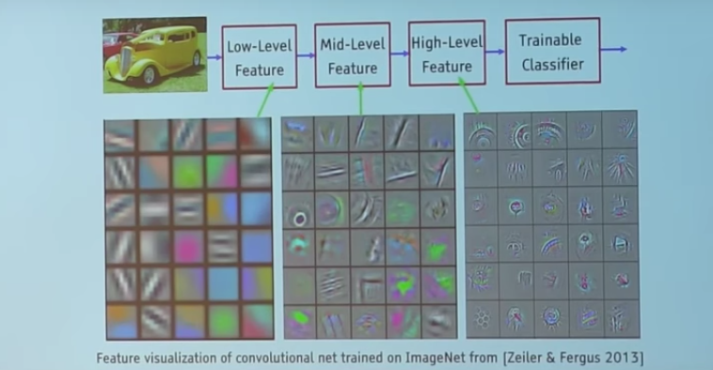
Featuuure Visualization

Slide 14
What is One Shot Learning?
Learning about a new person with a single instance of data
For ex- Face recognition with the help of a single picture

Slide 15
Some use cases
Criminal Detection through surveillance
Attendance
Payment Authorization
Security

Slide 16
Why one shot learning when there is CNN for image classification ? Think buddy

Slide 17
Let’s see the drawback of CNN approach first?

Slide 18
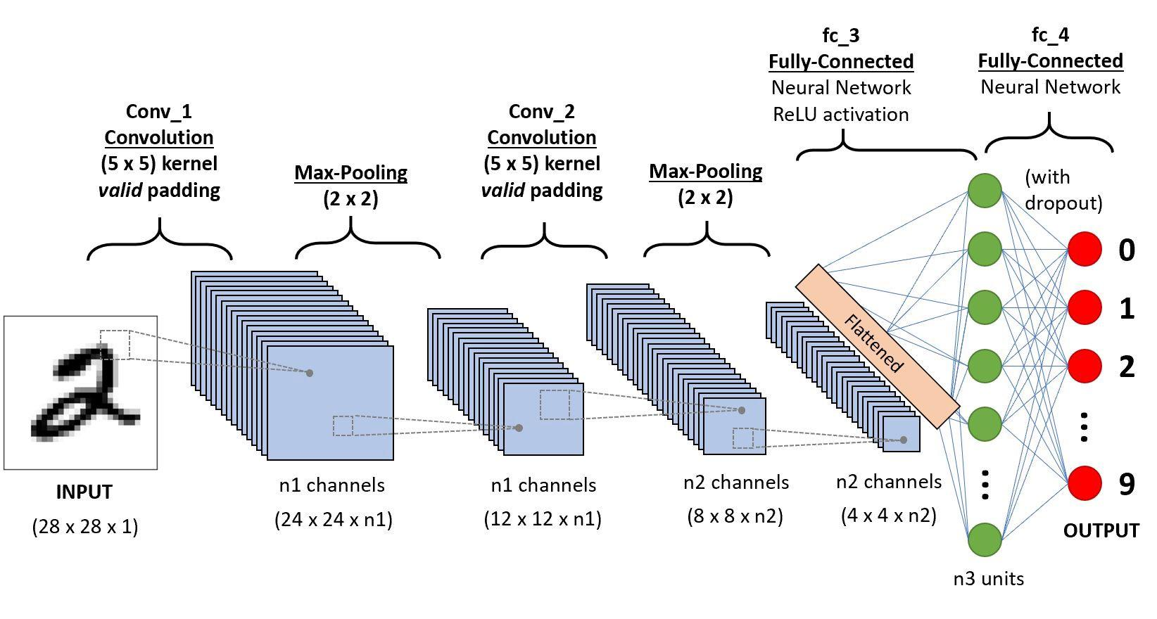
Need a lot of data to train on a particular class
Once the network architecture is fixed you can’t add new class
If you want add a new class then you have to fulfill two requirements
a). need a lot of image for that class it can be easily done with the help of data augmentation.
b). You have to change the CNN architecture as you have to add a new class as well as you have to retrain it and training a Neural Network it will took a lot of time.

Slide 19
How One Shot Learning work?

Slide 20
The brain doesn’t need thousands of pictures of the same object in order to be able to recognize it. But in deep learning, we need a large amount of data and the more we have, the better the results get.
One Shot Learning is following brain approach by recognizing classes with single image

Slide 21
Which approach One Shot Learning take?

Slide 22
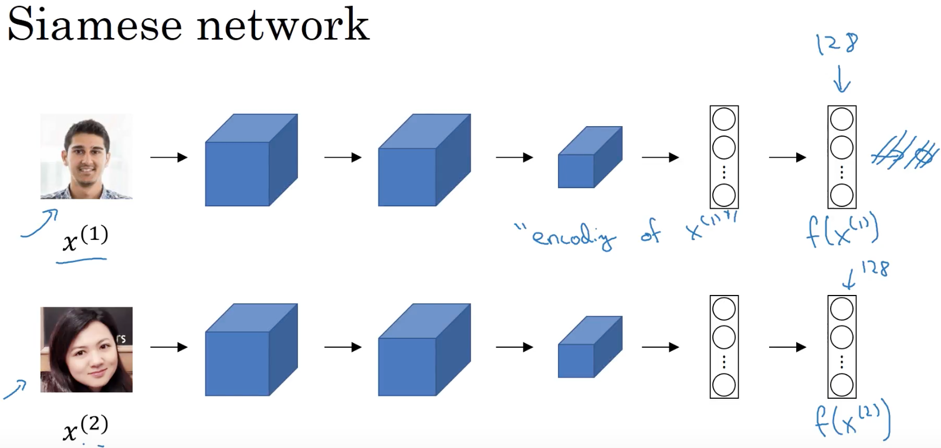
Siamese neural network
Siamese neural network has the objective to find how similar two comparable things are (e.g. signature verification, face recognition..). This network has two identical subnetworks, which both have the same parameters and weights.

Slide 23
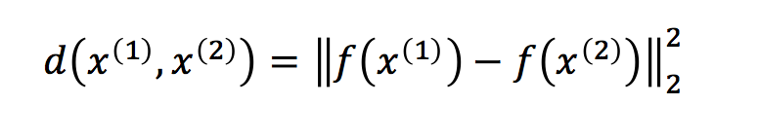
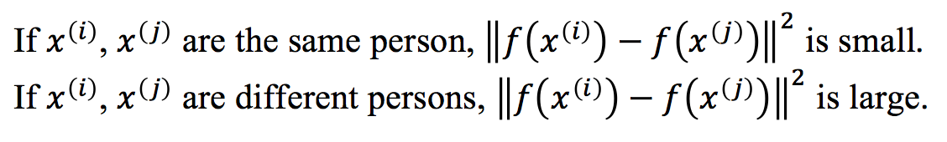

Slide 24
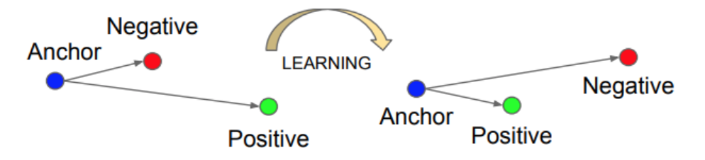
So, how can we learn the parameters in order to get a good encoding for the input image? Triplet loss function which is simply a loss function using three images: an anchor image A, a positive image P(same person as the anchor), as well as a negative image N (different person than the anchor). So, we want the distance d(A, P) between the encoding of the anchor and the encoding of the positive example to be less than or equal to the distance d(A, N) between the encoding of the anchor and the encoding of the negative example. In other words, we want pictures of the same person to be close to each other, and pictures of different persons to be far from each other.

Slide 25
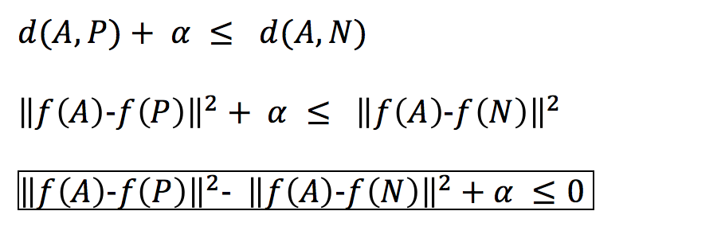
The problem here is that the model can learn to make the same encoding for different images, which means that distances will be zero, and unfortunately, it will satisfy the triplet loss function. For this reason, we are adding a margin alpha (hyperparameter), to prevent this from happening, and to always have a gap between A and P versus A and N.

Slide 26
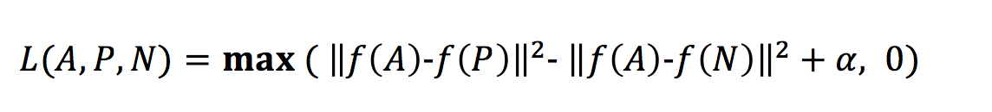
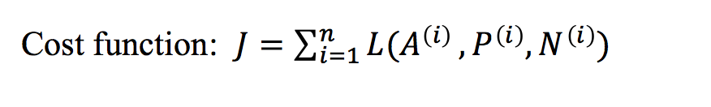
Triplet loss function

Slide 27
Training set: The training set should contain multiple pictures of the same person to have the pairs A and P, then once the model is trained, we’ll be able to recognize a person with only one picture. How do we choose the triplets to train the model? If we choose them randomly, it will be so easy to satisfy the constraint of the loss function because the distance is going to be most of the time so large. And the gradient descent will not learn much from the training set. For this reason, we need to find A, P, and N so that A and P are so close to N. Our objective is to make it harder to train the model to push the gradient descent to learn more.
- Microsoft Voice Report

Slide 28
Q&A

Slide 29

Break 🕚

Slide 30
Hands on
Download the code from the link below
shorturl.at/lyDEN
Download the files from
shorturl.at/jtwyW
Download Face Detecto
shorturl.at/vHLO7

Slide 31
Rerences
Coursera Deep Learning Specialization
How to Perform Face Recognition With VGGFace2 in Keras
https://towardsdatascience.com/one-shot-learning-face-recognition-using-siamese-neural-network-a13dcf739e
Thank you
Ravi Ranjan,
Facebook @raviranjan06311
Twitter @raviranjan0631
Github @raviranjan0631
Instagram @raviranjan0631
Youtube @raviranjan0631
Linkedin @/in/raviranjan0631

