Slide 1
The Open Source Data Center
  A Platform for innovation
  Cole Crawford
  Open Compute Foundation

Slide 2
In the beginning - Software
“Hello everybody out there using minix —
I’m doing a (free) operating system (just a hobby, won’t be big and professional like gnu) for 386(486) AT clones..”
Free Unix!
“Starting this Thanksgiving I am going to write a complete Unix-compatible software system called GNU (for Gnu's Not Unix), and give it away free(1) to everyone who can use it. Contributions of time, money, programs and equipment are greatly needed”.
Notes:
Before there was ever standard x86 hardware we had massive innovation happening around software.
Can anyone tell me who wrote either of these emails?

Slide 3







In the beginning - Software
Closed
Hybrid
Open
Notes:
Warp / Windows
Sun OS
Linux

Slide 4

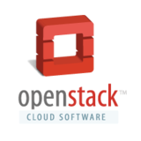


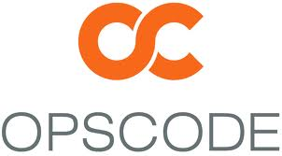



Evolution of the Cloud
Virtualization
Devops
IAAS / CLOUD
1998
2003
2006
2008
2009
2008
2009
2010
Proprietary
Open Source
Proprietary
Open Core
Open Source

Slide 5

In the beginning - Hardware
The current rack standard has no specification for depth or height.
The only “standard” is the requirement for it to be 19 inches wide.
This standard evolved out of the railroad switching era.

Slide 6
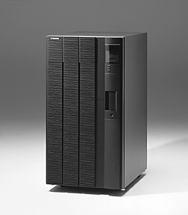
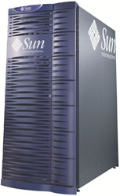

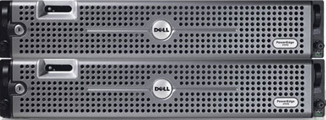
Evolution of the Data Center
Mainframe
Scale Up
Scale Out
1970s
1990s
2000s
2011++
Proprietary
Proprietary
Proprietary
Open Source

Slide 7





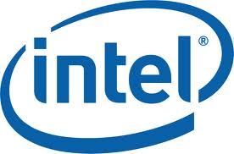

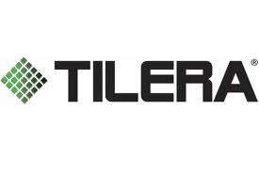








Open Compute
What is it?
Who is it?
Why does it exist?
5 Verticals – All Open Source
Virtual IO
Hardware Management
Data Center Design
Open Rack
Storage
To democratize hardware and eliminate gratuitous differentiation allowing for standardization across tier 1s and ODMs.

Slide 8
State of the Union
    Production Ready Open Source Software
    Vanity Free Open Source Hardware
Where do we go from here?

Slide 9
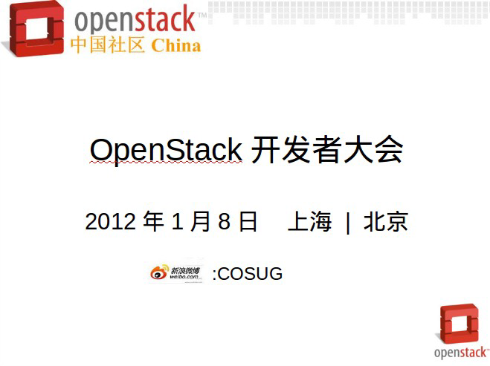
Bringing Community Together
Respect the community
  It's the community's brand – not yours
  Give plenty of lead time for volunteer or community-governed projects to respond.
Create your own brand
  It's the community's brand – not yours
  Develop your own, separate brand
Give credit to the community
  The most important asset to any community project are its individual contributors

Slide 10

The New Standard - Open Compute Certification
Validated reference architectures for any combination of hardware + software
Turn key supply chain management for hardware procurement
Ready to run bare metal provisioning – fully supported by ISVs / SIs / Distros
Exadata without the Exadollar!
Notes:
5 projects – all completely open to lower cost and increase data center efficiency

Slide 11
Open Compute + OpenStack
Turnkey certification
SI integration
Instant global channel creation
ODMs become hardware partners
Supply chain management becomes easy
Support throughout server / software lifecycle
Notes:
5 projects – all completely open to lower cost and increase data center efficiency

Slide 12
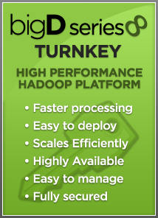


OCP + Hadoop
Notes:
5 projects – all completely open to lower cost and increase data center efficiency

Slide 13
Open Compute – Get Involved
Sign the CLA!
Join the mailing lists!
Open Source the Data Center
Change the world!
http://opencompute.org/about/get-involved/
Notes:
5 projects – all completely open to lower cost and increase data center efficiency

