Slide 1
AND
Flatten ANDs
AND
AND
AND
a
b
c
d
e
AND
c
d
e
a
b

Slide 2
Legend
OR
FieldReference
ConstantExpr
>
>
Expr
strpos
0
strpos
0
ConjunctExpr
upper
FOO
upper
BAR
a
a
Notes:
Expression: strpos(upper(a), 'FOO') > 0 OR strpos(upper(a), 'BAR') > 0
upper(a) is a Common SubExpression

Slide 3
>
>
Constant Folding
upper
upper
upper
‘FOO’
a
‘Foo’
a

Slide 4
Expr::eval
Expr::
evalEncodings
Expr::
evalWithNulls
Expr::evalAll
Finalize
Inputs: rows, data (input columns)
Operations: Check if this is a shared subexpression that has already been evaluated. If has results for all rows produce the results and terminate evaluation early. Otherwise, update “rows” to a subset of rows that are missing results.
Outputs: a subset of rows, data (unmodified), partial result
Inputs: rows, data, partial result
Operations: If expression is deterministic and depends on fewer columns than its parent, try to peel off encodings of the input data. On success, replace data with corresponding inner vectors, update the set of rows for evaluation to corresponding rows of the inner vectors and store the peeled off wrappings for later use.
Outputs: new rows, new data, peeled wrappings, partial result
Inputs: rows, data, peeled wrappings, partial result
Operations: If expression propagates nulls, check input data and identify rows where at least one input is null. Remove these rows from the set of rows for evaluation.
Outputs: a subset of rows, data (unmodified), peeled wrappings (unmodified), rows with null inputs, partial results
Inputs: rows, data, peeled wrappings, null rows
Operations: If special form, evaluate by calling Expr::evalSpecialForm(). If function call, (1) recursively evaluate input expressions; (2) remove rows with null inputs; (3) peel off encodings; (4) call VectorFunction::apply(); (5) adjust the result by applying peeled wrappings and setting nulls.
Outputs: newly computed result, peeled wrappings, null rows, partial result
Inputs: result vector, peeled wrappings, null rows, partial result
Operations: Adjust the result by applying peeled wrappings, setting nulls for null rows and incorporating partial result from earlier evaluation. If this is a shared subexpression store the result for future use.
Outputs: final result vector

Slide 5
OR
[a, b]
>
[a]
>
[b]
strpos
[]
0
strpos
[]
0
upper
[]
FOO
upper
[]
BAR
a
b

Slide 6
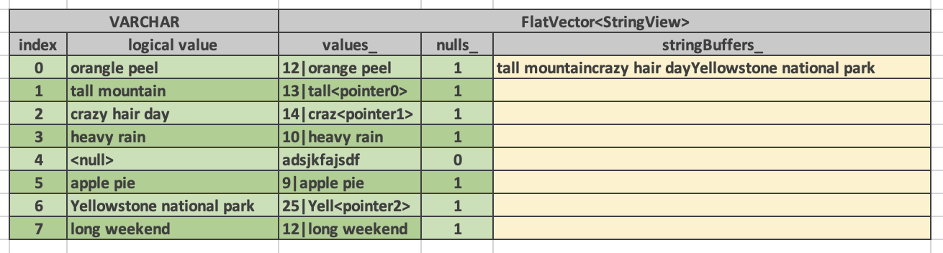
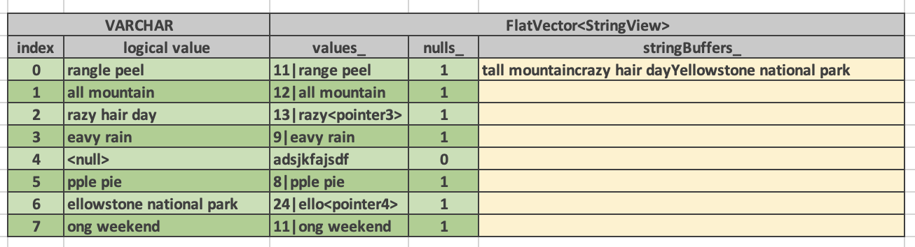

Slide 7
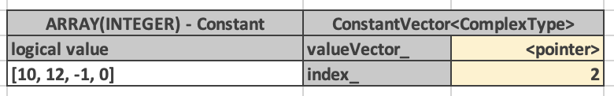
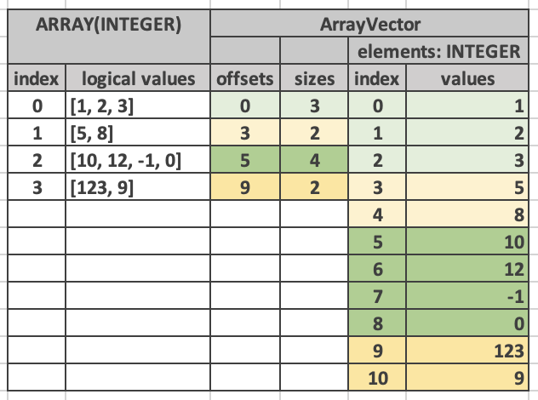
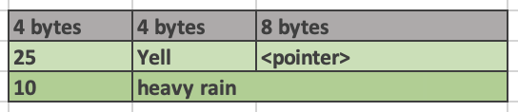

Slide 8
Query plan
Executable pipelines
Pipeline 3
collect
ShuffleWrite
Operator
Cosco Client
ShuffleWriteNode
LocalExchange
SourceOperator
LocalPartitionNode
(gather)
Local
Exchange
Queue
PartitionAnd
SerializeNode
Pipeline 1
Pipeline 2
LocalPartition
LocalPartition
…
PartitionAnd
SerializeOperator
PartitionAnd
SerializeOperator
…
…

Slide 9
HashJoinNode
joinType
leftKeys
rightKeys
filter (optional)
Probe side
Build side
Plan Node A
Plan Node C
Plan Node B

Slide 10
Probe-side pipeline
More downstream operators
JoinBridge
Build-side pipeline
HashProbe
HashBuild
Hash table
Operator A
Operator C
Operator B

Slide 11
Probe-side pipeline
JoinBridge
Build-side pipeline
HashJoinNode
HashProbe
HashBuild
LocalPlanner
Hash table
Plan Node A
ExchangeNode
Operator A
Exchange
TableScan
TableScan

Slide 12
Left-side pipeline
More downstream operators
MergeJoinSource
Right-side pipeline
MergeJoin
CallbackSink
Vectors
Operator A
Operator C
Operator B

Slide 13
Right-side pipeline
MergeJoinSource
Left-side pipeline
MergeJoinNode
MergeJoin
CallbackSink
LocalPlanner
Vectors
Plan Node A
Plan Node B
Operator A
Operator B
TableScan
TableScan

Slide 14
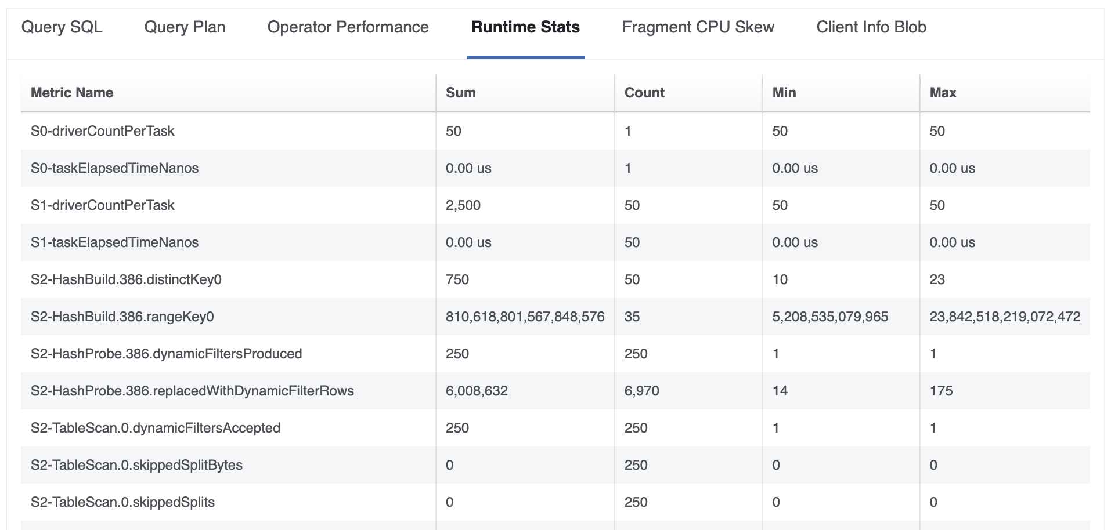

Slide 15
Presto Coordinator
SPI (Metadata APIs)
Get table schema
List splits
Etc.
Connector
(metadata)
Coordinator-Worker Interface
HTTP + JSON
Presto Worker
Connector
(data)
Presto Worker
Connector
(data)
Presto Worker
Connector
(data)
Presto Worker
SPI (Data APIs)
Fetch data for a given split
Etc.
Connector
(data)

Slide 16
1. ConnectorSplitManager::getSplits
Presto Coordinator
Connector
(metadata)
2. return ConnectorSplitSource
3. ConnectorSplitSource::getNextBatch
4. return ConnectorSplitBatch
5. PUT /v1/task/<task-id> (payload includes splits)
Presto Worker
Connector
(data)
Presto Worker
6. ConnectorPageSourceProvider::createPageSource(split)
Connector
(data)
Presto Worker
Connector
(data)
Presto Worker
Connector
(data)
7. return ConnectorPageSource
8. ConnectorPageSource::getNextPage()
9. return Page

Slide 17
Consuming pipeline
…
…
HashAggregation
AggregationNode
LocalPlanner
LocalExchangeSource
std::queue<RowVectorPtr>
LocalExchange
SourceOperator
LocalPartitionNode
Producing pipeline
LocalPartition
ExchangeNode
Exchange

Slide 18
Join
Query Plan
Executable Pipelines
Pipeline
Pipeline 1
…
…
Pipeline
Pipeline
HashJoinNode
LocalPlanner
HashProbe
Pipeline 2
HashBuild
XNode
CNode
COperator
YOperator
YNode
BNode
BOperator
Aode
AOperator

Slide 19
Local Exchange
Query Plan
Executable Pipelines
Pipeline 2
…
…
Local
Exchange
Local Partition Node
LocalPlanner
Pipeline 1
Pipeline 1
Local Partition
…
…

Slide 20
Local Merge
Query Plan
Executable Pipelines
Pipeline 3
…
…
Local
Merge
Local Merge Node
LocalPlanner
Pipeline 1
Pipeline 2
Callback
Sink
Callback
Sink
ANode
BNode
AOperator
BOperator
…
…
…
…

Slide 21
Query Plan
Executable Pipelines
Probe Pipeline
Probe Pipeline
…
…
JoinBridge
HashJoinNode
HashProbe
LocalPlanner
Hash table
Build Pipeline
Build Pipeline
…
Build Pipeline
HashBuild
…
…
…
…
…
…
…
…

Slide 22
N-to-1 Local Exchange
Pipeline 2
…
…
Local
Exchange
Source
Operator
Local
PartitionNode
LocalPlanner
LocalExchange
Source
…
Pipeline 1
Pipeline 1
Local. Partition
…
…
…

Slide 23
Pipeline 3
…
…
Local
Exchange
Source
Operator
LocalPlanner
Local
PartitionNode
…
LocalExchange
Source
…
…
Pipeline 1
Pipeline 2
Local Partition
Local Partition
…
…
…
…
…

Slide 24
1-to-N Local Exchange
Pipeline 2
Pipeline 2
Pipeline 2
…
…
…
Local
Exchange
Source
Operator
Local
Exchange
Source
Operator
Local
Exchange
Source
Operator
…
LocalPlanner
Local
PartitionNode
LocalExchange
Source's
…
…
Pipeline 1
Local Partition
…
…

Slide 25
outputConsumedDelay
The delay between the task finishing computing results and the downstream task or coordinator fetching these results.
createTime
Task started
lastEndTime
Task finished processing the last split
firstStartTime
Task started processing first split
endTime
Task finished
firstDataReceived
Task received first batch of data (non-leaf tasks only)

Slide 26
Coordinator or downstream worker
(consumer)
Worker
(producer)
GET {taskId}/results/0/0
X-Presto-Max-Size: 32MB
X-Presto-Page-Sequence-Id: 0
X-Presto-Page-End-Sequence-Id: 1
X-Presto-Buffer-Complete: false
GET {taskId}/results/0/1/acknowledge
HTTP 200
GET {taskId}/results/0/1
X-Presto-Max-Size: 32MB
X-Presto-Page-Sequence-Id: 1
X-Presto-Page-End-Sequence-Id: 2
X-Presto-Buffer-Complete: true
GET {taskId}/results/0/2/acknowledge
HTTP 200

Slide 27
0
1
2
Stage N
0
1
2
0
1
2
0
1
2
0
1
2
…
Stage N+1

Slide 28
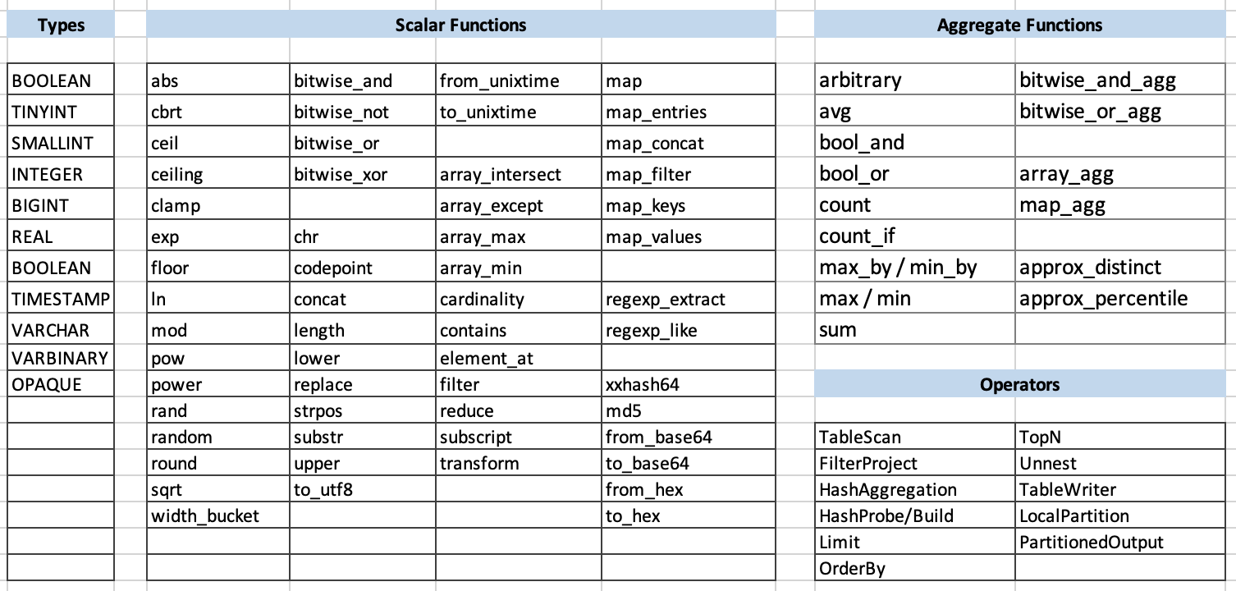
Sep 15, 2021

Slide 29
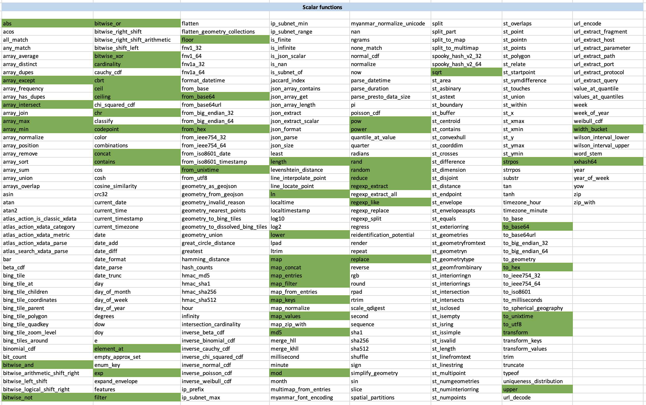
Sep 15, 2021

Slide 30
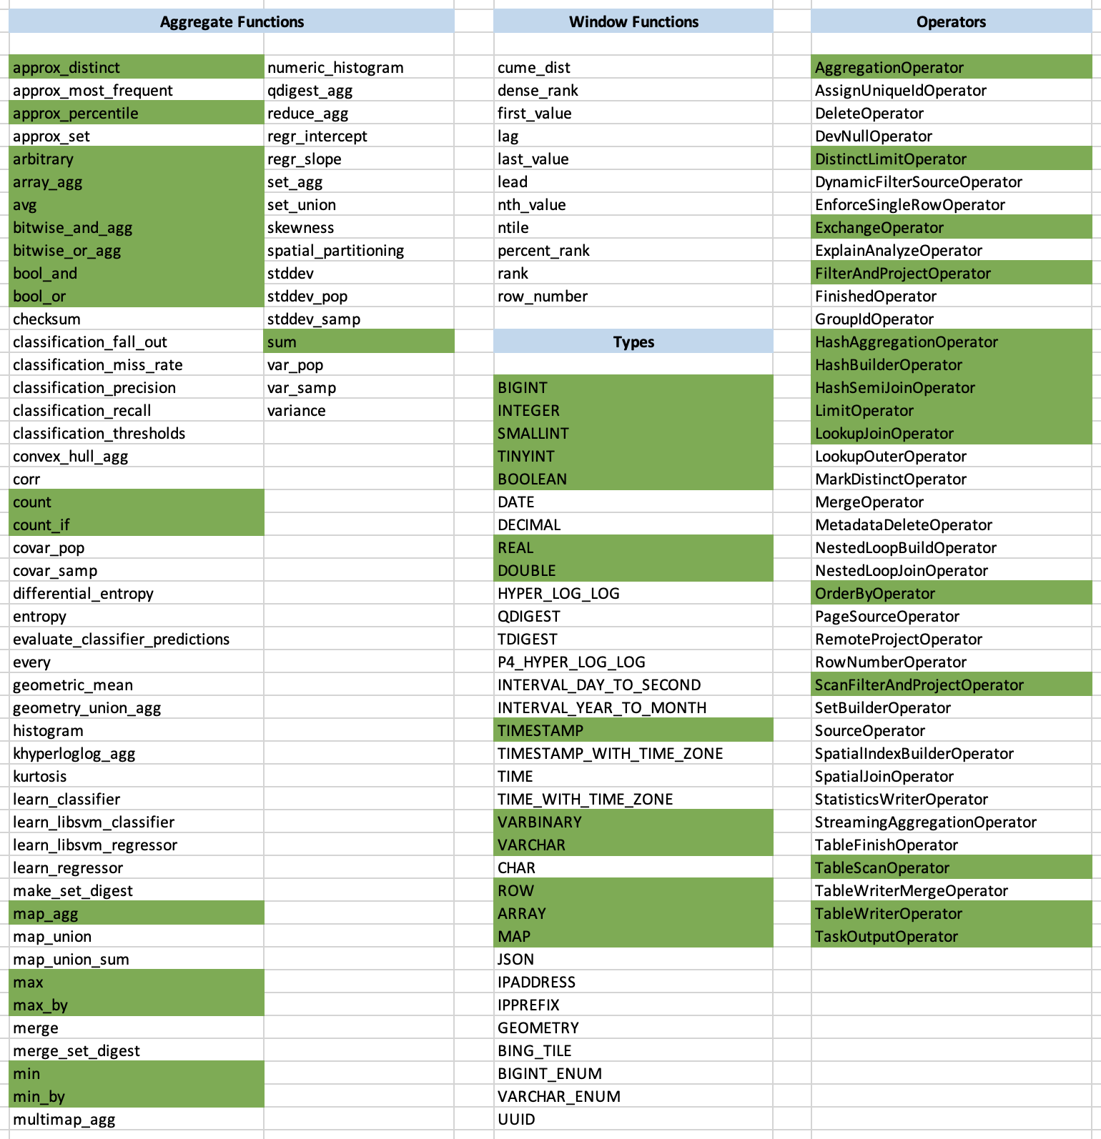
Sep 15, 2021

Slide 31
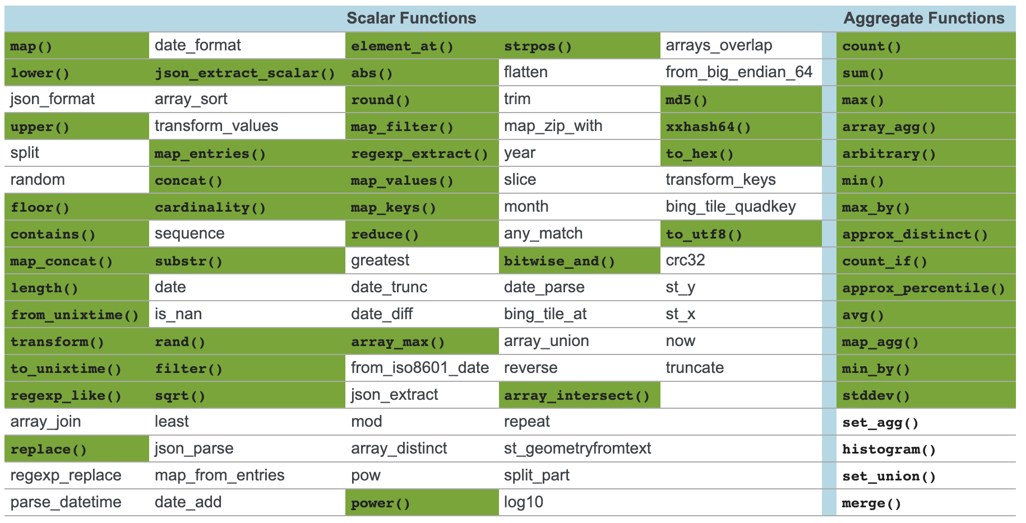
Sep 20, 2021

Slide 32
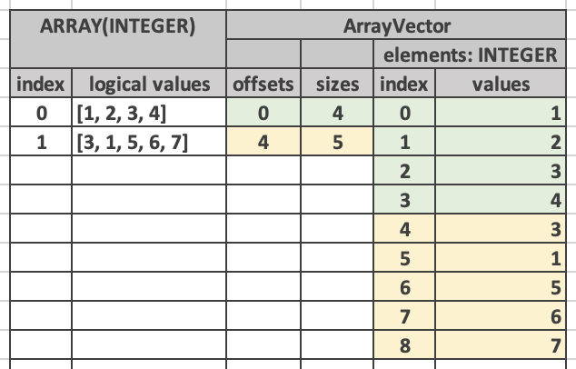
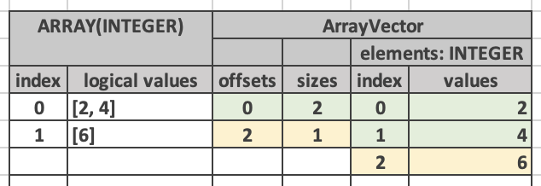
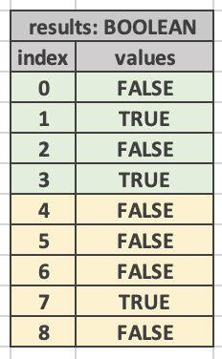
Callable::apply()

Slide 33
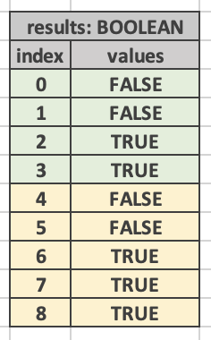
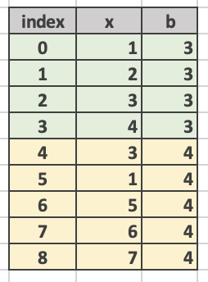
Callable::apply()

Slide 34
CallTypedExpr
name = “filter”
type = ARRAY(INTEGER)
Call…
name = “eq”
type = BOOLEAN
FieldAccessTypedExpr
type = ARRAY(INTEGER)
name = “a”
LambdaTypedExpr
signature = (x: INTEGER)
body = {x mod 2 = 0}
Call…
name = mod
type = INTEGER
Constant…
value = 0
FieldAccess…
name = “x”
type = INTEGER
Constant…
value = 2

Slide 35
pipeline
op N (sink)
op N-1
Data flows from source to sink
Downstream
…
op 2
op 1
Upstream
op 0
(source)

Slide 36
Velox Application
addSplit(planNodeId, split)
noMoreSplits(planNodeId)
Task
Splits for source node 0
Splits for source node 10
getSplitOrFuture(planNodeId,..)
Pipeline 0
Pipeline 1
TableScan
planNodeID: 0
driverId: 0
pipeline: 0
TableScan
planNodeID: 0
driverId: 1
pipeline: 0
TableScan
planNodeID: 10
driverId: 0
pipeline: 1
TableScan
planNodeID: 10
driverId: 1
pipeline: 1

Slide 37
Task
Task::getHashJoinBridge()
Task::allPeersFinished()
HashJoinBridge::tableOrFuture()
Task::getHashJoinBridge()
Task::allPeersFinished()
HashJoinBridge::setTable()
HashJoinBridge
BarrierState
Pipeline 0
Pipeline 1
HashProbe
planNodeID: 5
driverId: 0
pipeline: 0
HashProbe
planNodeID: 5
driverId: 1
pipeline: 0
HashBuild
planNodeID: 5
driverId: 0
pipeline: 1
HashBuild
planNodeID: 5
driverId: 1
pipeline: 1

Slide 38
Task
destination: 15
Exchange Client
Upstream Task
Upstream Task
Exchange
Source
Queue
Exchange
Source
Split
Exchange
Client
Exchange
Source
Split
Output Buffer 0
Output Buffer 15
Split
…
…
Task::getSplitOrFuture(planNodeId,..)
ExchangeClient::addRemoteTaskId
next()
Pipeline 0
Pipeline 0
Exchange
planNodeID: 0
driverId: 0
pipeline: 0
Exchange
planNodeID: 0
driverId: 1
pipeline: 0
Exchange
planNodeID: 0
driverId: 0
pipeline: 0
Exchange
planNodeID: 0
driverId: 1
pipeline: 0

Slide 39
Task
Task::getLocalExchangeSource(partition)
LocalExchangeQueue::enqueue()
Task::getLocalExchangeQueue(partition)
LocalExchangeQueue::next()
LocalExchange
Source
LocalExchange
Source
LocalExchange
Queue
Pipeline 0
Pipeline 1
LocalPartition
planNodeID: 5
driverId: 0
pipeline: 0
LocalPartition
planNodeID: 5
driverId: 1
pipeline: 0
LocalExchange
planNodeID: 5
driverId: 0
pipeline: 1
LocalExchange
planNodeID: 5
driverId: 1
pipeline: 1

Slide 40
Driver
op 0
(source)
op 1
op 2
(sink)
Driver
prev op
op
next op
isBlocked
Go to the start of the loop
getOutput
getOutput
isBlocked
null
isBlocked
isBlocked
isFinishing
needsInput
no
?
yes
finish
getOutput
yes
Output is null?
no
addInput
isBlocked
isBlocked
isBlocked
needsInput
getOutput
yes
Output is null?
no
addInput
finish

Slide 41
Driver
op
next op
Driver
op
next op
getOutput()
getOutput()
addInput()
nullptr
isBlocked()
kNotBlocked
isFinishing()
true
finish()

Slide 42
Nulls for Keys and Accumulators, then Free Flag
Keys
Accumulators
Variable Size

