Slide 1
JOURNAL CLUBS

Slide 2
Foundation Models
Few-shot Learnings
Chain-of-Thoughts

Slide 3
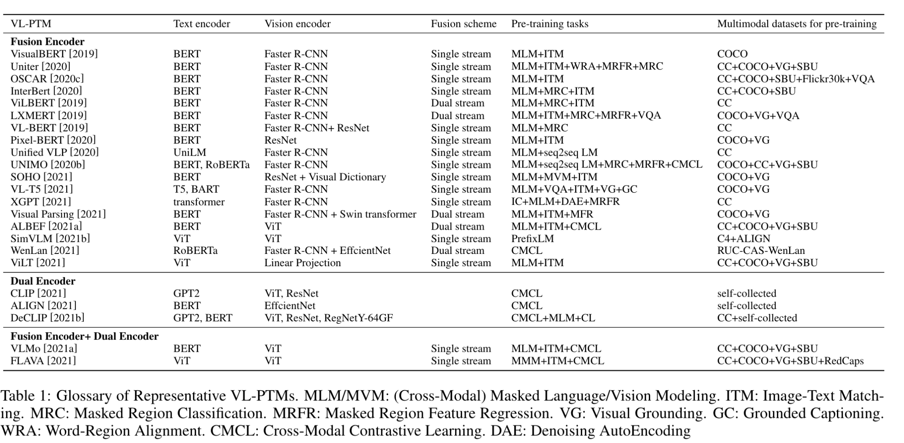
Du et al, 2022 - VLP Survey

Slide 4
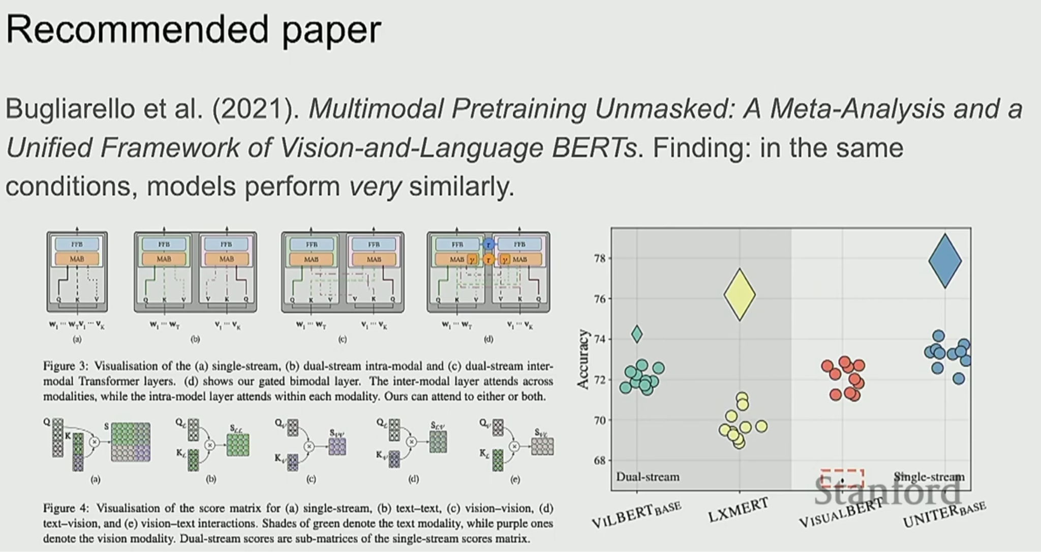
SLIDE: https://www.youtube.com/watch?v=5vfIT5LOkR0
PAPER: LINK

Slide 5
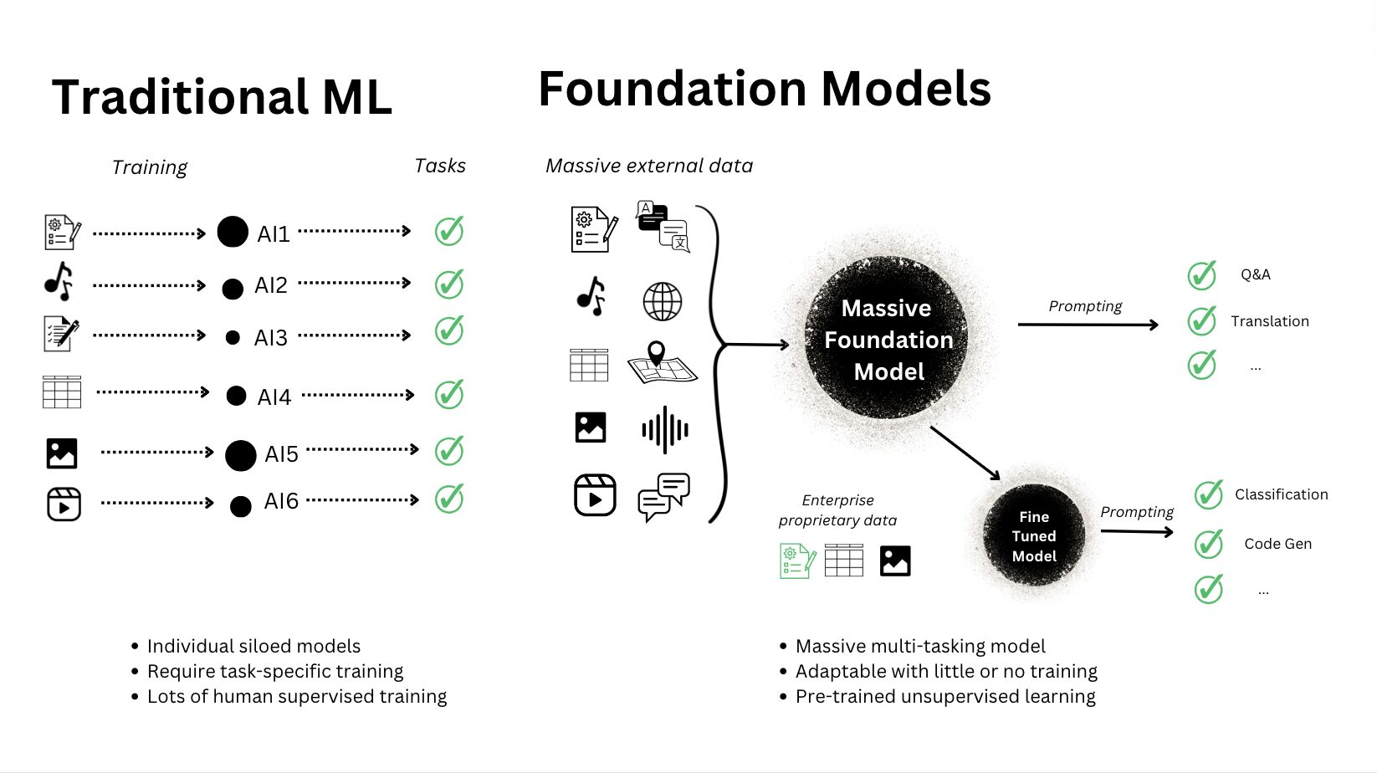
Foundation Models
Models trained on broad data
Generally self-supervised at scale (Unimodal/multimodal)
Adaptable to wide range of downstream tasks (Unifying tasks)
With little-to-none fine-tuning

Slide 6
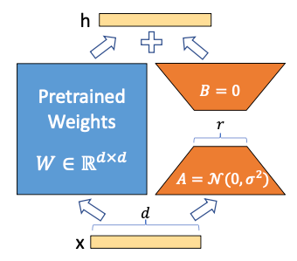
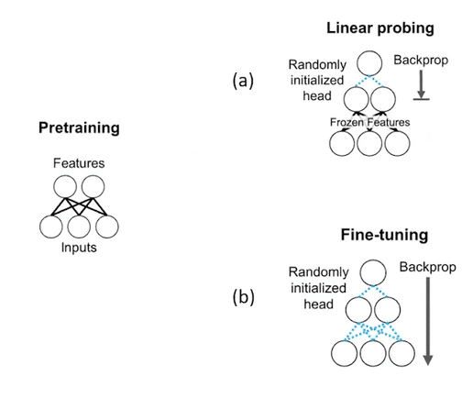
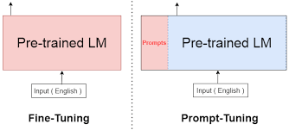
Foundation model’s Adaptation
Linear probing: simple; model must be very good
Prefix / Prompt-Tuning: mid-size datasets, memory-efficient
Full Fine-tuning: lots of data, lots of memory
Parameter-efficient fine-tuning (PERF)/Adaptors:

Slide 7
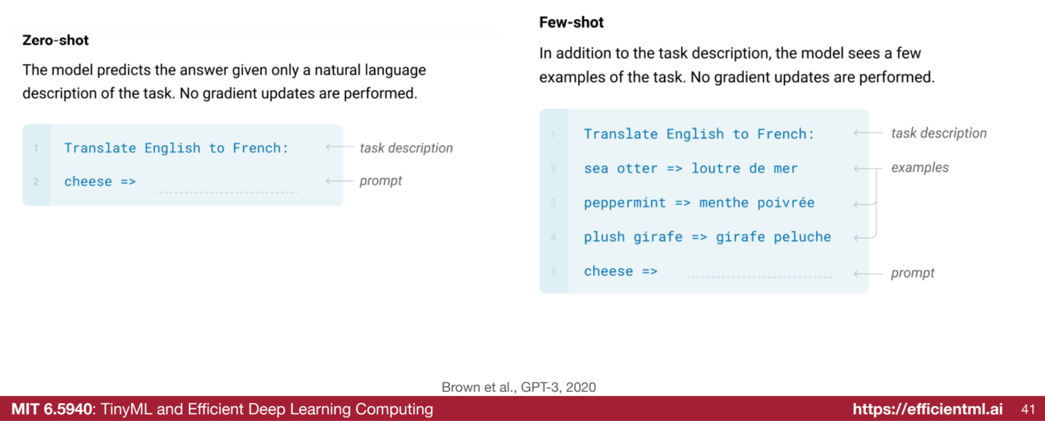
Foundation model’s Adaptation: Generalizability
Language Models are Few-Shot Learners
Zero-shot Prompting: no dataset, need engineer prompts, hit-or-miss
In-context Learning: little dataset, hit-or-miss
Chain-of-Thoughts: emerging

Slide 8
Multi-Modal Few-Shot Learners
Keep model frozen + Training modality projectors
Tsimpoukelli, Maria, et al. "Multimodal few-shot learning with frozen language models." Advances in Neural Information Processing Systems 34 (2021): 200-212.
Yu, Jiahui, et al. "Coca: Contrastive captioners are image-text foundation models." arXiv preprint arXiv:2205.01917 (2022).
Alayrac, Jean-Baptiste, et al. "Flamingo: a visual language model for few-shot learning." Advances in neural information processing systems 35 (2022): 23716-23736.
Li, Junnan, et al. "Blip-2: Bootstrapping language-image pre-training with frozen image encoders and large language models." International conference on machine learning. PMLR, 2023.

Slide 9
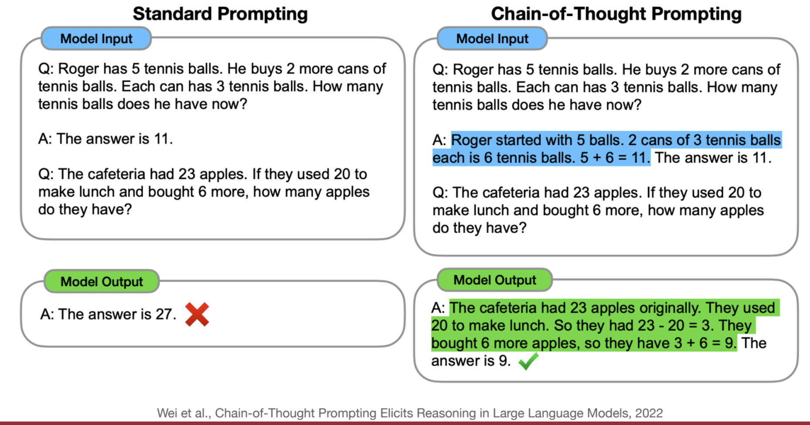
Foundation model’s Adaptation: Generalizability
Chain-of-Thoughts - 2022
KOSMOS-1 - 2023
Zero-shot Prompting: no dataset, need engineer prompts, hit-or-miss
In-context Learning: little dataset, hit-or-miss
Chain-of-Thought: emerging

