Slide 1
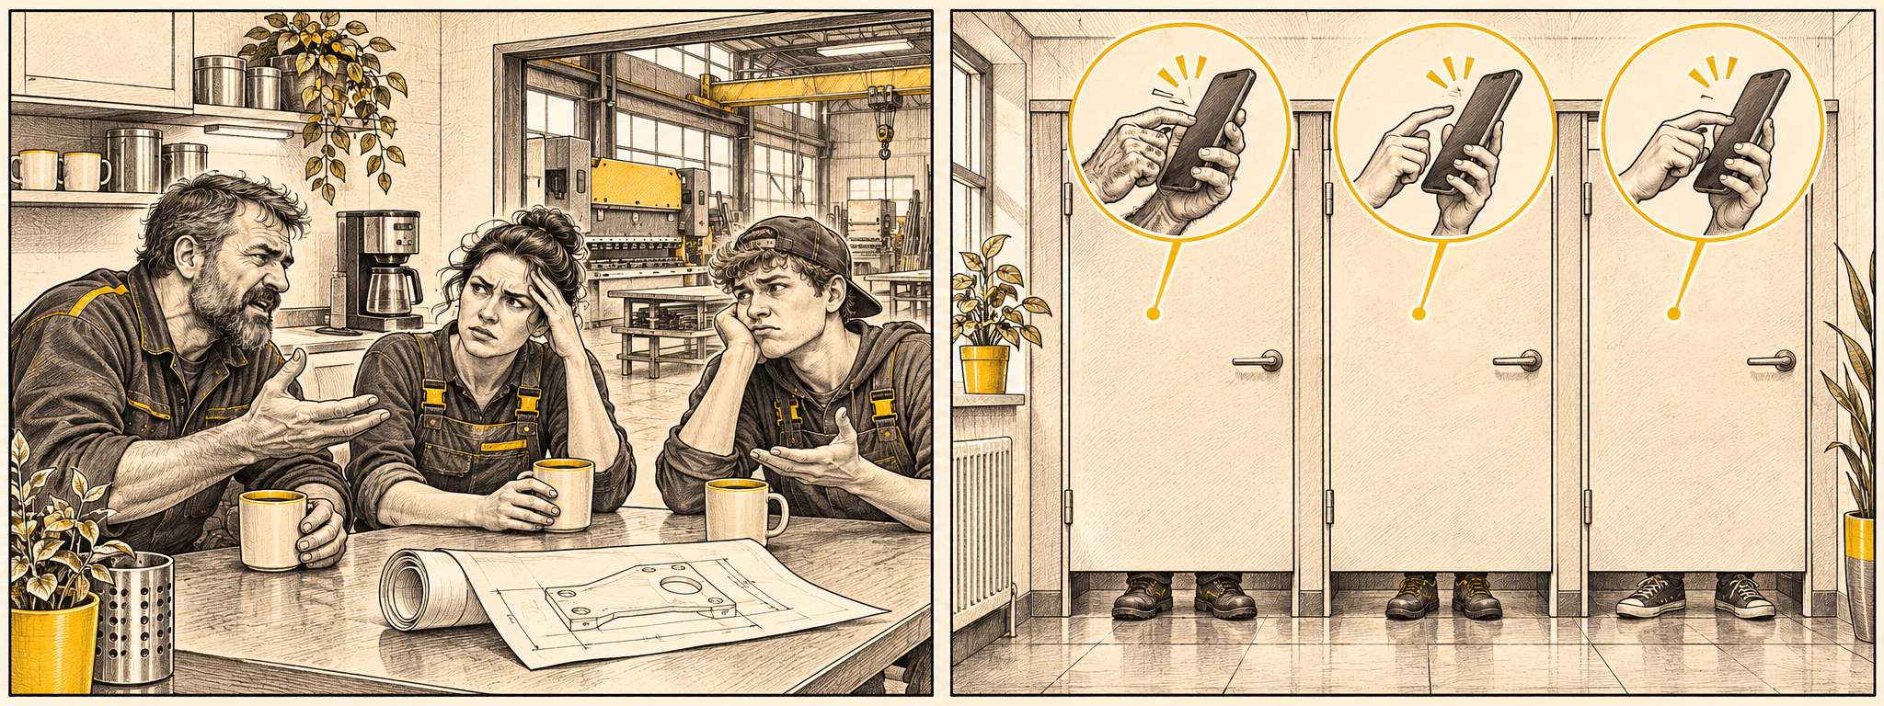
Do you hear
complaints
over coffee?
01
Notes:
TIMING: 0:00–0:20 (20 s) · Sarah
SPOKEN:
Quick show of hands: who of you hears complaints over coffee at work? [Raise your own hand, look around, wait three seconds.] Exactly. The people doing the work know where it gets stuck. They just say it in the wrong place.
CUE: No team introduction. Straight into the question.

Slide 2
Workplace
From friction
Low barriers.
Every voice.
to flow.
Share the issue.
Recognise it together.
Test a next step.
ROKIO
02
Notes:
TIMING: 0:20–0:55 (35 s) · Sarah · VISION
SPOKEN:
Now imagine a workplace where everyone actually likes to work. Where a mistake comes up on Monday morning – not on Friday at the coffee machine. Where the apprentice says: "The stock in the system is wrong" – and the boss says: "Thanks for telling us." And where people also say what works well.
Sounds utopian?
CUE: Slow down. Pause after "Sounds utopian?" and click.

Slide 3
Room for more engagement
10%
of employees in Germany
have a strong emotional bond
to their employer.
Gallup Engagement Index Germany 2025 · National employee data, not a study of our demo SME.
ROKIO
03
Notes:
TIMING: 0:55–1:15 (20 s) · Sarah · ONE BIG NUMBER
SPOKEN:
Here is today: only ten percent of employees in Germany feel a strong bond to their employer. In a company of fifty people, that is five. Five.
SOURCE: Gallup Engagement Index Germany 2025 (10 % high, 77 % low, 13 % no emotional attachment). National data, not a study of our demo company. Do not say "90 % complain" and do not promise that ROKIO changes these figures.
RESERVE FOR Q&A: 12 % are actively looking for a new job (in a company of 50: six people). Absence days high vs. no attachment: 5.7 vs. 9.7 per year – only a correlation, not a cause.

Slide 4
Let’s turn frustration
into participation.
ROKIO
04
Notes:
TIMING: 1:15–1:25 (10 s) · Sarah
SPOKEN:
The other forty-five are not lazy. Nobody asks them in a way that works. So let's turn frustration into participation.

Slide 5





One person reports. The team swipes. ROKIO maps friction and explores solutions.
Notes:
TIMING: 1:25–1:50 (25 s) · Sarah · THE LOGO BUILDS ITSELF
SPOKEN (one sentence per chain link as it appears):
This is ROKIO – RO for robotics, KI for artificial intelligence, O for orientation.
First link: someone names a problem.
Second link: the team recognises it.
Third link, with the dot: together they find the next step.
That is exactly the question our partner ROKI hears every day from businesses in Harburg, Lüneburg and Stade: "Where do we start?"
CUE: The animation runs automatically after the slide appears (~3.5 s). Speak along with it.

Slide 6
Low barriers.
One thumb.
No need to leave
your seat.
06
Notes:
TIMING: 1:50–2:05 (15 s) · Sarah · HAND-OVER TO THE VIDEO
SPOKEN:
For that, the barrier has to be tiny. One thumb. Thirty seconds. Anonymous. We call it the toilet test: if you would do it there, you will do it anywhere.
[Pull out your phone, hold the screen towards the audience – ROKIO open in English on the card "Updated drawings do not reach Workshop in time." – open https://hackathon26-nu.vercel.app/en/feed/HEIDEEN, choose "Workshop"]
This is Marco. Workshop, 6:40 a.m. He has exactly thirty seconds.
CUE: On "thirty seconds" click → the video starts with exactly this phone screen (match cut).

Slide 7
▶ Pitch video · 2:30
ROKIO
07
Notes:
TIMING: 2:05–4:35 (2:30) · VIDEO
CUE: The video shows the English app (demo code HEIDEEN). Insert the finished video here (Insert → Video → This device), set "Start: Automatically" and "Play full screen". Lights down if possible.
The video ends with "Your turn." and freezes for 2 s – click on the freeze → next slide (your QR slide) continues seamlessly.
BACKUP: video file on the laptop and on USB. If sound fails, play the subtitled version and speak along.

Slide 8

Your turn.
Take the toilet test.
Scan
Use Code FTFZVT
Swipe
08
Notes:
TIMING: 4:35–5:55 (80 s) · Sarah + teammate at the laptop · LIVE CORE FUNCTION
SPOKEN:
Your turn. Scan the code – it opens our website. Enter the code F-T-F-Z-V-T, pick your role at this hackathon: tutor, Corporate Track, Open Track, organisation or research team. Then swipe. Right: I know this. Left: not familiar. Stay in your seat.
[Teammate switches the projector to the live view: https://hackathon26-nu.vercel.app/en/live/FTFZVT]
Look at the screen – this is the AI Hackathon as a company. Every line is a handover. It is getting thicker. That is you.
[Teammate holds the red button on the phone and reports one REAL observation from these two days – e.g. two separate problems in one sentence. ROKIO splits it into two cards.]
You just gave [read number from screen] votes in under a minute. A questionnaire would have taken five.
FACTS: QR code → https://hackathon26-nu.vercel.app/de (verified by decoding). Code FTFZVT = English project "AI Hackathon" with the roles Tutor, Corporate Track participants, Open Track participants, Organisation, Research team. Entering the code on the German landing page opens the app in English automatically. No real personal data.
CUE: Do not wait for everyone. At 5:55 switch back to the slides.
PLAN B (no network): play the backup recording of the rehearsal and say: "This is what it looked like in our rehearsal – try it after the pitch."

Slide 9
Live, not a mock-up
Where AI works
Splits one spoken story into single problems
Rewrites each as an anonymous card every team understands
Maps it to handovers and proposes solutions from a vetted pattern library
OpenAI language model on our server · every answer checked against a fixed format
What we tested
Project set up in ~10 seconds
First card on screen instantly
5 of 5 test reports split correctly into single problems (after two format fixes)
3 full runs on mobile, including a brand-new project
Honest limits
Assigning new reports takes 20–40 seconds
Chrome speech input sends audio to Google – a pilot needs local transcription
Hours are employee estimates, not measurements
Left out on purpose: rankings, timestamps, names, ROI promises
ROKIO
09
Notes:
TIMING: 5:55–7:00 (65 s) · Sarah · CHECKLIST: AI, TESTS, LIMITS
SPOKEN:
What you just used is live – not a mock-up.
AI does three jobs: it splits one spoken story into single problems, rewrites each as an anonymous card that every team understands, and maps it to handovers – with solutions from a vetted pattern library. It runs on an OpenAI language model on our server, and every answer is checked against a fixed format.
We tested it: a project is set up in about ten seconds, the first card appears instantly, and our test reports were split correctly five out of five times – after we fixed two format errors.
And honestly: assigning new reports still takes twenty to forty seconds. Speech input in Chrome currently sends audio to Google – a pilot needs local transcription. And all hours are estimates by the employees, not measurements.
Q&A RESERVE: no names, no timestamps, no stored audio; topics visible only from 3 votes; works council (§ 87 (1) no. 6 BetrVG) involved from day one.

Slide 10
Next coffee break:
one less complaint.
10
Notes:
TIMING: 7:00–7:45 (45 s) · Sarah · CLOSING + ASK (15 s buffer to 8:00)
SPOKEN:
We started with complaints over coffee. Imagine the next coffee break sounds different: "We raised it. We tested a change. And we can see what happened."
Our ask to ROKI: give us three metal fabrication SMEs for a four-week pilot – each bringing one troublesome handover – with the works council on board from day one.
Your people know where work gets stuck. Give them a reason to say it.
CUE: Pause after the last sentence. Say "Thank you." Leave this slide up during Q&A (QR slide as backup for anyone who wants to try).

