Slide 1
Panel: Sustaining Facilities CI / Developing Community
Tim Ahern, IRIS Director of Data Services

Slide 2
IRIS is…
An NSF funded University Consortium in Seismology
124 US full members
127 foreign affiliates
Has existed for 34 years
IRIS Data Services has data from
5 decades
~35,000 globally distributed observation points
~30 types of time series data, not just ground motion
~ ½ petabyte archive growing at ~75 terabytes per year
Distributes ~1.2 petabytes per year

Slide 3


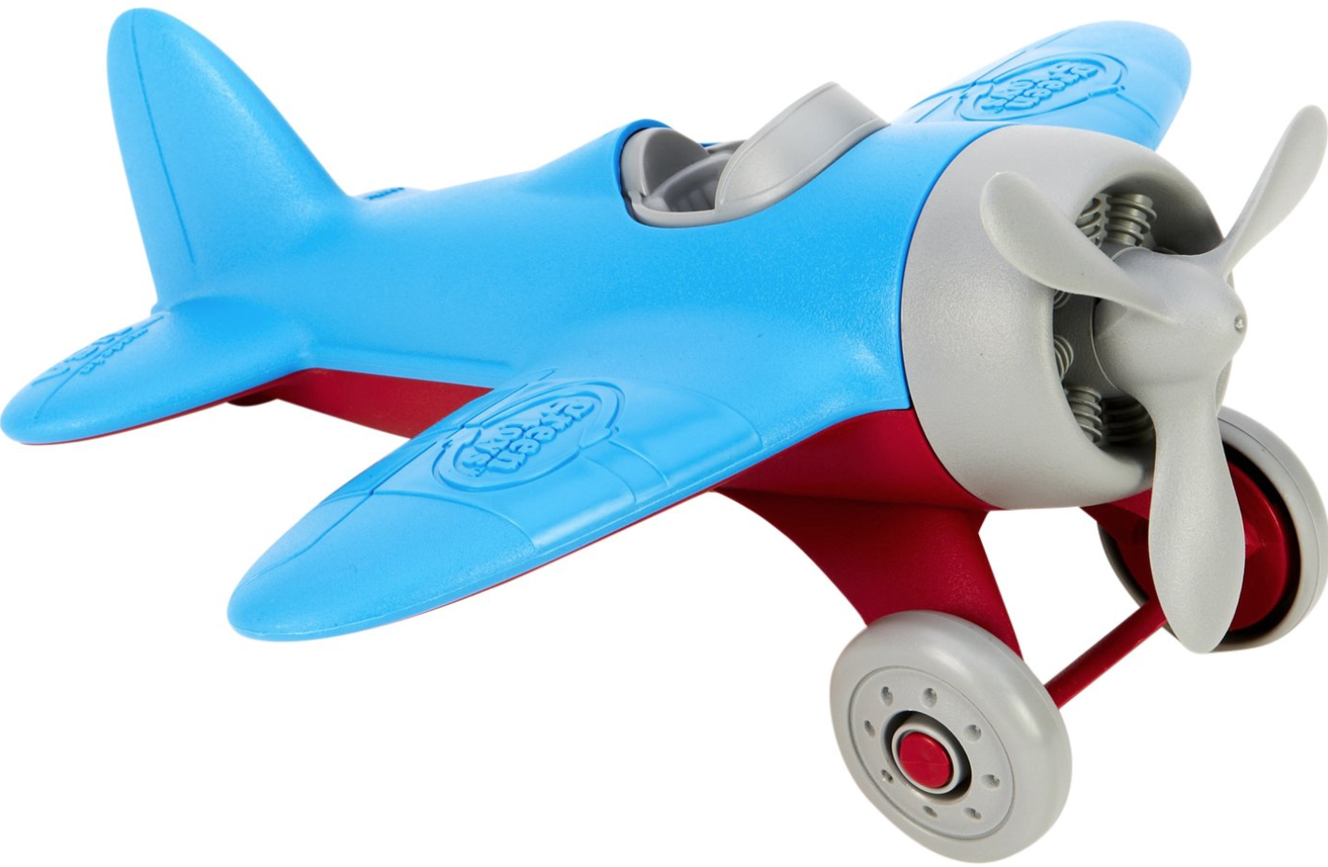
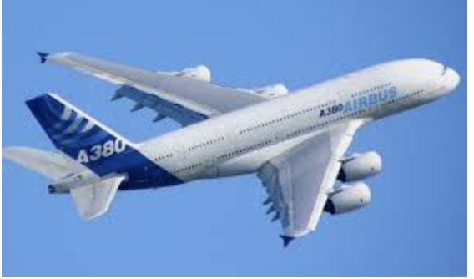
What are the dimensions of CI
Aspects similar to Big Data, there is no one answer (or solution)
Volume
storage kilobytes to petabytes
single to thousands of cores
individual PIs to CI teams
Velocity
low ingestion rates ~0 to petabytes/day or
a few transactions to peta-transactions per day
Variety
samples - spreadsheets – large structured or unstructured files
earth science data are very diverse
have common attributes of space and time in common
Veracity
products vetted by domain repositories build trust
specific domain formats make it hard for non-experts to trust raw data
more general exchange formats can build bridges
Most facilities have domain specific needs that are unique
differing requirements lead to different approaches
most centers are funded by NSF divisions with a domain focus and no overarching NSF approach
it is understandable that independent CI solutions exist

Slide 4
What are the barriers towards sustaining CI solutions both within facilities and externally?
Legacy systems that have evolved over decades
focused on a specific domain’s problems
often not loosely coupled components but monolithic systems
Domain standards are required to support richness of metadata
Moving to international standards requires resources that domains may not benefit from
CI solutions continually evolve
resources at facilities are limited
limited facility resources prone to loss of key personnel and knowledge

Slide 5
What are possible models for CI sustainability?
Sharing of computational and storage resources are more cost effective
Savings limited to primarily hardware, operating, and maintenance costs
Does not eliminate need for CI staff at individual facilities
Cloud native solutions are viable but will take time
Porting of existing IT solutions is far more complex
Improved communication between facilities could
Improve efficiency of staff
Reduce redundancy
Encourage interoperability
Fee for service
NSF funded organizations devalue their contributions
Charge for value added services
Development of products with broad appeal could be revenue generators

Slide 6
Can sharing, reuse, interoperability provide pathways to sustainability
Shared hardware could benefit facilities
XSEDE, NSF cloud (Jetstream and Wrangler) etc
NSF funded AWS/Azure resources perhaps
Use of common frameworks across facilities
Common knowledge base and shared expertise
NSF CI technical workshops and help desk could improve efficiency and reduce costs
XSEDE has a help desk as a base service
A few interoperable formats for sharing supported by services
HDF5
ASDF
netCDF
GeoCSV
NSF must understand a need to continue being the primary funding agency but it could develop a more cost effective infrastructure

Slide 7
How can we create and sustain a community to facilitate sharing and sustainability?
Reduction of costs
Providing a common hardware platform with standard tools and services (e.g. Jetstream and Wrangler, Azure, AWS)
Negotiation by NSF for facility wide software licenses
Shared approaches
Annual hands on training workshops for CI technical staff
Keep abreast of latest technologies
Understand recommended NSF CI solutions
Meet their peers from other organizations
Reuse software components rather than developing solutions

Slide 8
How can it be sustained?
Maintain usefulness to your community
Show how assets can be broadly leveraged across domains and communities
General public and K-16
Simpler formats that are more easily undestood
GeoCSV format from the Earthcube GeoWS Building Block
Products and services for a fee
Weather
Earthquakes
Emergency response
Science highlights

Slide 9
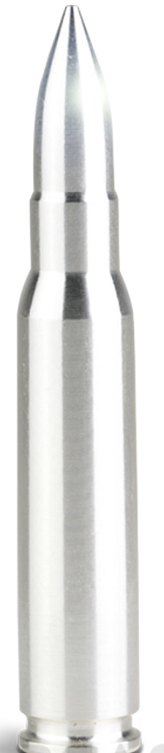
Thanks
I look forward to further conversations
Sustainability is a difficult problem and there are no silver bullets to solve this

