Slide 1
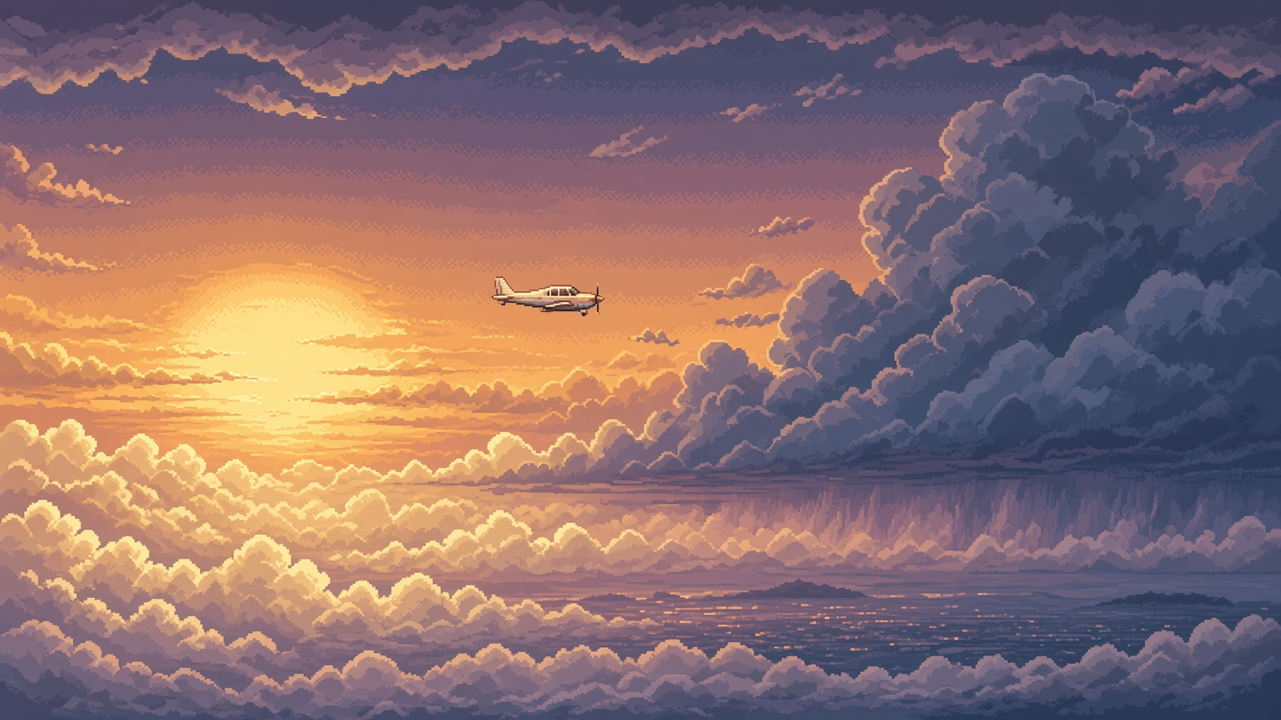
UNDERGRADUATE PROJECT PROPOSAL · UNITY 2D
Flappy Poeing
Tap to climb. Dodge to survive. Weather to endure.
Notes:
Flappy Poeing: a pixel-art hybrid of one-tap arcade, bullet-hell and living weather, built as a feasible solo Unity 2D title.

Slide 2
ROADMAP
Five questions.
01
02
03
04
05
Why this game
How it plays
What it looks like
Why it can ship
What it contributes
Notes:
Ten minutes, five questions, one buildable game.

Slide 3
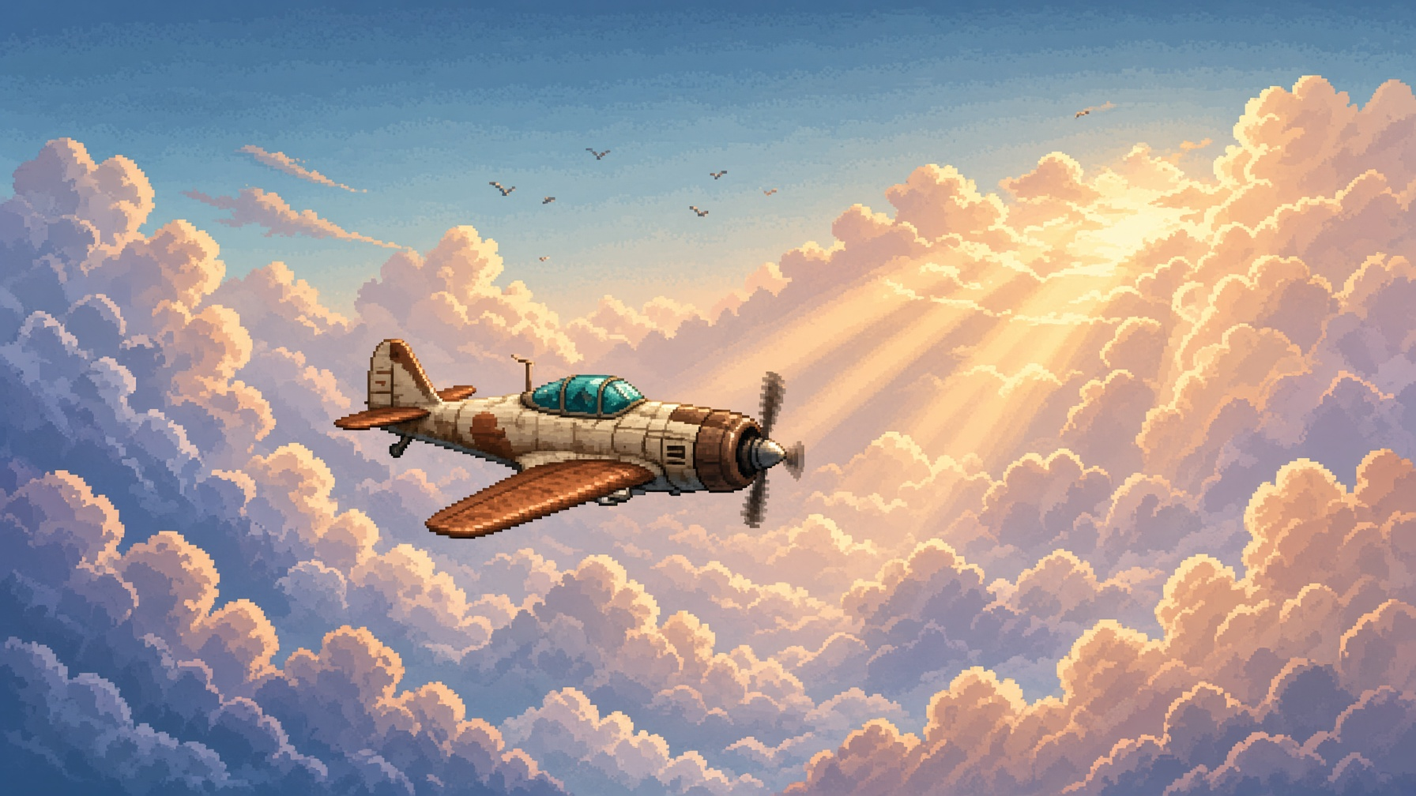
MOTIVATION
The sky is still empty.
Notes:
Flappy Bird proved one thumb can obsess the world, but the loop is thin. Bullet-hell has spectacle and an onboarding cliff. The gap between them is the opportunity.

Slide 4
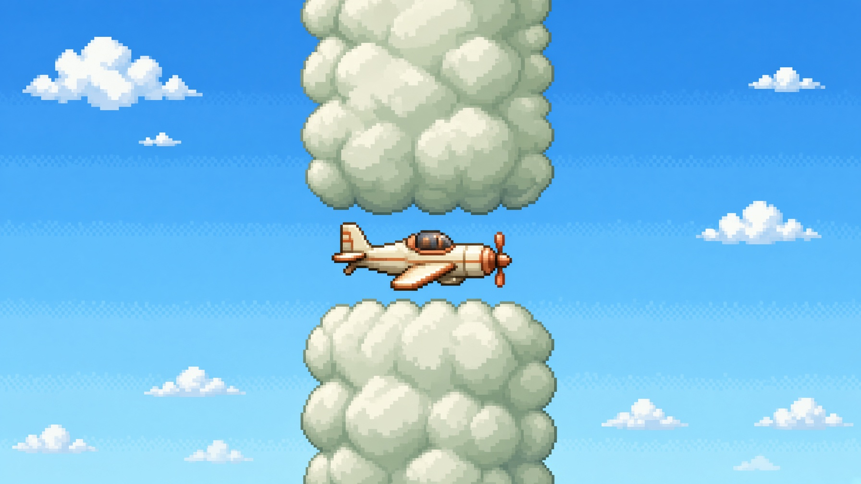
CONCEPT
One tap.
One point.
A living sky that scores every heartbeat.
Notes:
Each tap lifts the nose and awards +1. Gravity, wind, rain, birds and bullets all share one collision language. Score thresholds rewrite the weather and summon bosses.

Slide 5
DESIGN PILLARS
Four rules.
01
02
03
04
One verb
Sky as character
Readable spectacle
Score as story
Tap is lift, score, and dodge.
Weather changes physics.
Beauty never hides threat.
No menus. No skill tree.
Notes:
If a feature breaks a pillar, it does not ship.

Slide 6
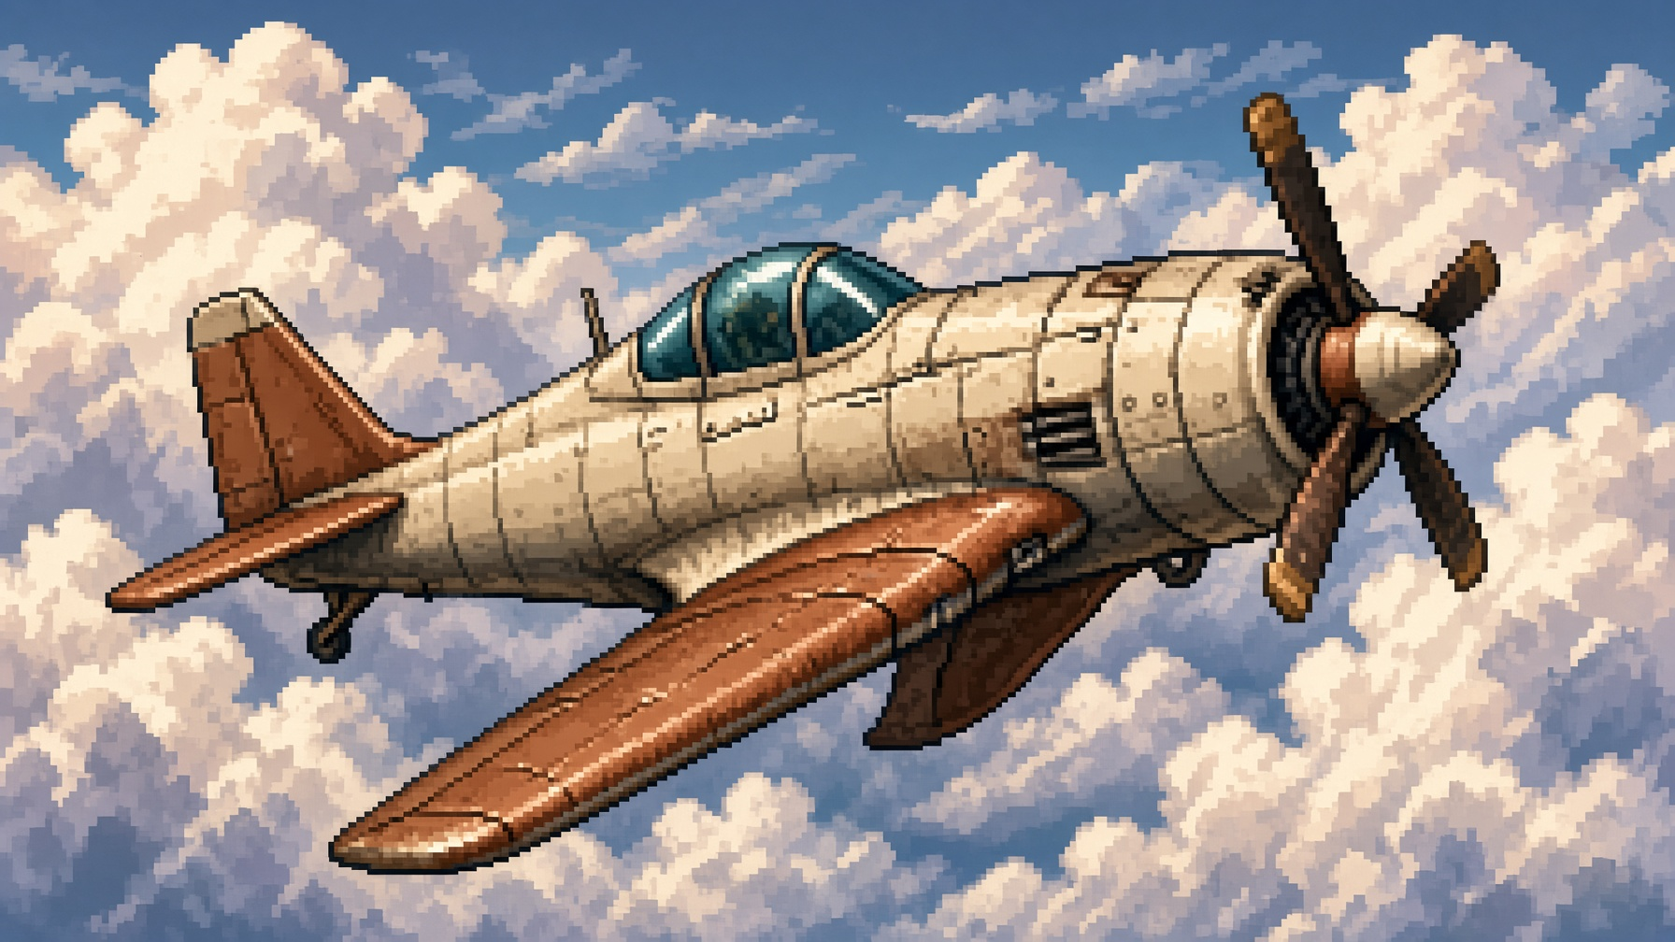
PLAYER CRAFT
Poeing.
A light fighter — not a bird.
Notes:
Cream fuselage, copper wings, teal glass. Generous visual sprite, tight collision capsule on the fuselage only — the player trusts the art.

Slide 7
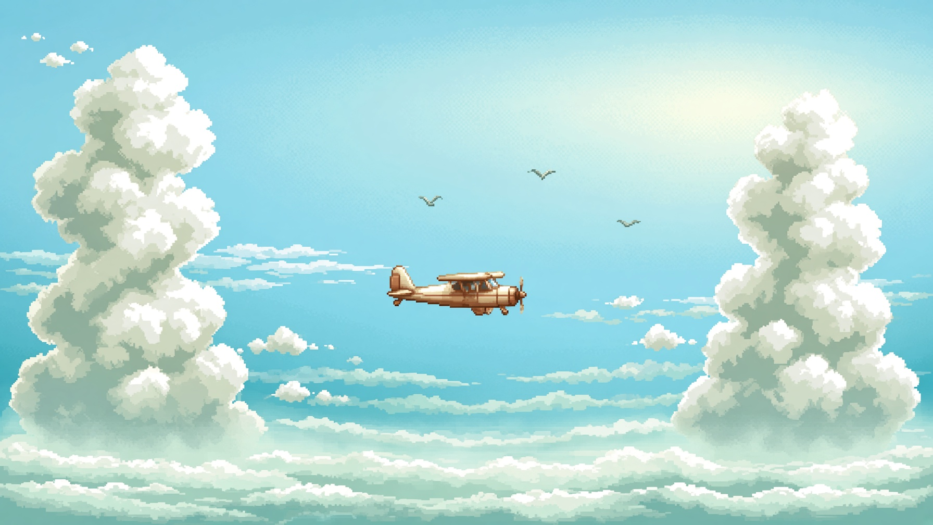
CORE LOOP
Five seconds.
A hundred points.
Tap
Read
Endure
Survive
Cross
Notes:
Tap to climb and score. Read the sky. Endure the weather. Survive the boss barrage. Cross into a new biome. Never a second input.

Slide 8
BIOME 01
Clear Skies
0 – 29
Learn the tap.

Slide 9
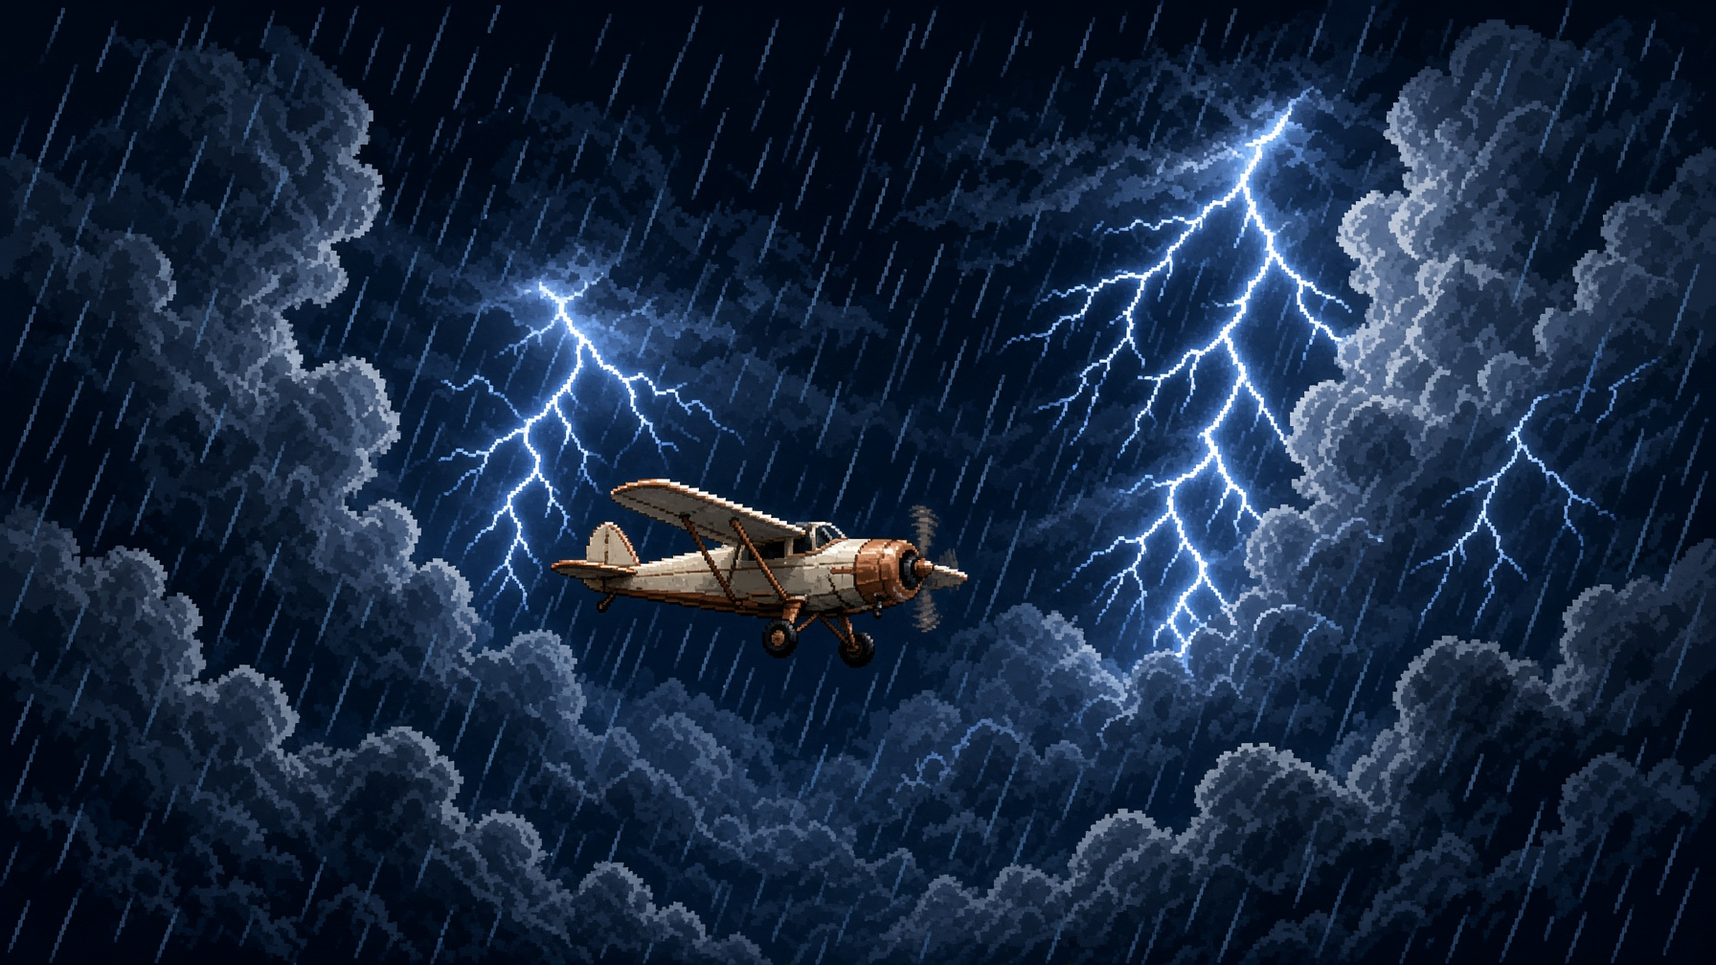
BIOME 02
Thunderfront
30 – 69
The sky turns against you.

Slide 10
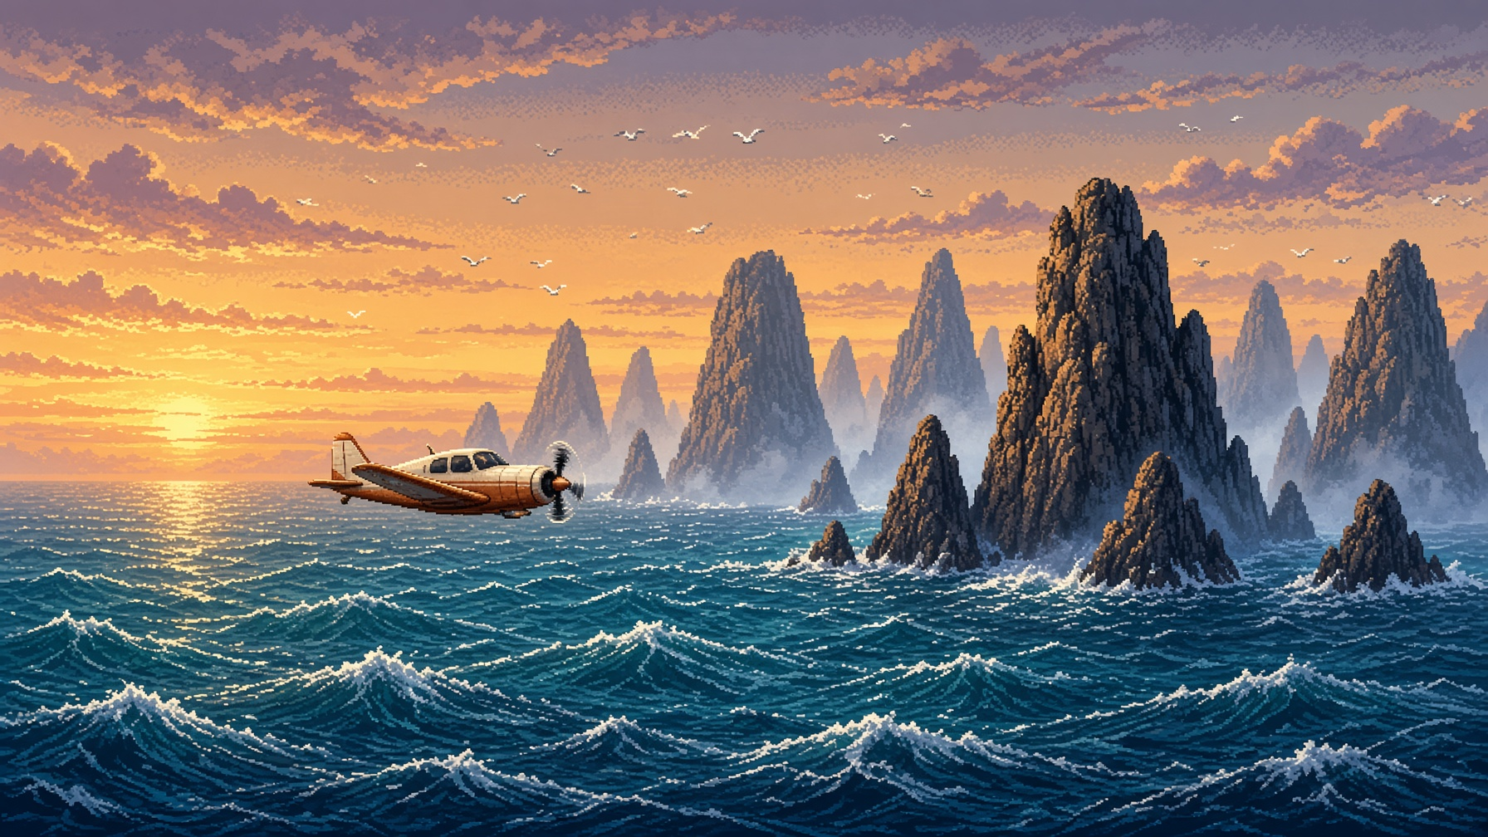
BIOME 03
Open Sea
70 +
Fly low or drown in spray.

Slide 11
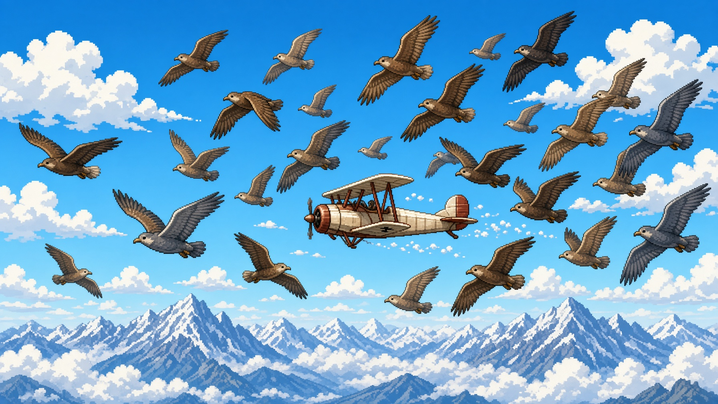
WILDLIFE & WEATHER
Birds are living pipes.
Storms are living difficulty.
Notes:
Flocks cruise, dive and scatter from a pool. Rain cuts readability, wind shears the arc, lightning denies a lane — difficulty without a second button.

Slide 12
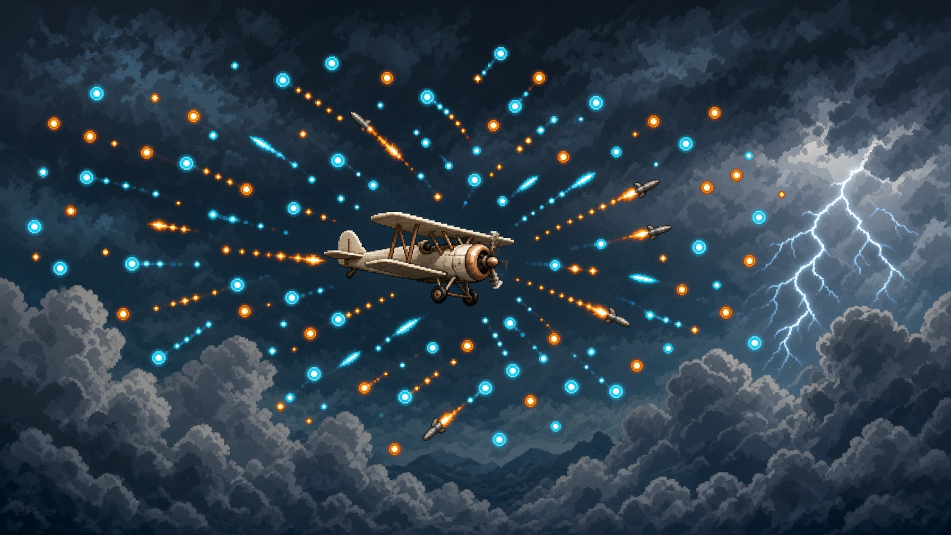
DANMAKU LAYER
Bullet-hell,
taught by a thumb.
Notes:
Scripted rings, fans, spirals and aimed shots. Colour-coded families, guaranteed safe lanes, pooled sprites with a hard projectile cap.

Slide 13
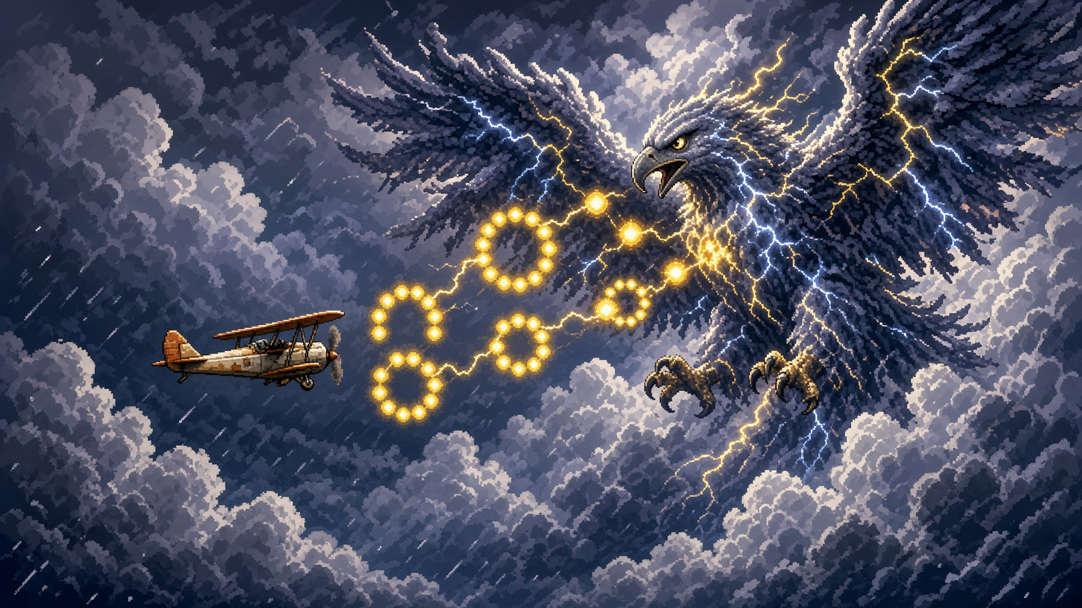
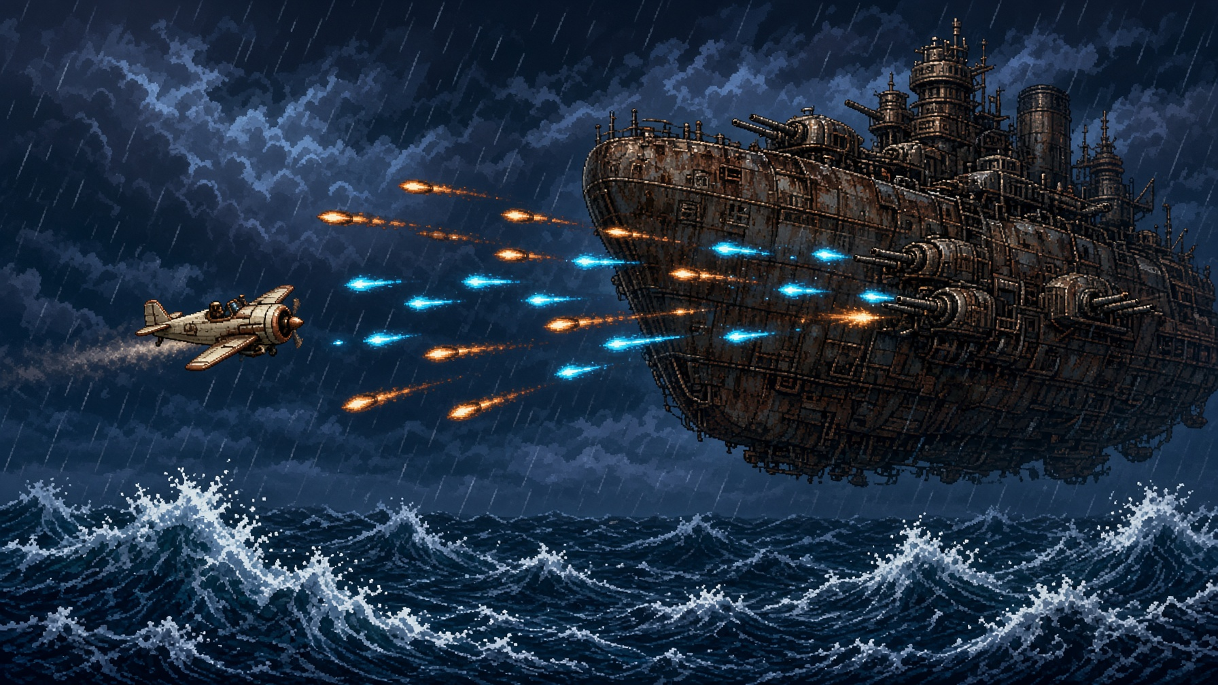
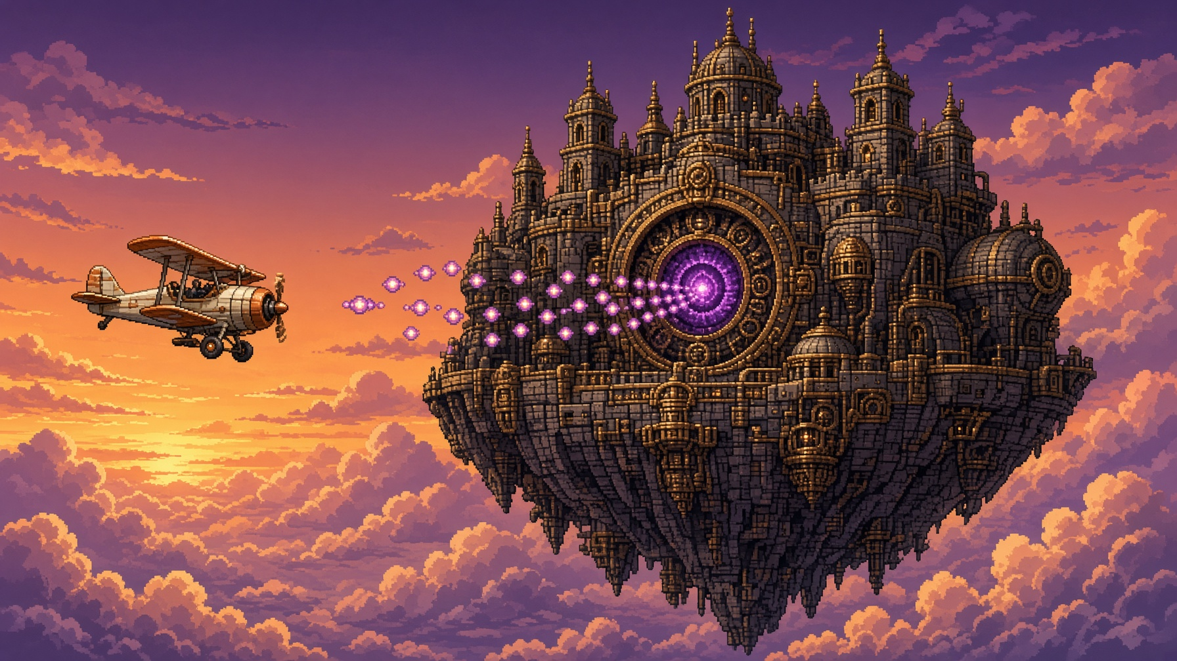
SCORE-GATED ENCOUNTERS
Three bosses.
Tempest Eagle
Ironwake
Sundown Citadel
SCORE 30
SCORE 70
SCORE 120
Notes:
Every tap still scores during a boss. Surviving is the gate; greed is the high score.

Slide 14
PROGRESSION
The score is the campaign.
0
30
70
120
Onboard
Boss
Boss
Finale
Notes:
No chapter select. The run is the story.

Slide 15

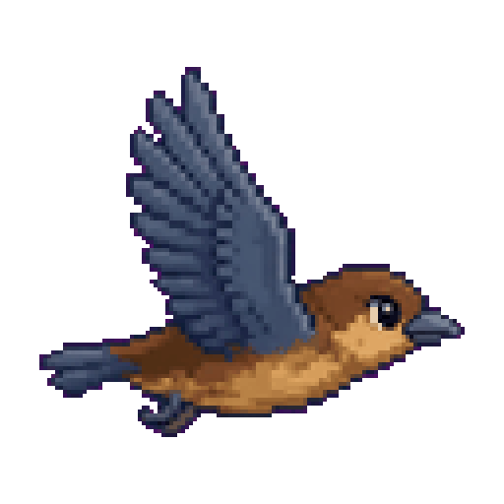

ART DIRECTION
A 16-bit sky,
production-ready.
DAWN
STORM
SEA
Poeing
Flock bird
Orb bolt
Notes:
Shared palette, magenta-keyed sheets, pixel-crisp at any scale. The sprite bible already exists.

Slide 16
FEASIBILITY
Unity 2D.
Nothing exotic.
Tap input
Rigidbody2D
Score service
Biome director
Weather stack
Spawn pool
Boss FSM
Capsule collider
Notes:
Every system maps to a stock Unity feature. No custom renderer, no netcode, no procedural generation. The risk is design, not infrastructure.

Slide 17
EXECUTION
14 weeks.
One developer.
W1–2
W3–4
W5–6
W7–8
W9–11
W12–14
Prototype
Slice
Wildlife
Weather
Bosses
Ship
Notes:
Vertical slice by week 4. Weather — the thesis feature — lands weeks 7 to 8. Content freeze week 12.

Slide 18
ACADEMIC CONTRIBUTION
Not a clone.
A thesis.
GENRE
SYSTEMS
NARRATIVE
PRACTICE
Hybrid loop study
Weather as difficulty
Score as campaign
Solo Unity pipeline
Notes:
A defendable thesis: hybrid loop, environment as a first-class difficulty axis, menu-free progression, and a complete student production pipeline.

Slide 19
POTENTIAL & RISK
Honest risks.
Already designed against.
Notes:
Clone perception: plane identity, three biomes, named bosses. Difficulty spike: fuselage hitbox, telegraphs, bullet-free biome one, assist slow-mo. Scope creep: no shop, no skins, no multiplayer.

Slide 20
May I build this sky?
Frozen scope. Fourteen weeks. Assets in hand.
Notes:
The hop is the only mechanic that has to be perfect. Thank you — questions welcome.

