Slide 1
MSIL & CLI
Kun-Yuan Shieh

Slide 2
Outline
.NET?
.NET framework
Inside the CLR execution engine
Introduction to MSIL
  Part I
  Part II
Tools

Slide 3
.Net?

Slide 4
What is .NET?
Software platform
Language neutral
Accessible over many devices and operating systems
Component Based
Microsoft's Vision of the future

Slide 5
What is .NET?
.NET is a new framework for developing web-based and windows-based applications within the Microsoft environment.
.NET Application
.NET Framework
Operating System + Hardware

Slide 6
.NET Framework

Slide 7
What is the .NET framework
Infrastructure for the overall .NET Platform.
Major Components :
  Common Language Runtime (CLR)
  Base Class Library
  Common Type System (CTS)
  Common Language Specification (CLS)

Slide 8
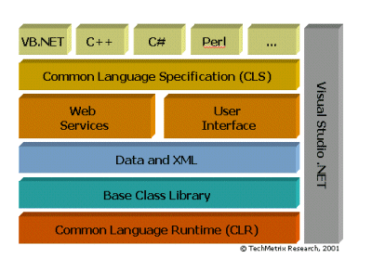
.NET Framework structure
(http://www.dotnet101.com/articles/art014_dotnet.asp)

Slide 9
Compiling process in .NET
VB.NET
VC.NET
C#.NET
MSIL
(Microsoft Intermediate Language)
CLR
Unmanaged native
Code
JIT compiler
Native Code

Slide 10
Compiling process in .NET
Compiled into the Intermediate Language (IL ), Not directly compiled into machine code
Metadata accompanies the IL, it describes the contents of the file (e.g.. parameters, methods…)
The Manifest describes what other components the Intermediate Language (IL) executable needs

Slide 11
Common Language Runtime (CLR)
CLR works like a virtual machine in executing all languages
Checking and enforcing security restrictions on the running code
Manages memory through an extremely efficient garbage collector
Common Type System (CTS)
Conversion from IL into code native to the platform being executed on

Slide 12
Common Language Runtime (CLR)
All .NET languages must obey the rules and standards imposed by CLR. Examples:
  Object declaration, creation and use
  Data types, language libraries
  Error and exception handling
  Interactive Development Environment (IDE)

Slide 13
Common Type System (CTS)
CTS is a rich type system built into the CLR
  Implements various types (int, double, etc)
  And operations on those types
Strictly enforces type safety
Ensures that classes are compatible with each other by describing them in a common way
Enables types in one language to interoperate with types in another language

Slide 14
Common Language Specification
CLS is a set of specifications that language and library designers need to follow
  This will ensure interoperability between languages
Specification that a language must conform to, to be accepted into the .NET framework
The specification are detailed at http://msdn.microsoft.com/net/ecma/

Slide 15
Intermediate Language (IL)
.NET languages are not compiled to machine code. They are compiled to an Intermediate Language (IL).
CLR accepts the IL code and recompiles it to machine code. The recompilation is just-in-time (JIT) meaning it is done as soon as a function or subroutine is called.
The JIT code stays in memory for subsequent calls. In cases where there is not enough memory it is discarded thus making JIT process interpretive.

Slide 16
Some CLI implementation
CLR – Microsoft’s commercial offering
SSCLI ( code-named “Rotor” ) – Microsoft’s Shared Source CLI
Mono - open source project initiative sponsored by Ximian ( now a part of Novell )
Portable .NET – by Southern Storm Software, Pty Ltd, an Australian company
OCL – portions of the implementation of the CLI by Intel

Slide 17
Inside the CLR Execution engine

Slide 18
Assemblies
Assemblies are the smallest unit of code distribution, deployment and versioning
Individual components are packaged into units called assemblies
Can be dynamically loaded into the execution engine on demand either from local disk, across network, or even created on-the-fly under program control

Slide 19
Single file and multi file assembly
Single File Assembly
Multi File Assembly
A.netmodule
Manifest
(No Assembly Metadata)
ThisAssembly.dll
ThisAssembly.dll
Manifest
Manifest
Metadata
MetaData
MetaData
MSIL
MSIL
MSIL
B.netmodule
Resources
Resources
Manifest
(No Assembly Metadata)
Metadata
MSIL

Slide 20
Assembly characteristics
Self-describing
  To enable data-driven execution
Platform-independent
Bounded by name
  Locate assemblies by querying four-part tuple that consists of a human-friendly name, an international culture, a multipart version number, and a public key token.
Assembly loading is sensitive to version and policy
  Assemblies are loaded using tunable biding rules, which aloow programmers and administrators to contribute policy to assembly-loading behavior.
Validated
  Each time an assembly is loaded, it is subjected to a series of checks to ensure the assembly’s integrity.

Slide 21
Self-describing
Modules:
  Blueprint for types in the form of metadata and CIL
  Single file containing the structure and behavior for some or all he types and/or resources found in the assembly
An assembly always contains at least one module but has the capacity to include more
Assemblies themselves have metadata that describe their structure: manifest

Slide 22
Manifest
Compound name for the assembly
Describe the public types that the assembly exports
Describe types that the assembly will import from other assemblies
.assembly extern mscorlib
{
.ver 0:0:0:0
}
.assembly HelloWorld
{
.ver 0:0:0:0
}
.module HelloWorld.exe
// MVID: {D662624F-D333-48B7-ACB2-E06B4F75DC3D}
.imagebase 0x00400000
.subsystem 0x00000003
.file alignment 512
.corflags 0x00000001
// Image base: 0x06d20000

Slide 23
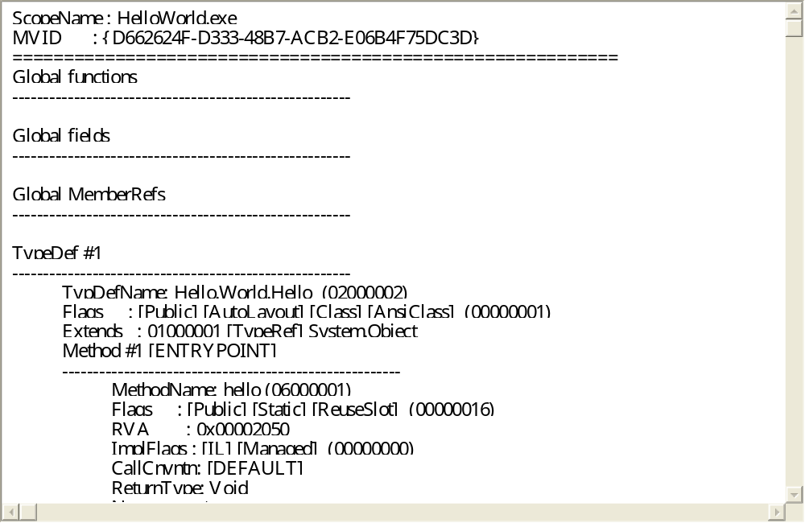
Take a look at metadata

Slide 24
Tools

Slide 25
Tools
Download & install from Microsoft®
  .NET Framework Redistributable Package version 1.1
  .NET Framework SDK Version 1.1
Tools
  C# compiler: Csc.exe
  IL assembler: ilasm.exe
  IL diassembler: ildasm.exe

Slide 26
Path
csc.exe
  c:\WIDOWS\Microsoft.NET\Framework\v1.1.4322
  ( for MS. CLR)
ilasm.exe
  C:\WINDOWS\Microsoft.NET\Framework\v1.1.4322
  ( for MS. CLR)
ildasm.exe
  C:\Program Files\Microsoft.NET\SDK\v1.1\Bin
  ( for MS. CLR)

Slide 27
If you have
Microsoft Visual Studio .NET 2003
csc.exe
  c:\WIDOWS\Microsoft.NET\Framework\v1.1.4322
  ( for MS. CLR)
ilasm.exe
  C:\WINDOWS\Microsoft.NET\Framework\v1.1.4322
  ( for MS. CLR)
ildasm.exe
  C:\Program Files\Microsoft Visual Studio .NET 2003\SDK\v1.1\Bin
  ( for MS. CLR)

Slide 28
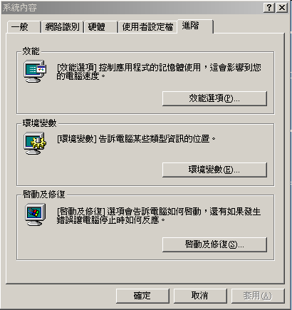
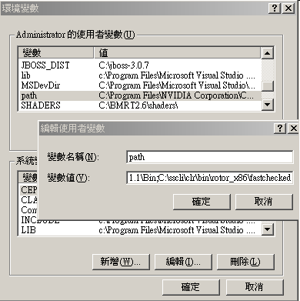

Slide 29
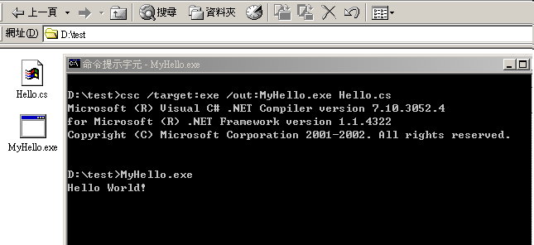
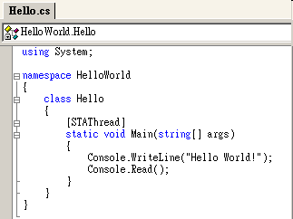
csc

Slide 30
References
Standard ECMA-334(c#)
  http://www.ecma-international.org/publications/standards/Ecma-334.htm

