Slide 1
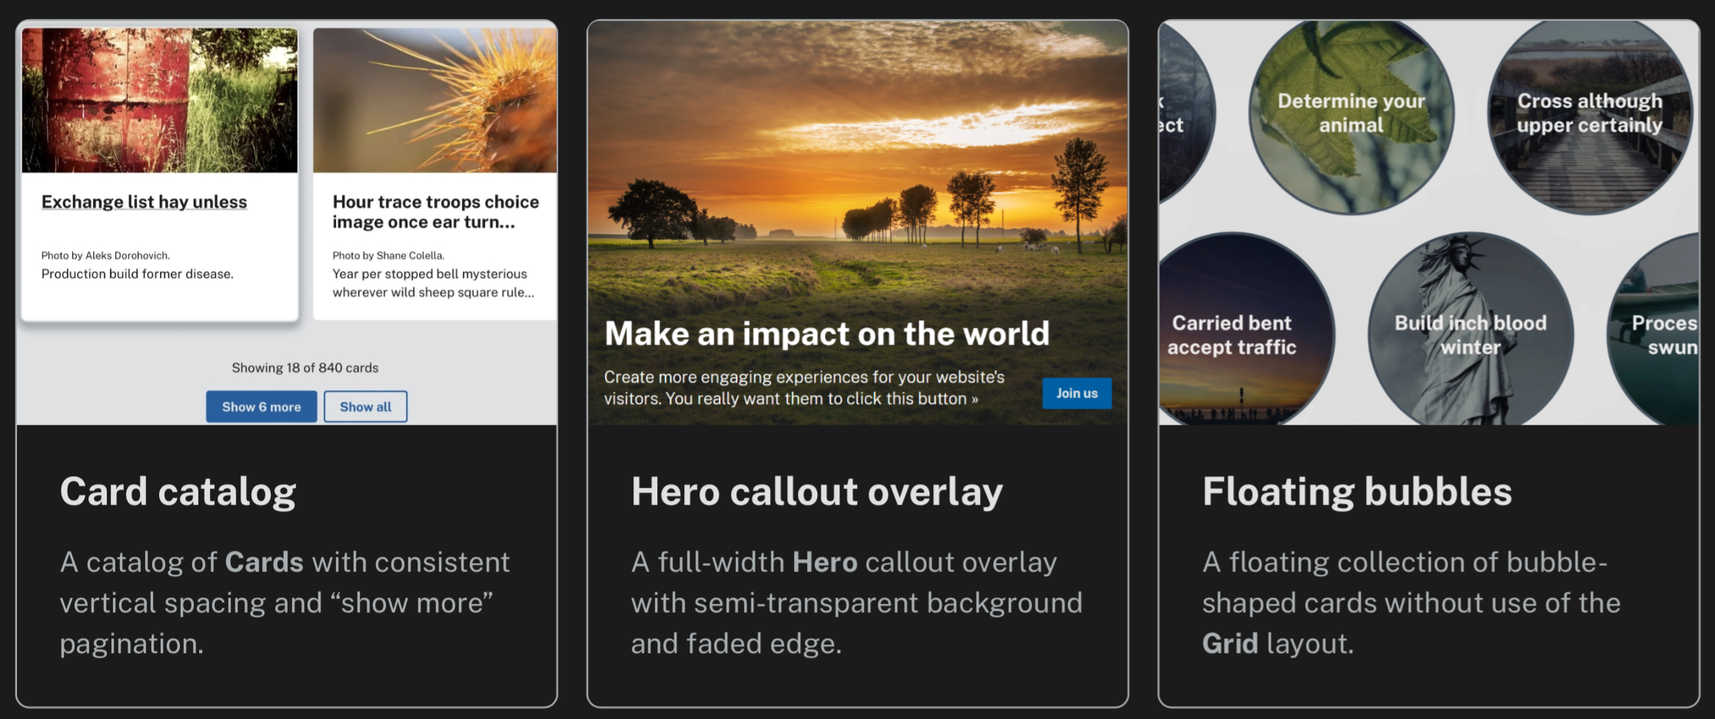

design pattern idea book
for U.S. Web Design System sites

Slide 2


